Slide 1
MVC v Flux/Redux
Redux
event
MVC
Action
event
Dispatcher
model
model
Timing
Problems
model
model
view
view
All done
All same time
view(s)

Slide 2
FLUX UNIVERSAL DATA FLOW
MVC Compare
Models = Store
Event/data change = action creator → action → dispatcher → callback
Views = React
Action
Dispatcher
callbacks
Web
API
Action
Creators
Store
User
interactions
React
Views
Change
Events
Action → store → view → action → store → view → action → ...

Slide 3
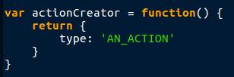
Actions
An ‘action creator’ is just a function that creates an action and returns it.
event
Action
Dispatch

Slide 4
???
The Redux instance is called a store
Reducers could be called ‘action handlers’ and/or ‘state changers’
Middleware must output an action (t/f?)
event
Action
Dispatch
middleware
API
Dispatch
Action
Data
S
State
t
Current
State
Reducers
o
r
New
State
e
Updates
Change
events
React
Views

Slide 5
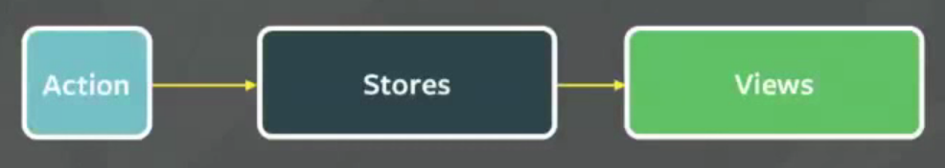
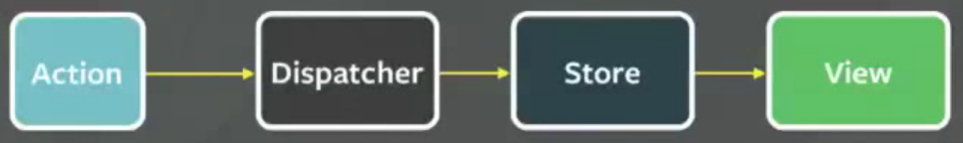
Notes
Use ‘combineReducers()’ to combine multiple reducers into 1
  Redux expects 1 reducer
  When you dispatch an action, Redux calls all reducers
FLUX
  Once an action is fired not other actions can enter the loop until the loop is finished.
  i.e., the data layer will completely finish processing before any other actions are are triggered. This is controlled by the Dispatcher. If it does get a new action before it finishes processing it ‘can’ throw.
GraphQL is a popular sever side tool for managing APIs: www.graphql.org
Flux May, 2014
  https://youtu.be/nYkdrAPrdcw?list=PLb0IAmt7-GS188xDYE-u1ShQmFFGbrk0v&t=621

Slide 6
Provider & connect()
Provider is a component
  It provides the redux instance to all components
  You wrap the root React component with it
Connect is a function
  Connects components to the Redux store
  Used to read from the store and dispatch actions

Slide 7
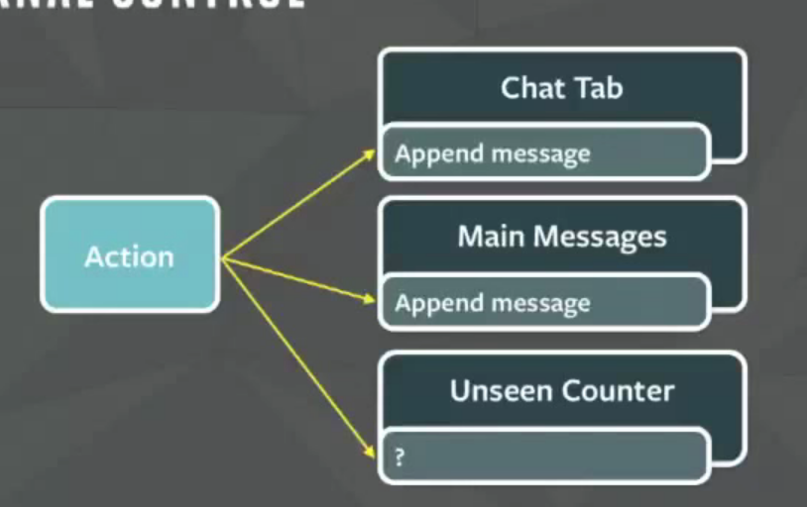

Slide 8
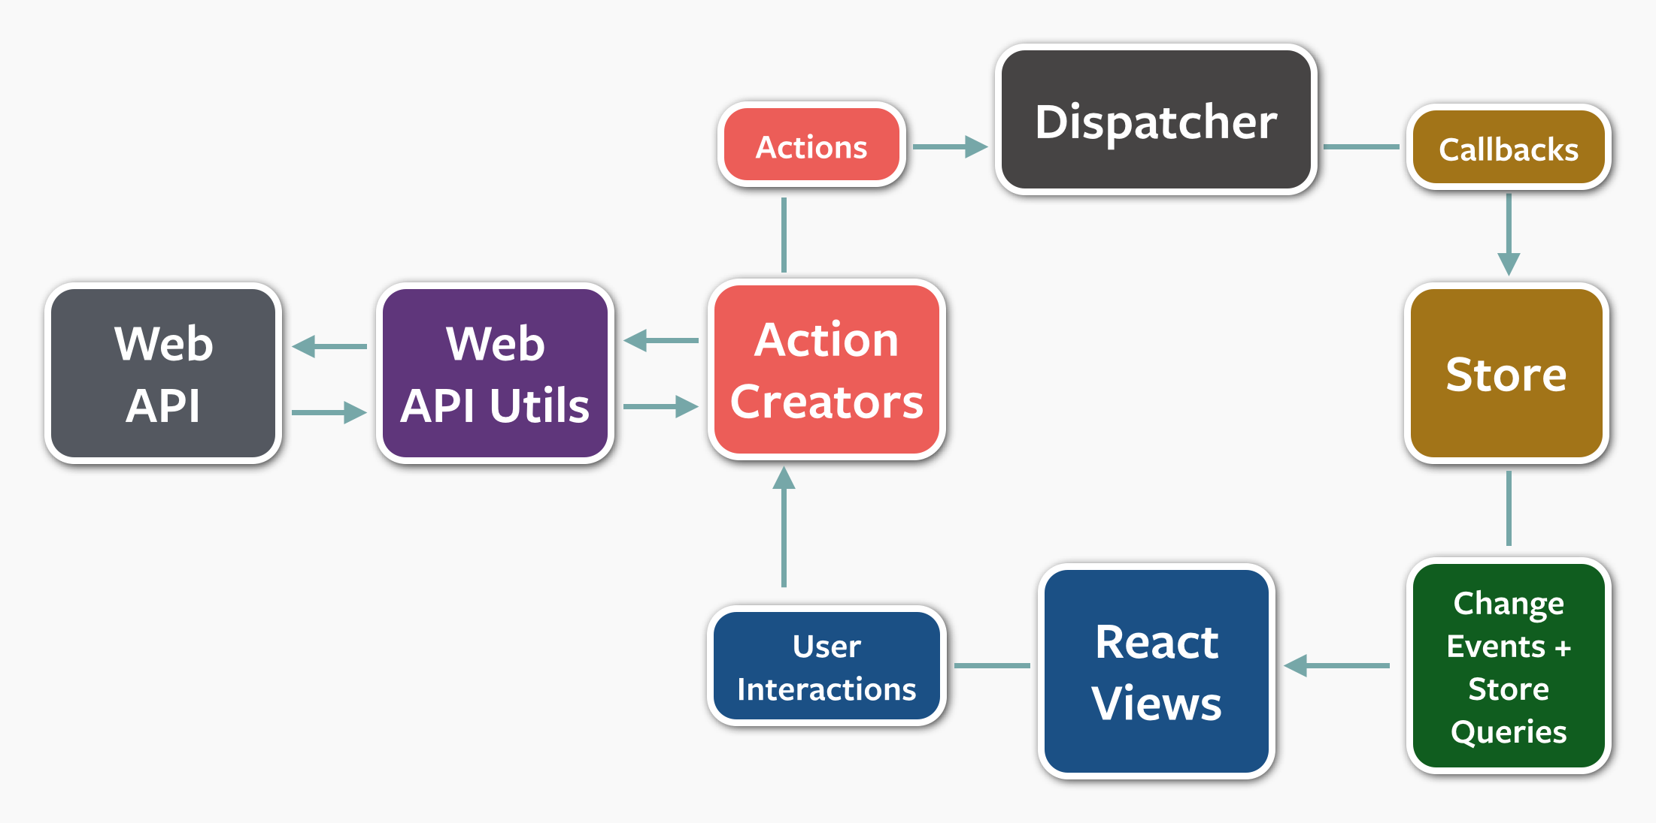

Slide 9
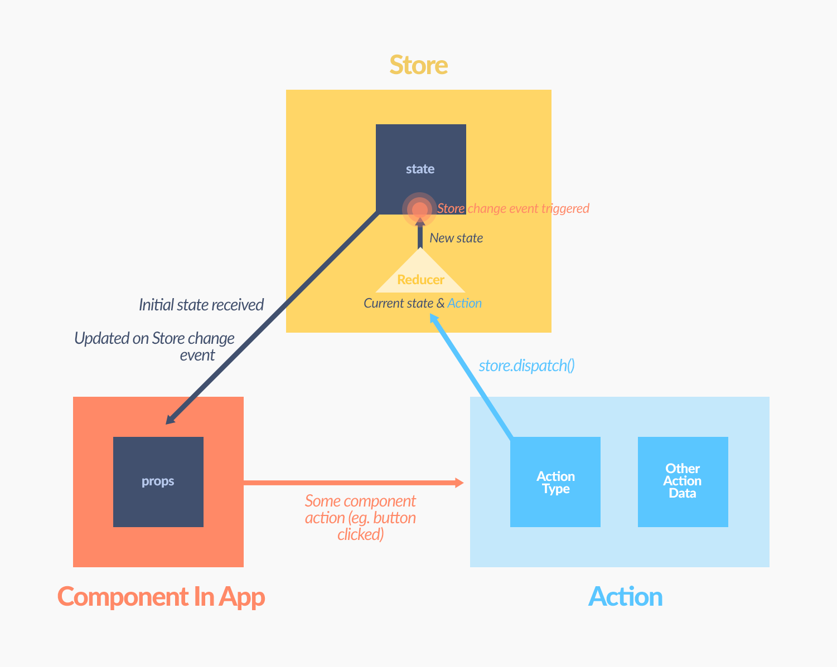

Slide 10
