Slide 1
Data analysis of the following:
Turbidity
Wave Height
Temperature
E. Coli

Slide 2
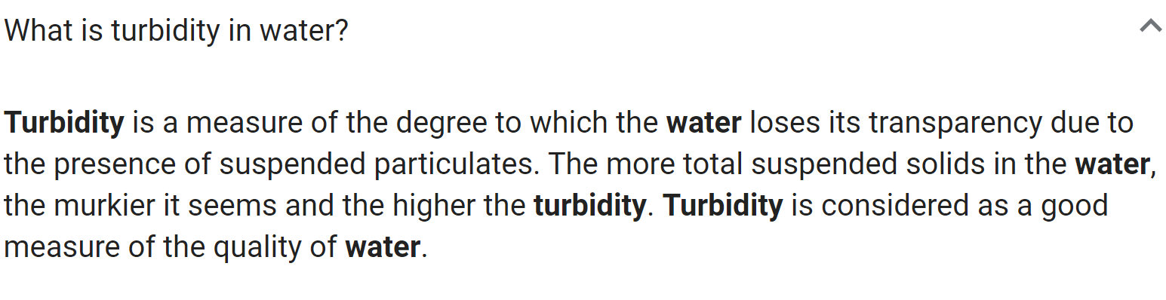
Notes:
What Causes Turbidity?
Organisms like phytoplankton can contribute to turbidity in open water. Erosion and effluent from highly urbanized zones contribute to the turbidity of waters in those areas. Construction, mining and agriculture, disturb the soil and can lead to raised levels of sediment which run off into waterways during storms. Storm water from paved surfaces like roads, bridges and parking lots also contribute to turbidity.

Slide 3
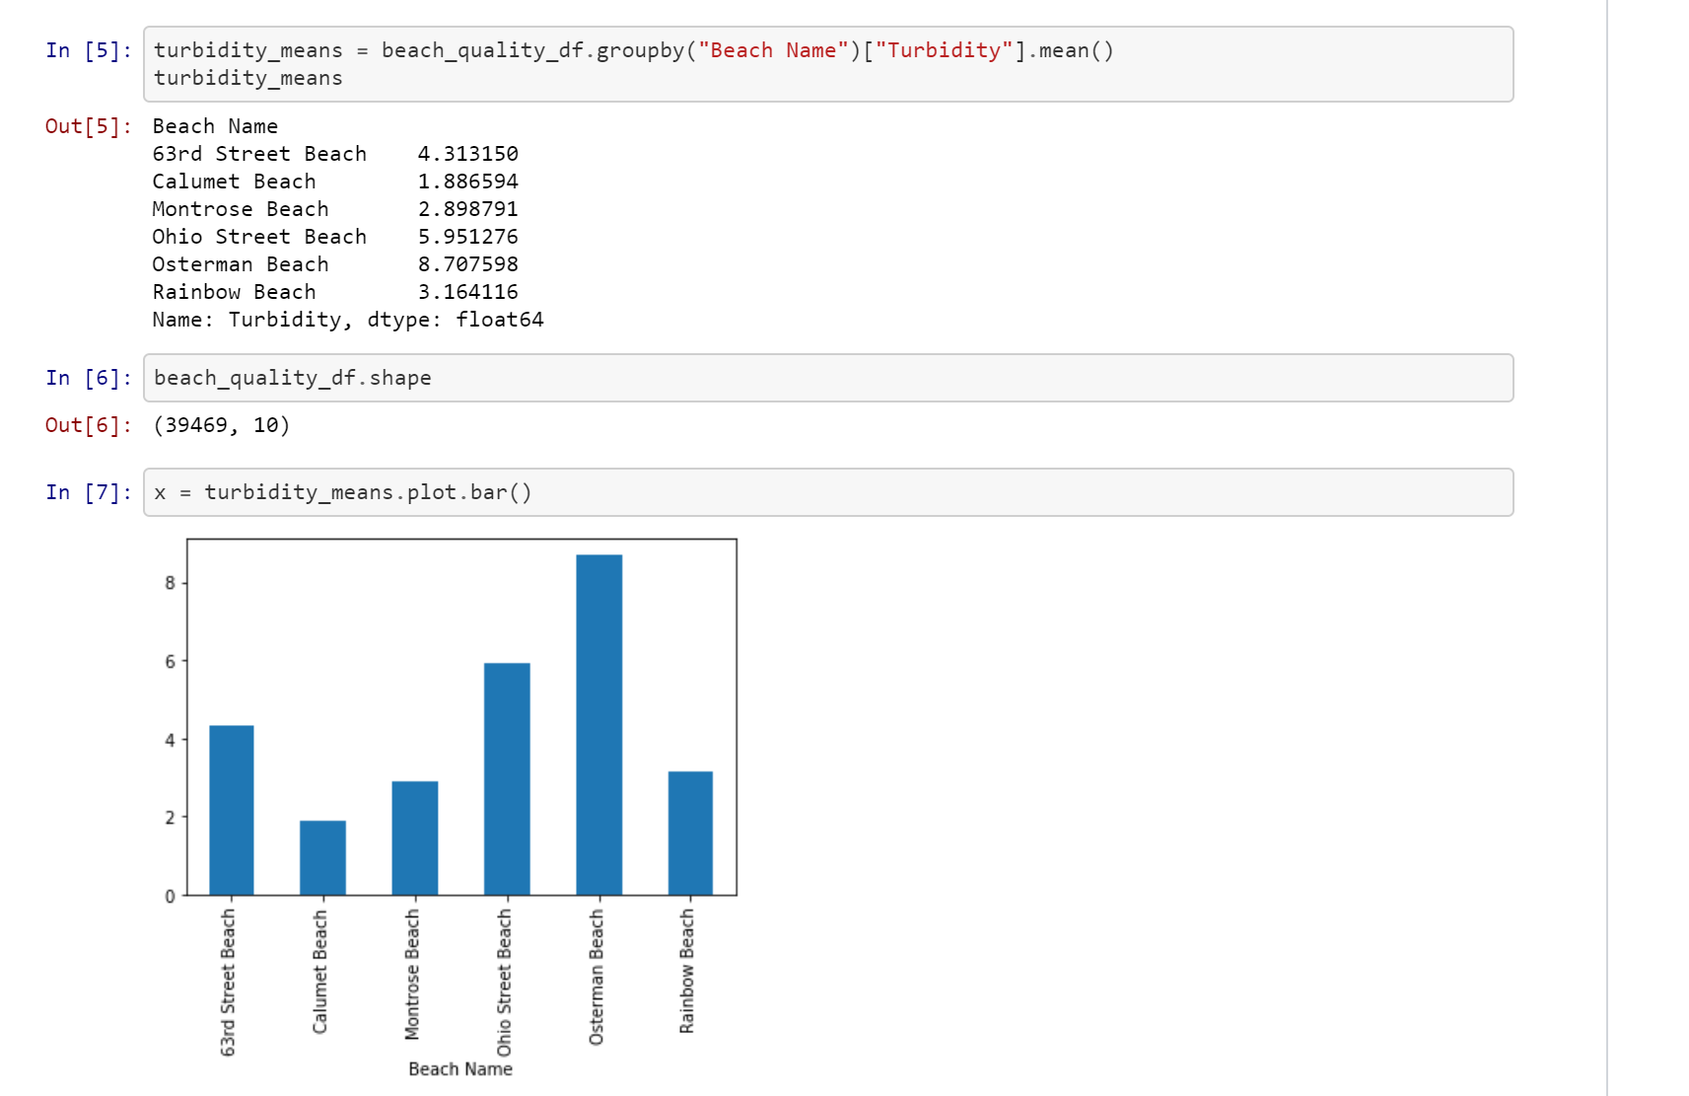
TURBIDITY

Slide 4
Add 2014/2015

Slide 5
Data analysis of the following:
Turbidity
Wave Height
Temperature
E. Coli

Slide 6

Wave Height

Slide 7
Add 2014/2015

