Slide 1
Android Multimedia Framework
By,
T.Venkata Rao.

Slide 2
Agenda
What is Multimedia in a mobile device.
Android Multimedia Framework Overview.
–Open MAX
–Stagefright
–Media Player service
–File format
–Codec
–What we can do with this

Slide 3
What is Multimedia in mobile device
Multimedia is the most important component in modern mobile device
–Multimedia framework is used to process video/audio input and output to satisfy certain functionality including
Video and Audio :
–Storage video and audio in media
–Playback video and audio
–Record video and audio

Slide 4
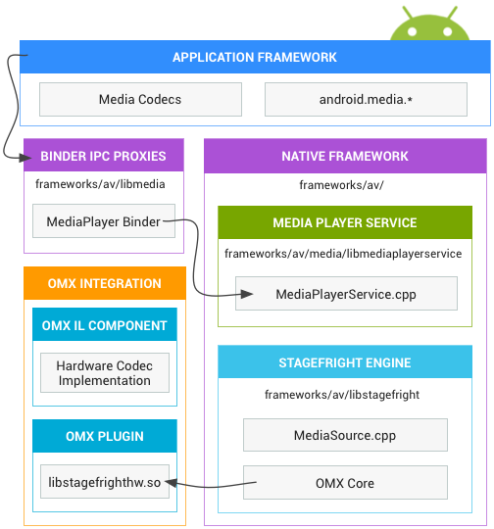
Media Framework Architecture

Slide 5
Media Framework Architecture
Application Framework:
At the application framework level is application code that utilizes android.media APIs to interact with the multimedia hardware.
Media Codec class can be used to access low-level media codecs, i.e. encoder/decoder components.
It is part of the Android low-level multimedia support infrastructure.
Binder IPC Proxies :
The Binder IPC proxies facilitate communication over process boundaries.
Synchronous communication b/w processes.
They are located in the frameworks/av/media/libmedia directory and begin with the letter "I".
Native Framework :
At the native level, Android provides a multimedia framework that utilizes the Stagefright engine for audio and video recording and playback.

Slide 6
Media Framework Architecture
Stage-fright :
Stage-fright is the group of software bugs
Stage-fright comes with a default list of supported software codec's and you can implement your own hardware codec by using the Open Max integration layer standard.
For more implementation details, see the Media Player and Stage-fright components located in frameworks/av/media.
You must create the OMX components and an OMX plug-in that hooks together your custom codecs with the Stagefright framework.
The component interface is located in the frameworks/native/include/media/OpenMAX/OMX_Component.h file.
Build your plugin as a shared library with the name libstagefrighthw.so in your product Makefile.

Slide 7
Media Framework Architecture
Stagefright and Open CORE :
Android introduce Stagefright to replace Open CORE start from éclair.
Either Open CORE or Stagefright is linked to Media Player Service, so application level never know about them.
Both of them based on same conception, but take different implementation
–Stagefright take parser and decode as a whole. Open core take them as individual node.
–Stagefright take parser, decoder, sink/output as serial operation. Open core take them as parallel.
–Different Synchronization mechanism.
Easier for Stagefright to develop parser.
Adopt OMX from Open CORE.
Open CORE more stable and mature, low risk.
Open CORE supports more container format and codec.
Stragefright is more easier to development.

Slide 8
Media Framework Architecture
Open MAX :
Open MAX is a royalty-free, cross-platform API.
That provides comprehensive streaming media codec and application portability.
It enables accelerated multimedia components to be developed, integrated and programmed across multiple operating systems and silicon platforms.
The Open MAX API will be shipped with processors to enable library and codec implementers.
OpenMAX provides three layers of interfaces:
1.Application Layer (AL)
2.Integration Layer (IL)
3.Development Layer (DL).

Slide 9
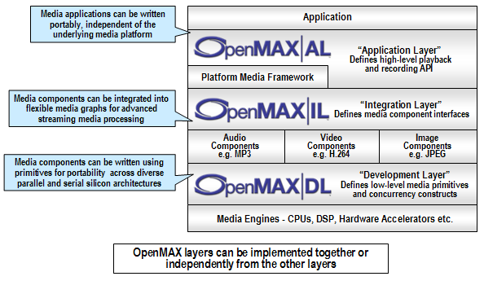
Open MAX Architecture

Slide 10
Open MAX Architecture
Open MAX Application Layer :
Open Max Al interface between Applications like Media Player and Media framework.
The AL provides application portability with regards to the multimedia interface.
Open MAX Integration Layer :
Open Max IL interface between Media framework and Codec’s.
The Open MAX IL API allows the user to load, control, connect, and unload the individual components.
Open MAX IL serves as a low-level interface for audio, video, and imaging codecs used in embedded and/or mobile devices.
It gives the ability to application and Frameworks interface with multimedia codecs and supporting components (i.e. sources and sinks) in a unified manner.
The codecs themselves may be any combination of hardware or software and are completely transparent to the user.

Slide 11
Open MAX Architecture
Open MAX Development Layer :
Open Max DL interface between Codec’s and Hardware.
Open MAX DL defines an API which contains a comprehensive set of audio, video and imaging functions.
That can be implemented and optimized on new processors by silicon vendors and then used by codec vendors.
It includes
– Audio signal processing functions such as FFTs and filters.
– Imaging processing primitives such as color space conversion.
– Video processing primitives to enable the optimized implementation of codecs such as MPEG-4, H.264, MP3, AAC and JPEG.

Slide 12
Open MAX Integration Layer
The OpenMax IL (Integration Layer) API defines a standardized media component interface to enable developers and platform providers to integrate and communicate with multimedia codec’s implemented in hardware or software ”.
OpenMax IL Features:
A flexible component-based API core.
Ability to easily plug in new codec’s.
Capable of being implemented as either static or dynamic libraries.
Ease of communication between the client and the codec’s and between codec’s themselves.
Open Max IL Profiles:
Base Profile :- support non tunneled communication
Interop Profile :- support non tunneled communication and tunneled communication.

Slide 13
Open MAX Integration Layer
Non tunneled communication:- exchanging data buffers b/w IL client and component.
Tunneled communication:- components to exchange data buffers directly with each other.
Proprietary Communication:-Third party based.
IL Client:- MDF (Multimedia Device Framework) plays the role of the Open MAX IL client within the Open MAX IL architecture.
IL core:- Open MAX IL Core is a platform-specific entity which is used to load and unload Open MAX IL Components, and to facilitate communication between them.

Slide 14
Open MAX Integration Layer
Open MAX IL domains :
The Open MAX IL components are divided in three main domains: audio, video and imaging
A support for other domains (timing info,bit stream) is provided. It is generally classified as “other” domain
The other domain includes also the mixed-domain components, like video/imaging processors
Open MAX IL Core :
Provides the functions to build and destroy each component
It gives all the information functionalities needed
– List of components
– List of capabilities (roles) where supported
It tries to set up the direct connection between two components

Slide 15
Open MAX Architecture
IL Components :
An Open MAX IL component is a black box.
That receives instruction with asynchronous commands and transmit/receive data through ports
It is uniquely identified by a string name, like the following
“OMX.vendor_name.component_name”

Slide 16
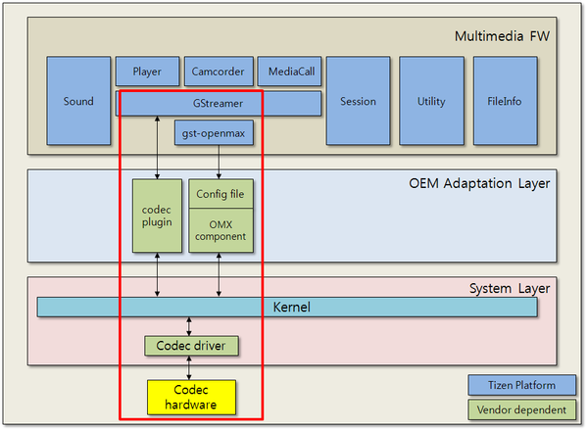
Data Flow

Slide 17
Open MAX API list
For each OMX core, there are function points need to be implmented.
–pOMX_Init
–pOMX_Deinit
–pOMX_ComponentNameEnum
–pOMX_GetHandle
–pOMX_FreeHandle
–pOMX_GetComponentsOfRole
–pOMX_GetRoleofComponent
–pOMX_SetupTunel
–pOMX_GetContentPipe
–pOMXConfigParser

Slide 18
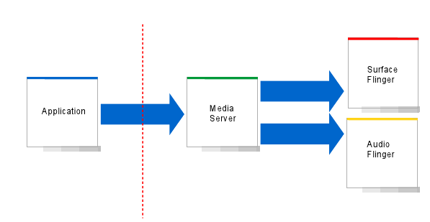
Media Framework Top View
SF, AF : Hardware abstractions for the audio and video
Flinger : The software implementation that combines either the visual surfaces or the audio output from multiple applications into a common stream that is sent to hardware

Slide 19
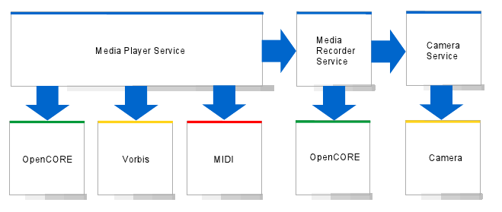
Top Level View of Media Server Process
It can instantiate a number of Media Player objects.
Open Core, Vorbis, MIDI : The different media player types.

Slide 20
Top Level View of Media Server Process
Media Player :
Each of the media player contains a codec (coder-decoder).
Coder encodes a data stream or signal for transmission, storage or encryption.
Decoder decodes it for playback or editing.
In a recording device, ADC converts analog signals into digital signals which are then passed into coder.
Vorbis Player
Plays ogg vorbis files :
A lightweight, psycho-acoustic codec
Used in internal sounds like ringtones, application sounds /system/media/audio/alarms or ringtones

Slide 21
Top Level View of Media Server Process
MIDI Player :
Plays MIDI files
MIDI : Musical Instrument Digital Interface
–An electronic musical instrument industry specification
–Enables wide variety of digital musical instruments, computers and other related devices to connect and communicate with one another
Open CORE :
Bulk of the framework
Anything other than Ogg and MIDI routed over to OpenCORE
Contains major codecs like
–Audio : MP3, AAC, AMR
–Video : H.263 , H.264 , AVC
Media Server is smart enough to recognize file type and call the appropriate player

Slide 22
Top Level View of Media Server Process
Media Recorder Service :
It also uses a proxy model
–A Media Recorder Object exists in the Java layer
–Media Recorder Service does the actual recording
Integrated with camera service for video recording
Authoring engine is Open CORE
Camera Service :
Operates in conjunction with media service and independently for still images
To take a still image
–Instantiate a camera object (a proxy for the camera service)
–Camera service takes care of handling preview, limiting the amount of data flowing between the application and hardware
–For Video recording, the frames are sent to Open CORE which does the encoding

Slide 23
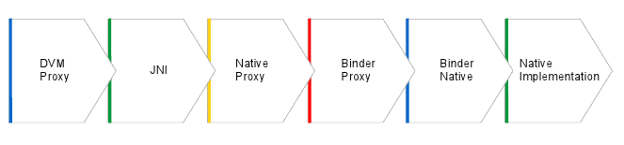
Typical Stack for Media Function Call
How a media function call from an application make its way down to the framework and into the media engine
DVM Proxy : The java object, we are talking to
E.g:–For a media player, it is the media player java object.
It is a proxy for the Native Proxy which in turn is the proxy for the actual native implementation

Slide 24
Typical Stack for Media Function Call
We go through the JNI layer (Java Native Interface)
JNI :
A programming framework
Enables Java code running in JVM to interact with native applications (Programs specific to a hardware and operating system platform) and libraries written in other languages such as C, C++ and assembly.
E.g. : Create a media player object in java
We make a call through the JNI layer to instantiate a C++ object
The media player java object contains reference to the C++ object, weak references to garbage collection, etc.

Slide 25
Typical Stack for Media Function Call
Strong references :
Strong reference to an object : The garbage collector cannot collect an object in use by an application while the application's code can reach that object.
Ordinary Java objects are strong by default.
E.g. :
StringBuffer_buffer = new_StringBuffer();
creates a new StringBuffer() and stores a strong reference to it in the variable buffer.
Weak references :
Permits the garbage collector to collect the object while still allowing the application to access the object.
Useful for objects that use a lot of memory
Can be recreated easily if they are reclaimed by garbage collection

Slide 26
Typical Stack for Media Function Call
Native proxy :
Native proxy is a C++ object that talks through the binder interface.
This enables to provide media service access to native applications.
Native applications cannot communicate through JNI.

Slide 27
Typical Stack for Media Function Call
Binder :
Binder is the abstraction for IPC
It marshals (guides) objects across process boundaries through a special kernel driver
Processes can share memory - enables moving data back between applications and media player , move file descriptors duped across processes etc.
Used extensively in Surface Flinger and Audio Flinger
Binder Proxy :
The Marshalling code in the application side
Binder Native :
The Marshalling code in the server side

Slide 28
Typical Stack for Media Function Call
Native Implementation :
The actual implementation
A Media Player service instantiates a Media Player object in the service which is proxies in the application by the Media Player Java object
High overhead involved in making a call through this stack
This is acceptable since we do not make a lot of calls to the
media player service.
Media player objects must be reused as much as possible

Slide 29
Codec / Decode and File Format
Codec / Decode :
device or computer program capable of encoding and/or decoding a digital data stream or signal.
A codec encodes a data stream or signal for transmission, storage or encryption and decode it for playback or editing.
codec = coder + decoder
Raw multimedia data is huge, codec compress them to facilitate store and transfer.
File Format :
Also call container or wrapper format.
Specify how different data elements and meta data coexist in a computer file or stream.
Always contain coded video, coded audio, subtitles and chapter-information.

Slide 30
Codec / Decode and File Format
Codec – Audio :
–AAC, MPEG-4 Audio Part 3 subpart 4
–AC-3, Dolby Digital codec
–AMR, Adaptive Multi-Rate Audio codec
–AMR-WB, Adaptive Multi-Rate Wide band
–MP2, MPEG1/2 Audio Layer II
–MP3, MPEG2 Audio Layer III
–Vorbis, OGG audio, open source project
–Wma, Windows Media Audio
–Real Audio, Real Network
–ALAC, Apple Lossless Audio Codec

Slide 31
Codec / Decode and File Format
Codec -Video :
MPEG–1, MPEG–1 Part 2
MPEG–2/H.262, MPEG–2 part 2
MPEG–4 ASP, MPEG–4 Part 2
MPEG–4 AVC/H.264, MPEG–4 Part 10
VC–1
The informal name of SMTP 421M video codec standard
VC-2
An open and royalty - free video compression format, Dirac.
VC-3
DNXHD, Digital Nonlinear Extensible High Definition
The DNXHD codec was submitted to the SMPTE organization as the framework for the VC-3 family of standard.

Slide 32
MPEG standard
Standard MPEG
–Moving Picture Experts Group.
The standard for storage and retrieval of moving pictures and audio on storage media. Approved Nov. 1992
–VCD
–MP2, MPEG-1 Audio Layer I
The standard for digital television. Approved Nov. 1994
– DVD
–MP3, MPEG-2 Audio Layer III

Slide 33
MPEG standard
MPEG -4
–The standard for multimedia application
MPEG-4 part 2, Advanced Simple Profile
–used by codecs such as DiVX, Xvid, Nero Digital and 3ivx,Quick time 6
MPEG-4 part 10, MPEG-4 AVC (Advanced Video Coding)/H.264
–used by x264 encoder, Nero Digital AVC, Quicktime 7, and high-definition video media like Blu-ray Disc

Slide 34
MPEG standard
MPEG4 -SP (Simple Profile) Video :
Designed as replacement for MPEG1/2 codecs
Simple encoder.
Typical MPEG – 4 Stream :
Usually higher quality than 3GPP
H.264 video codec
AAC audio codec
Bit rates up to 500K bps

Slide 35
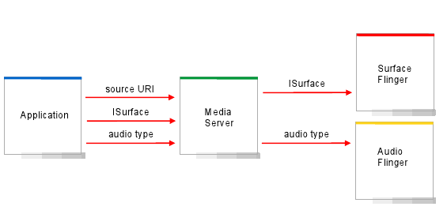
Media Playback
Overview of how a media playback session would look like

Slide 36
Media Playback
Application provides three main pieces of data
Source URI : Location of file –SD Card , a resource in application
apk,network stream.
Surface : The abstraction for the view that you see.
Audio type : So that media service can route the audio accordingly.
The audio/video frames are decoded inside the media server and they get output directly to the Surface/Audio Flinger.
Low overhead, since no data flowing back to the application.

Slide 37
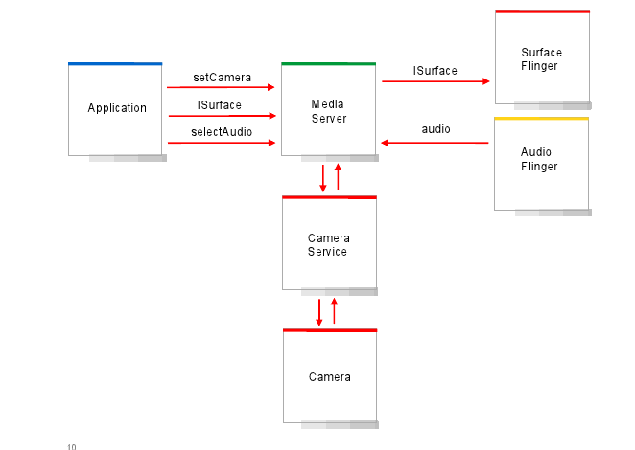
Recorder Media
Overview of how a media recording session would look like

Slide 38
Recorder Media
Application provides :
Camera Object :– Application can create its own camera object or let the media server create a new camera object.
Surface :- where the preview will be displayed.
Audio source :– Microphone.
Camera feeds frames through the camera service to the media server.
It is pushed to the surface for preview and into Open CORE for encoding.
There exists a file authoring piece which takes the frames from audio and video, mixes them together and writes them out to a file.

