Slide 1
Touch screen Driver Implementation
by,
T.Venkatarao

Slide 2
Contents
Touch Screen hardware info
Touch Screen register info
Communication between Touch Screen and PC
Connection with target board
DSI(display serieal interface)
Input Subsystem
Event Semantics
Touch Screen working flow
Driver Implementation

Slide 3
Touch Screen hardware info
Introduction :
1971 Dr. Sam Hurst, founder of Elographics developed the first touch opaque sensor “Elograph”. In 1974 He developed the first real touch screen.
FT5406DQ9 :
The FT5x06 Series ICs are single-chip capacitive touch panel controller ICs with a built-in 8 bit Micro-controller unit (MCU).They adopt the mutual capacitance approach, which supports true multi-touch capability.
Some features:
* Mutual Capacitive Sensing Techniques.
* True Multi-touch with up to 10 Points of Absolution X and Y Coordinates.
* Auto-calibration:Insensitive to Capacitance and Environ-mental Variations.
* Supports up to 26 Transmit Lines and 16 Receive Lines .
* Supports up to 8” Touch Screen.

Slide 4
Touch Screen hardware info
Operation Modes :
1. Active Mode :
When in this mode, FT5x06 actively scans the panel. The default scan rate is 60 frames per second.
2. Monitor Mode :
When in this mode, FT5x06 scans the panel. The default scan rate is 25 frames per second. When in this mode, most algorithms are stopped. A simpler algorithm is being executed to de-termine if there is a touch or not.
3. Hibernate Mode :
In this mode, the chip is set in a power down mode. It shall only respond to the “WAKE” or “RESET” signal from the host processor.

Slide 5
Touch Screen register info
Required register info :
DEVICE_MODE
GEST_ID
TD_STATUS
TOUCHn_XH
TOUCHn_XL
TOUCHn_YH
ID_G_THGROUP
ID_G_THPEAK
ID_G_ CLB

Slide 6
Communication between Touch Screen and PC
External Interface:
* I2C/SPI: an interface for data exchange with host .
* INT: an interrupt signal to inform the host processor that touch data is ready for read .
* WAKE: an interrupt signal for the host to change FT5x06 from Hibernate to Active mode .
* /RST: an external low signal reset the chip .

Slide 7
Communication between Touch Screen and PC
Host Interface :
The bellow figure shows the interface between a host processor and FT5x06. This interface consists of the following three sets of signals:
* Serial Interface.
* Interrupt from FT5x06 to the Host.
* Wake-up Signal from the Host to FT5x06.

Slide 8
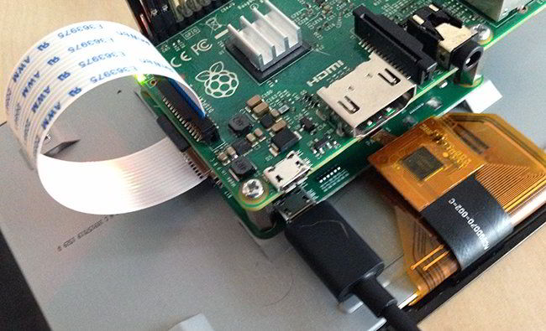
Connection with target board

Slide 9
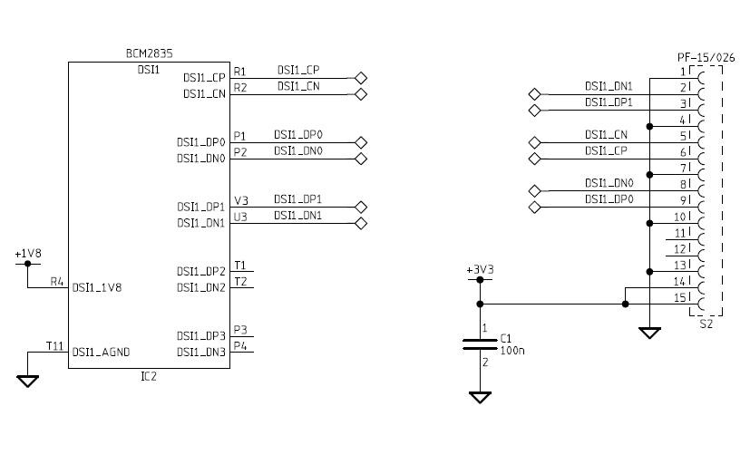
DSI(display serieal interface)
DSI (Display serial interface) is a high-speed serial interface.

Slide 10
Input Subsystem
Input subsysteam :
The input subsystem is the part of the Linux kernel that manages the various input devices that a user uses to interact with the kernel, command line and graphical user interface.
Examples:-
1.Keyboards
2.Mice
3.Joysticks
4.Touch Screens

Slide 11
Input Subsystem
The event interface allows you to query which features and capabilities are available for a particular device. The types of events supported by the event interface are:
A wide range of individual codes can be found within each event type.
For example :
* The EV_ABS specifies codes to distinguishes between ABS_X, ABS_Y and ABS_Z axes and ABS_PRESSURE and many more.
* Similarly, the EV_KEY feature type includes literally hundreds of different key and button codes.

Slide 12
Input Subsystem
The three major elements of the input subsystem are:
1.Input Core
2.Event Handlers
3.Input Device Drivers
Note that while the normal path is from low-level hardware to drivers, drivers to input core, input core to handler and handler to user space, there usually is a return path as well.

Slide 13
Multi-Point versus Multi-Touch
single-point:
Single-point interaction. One x/y coordinate, button/key state.
single-touch:
Not a single point, but a single area. touching with a thumb is different than touching with a stylus. Touch screens that only do single point interaction are technically no different than a mouse.
Multi-point:
Multiple points of interaction.
multi-touch:
Muliple separate input contact areas.

Slide 14
Event Semantics :
Event Semantics :
ABS_MT_TOUCH_MAJOR
ABS_MT_TOUCH_MINOR
ABS_MT_WIDTH_MAJOR
ABS_MT_WIDTH_MINOR
ABS_MT_PRESSURE
ABS_MT_POSITION_X
ABS_MT_POSITION_Y

Slide 15
Event Semantics :
ABS_MT_TOOL_TYPE
The type of approaching tool.
The protocol currently supports:
MT_TOOL_FINGER
MT_TOOL_PEN
ABS_MT_BLOB_ID
ABS_MT_TRACKING_ID

Slide 16
Touch Screen working flow
X Windows
Qt
Custom Application
/dev/input/mice
/dev/input/eventX
/dev/input/js
Console
User Space
Kernel Space
Input CORE
Virtual
Terminal
Input Event Handlers
mousedev, joydev, keyboard,
evdev
Keyboard
Input
Input
Device Drivers
Serio
USB HID
Bluetooth
HID
I2C
SPI
GPIO
Kernel Space
Hardware
PS/2
Mouse
Keyboard
Touch
Controller
Serio
Mouse
Keyboard
Bluetooth
Mouse
Keyboard
I2C Touch
Controller
SPI
Accelero
meter
Rotary

Slide 17
Driver Implementation
Raspberry Pi uses a FT5406 attached to the VideoCore's I2C bus.The firmware runs a thread that periodicaly does a registerdump to a shared memory window. The interrupt and wake signals seem disconnected.
Required properties:
- compatible: "raspberrypi,raspberrypi-ft5406"
- reg: address range of the shared memory with register dump
Driver for ft5406 touchscreen controller accessible via Raspberry Pi firmware.
For this driver implement the thread function. that function polls the memory based register copy of the ft5406 registers using the number of points register to know whether the copy has been updated (we write 99 to the memory copy, the GPU will write between 0 - 10 points).

