Slide 1
DEVICE DRIVERS
MOHAN

Slide 2
CONTENTS
Device Driver Definition.
Classes of Device Drivers.
Building & Running Modules

Slide 3
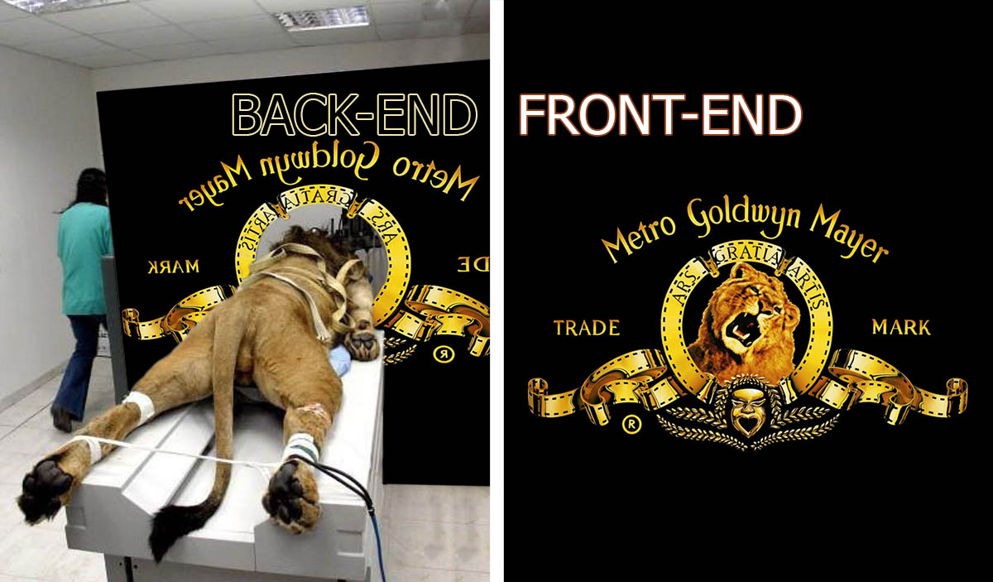

Slide 4

DEVICE DRIVER
WHAT
WHY
HOW

Slide 5
DEVICE DRIVERS
Basic Program requirements
module_init(hello_init);
module_exit(hello_exit);
MODULE_LICENSE("Dual BSD/GPL");
printk(KERN_ALERT "Hello, world\n");
Makefile
Insmod , rmmod & dmesg

Slide 6
DEVICE DRIVER
Is driver really needed ?
Any device exist without driver ?
Can I use single resource to multiple similar devices ?

Slide 7
DEVICE DRIVERS
MODULE PARAMETERS
Passing command line arguments to the modules.
These parameter values can be assigned at load time by
Insmod Or modprobe.
module_param (name, type, perm)
module_param_array(name, type, nump, perm)
Why load time ?

Slide 8
DEVICE DRIVERS
Dynamic Modules
Piece of code that can be added to the kernel at runtime.
Insmod,rmmod,modprobe are the commands to insert and remove modules .
Dynamic modules are the best usage in the market.
Then What about static modules ?

Slide 9

DEVICE DRIVERS
User space
Kernel space

Slide 10
DEVICE DRIVERS
Drawbacks in user-space approach
Interrupts are not available in user space
Response time is slower, because a context switch is required to transfer infor-mation or actions between the client and the hardware.

Slide 11
DEVICE DRIVERS
Insmod Vs modprobe
modprobe and insmod are used to install or load modules to linux kernel
Unlike insmod, modprobe calculates all of the module dependencies and then load the module along with the dependencies.
How modprobe knows about Dependencies ?

Slide 12
DEVICE DRIVERS
Depmod
Depmod.d
Modules.dep
Why modprobe won't work for .ko files?

Slide 13
DEVICE DRIVERS
Classes of Devices
Character Devices
Block Devices
Network Devices

Slide 14
DEVICE DRIVERS
Character devices
It can be written to and read from a byte at a time.
Implement open,close, read and write functions/operations.
Example – Serial port, keyboard,mouse etc...

Slide 15
DEVICE DRIVERS
SYMBOLS
What is Symbol & Symbol Table?
Why exporting a Symbol ?
How is it exported ?
EXPORT_SYMBOL()
EXPORT_SYMBOL_GPL()
nm & System.map

Slide 16
DEVICE DRIVERS
Major & Minor Numbers
Allocating and Freeing Device Numbers
int register_chrdev_region(dev_t first, unsigned int count, char *name);
int alloc_chrdev_region(dev_t *dev, unsigned int firstminor, unsigned int count, char *name);
void unregister_chrdev_aregion(dev_t first, unsigned int count);

Slide 17
DEVICE DRIVERS
Application Programming | Linux module Programming
Application program will perform a single task from beginning to end. | The kernel program can start anywhere and end anywhere.
There is glib c library. | No library support.
Application program has single entry point main | Kernel programs have multiple entry points like open, release, ioctl,read, write etc
Applications run in user space. | A module run in kernel space.

Slide 18

DEVICE DRIVERS

