Slide 1
A Monte Carlo Simulation of Early Covid-19 Data

Slide 2
Introduction to Paper
We investigated the paper “A random walk Monte Carlo simulation of COVID-19-like infection spread”
Paper submitted 2 July, 2020
Used early Covid-19 data to predict the spread of Covid

Slide 3
Lack of Data
Paper finished early in the pandemic
Little was known about Covid-19 in July

Slide 4
Random Walk
A random walk is a process that describes a path of succession in space
Use previous , position of the person and a random variable to move the person
We can use this movement to graph interactions between people

Slide 5
Model Overview
Set patient 0 at the center of the population
Used a random walk for each person
If a healthy person is within 2 meters of an infected person, they got infected

Slide 6
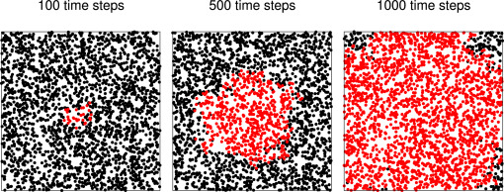
Their Model Results
This is a model of the infection spread of New York City
Each dot represents a person
Dots are close together to represent a dense urban area
We can think of the time step as a day

Slide 7
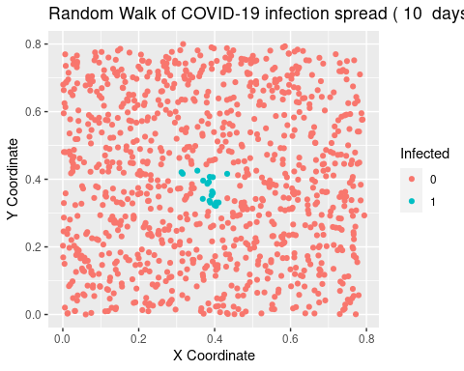
Our Recreation
Although we do not have the exact same code, and are the paper did not publish their set seed
We are able to get a similar pattern
Were not able to use as many people because of computational limitations

Slide 8
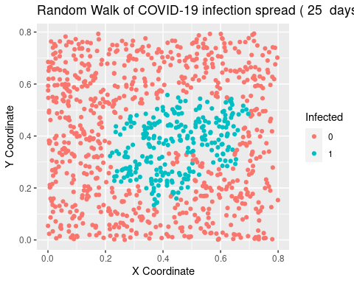

Slide 9
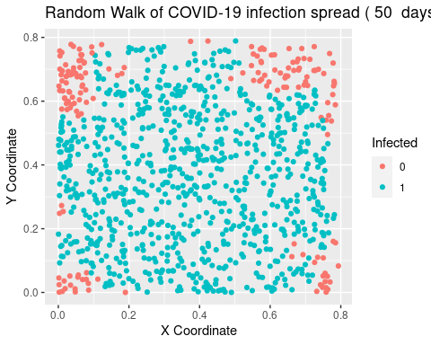

Slide 10
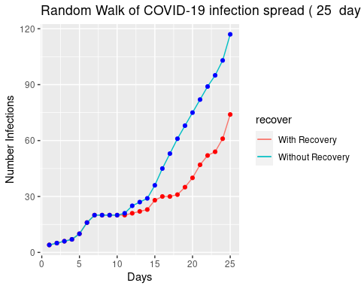
COVID-19 Infections with Recovery
Original Paper did not have any recoveries
We assumed each person would recover after 11 days

Slide 11
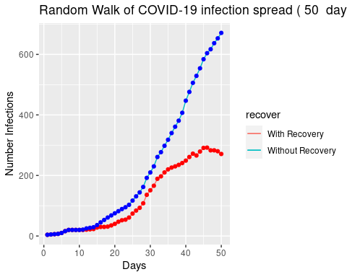
Our Model

Slide 12
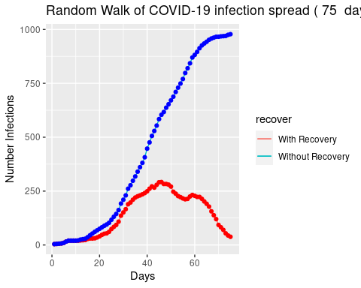

Slide 13
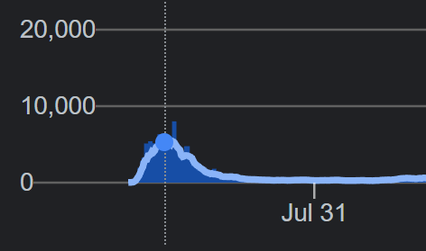
New York Real Life Covid Cases

Slide 14
Colorado Real Life Cases
Using data from Colorado to use parameters like transmission rate and recovery rate.
Took an average for transmission rate based on 25 simulations in data.
Found the transmission rate to be 0.47
A person recovers every 8 days

Slide 15
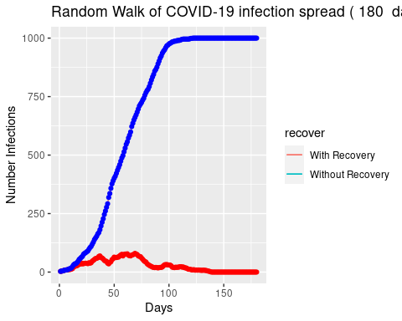
Colorado Real Cases
Use Monte Carlo to compute 180 iterations of the simulation.
With a starting population of 1000, we can see the spread of Covid-19.
Without a recovery rate we see that all of the people become infected around day 125.
With a recovery rate we see that the spread would eventually stop around day 150.

Slide 16
Colorado Data
There are limitations to the Colorado data considering that we did not implement a vaccination.
This data was also taken from when Covid-19 was not considered an epidemic anymore.
Still useful to predict how safety measures could impact the spread of the virus.
Also helpful when determining the length of infections for the virus.

Slide 17
Conclusions
We were able to replicate the study for a random walk with monte carlo simulations and implement a recovery rate.
From there we used MC simulations to estimate the spread of Covid-19 for other places like New York City and Colorado.
Our models could be improved further by varying probabilities by age or using social distancing measures, but adding in a recovery rate improves the original study.

