Slide 1

Disfluency Detection using Deep Learning
Under guidance of Dr. D. Susan
School of Electrical and Electronics Engineering
Department: ECE
1. Kuppa Sai Sri Teja 120004117
2. T. Vivekananda Reddy 121004261
3.G V S S Gowreesh 121004100

Slide 2
Motivation
Stuttering is a speech disorder affecting tens of millions of people on an everyday basis, this is characterized by repetition of sounds, syllables, or words; prolongation of sounds; and interruptions in speech known as blocks.
An individual who stutters exactly knows what he or she would like to say but has trouble producing a normal flow of speech.

Slide 3
Introduction
This has been an unaddressed problem till date but the suffering is about 1% of the whole population.
This project decodes the speech or blocks and process them using deep learning and ultimately gives the content precisely.
The model is built with respect to real-time implementation. From the speech it is possible to identify a person’s emotion.
This helps people in business meetings, public speaking for monitoring of features like volume, rate of speech, and intonation.

Slide 4
Work flow
Data collection
Testing phase
pauses
repetitions
Fillers words
Organization of data
Training phase
Success
Model creation

Slide 5
Data Collection Work Flow
Person Speech
WebSite built for data collection
Data Cleaning
1.Eqaulize the sampling rate for all the audios.
2. Pass through Low pass filter to get vital information.
4.Chunk Data to 10 secs of duration.
3.Draw the spectrograms and prepare MFCC data to experiment it.
Complete database is stored in AWS

Slide 6
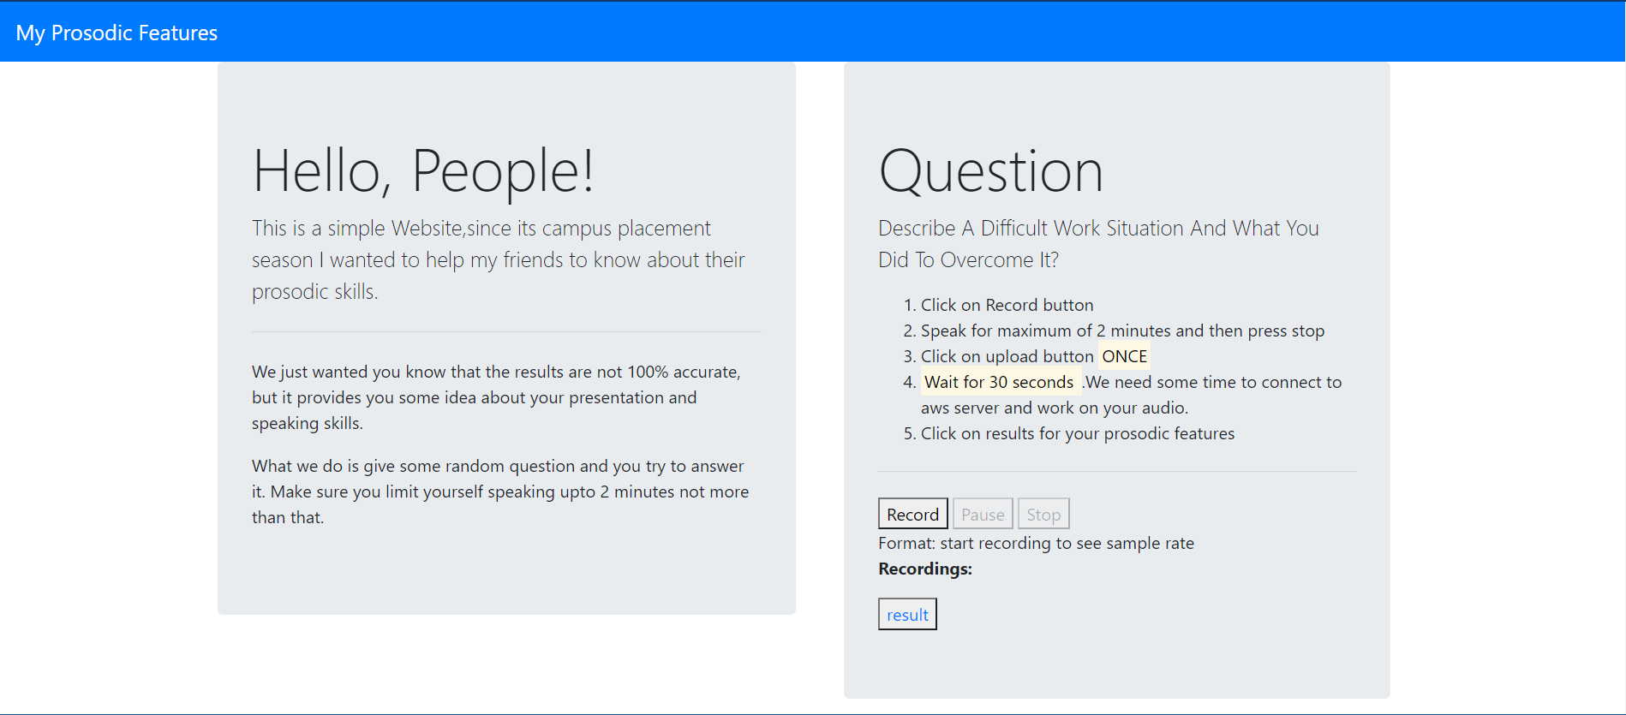
Website for Data Collection : https://myprosody.herokuapp.com/

Slide 7
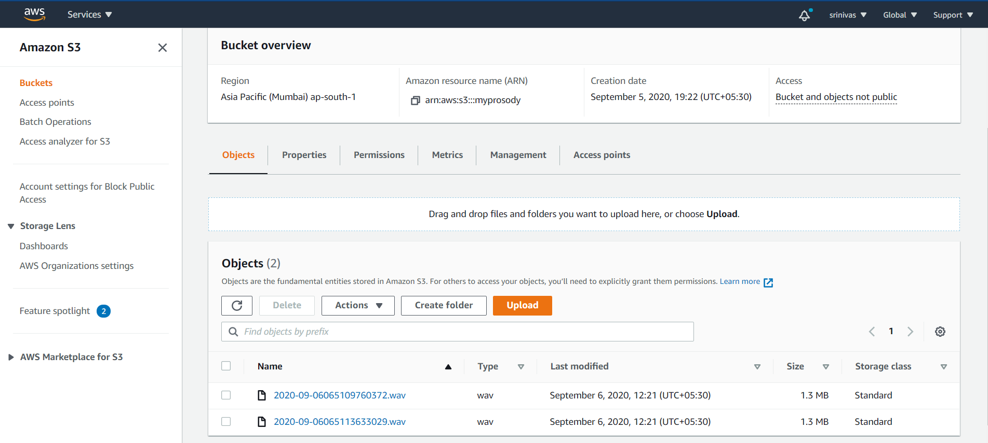
AWS Bucket in S3

Slide 8
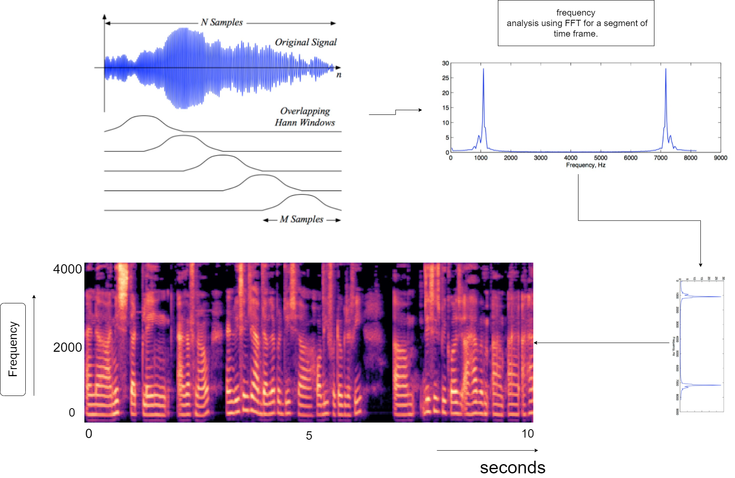
Making a Spectrogram
hz

Slide 9
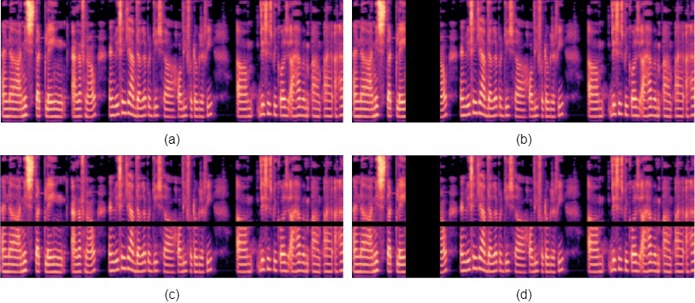
Augmentation Techniques
Original Spectrogram
Spectrogram with Time masking
Spectrogram with Frequency masking
Spectrogram with time and Frequency masking.

Slide 10
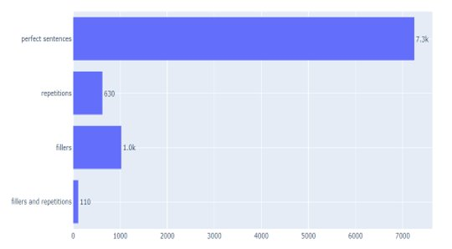
Complete data after annotation

Slide 11
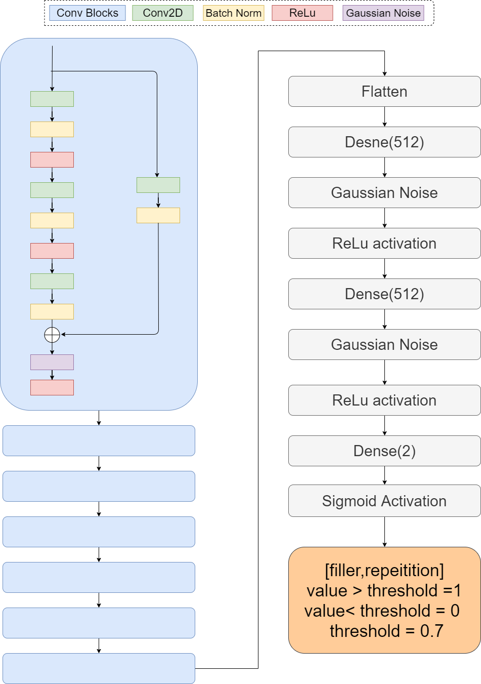
Neural Net
Architecture

Slide 12
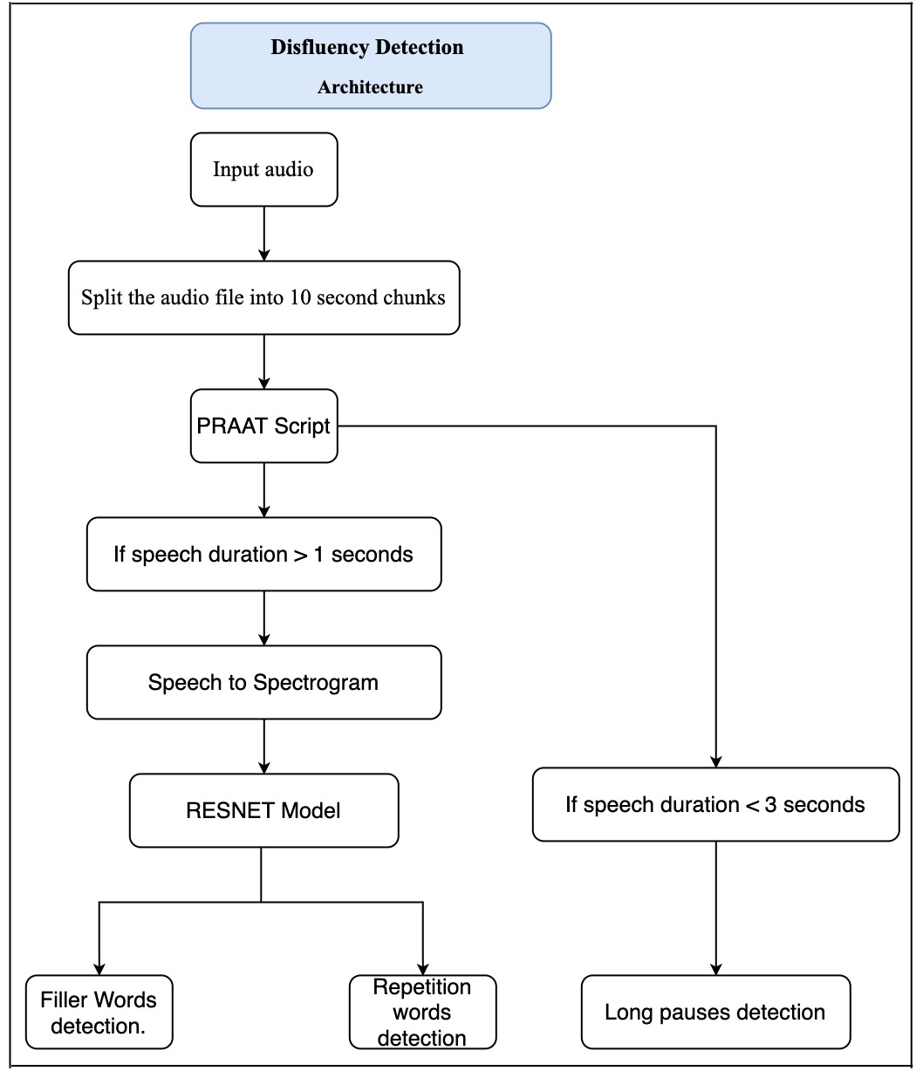
PRAAT Script decides long pauses and Deep learning models classifies filler words and Repetition words.
The total length of the speech for spectrogram is 10 seconds.
RESNET Architecture is used as deep learning model architecture to avoid the problem of overfitting by learning a neat way.

Slide 13
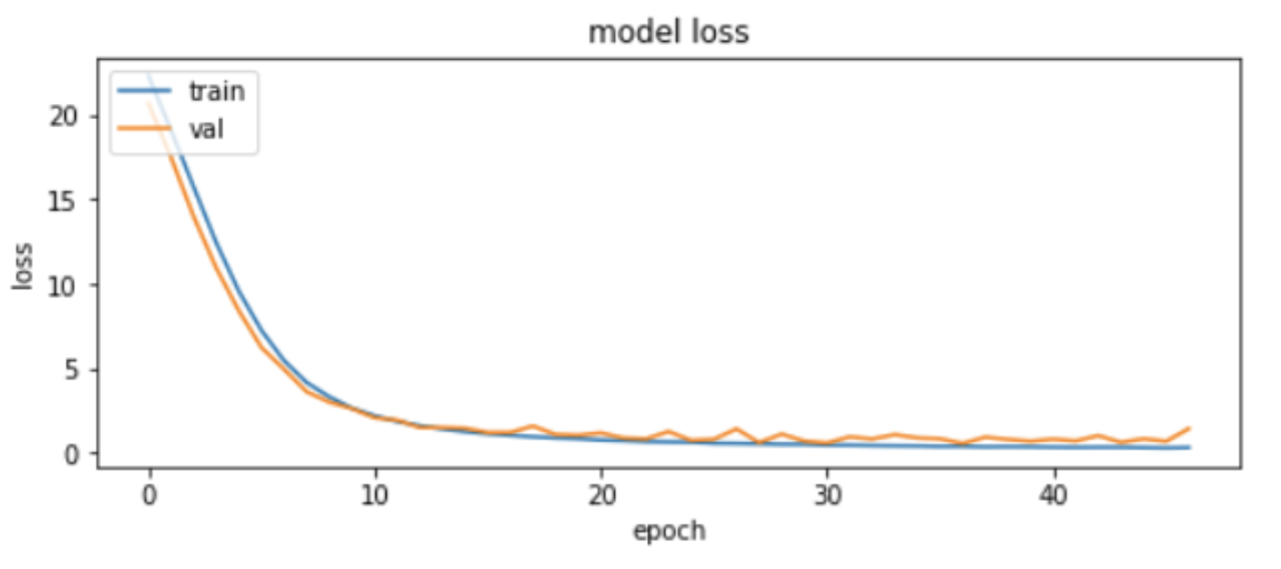
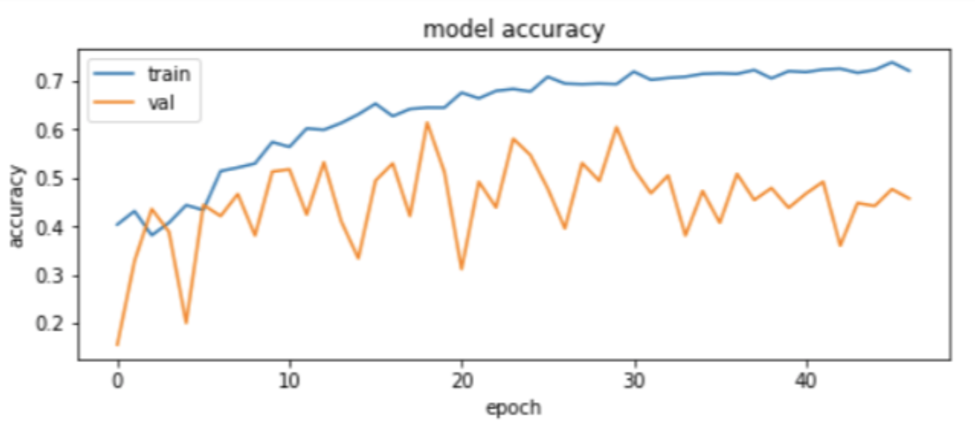
Model Loss Plot
Accuracy Plot

Slide 14
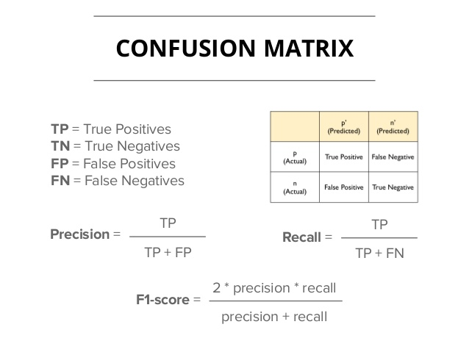
Disfluency | F-score(%)
Filler words | 83.86(F1- score)
Repetition words | 81.03(F1- score)
Both Fillers and Repetitions | 64.08( F2-score)
Long Pauses | 100
Initial Results
F2-Measure
(5 * Precision * Recall) / (4 * Precision + Recall)
F1-Measure
2*((Precision*Recall)/(Precision + Recall))

Slide 15
References
Kourkounakis, Tedd & Hajavi, Amirhossein & Etemad, Ali. (2019). “Detecting multiple speech disfluencies using a deep residual network with bidirectional long short-term memory”.
Kathryn Womack, Wilson McCoy, Cecilia Ovesdotter Alm, Cara Calvelli, Jeff B Pelz, Pengcheng Shi, and Anne Haake, “Disfluencies as extra-propositional indicators of cognitive processing,” in Proceedings of the workshop on extra-propositional aspects of meaning in computational linguistics. Association for Computational Linguistics, 2012, pp. 1–9.
S. Das, N. Gandhi, T. Naik and R. Shilkrot, "Increase Apparent Public Speaking Fluency by Speech Augmentation," ICASSP 2019 - 2019 IEEE International Conference on Acoustics, Speech and Signal Processing (ICASSP), Brighton, United Kingdom, 2019, pp. 6890-6894, doi: 10.1109/ICASSP.2019.8682937.
Dale J Barr and Mandana Seyfeddinipur, “The role of fillers in listener attributions for speaker disfluency,” Language and Cognitive Processes, vol. 25, no. 4, pp. 441–455, 2010.
Park, D., William Chan, Y. Zhang, Chung-Cheng Chiu, Barret Zoph, E. D. Cubuk and Quoc V. Le. “SpecAugment: A Simple Data Augmentation Method for Automatic Speech Recognition.” INTERSPEECH (2019).
P. A. Heeman, R. Lunsford, A. McMillin, and J. S. Yaruss, “Using clinician annotations to improve automatic speech recognition of stuttered speech,” INTERSPEECH, pp. 2651– 2655, 2016.

Slide 16
Thank you

