Slide 1

Facial Emotion Recognition using 3D Convnets
Under guidance of Dr. A. Revathi
1. Kuppa Sai Sri Teja 120004117
2. T. Vivekananda Reddy 121004261
3.G V S S Gowreesh 121004100

Slide 2
Applications that use Emotion as Feature.
Forms of speech, gestures and emotions are the prominent ways to communicate between 2 persons.
Many promising fields work on emotion recognition systems helps the computer to effectively communicate with the human.
Apt emojis using facial features is one of the key updates in today's social media app developers.

Slide 3
Emotion recognition of people in the community can even help in situations of safety like public harassment , harsh protest and accidents. Emotion of the players helps the gaming industry for improvement in its gaming components.
for a student different methods of explanations are adapted a in a E-learning education field .

Slide 4
Introduction
A change of user’s emotion is one of the foundation of communication. Emotional states can motivate human’s actions, and can also supplement the meaning of communication.
facial expression recognition has its own characteristic. In particular, facial expression can be considered as dynamic variation of key parts (e.g. eyes, nose and mouth), which are fused to form the variation of local parts and the whole face, and the key challenge becomes to capture such dynamic variation of facial physical structure from consecutive frame.

Slide 5
We used Dynamic data as it consists of sequences of images whereas static data consists of still images.
Most of the static datasets are easy to predict because these consist of images taken in a laboratory with fine lighting conditions.
Dynamic data is helpful in extracting temporal features rather than static data. So it gives high accuracy In real-time, data over a long period of time is retrieved.
The model is built with respective to real-time implementation. From actions, speech, facial expressions we can identify a person’s emotion.
The Database we used is the SAVEE database. We use Python as our system simulation platform.

Slide 6
PYTHON
Python provides the following requirements:
It is an extraordinary library for projects based on signal processing.
2. NumPy library allows matrix manipulations, MATPLOTLIB for plotting of functions and data, and scientific python implementation of algorithms.
3. A wide variety of feature extraction tools are available.
Creating a database for translation of video to frames and processing each frame.
4. Inbuilt algorithms and functions provide easy flow in programming.

Slide 7
SAVEE Dataset
Surrey Audio-Visual Expressed Emotion (SAVEE) database has been recorded as a pre-requisite for the development of an automatic emotion recognition system
SAVEE database consists of 4 professional signers with 7 different emotions namely angry, sad, surprised, disgusted, happy, fear, neutral,480 British English utterances in total
The sentences were chosen from the standard TIMIT corpus and phonetically-balanced for each emotion.
Subject identity bias, variations in pose, illumination and occlusions are common in unconstrained facial expression scenarios.

Slide 8
Types of emotion
Angry
Sad
Disgust
Fear
Happy
Surprised
Neutral

Slide 9
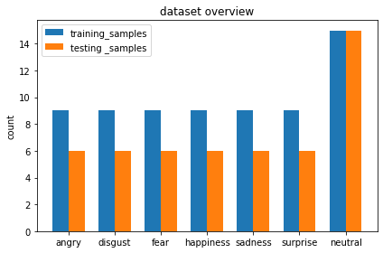
Dataset Overview(Dynamic Frame)

Slide 10
Dataset Overview(Static Frame)
Emotion | Train | Test
Angry | 1486 | 1482
Disgust | 1711 | 2029
Fear | 1548 | 1668
Happy | 1600 | 1939
Neutral | 3461 | 3363
Sad | 1891 | 2122
Surprised | 1453 | 1863

Slide 11
Process of Identification Emotion
Static Methods
Passing Processed images through CNN.(RESNET)
Passing landmarks of the face through simple ANN.
Dynamic Methods
Passing Video through a 3D convnets for dynamic working.
Training a sequence of facial landmarks for better understanding.

Slide 12
Working Process
COMPLETE WORK FLOW OF THE MODEL
WORKING DIAGRAM OF THE 2D WAVELET DECOMPOSITION
KEY POINTS POSITIONS EXTRACTED FROM A FACE
KEY POINTS POSITIONS EXTRACTED FROM A SIGNERS FACE
WORKING DIAGRAM OF THE SYSTEM USING 3D_CONVNETS
CONFUSION MATRIX PLOTS OF RESULTS

Slide 13
FEATURE EXTRACTION:
Feature extraction is the most efficient and meaningful way of representing the physical quantity like sound, image, temperature data, etc. This is important for analysis and classification. We have used a concept of 2d wavelet decomposition for retaining the important feature with a decrease in the size of the image. This is then converted to grayscale. This conversion decreases computational cost. One layer is easy to process rather than 3 layers.

Slide 14
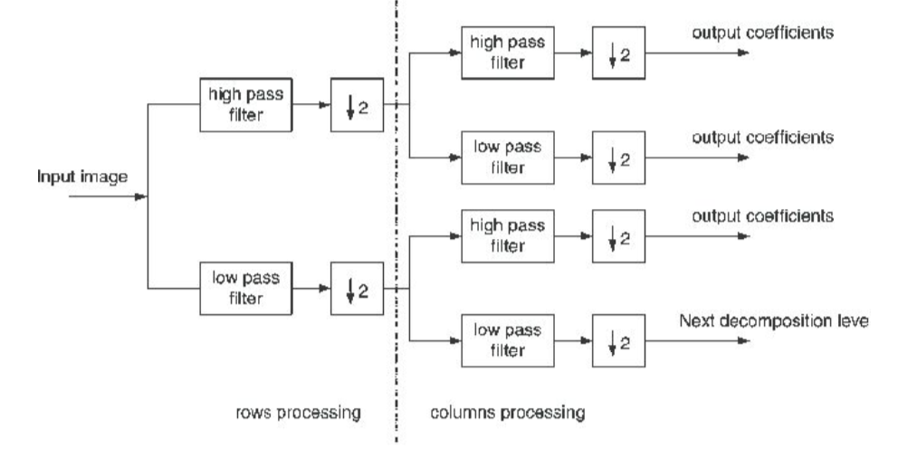
WORKING DIAGRAM OF 2D WAVELET DECOMPOSITION

Slide 15
GREY SCALING AND FACIAL LANDMARKS EXTRACTION:
The resizing is done using OpenCV’s library and python.for image decimation OpenCV uses INTER_AREA interpolation as it gives moire'-free results. Doing this helps neural nets performance speedup during training and testing. fx and fy are the size of the input image.
Greyscale = ( Red + Blue + Green )/3
Generally, images are seen in RGB while having all color combinations of red, blue, and green. This image is a converted greyscale which is of likely color combinations of back and white.

Slide 16
FACIAL LANDMARK EXTRACTION:
We have used a machine learning model to extract the facial landmarks from the image sequences. Changes in facial landmarks can be a key thing in making a good deep learning model for emotion detection. We choose to extract eyes, nose, eyebrows, mouth, and chin. The positions are given in a cartesian coordinate which consists of (x,y), we have done a feature processing of finding the distance from noise point to all the remaining points extracted which lead us to a 1d tensor of values rather than 2d tensor.

Slide 17
We have used the dlib library for extracting facial landmarks. A total of 68 points are received from this model. This method starts by using:
A training set of labeled facial landmarks on an image. These images are manually labeled, specifying specific (x,y) coordinates of regions surrounding each facial structure.
2.Priors, of more specifically, the probability of distance between pairs of input pixels

Slide 18
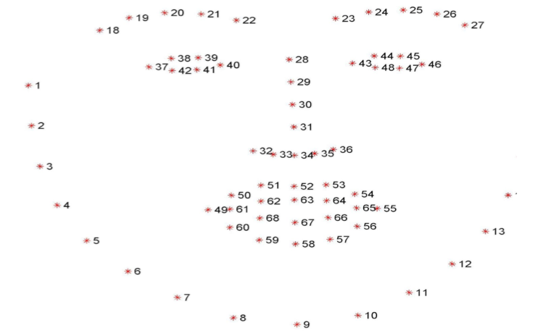
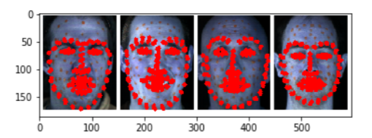
The end result is a facial landmark detection that can be used to detect facial landmarks in real-time with quality predictions
KEY POINTS POSITIONS EXTRACTED FROM A FACE
KEY POINTS POSITIONS EXTRACTED FROM A SIGNERS FACE

Slide 19
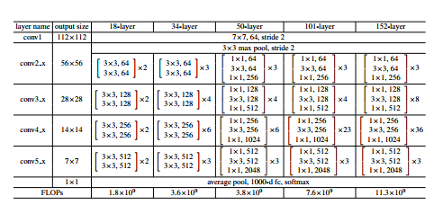
RESNET ARCHITECTURES
We have chosen RESNET34 because it have comparative less layers than VGG16 which reduces computation time.

Slide 20
3D CONVNETS:
1.Convolution layers :
Convolutional layers are the essential layers that extract the key features in an image. A kernel of matrix 3*3 is convolved with each image in the 3d matrix. When convolved we extract the edges and shapes of a specific emotion. The operations performed by this layer are still linear/matrix multiplications, but they go through an activation function at the output, which is usually a non-linear operation.

Slide 21
2.Max Pooling
Max pooling is a robust method in convolutional layers that extract the highest number is a matrix of 2*2 which helps to reduce the dimensions without losing the important features in the data. Reducing the dimensions helps in saving computational costs. This helps to gain insight into movements in different parts of the face for each emotion.
3.Dense layers:
The output from the convolutional layers is then flattened to a 1d array and then given to the dense layers. The dense layer is a linear operation on the layer’s input vector. A series of dense layers of shapes 2048,512,7 are placed to result in the seven emotions.

Slide 22
4.Dropout:
A dropout of 0.4 is added to avoid the problem of overfitting in the neural network. It makes four out of 10 neurons dead for an epoch and then retrains back. Using this way each neuron has an ability to learn and output good results.
5.Normalization layer
Used at the input for feature scaling, and in batch normalization at hidden layers.

Slide 23
METHOD USED
1. OBJECTIVE:
Classify an emotion out of seven emotions based on trained data and test data.
2. CRITERIA TO CHOOSE A METHOD:
We should choose a proper pre-processing technique, feature extraction technique & classification algorithm to suit all our needs such as,
The pre-processing technique should be efficient in extracting import movements in the parts of the face.
The feature should be able to completely characterize the given input video file.
The classification algorithm should be efficient and has to be applicable to large datasets.
3. METHOD CHOSEN:
After searching all the available methods such as 2d wavelet transform, hough transform, facial landmarks, 3D CNN, RNN, LSTM, and GRU we finally ended up with 2-D WAVELET TRANSFORM as pre-processing technique and 3D convnets for classification.

Slide 24
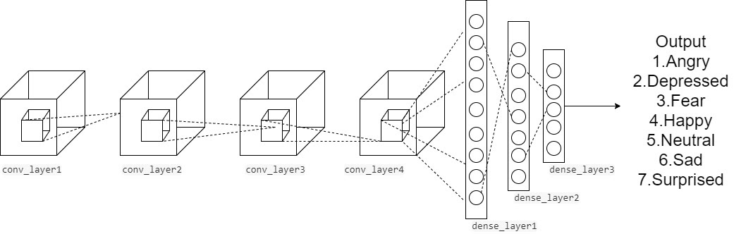
Implementation
SOFTWARE REQUIREMENTS:
Python
Keras
Pywavelets.
WORKING DIAGRAM OF THE SYSTEM USING 3D_CONVNETS

Slide 25
2-D WAVELET DECOMPOSITION:
Each video that has 40 frames has been passed through the wavelet.
images of shape 48*42 are formed by downsampling.
Low Low(LL) frequency data is taken as input due to high-quality data.
The same process has been done for every frame of the video to determine the detailed features.
FACIAL LANDMARK EXTRACTION:
facial landmarks are extracted from the frames of the videos using a regression tree model.
Change in the movements of eyes, mouth, eyebrows is observed and make a matrix of size 40*28*28*3. which states that there are 40 frames of each image size 28*28(width, height) with 3 channels.
A total of 68 points are obtained and then plotted to the image and is given as input to the 3D convent.

Slide 26
MODELLING TECHNIQUE:
We are using a 3D convnet for classification techniques.
3D convnets trace the features of moving elements in the face and store and tune weights accordingly so that it classifies correct emotion when a new sample is given.
Max pooling, Dropout, and Regularization techniques are used to preserve the important features without the problem of overfitting.
TESTING:
Extract the facial landmarks for a given random video and then pass through the neural net.
The database in this project consists of four actors with 120 videos of each.
Select a test case containing a video of emotion with 40 frames.
The neural net provides a probability of emotion for all the emotion
The emotion with the highest probability is considered as an actual emotion.
The same procedure has to be applied for all test cases.

Slide 27
WORKING OF SYSTEM:
A video is given as an input which consists of a sequence of frames.
2D wavelet decomposition for all the images is performed.
Then the image is resized uniform with the same height and width.
Extracted facial landmark features are formed into images as sequences of frames.
The obtained frames from test data are given to the 3D convolutional neural network.
The 3D convnet gives an output of probabilities of each emotion.
The respective emotion whose probability is maximum is the original emotion of the given test data.

Slide 28
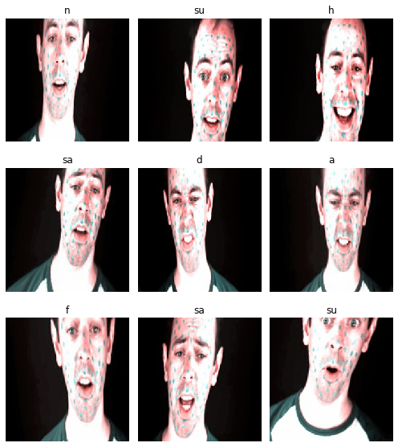
Data after augmentation

Slide 29
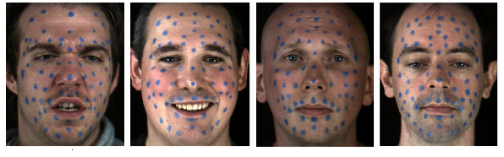
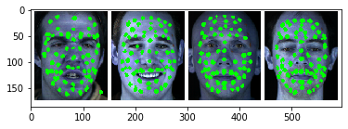
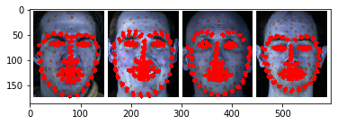
Important Facial Landmarks
By computer vision techniques
By deep learning techniques

Slide 30
Results and discussions
From the dataset, a 7:1 ratio of a split is done between training and testing samples. So for training 13 samples are taken and for testing 2 samples are taken for each emotion and then predicted for each speaker.
Accuracies for each actor are:
DC: 92.9%
JK: 85.71%
KL: 85.71%
JE:64.29%
Dc has the highest accuracy with the misclassification of depression samples.JE actors have the least accuracy misclassification for surprised, angry, and depression samples. The confusion matrices are plot for keen observations of misclassifications of all the actors.

Slide 31
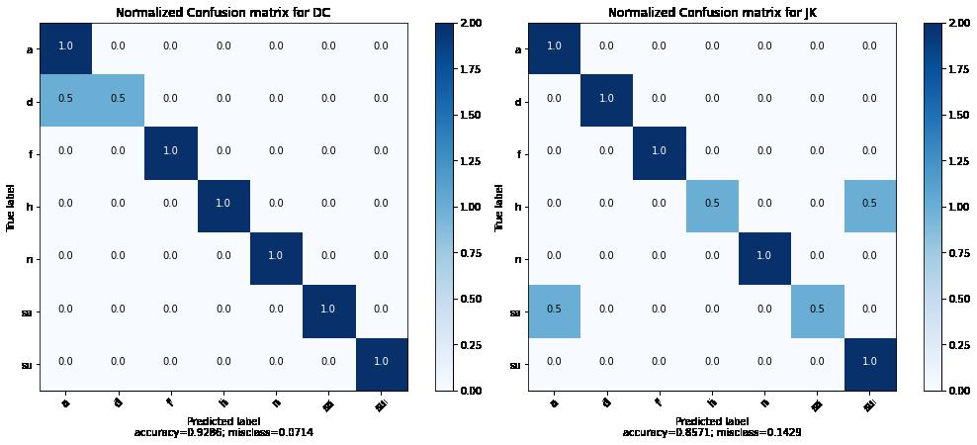
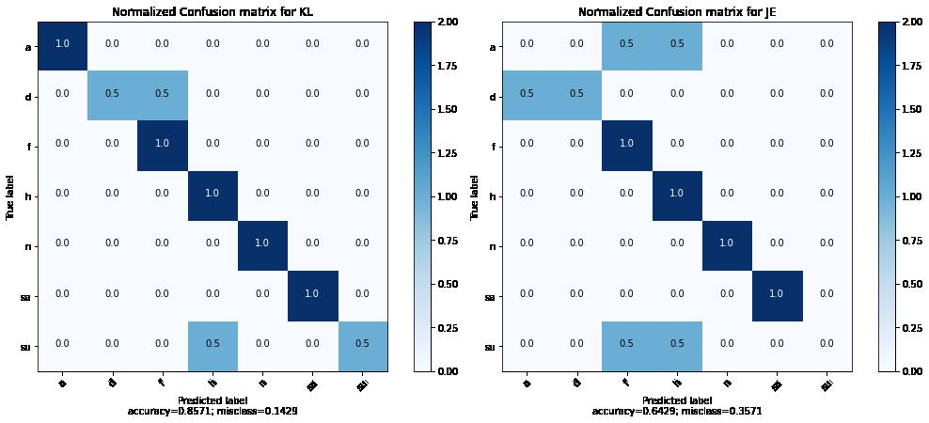
CONFUSION MATRIX PLOTS OF RESULTS

Slide 32
References
K. Zhang, Y. Huang, Y. Du and L. Wang, "Facial Expression Recognition Based on Deep Evolutional Spatial-Temporal Networks," in IEEE Transactions on Image Processing, vol. 26, no. 9, pp. 4193-4203, Sept. 2017.
H. Jung, S. Lee, J. Yim, S. Park, and J. Kim, “Joint fine-tuning in deep neural networks for facial expression recognition,” in Computer Vision (ICCV), 2015 IEEE International Conference on. IEEE, 2015, pp. 2983–2991.
Deep-Emotion: Facial Expression Recognition Using Attentional Convolutional Network Shervin Minaee1 , Amirali Abdolrashidi2 1Expedia Group 2University of California, Riverside.
S. Haq and P.J.B. Jackson, "Multimodal Emotion Recognition", In W. Wang (ed), Machine Audition: Principles, Algorithms and Systems, IGI Global Press, ISBN 978-1615209194, chapter 17, pp. 398-423, 2010.

Slide 33
Thank You

