Slide 1

Trend Analysis

Slide 2
Path we will tread….
Identify Failing Batteries
Associating conductance with discharge profile
New features :
1. Slope of discharge
2. DOD
Filter cases based on low DOD and drop in conductance

Slide 3
Conductance + Discharge Profile
Trend 1 : CUP Profile
Trend 2 : “W” Profile

Slide 4
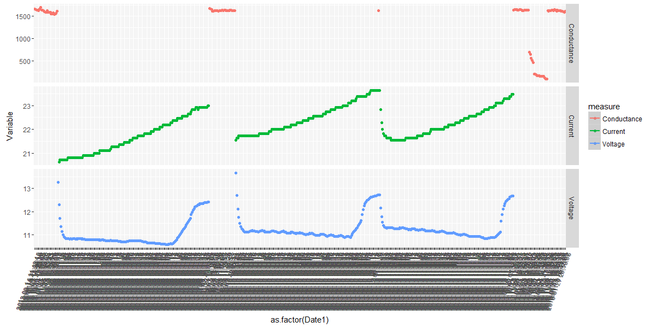
Trend I : Cup Shaped Profile
Discharge profiles at 3 different dates.
Varying constant current
Notes:
Depth of discharge of voltage calculated from float voltage of 13.4
Varying constant current
Does the voltage increase denote that the supply is from mains ?

Slide 5
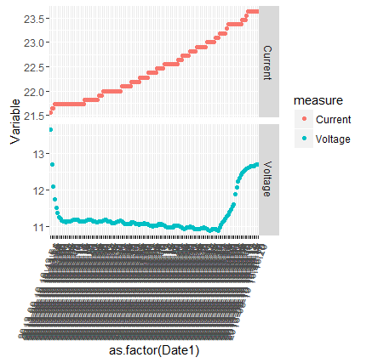
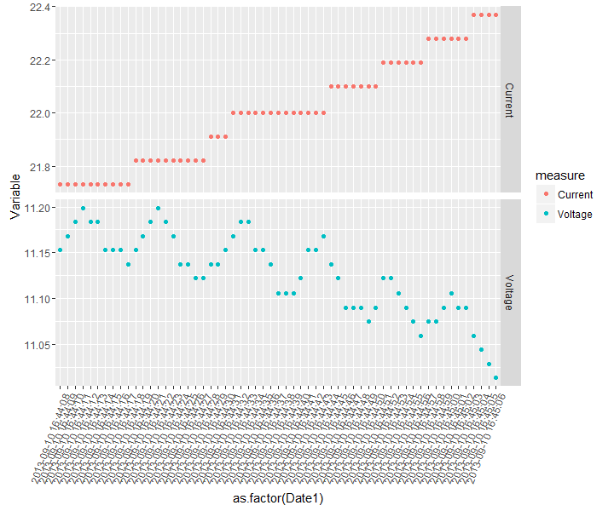
Trend I : Cup Shaped Profile – Closer Look
Slope of Discharge at constant current v/s as prescribed by the manufacturer
Notes:
Slope of discharge to be compared against the manufacturer prescribed discharge profile
Absolute depth of discharge to be calculated

Slide 6
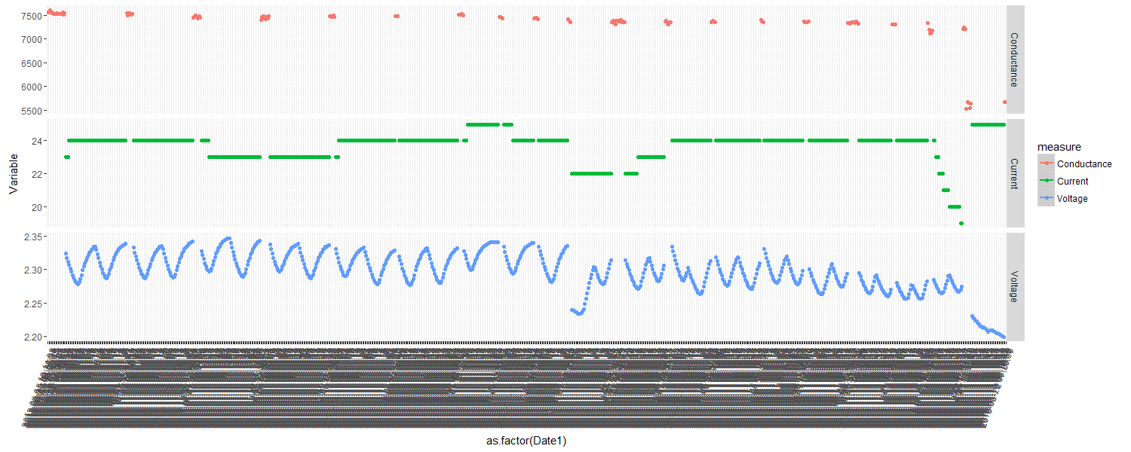
Trend II : “W” Shaped Profile
Current kept constant, not varying too much
More cycles of discharge profiles
Notes:
Each of the “W” profile denotes a certain period of time
The “W” profile is in fact two “Coup de Fouet” effects at two intervals of 30 seconds each

Slide 7
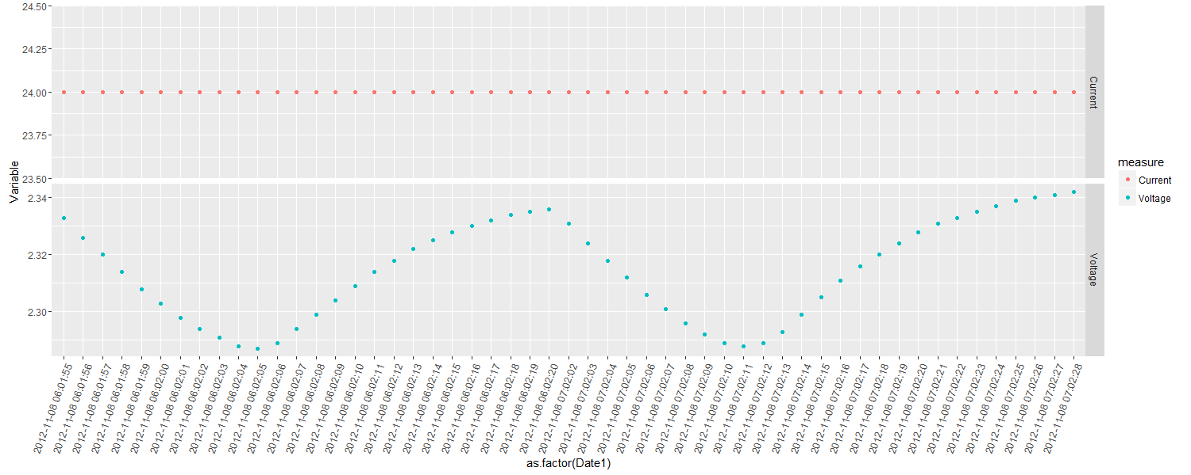
Trend II : “W” Shaped Profile – Closer Look
Time duration of 30 second . Coup de Fouet effect ??
Time gap of 1 minute between 2 cycles
Notes:
The “W” profile is in fact two “Coup de Fouet” effects at two intervals of 30 seconds each
There is a time gap of 1 minute between each of these discharge profiles

Slide 8
New Features
Slope of Discharge
DOD

Slide 9
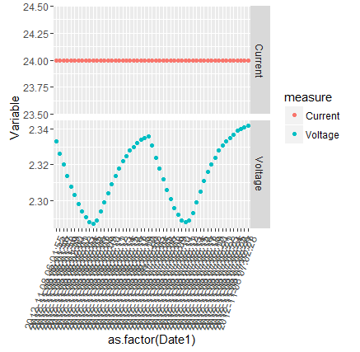
Feature Extraction from existing data
New features introduced
Calculated the slope of each of these discharge and charge profiles
Calculated the DOD for each discharge cycle
DOD of discharge calculated from float voltage i.e for 2 volt , float voltage taken as 2.23 volts and for 12 v batteries float voltage taken as 13.4 ( Source Wikipedia)
Looked at those cases with DOD less than 80%

Slide 10
Filter based on DOD
Sample 1: 128 batteries
Sample 2 : 1000 batteries

Slide 11
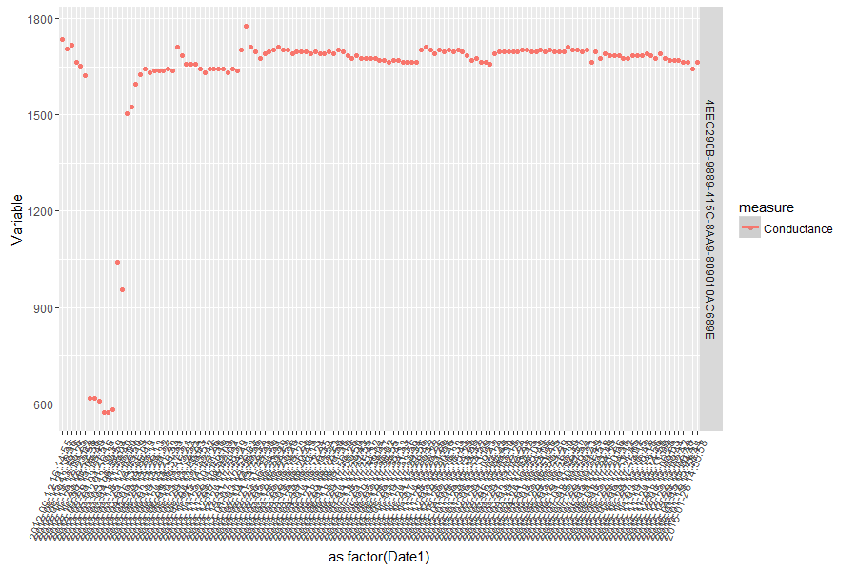
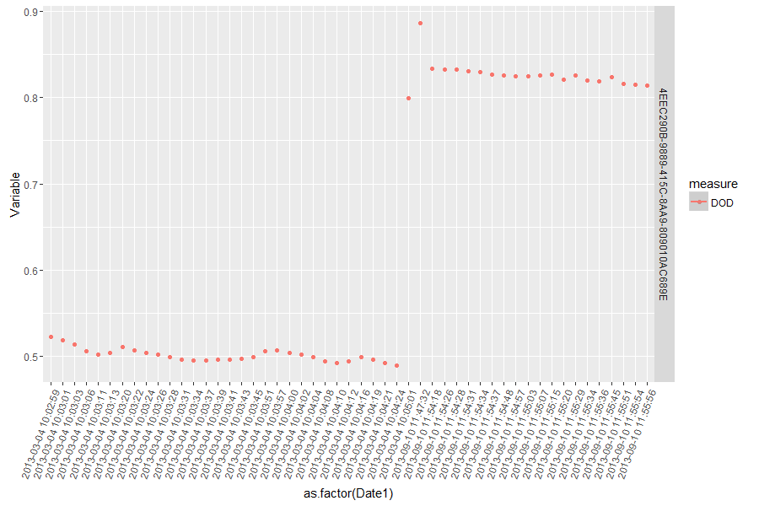
Sample 1 : DOD < .8
Sample size : 128 batteries with high spread of conductance , 21 cases with DOD < .8 13 cases showed trend of dropping to more than half of original level of conductance
For DOD < .65, 5 cases, all of them showed the above trend.

Slide 12
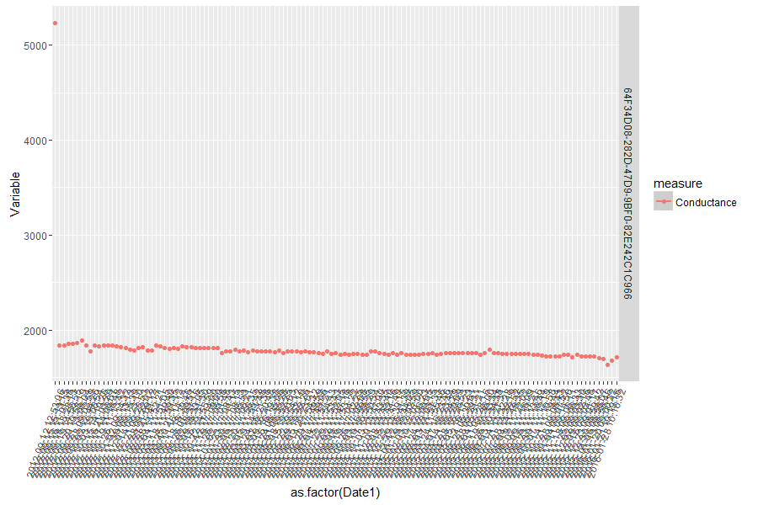
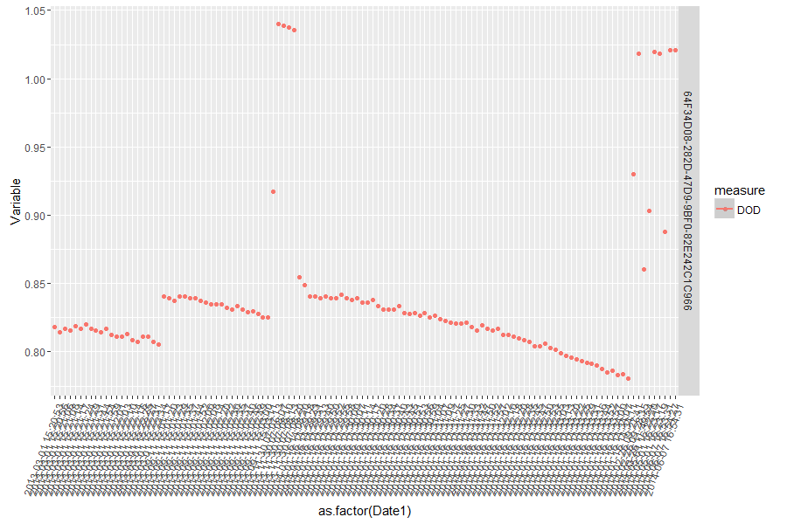
Sample 1 : DOD < .8
8 out of the 21 cases where DOD was less than .8
Notes:
1. In these cases, the high spread in conductance was because of just one reading which was an aberration. And the DOD is also just hovering around .80 mark

Slide 13
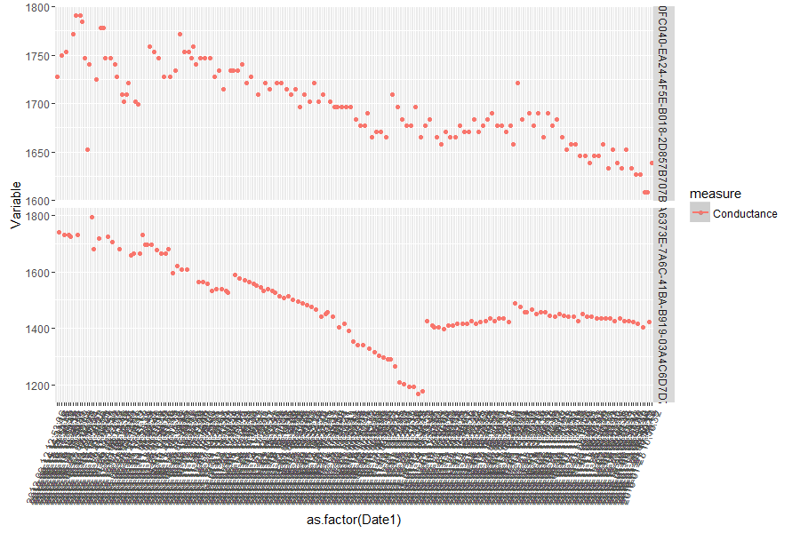
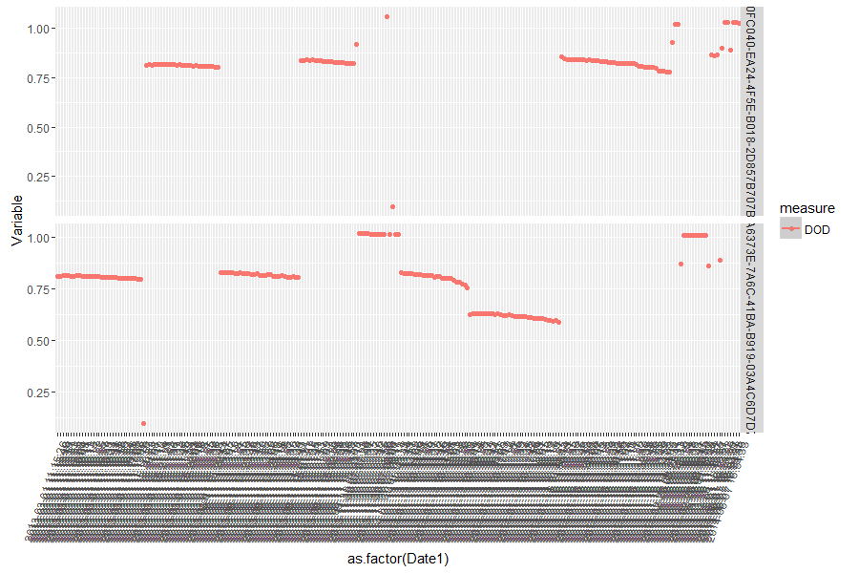
Sample II : DOD < .65
One Sample out of 46
One Sample out of 6 cases
1000 batteries, 52 cases with at least an instance of less than .65, 6 cases showed trend as the earlier case. They also showed continuous instances of large DOD. The fall in conductance was on average to 65% of original value.
Our of the balance 46 cases most of them were one off instance where the DOD had large values
Notes:
1. In these cases, the high spread in conductance was because of just one reading which was an aberration. And the DOD is also just hovering around .80 mark

Slide 14
Inferences for validation and Next steps
Inferences based on sample analysis
Next Steps
Large value of DOD per-se might not be a good indicator.
However multiple large values of DOD might be an indicator.
All cases in the sample where conductance showed sharp drop and subsequent rise to higher levels also had multiple instances of large DOD.
From the above can we construe , instances were conductance drops sharply followed by regaining to higher levels, in association with large values of DOD, be taken as cases where batteries have failed ?
If the inferences we have derived is valid we can proceed with labelling of the relevant cases as failed batteries.
Can look back in time from point of failure and create more sub classes.
Based on these classification we can carry out our modelling process.
We can also look at some more variables like age of batteries in addition to the ones we have.

Slide 15
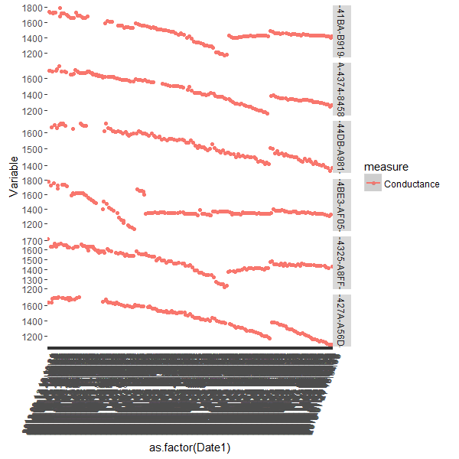
Plant and String Details of some batteries
Battery | Plant | Site | String
0EA6373E-7A6C-41BA-B919-03A4C6D7D798 | A1 - A4 POS | PS 3 | A3 POS
0FDA167A-FD8A-4374-8458-256067993227 | A5 - A8 NEG | PS 3 | A6 NEG
15606E32-B634-44DB-A981-F550A60DDF03 | B5 - B8 NEG | PS 2 | B8 NEG
1F2CF22E-2411-4BE3-AF05-BF25A9E2EC61 | A5 - A8 NEG | PS 9 | A5 NEG
20CA2342-874B-4325-A8FF-EFD177D00A9A | B1 - B4 POS | PS 2 | B3 POS
285C9918-F3A3-427A-A56D-0E965EB81008 | A1 - A4 POS | PS 4 | A2 POS
Sample size : 1000
Filter : DOD < .65
Total Batteries filtered : 52
Batteries showing big dropping trends : 6
Refer slide 13

Slide 16
Analysis of 950 batteries
The samples had ranges of DOD between 0.76 to 1+
A random sample of 165 were taken from these 950 for analysis
The random sample were divided into 3 tranches of 50:50:65
Each tranche was further subdivided into bins as per based on DOD values. The three bins were
Bin1 : DOD < 0.8
Bin2 : DOD > 0.8 < 0.9
Bin3 : DOD > 0.9

Slide 17
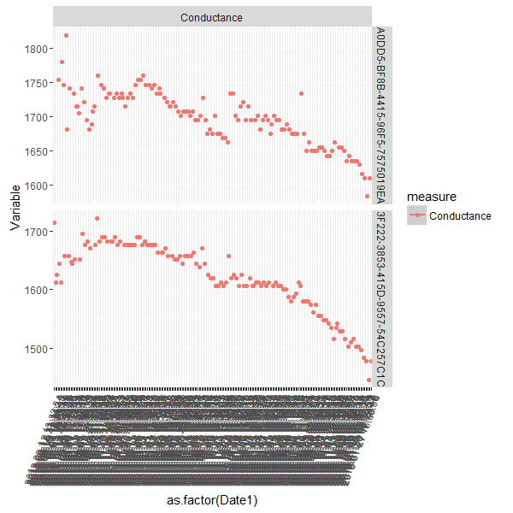
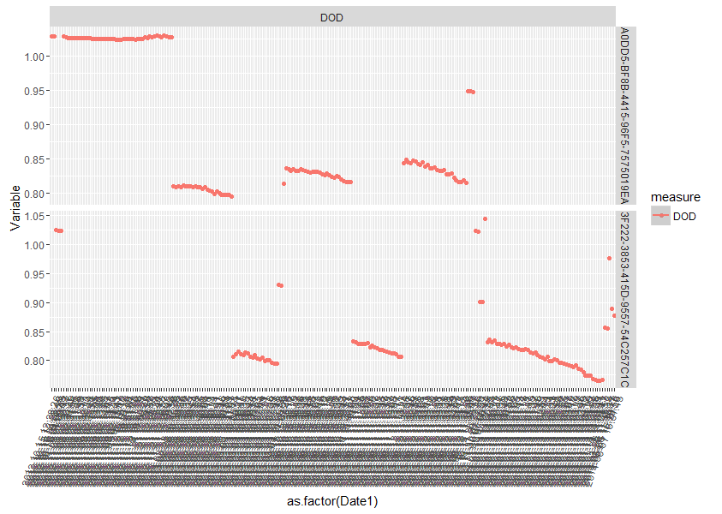
Tranche I : 50 Batteries : DOD < 0.8 ( 20 Batteries)
The above are two batteries which differ in the number of values below DOD 0.8.
The first case show negligible values below 0.8 , 2nd shows more values.
The % Drop in conductance for the second is much higher than the first
This trend was observed in all 20 samples.
Notes:
Tranche 1 : 50 Batteries : < 0.8 : 20 batteries : Most of the DOD values are between 0.8 and 0.85. However those cases where there were more cases below 0.8 it was associated with sharper drop in Conductance.

Slide 18
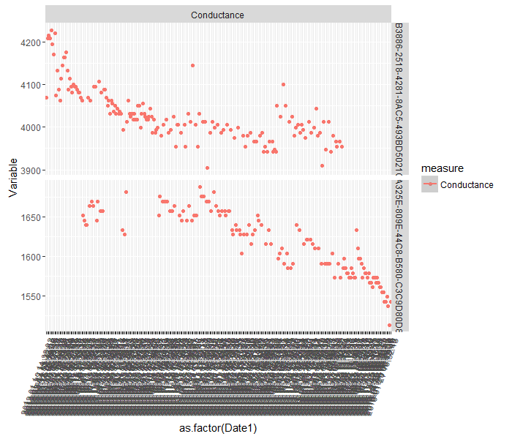
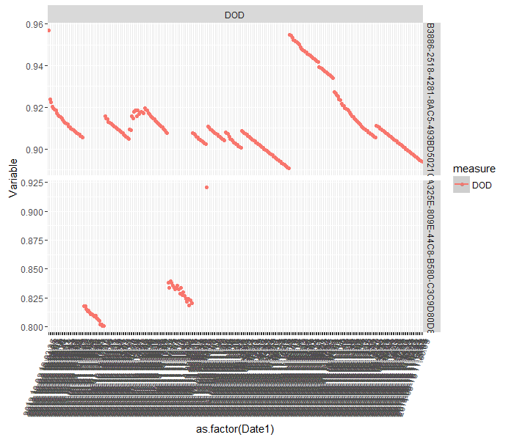
Tranche I : 50 Batteries : DOD > 0.8 < 0.9 ( 22 Batteries)
The conductance slopes are generally milder.
However as seen before, those showing relatively larger drop in conductance shows more values at the lower rung of DOD.

Slide 19
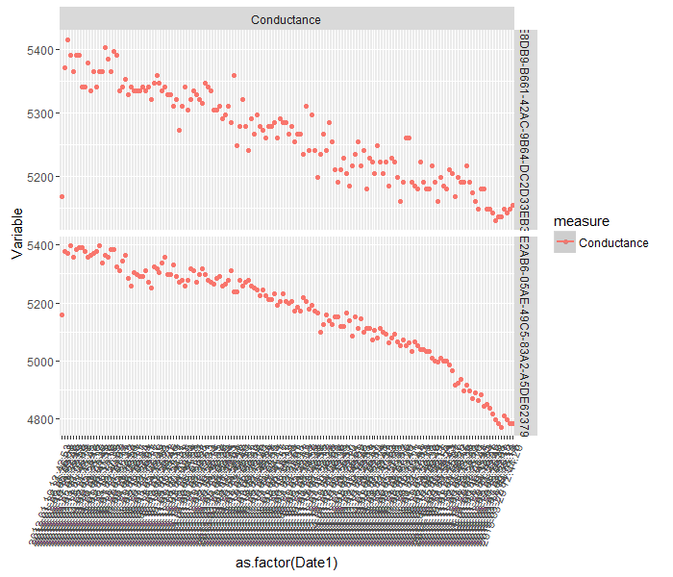
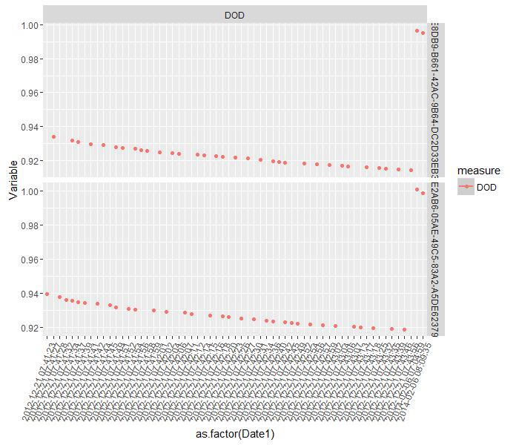
Tranche I : 50 Batteries : DOD > 0.9(8 Batteries)
The conductance slopes are very mild.
No specific trends or associations between DOD and Conductance profiles

Slide 20
Inferences from 165 samples from 950
Tranche 1 : 50 Batteries
Tranche 2 : 50 Batteries
Tranche 3 : 65 Batteries
Bin1 :
DOD
< 0.8
Batteries : 20
DOD: Mostly between 0.8 – 0.85
DOD < 0.8 + Sharpest Conductance drop association: All
Batteries : 17
DOD: Mostly between 0.8 – 0.85
DOD < 0.8 + Sharpest Conductance drop association: All
Batteries : 28
DOD: Mostly between 0.8 – 0.85
DOD < 0.8 + Sharpest Conductance drop association:3/5
Bin2 :
DOD > 0.8 < 0.9
Batteries : 22
DOD: Mostly between 0.8 – 0.85
Sharpest Conductance drop associated with lower DOD values:5/5
Batteries : 26
DOD: Mostly between 0.8 – 0.85
Sharpest Conductance drop associated with lower DOD values: 3/5
Batteries : 31
DOD: Mostly between 0.8 – 0.85
Sharpest Conductance drop associated with lower DOD values: 6/6
Bin1 :
DOD
> 0.9
Batteries : 8
Conductance : Gradual slopes
No specific association noticed between DOD and conductance
Batteries : 7
Conductance : Gradual slopes
No specific association noticed between DOD and conductance
Batteries : 6
Conductance : Gradual slopes
No specific association noticed between DOD and conductance
DOD profiles for most of the cases predominantly lie between 0.8 and 0.85 range
The % of points lower than 0.8 is also associated with sharper drops in conductance i.e. more the points which are below 0.8 more the drop in conductance relatively.
Even for those bins whose DOD were higher than 0.8, the sharpest drop in conductance was associated with more values at the lower ranges of the DOD

Slide 21
Analysis of 1000 batteries
These samples were divided into several bins as per the % drop in conductance from the peak value of conductance
Bin1 : % drop to < 20%
Bin2 : % drop to < 20% - 50%
Bin3 : % drop to < 50% - 65%
Bin4 : % drop to < 65% - 80%
Bin5 : % drop to < 80% - 90%
Bin6 : % drop to > 90%
For each bin another measure used was to find the % of points which had values of DOD less than .8

Slide 22
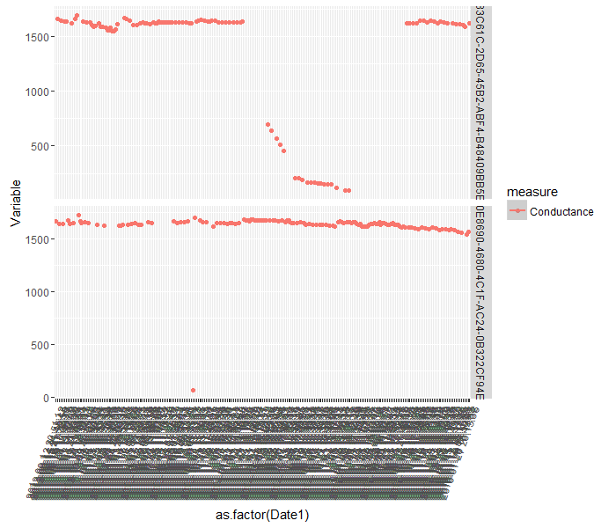
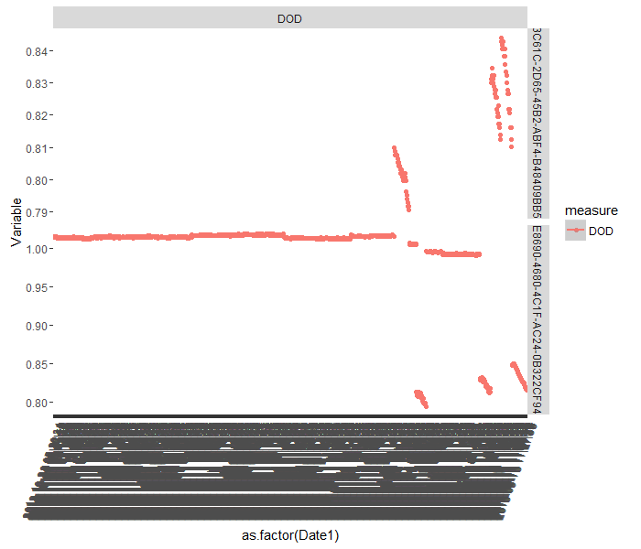
Conductance Drop < 0.2
2 batteries
The first battery, has the dropping and retracting trend, with about 10% values below DOD of 0.8
The second case is more because of an outlier in conductance value. 0.5 % < 0.8 DOD

Slide 23
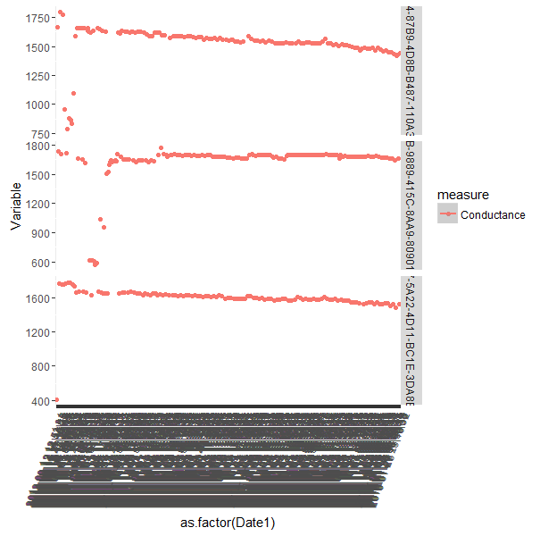
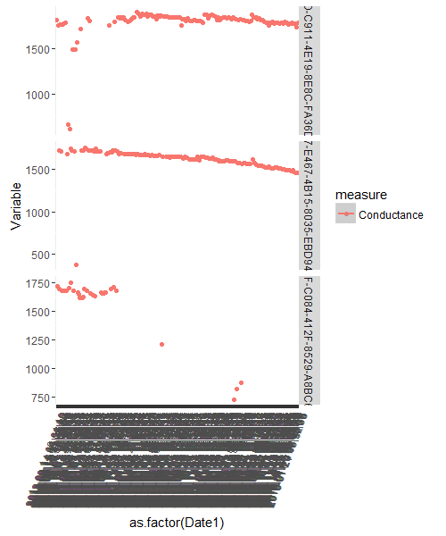
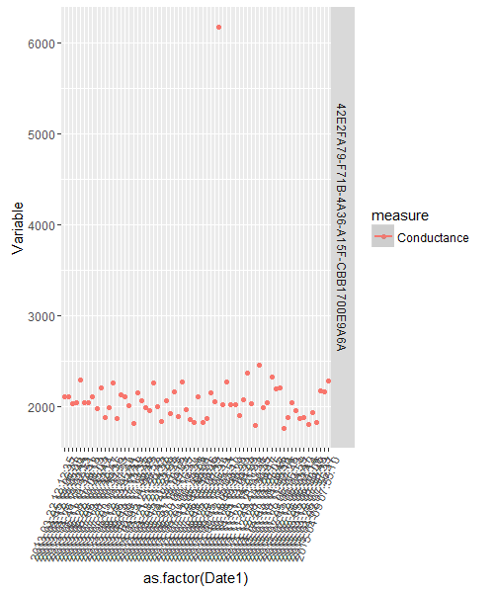
Conductance Drop > 0.2 < 0.5 ( 7 Cases)
1& 2 have > 10 % points where DOD less than 0.8 .
6 : has around 5 % points where DOD less than 0.8
3,4,5 have less than 5% points where DOD less than 0.8
7 has no point less than 0.8

Slide 24
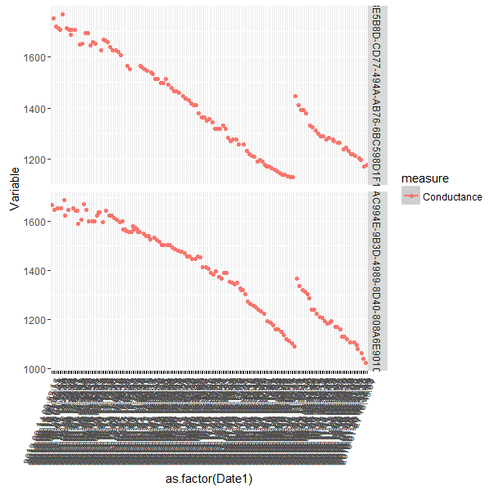
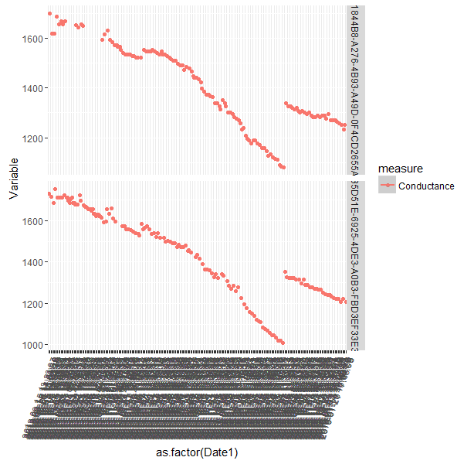
Conductance Drop > 0.5 < 0.65 (4 cases)
Case 1& 2 have more than 10% cases where DOD is less than 0.8
Case 4 has around 8% and case 3 has around 6 %

Slide 25
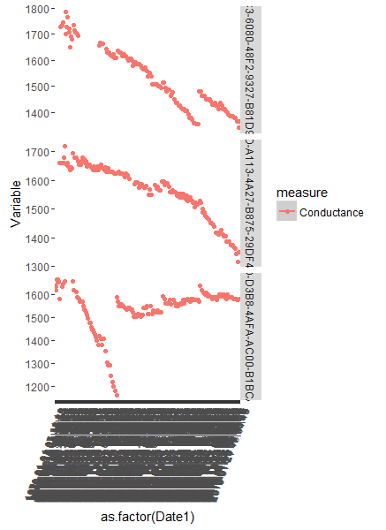
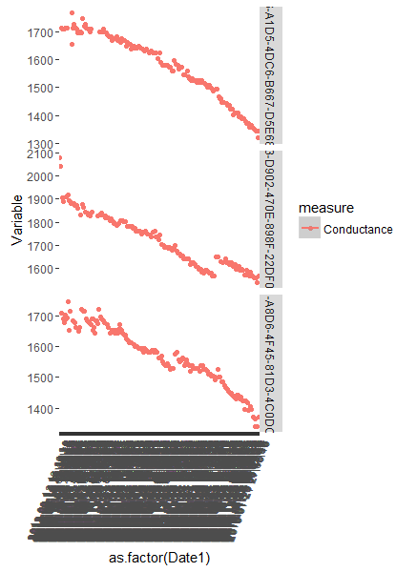
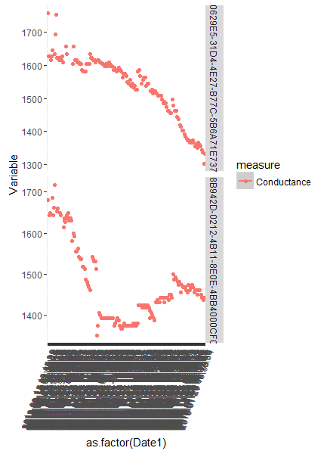
Conductance Drop > 0.65 < 0.8 : Group 1
8 Batteries
4 showing drop and retracting trends. Others sharp drops
All these batteries have more than 10% of their values below DOD 0.8 ( Ranges from 10% to 30%)

Slide 26
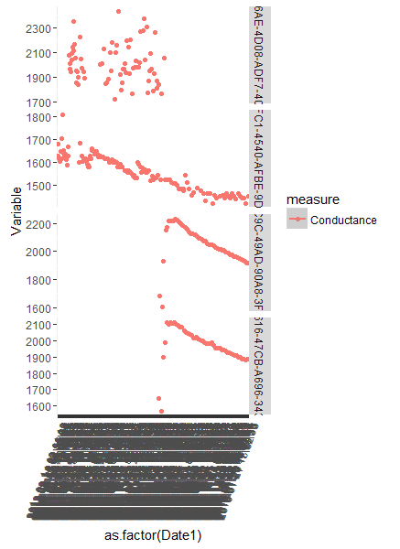
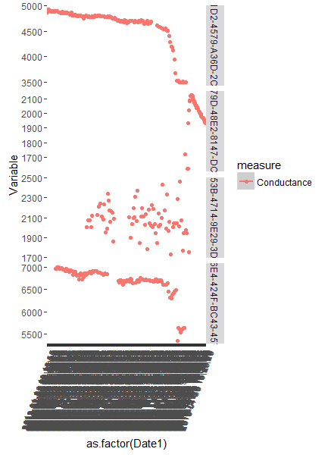
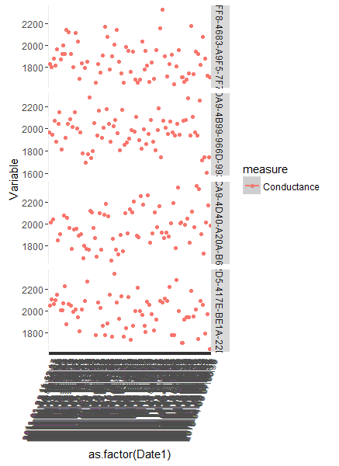
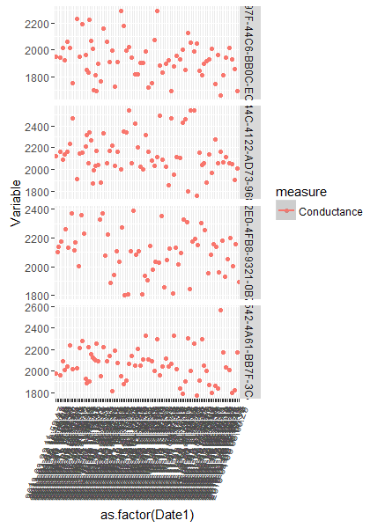
Conductance Drop > 0.65 < 0.8 : Group II
22 Batteries
13 showed high variable profile.
19 of these batteries have 100% of their DOD values above 0.8. 3 of them have less than 3% values less than .8

Slide 27
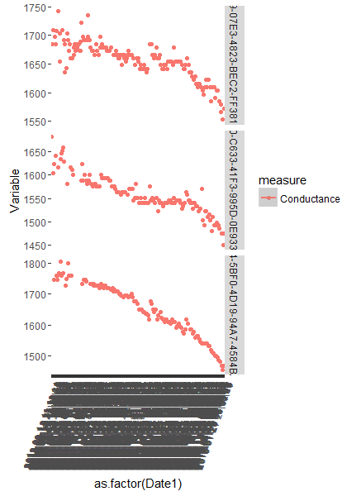

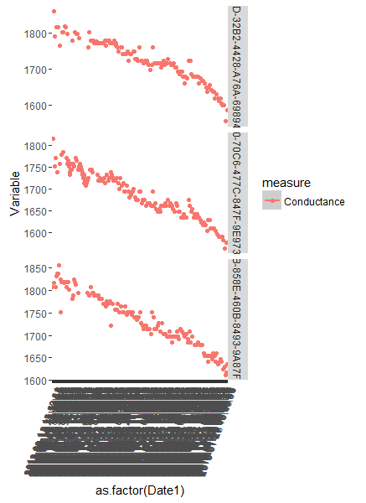
Conductance Drop > 0.80 < 0.9 : Group 1
9 Batteries
All showing gradual drops. The drops are more muted than the previous bins
All these batteries have more than 10% of their values below DOD 0.8 ( Ranges from 12% to 27%)

Slide 28
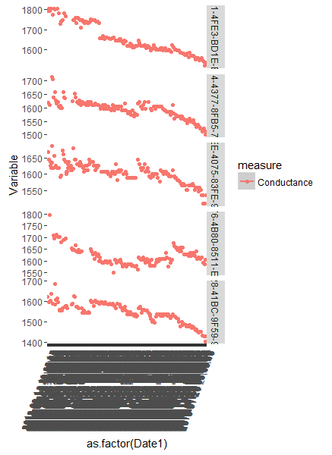
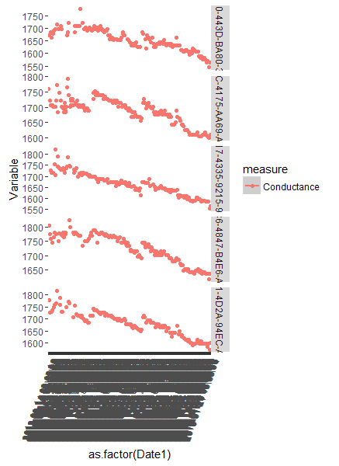
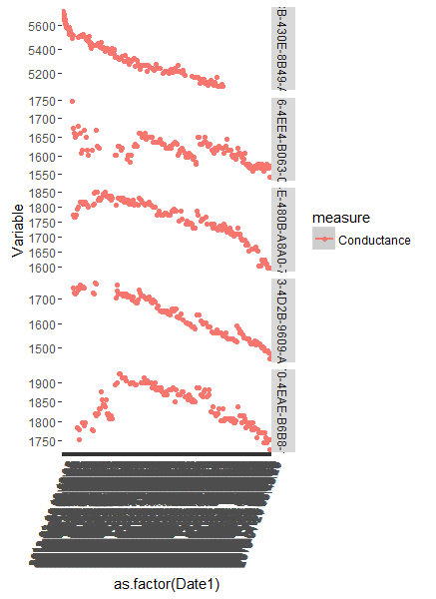
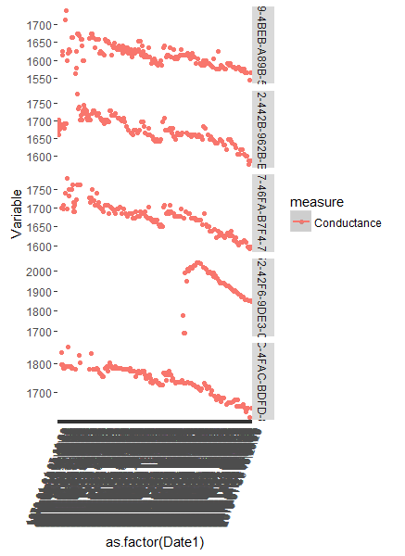
Conductance Drop > 0.8 < 0.9 : Group II
21 Batteries
Mostly gradual or flatter conductance drops
16 of these batteries have 100% of their DOD values above 0.8. 3 of them have less than 3% and 2 less than 8% respectively of values less than .8

Slide 29
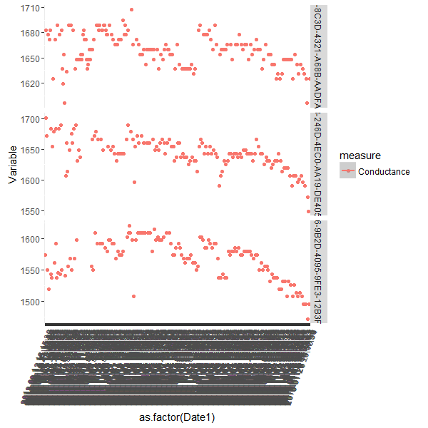
Conductance Drop > 0.9 : Group 1
3 Batteries
Mostly flat conductance profiles.
All these batteries have more than 10% of their values below DOD 0.8 ( Ranges from 41% to 15%)

Slide 30
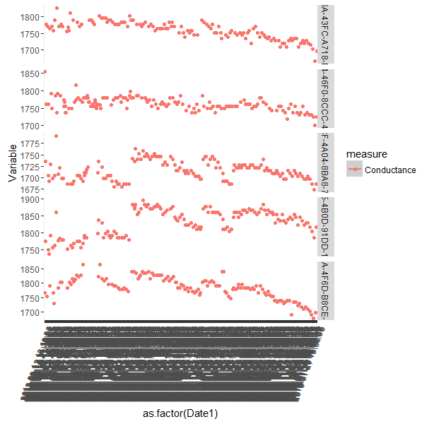
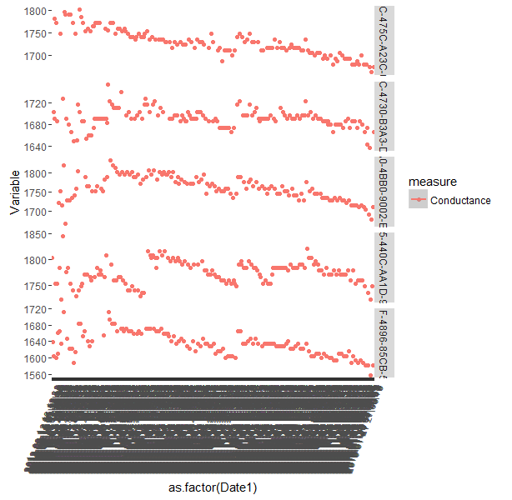
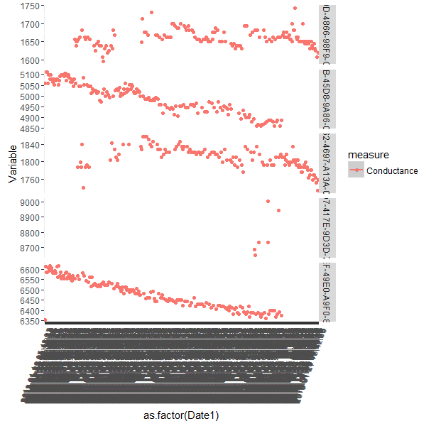
Conductance Drop > 0.9 : Group II
27 Batteries
Mostly flat conductance drops
16 of these batteries have 100% of their DOD values above 0.8. 3 of them have less than 3% and 2 less than 8% respectively of values less than .8

Slide 31
Inferences from analysis
A general trend which was observed was that, the DOD(from voltage perspective) for most of the batteries were predominantly between the range of 0.85 – 0.80.
An interesting association seen was the that between % of values having DOD values less than 0.8 and the % drop in conductance.
Batteries which had sharper drop in conductance had relatively larger % of values below the 0.8 DOD levels.
A good filter for identifying potential cases of failing batteries could be the following
Drop in conductance > 80% of highest conductance level
10% or more values with larger than 0.8 DOD
On the above filter, another level of filter for % of conductance points below 80% was added
3% or more values with larger than 80% of conductance level
Sample 1 : 1000
Sample 2 : 1000
21 cases filtered with above filter
Top 10 of these cases have falling and retracting trend
Rest of the cases have sharp conductance drops
24 cases filtered with above filter
Top 9 of these cases have falling and retracting trend
Rest of the cases have sharp conductance drops

Slide 32
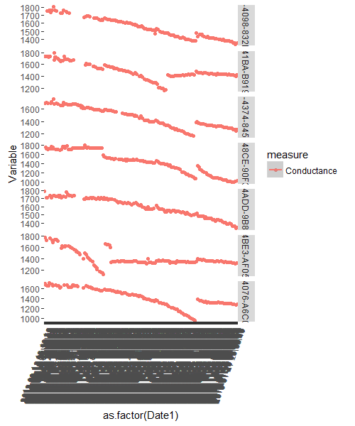
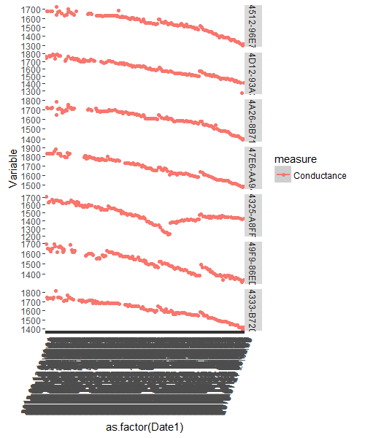
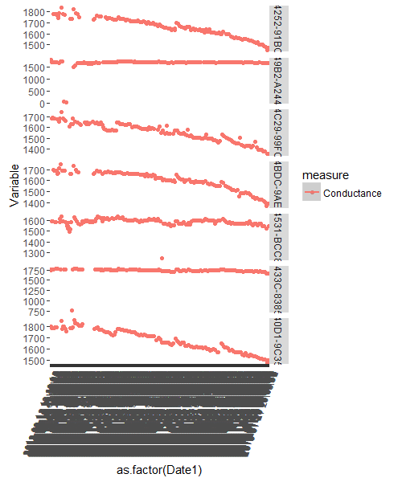
Sample 1: 1000 ( 21 Batteries)
Top of the list dominated by batteries having dropping and then retracting trends
All of them have substantial proportion of values above the 80% DOD range ( Average 23%)

Slide 33
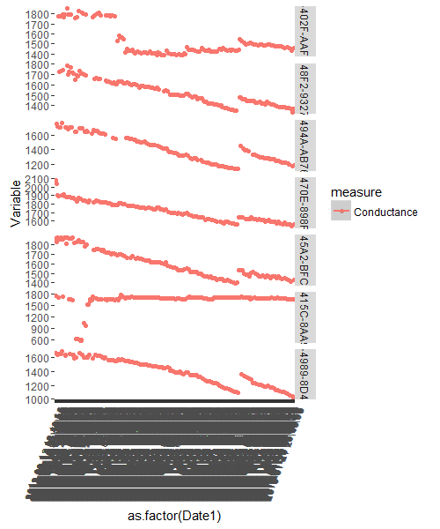
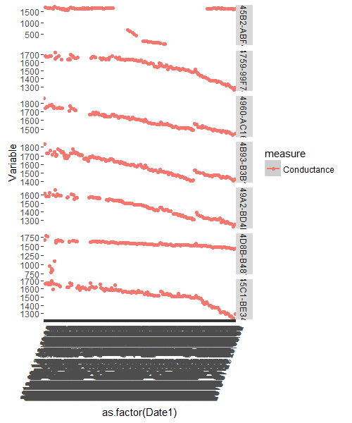
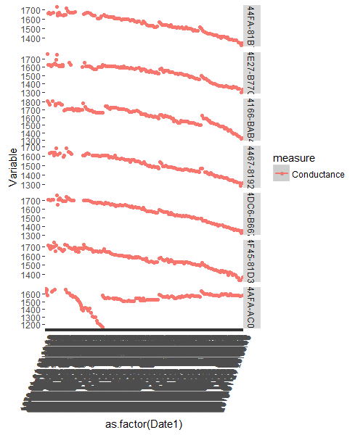
Sample II: 1000 ( 29 Batteries)
Top of the list dominated by batteries having dropping and then retracting trends
All of them have substantial proportion of values larger than 80% DOD range ( Average 22%)

Slide 34
Features for identifying Potential Battery Failure
Potential Failure Cases
Tending towards failure
Normal Batteries
Drop in Conductance < 80%
% of point with values lower than 80% DOD > 10%
% of points with values lower than 80% conductance drop > 3%
Drop in conductance : 90% - 80%
% of point with values lower than 80% DOD > 10%

Slide 35


