Slide 1

Trend Analysis II

Slide 2
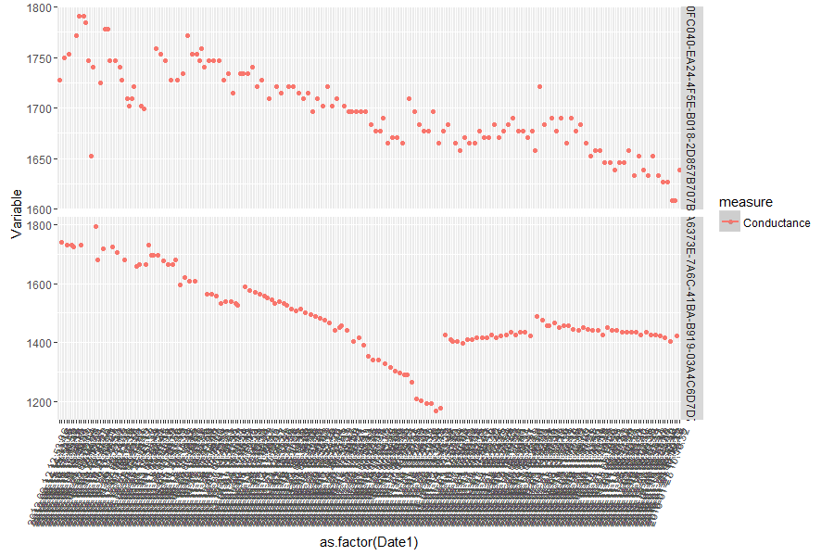
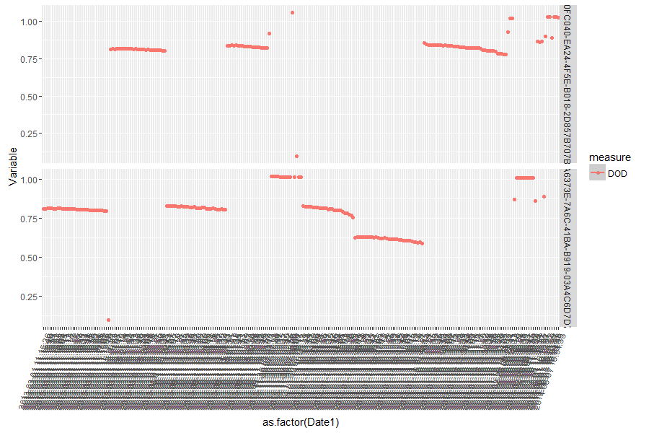
Sample II : DOD < .65
One Sample out of 46
One Sample out of 6 cases
1000 batteries, 52 cases with at least an instance of less than .65, 6 cases showed trend as the earlier case. They also showed continuous instances of large DOD. The fall in conductance was on average to 65% of original value.
Our of the balance 46 cases most of them were one off instance where the DOD had large values
Notes:
1. In these cases, the high spread in conductance was because of just one reading which was an aberration. And the DOD is also just hovering around .80 mark

Slide 3
Analysis of 950 batteries
The samples had ranges of DOD between 0.76 to 1+
A random sample of 165 were taken from these 950 for analysis
The random sample were divided into 3 tranches of 50:50:65
Each tranche was further subdivided into bins as per based on DOD values. The three bins were
Bin1 : DOD < 0.8
Bin2 : DOD > 0.8 < 0.9
Bin3 : DOD > 0.9

Slide 4
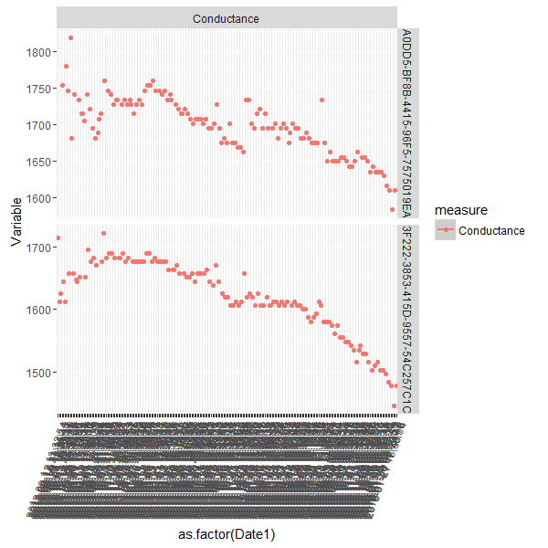
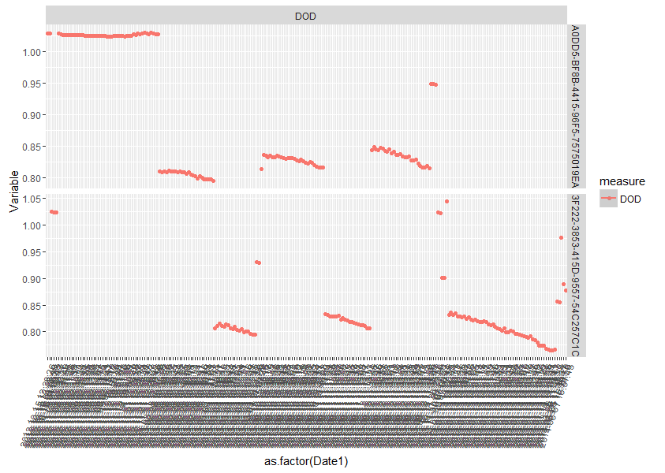
Bin1 : DOD < 0.8
The above are two batteries which differ in the number of values below DOD 0.8.
The first case show negligible values below 0.8 , 2nd shows more values.
The % Drop in conductance for the second is much higher than the first
This trend was observed in all 20 samples.
Notes:
Tranche 1 : 50 Batteries : < 0.8 : 20 batteries : Most of the DOD values are between 0.8 and 0.85. However those cases where there were more cases below 0.8 it was associated with sharper drop in Conductance.
Did not observe any cases with dropping and retracing trend within these samples.

Slide 5
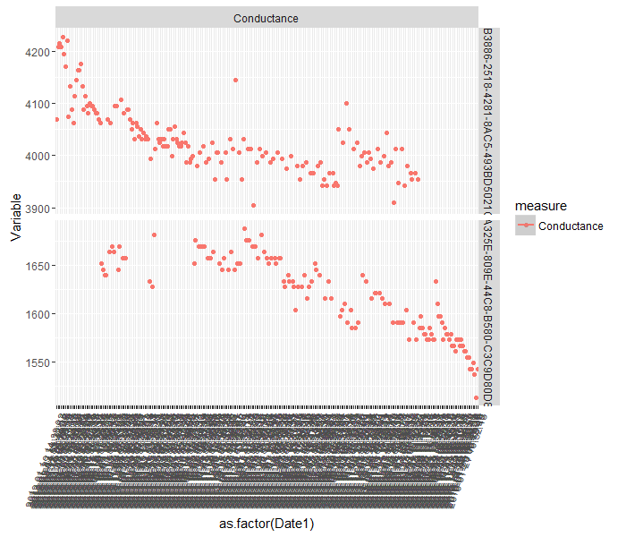
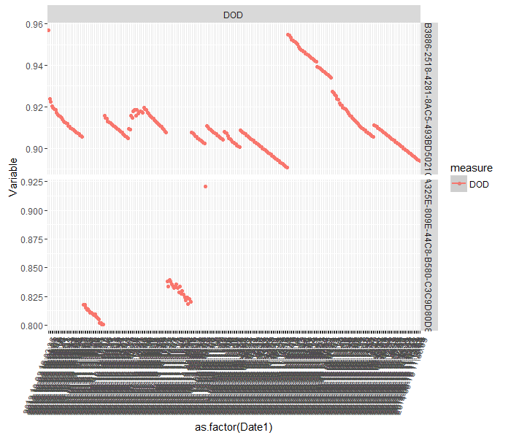
Bin II : DOD > 0.8 < 0.9
The conductance slopes are generally milder.
However as seen before, those showing relatively larger drop in conductance shows more values at the lower rung of DOD.

Slide 6
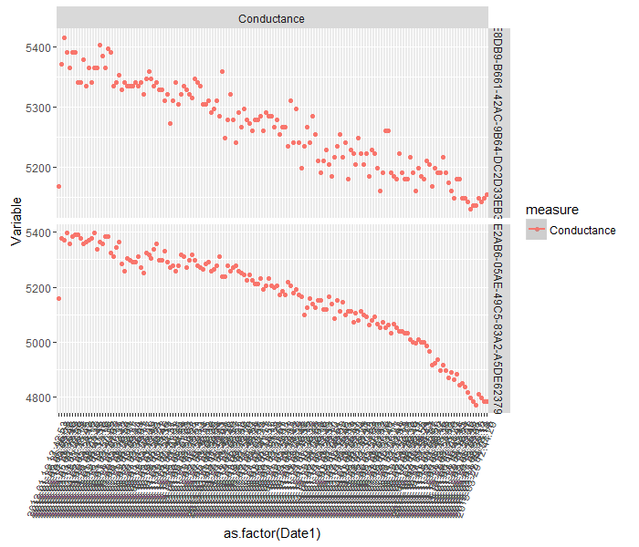
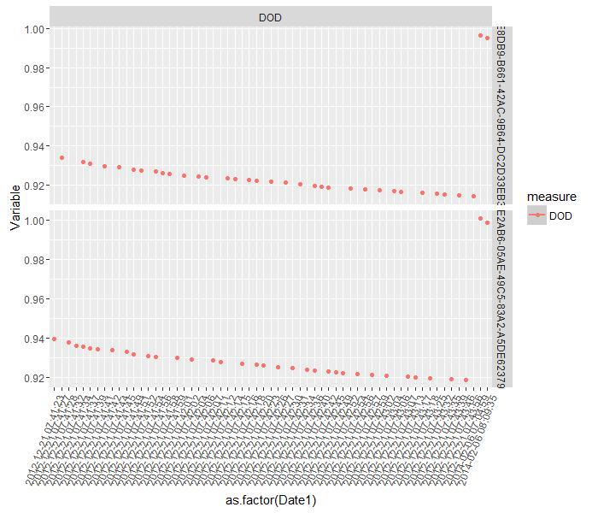
Bin III : DOD > 0.9
The conductance slopes are very mild.
No specific trends or associations between DOD and Conductance profiles

Slide 7
Inferences from 165 samples from 950
Tranche 1 : 50 Batteries
Tranche 2 : 50 Batteries
Tranche 3 : 65 Batteries
Bin1 :
DOD
< 0.8
Batteries : 20
DOD: Mostly between 0.8 – 0.85
DOD < 0.8 + Sharpest Conductance drop association: All
Batteries : 17
DOD: Mostly between 0.8 – 0.85
DOD < 0.8 + Sharpest Conductance drop association: All
Batteries : 28
DOD: Mostly between 0.8 – 0.85
DOD < 0.8 + Sharpest Conductance drop association:3/5
Bin2 :
DOD > 0.8 < 0.9
Batteries : 22
DOD: Mostly between 0.8 – 0.85
Sharpest Conductance drop associated with lower DOD values:5/5
Batteries : 26
DOD: Mostly between 0.8 – 0.85
Sharpest Conductance drop associated with lower DOD values: 3/5
Batteries : 31
DOD: Mostly between 0.8 – 0.85
Sharpest Conductance drop associated with lower DOD values: 6/6
Bin1 :
DOD
> 0.9
Batteries : 8
Conductance : Gradual slopes
No specific association noticed between DOD and conductance
Batteries : 7
Conductance : Gradual slopes
No specific association noticed between DOD and conductance
Batteries : 6
Conductance : Gradual slopes
No specific association noticed between DOD and conductance
DOD profiles for most of the cases predominantly lie between 0.8 and 0.85 range
The % of points lower than 0.8 is associated with sharper drops in conductance i.e. more the points which are below 0.8 more the drop in conductance.
Even for those bins whose DOD were higher than 0.8, the sharpest drop in conductance was associated with more values at the lower ranges of the DOD
Notes:
1. From the above analysis another aspect which evolved is the points below 0.8 DOD. Rather than going for one off points which had gone below this threshold it was more apt to look for the % of points which are lower than the threshold. The more the points which are below the threshold, more the probability of sharper conductance and more likely we get the failure cases we want.

Slide 8
Analysis of 1000 batteries
These samples were divided into several bins as per the % drop in conductance from the peak value of conductance
Bin1 : % drop to < 20%
Bin2 : % drop to < 20% - 50%
Bin3 : % drop to < 50% - 65%
Bin4 : % drop to < 65% - 80%
Bin5 : % drop to < 80% - 90%
Bin6 : % drop to > 90%
For each bin a new feature, indicating the % of DOD values less than .8,was included for the analysis.
Notes:
For this new sample of 1000 batteries, the binning was done with respect to the drop in conductance level. This was done to get a different perspective.
For each bin a new feature related to the % of points below 0.8 DOD was included for the analysis.

Slide 9
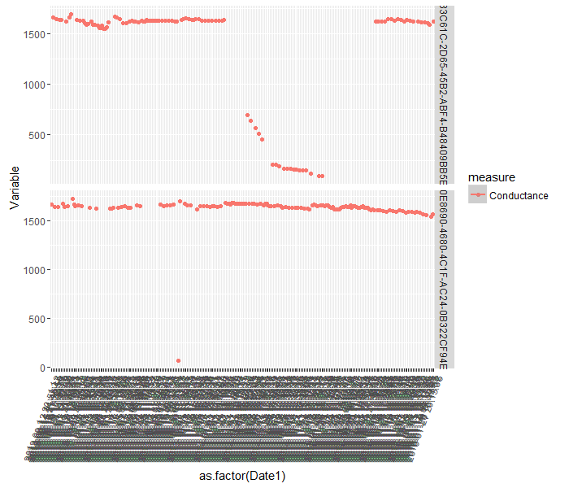
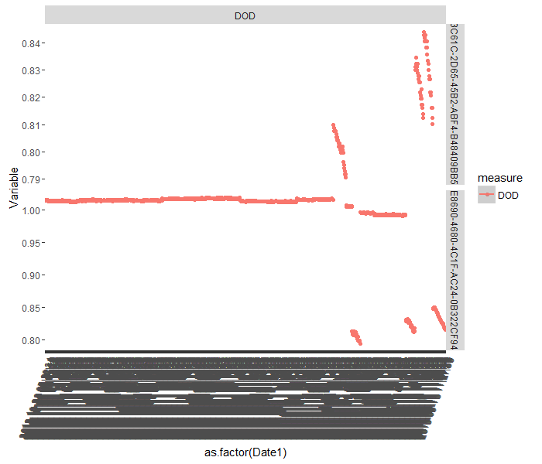
Conductance Drop < 0.2
2 batteries
The first battery, has the dropping and retracting trend, with about 10% values below DOD of 0.8
The second case is more because of an outlier in conductance value. 0.5 % < 0.8 DOD

Slide 10
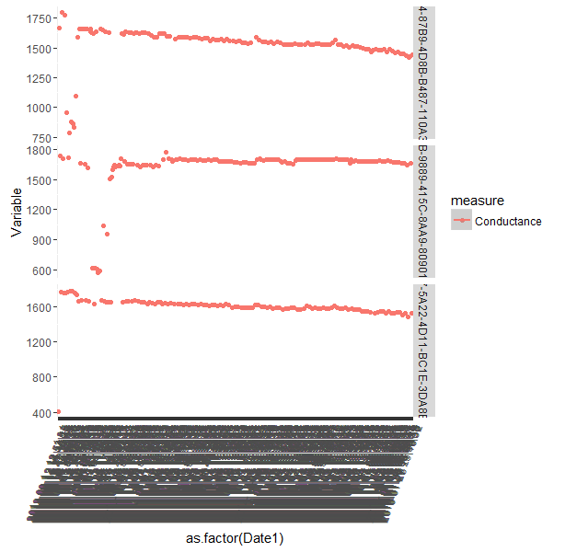
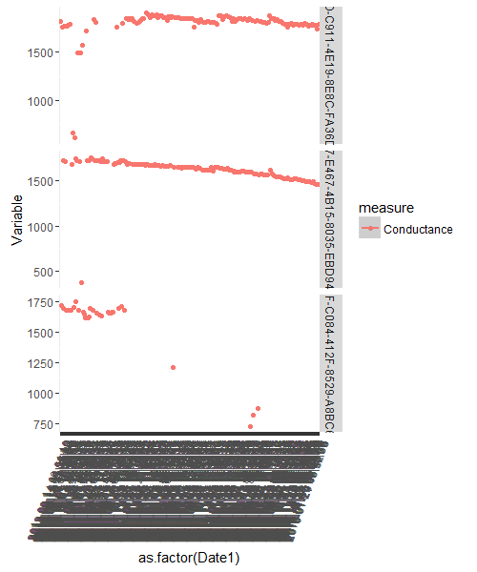
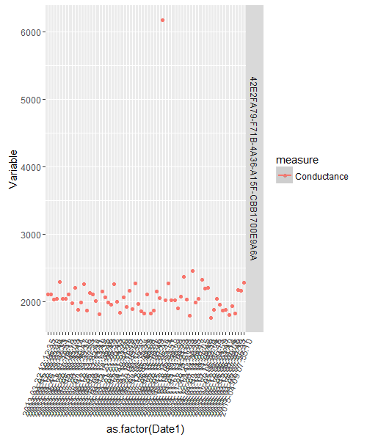
Conductance Drop > 0.2 < 0.5 ( 7 Cases)
1& 2 have > 10 % points where DOD less than 0.8 .
6 : has around 5 % points where DOD less than 0.8
3,4,5 have less than 5% points where DOD less than 0.8
7 has no point less than 0.8

Slide 11
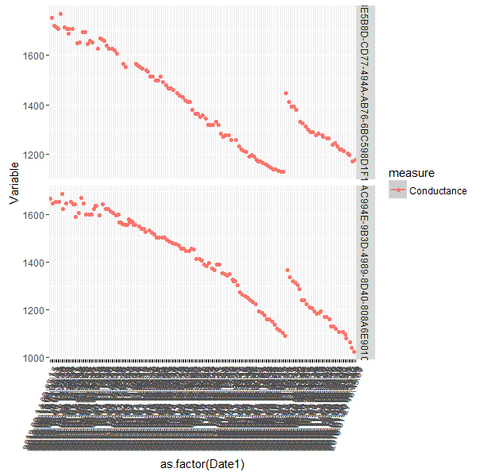
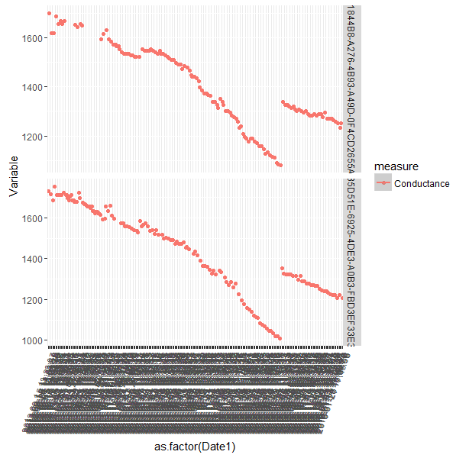
Conductance Drop > 0.5 < 0.65 (4 cases)
Case 1& 2 have more than 10% cases where DOD is less than 0.8
Case 4 has around 8% and case 3 has around 6 %

Slide 12
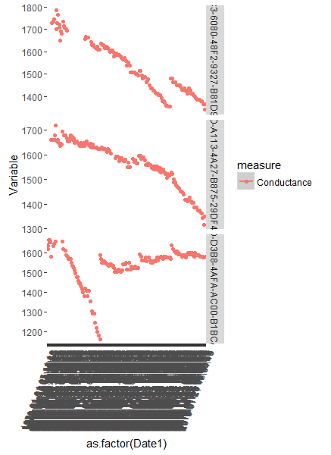
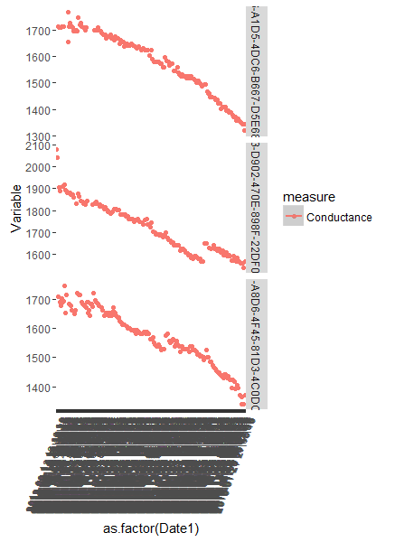
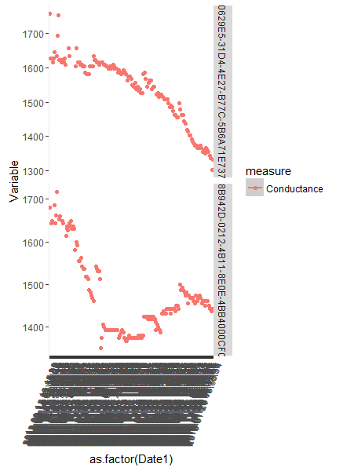
Conductance Drop > 0.65 < 0.8 : (100 cases – 30 sampled)Group 1
8 Batteries
4 showing drop and retracting trends. Others sharp drops
All these batteries have more than 10% of their values below DOD 0.8 ( Ranges from 10% to 30%)
Notes:
For those batteries

Slide 13
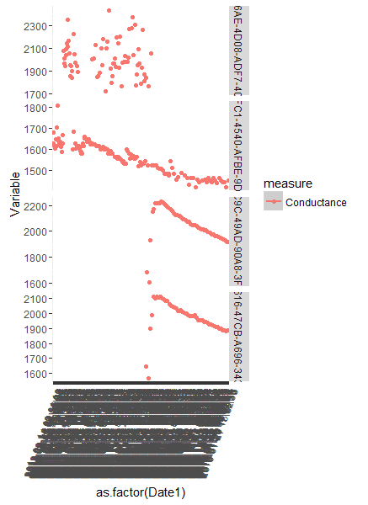
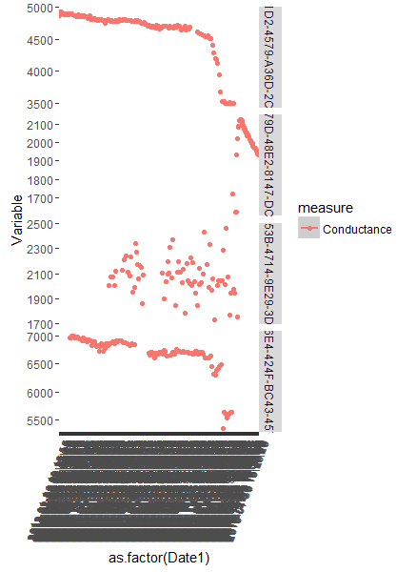
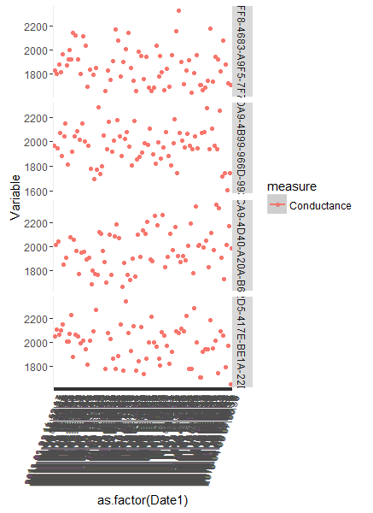
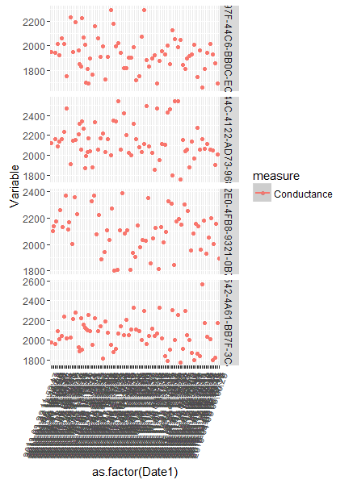
Conductance Drop > 0.65 < 0.8 : Group II
22 Batteries
13 showed high variable profile.
19 of these batteries have 100% of their DOD values above 0.8. 3 of them have less than 3% values less than .8

Slide 14
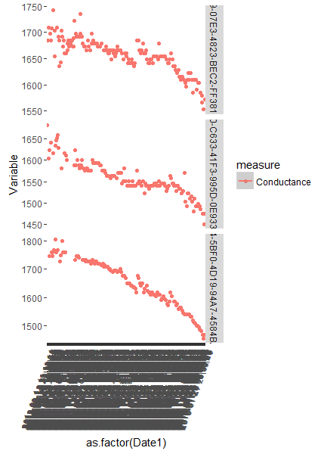

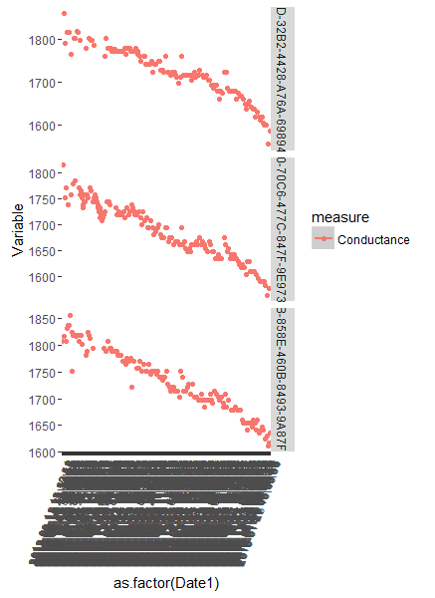
Conductance Drop > 0.80 < 0.9 : (492 cases : 30 samples)Group 1
9 Batteries
All showing gradual drops. The drops are more muted than the previous bins
All these batteries have more than 10% of their values below DOD 0.8 ( Ranges from 12% to 27%)
Notes:
492 cases observed in this bin

Slide 15
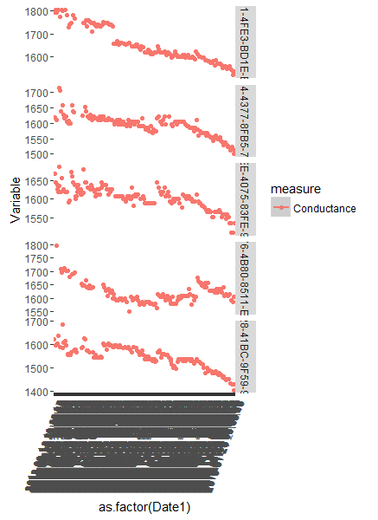
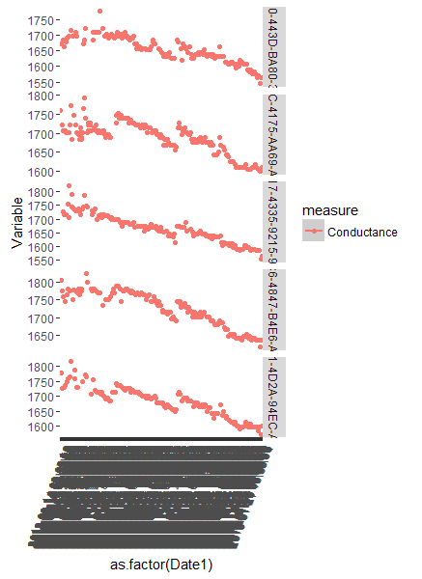
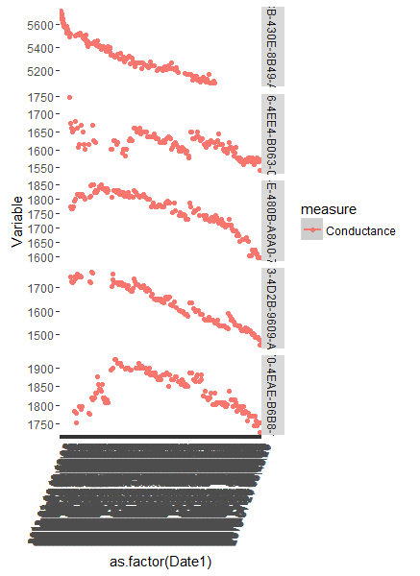
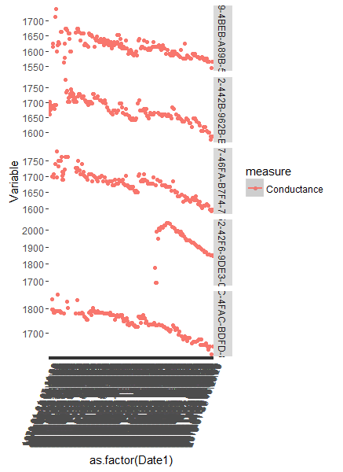
Conductance Drop > 0.8 < 0.9 : Group II
21 Batteries
Mostly gradual or flatter conductance drops
16 of these batteries have 100% of their DOD values above 0.8. 3 of them have less than 3% and 2 less than 8% respectively of values less than .8

Slide 16
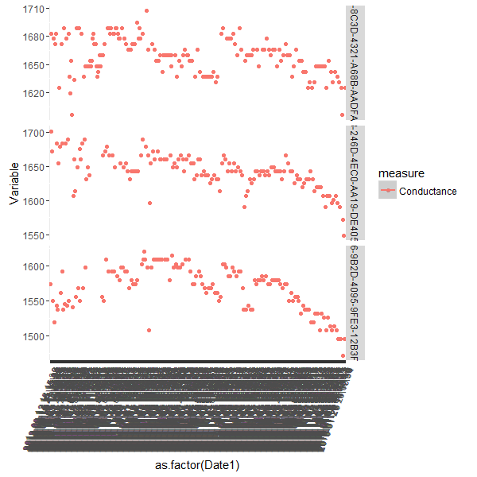
Conductance Drop > 0.9 : (394 Cases : 30 Samples) Group 1
3 Batteries
Mostly flat conductance profiles.
All these batteries have more than 10% of their values below DOD 0.8 ( Ranges from 41% to 15%)

Slide 17
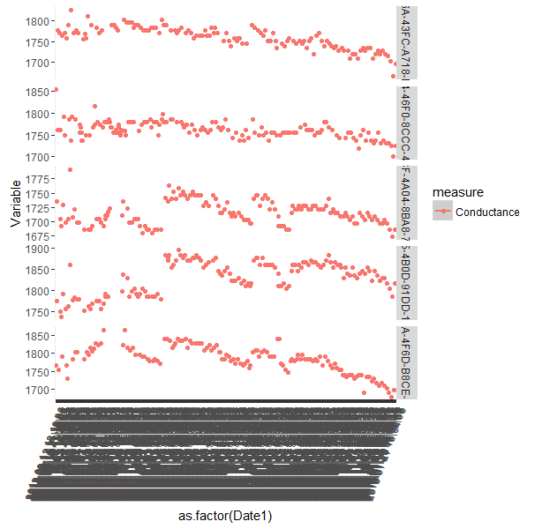
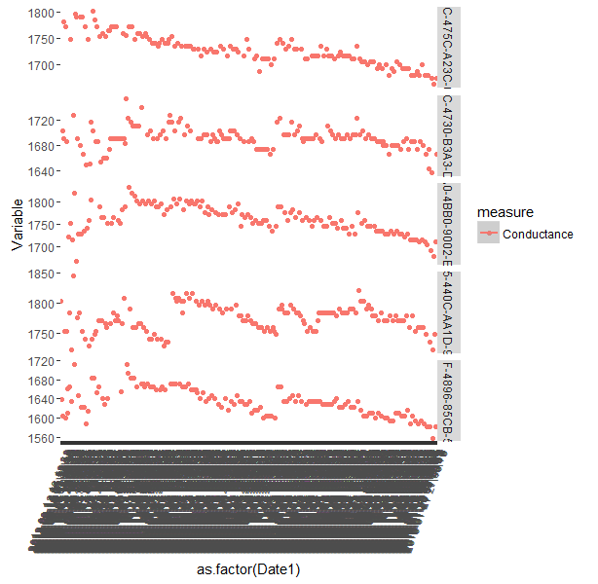
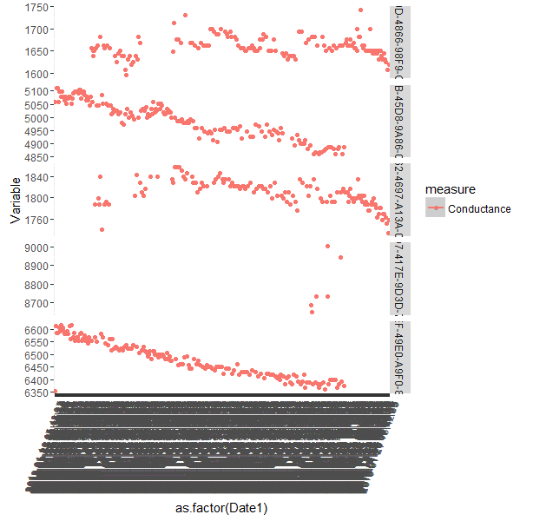
Conductance Drop > 0.9 : Group II
27 Batteries
Mostly flat conductance drops
16 of these batteries have 100% of their DOD values above 0.8. 3 of them have less than 3% and 2 less than 8% respectively of values less than .8

Slide 18
Inferences and Feature engineering
A general trend which was observed was, the DOD(from voltage perspective) for most of the batteries were predominantly between the ranges : 0.85 – 0.80.
Association between % of values having DOD values less than 0.8 and % drop in conductance was observed.
Batteries which had sharper drop in conductance had relatively larger % of values below the 0.8 DOD levels.
A good filter for identifying potential cases of failing batteries could be the following
Drop in conductance > 80% of highest conductance level
10% or more values with larger than 0.8 DOD
On the above filter, another level of filter for % of conductance points below 80% was added
3% or more values with larger than 80% of conductance level
A composite score with all these factors was incorporated
Both samples were ranked according to the composite score
Sample 1 : 1000
Sample 2 : 1000
21 cases filtered with above filter
Most cases in top 10 have falling and retracting trend
Rest of the cases have sharp conductance drops
29 cases filtered with above filter
Most cases in top 14 have falling and retracting trend
Rest of the cases have sharp conductance drops

Slide 19
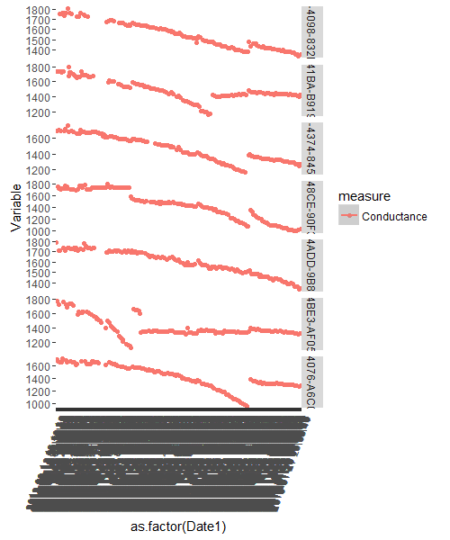
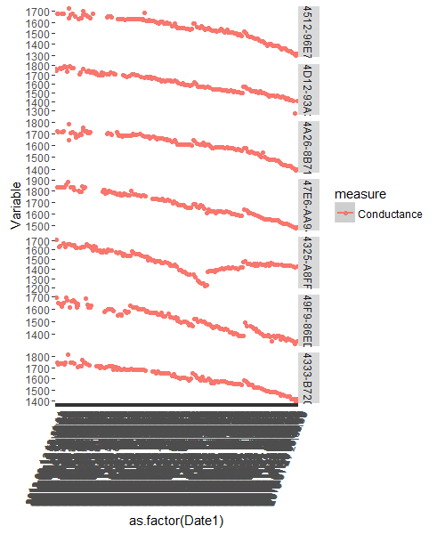
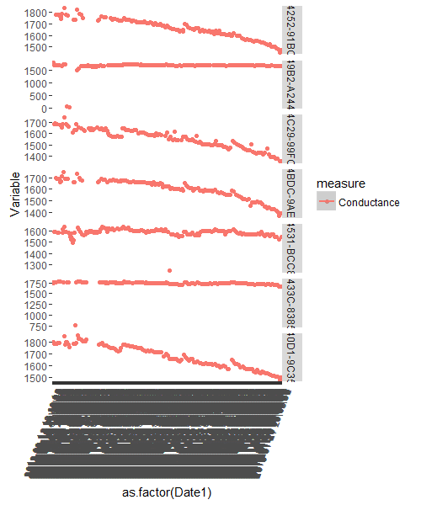
Sample 1: 1000 ( 21 Batteries)
Top of the list dominated by batteries having dropping and then retracting trends
All of them have substantial proportion of values above the 80% DOD range ( Average 23%)

Slide 20
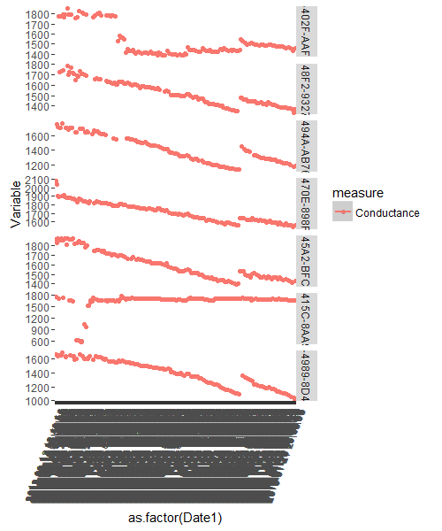
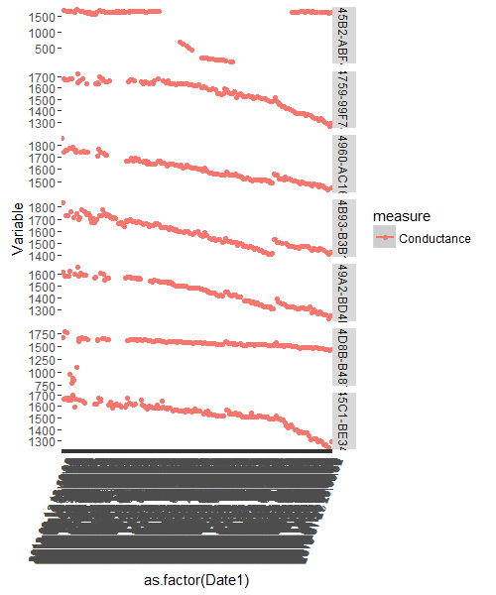
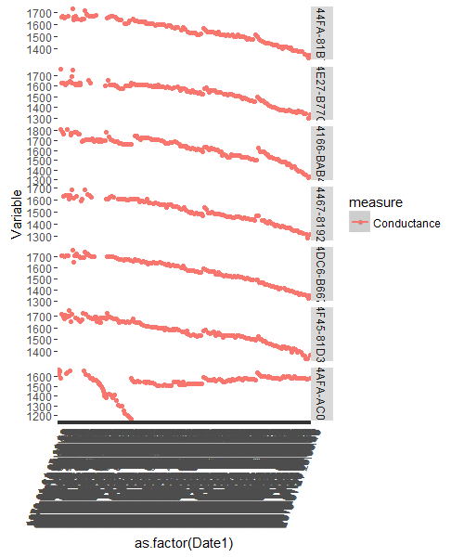
Sample II: 1000 ( 29 Batteries)
Top of the list dominated by batteries having dropping and then retracting trends
All of them have substantial proportion of values larger than 80% DOD range ( Average 22%)

Slide 21
Features for identifying Potential Battery Failure
Potential Failure Cases
Tending towards failure
Normal Batteries
Drop in Conductance < 80%
% of point with values lower than 80% DOD > 10%
% of points with values lower than 80% conductance drop > 3%
Drop in conductance : 90% - 80%
% of point with values lower than 80% DOD > 10%

Slide 22
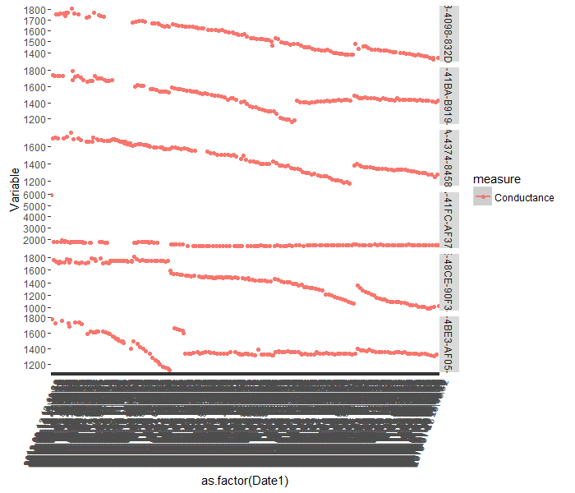
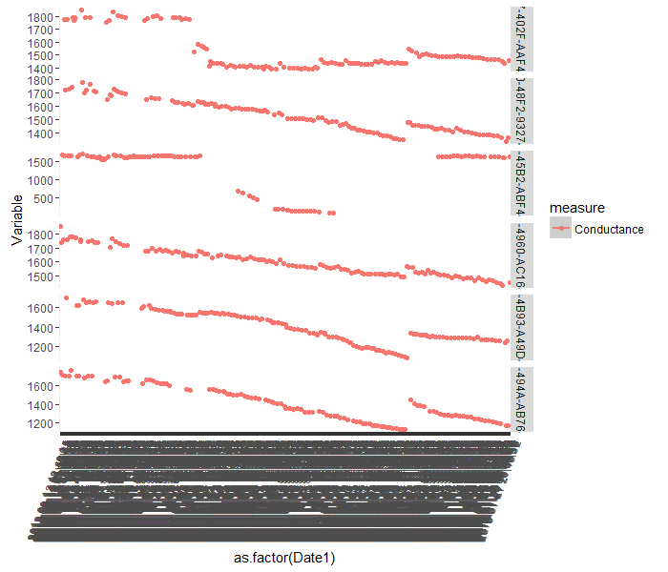
K – Means Clustering : Exploratory
Sample 1 : 1000
Sample 2 : 1000
Cluster 1 : 992 Batteries
Cluster 2 : 8 Batteries
Cluster 1 : 981 Batteries
Cluster 2 : 19 Batteries

Slide 23


