Slide 1

BMIS 2.0 Data Discovery Update
09/15/2016

Slide 2
Overview
Objective
Data
Analyses
Model Structure
Phase II Recommendation
Solution Approach
Model Updates
Other Analysis

Slide 3
Objective
Evaluate data sufficiency for building for building models to
Predict the Likelihood of Sensor Failures
Predict the Likelihood of Clamp Failures
Predict the Likelihood of Stop Case

Slide 4
DATA & Analysis

Slide 5
Data – Sources and Cleaning
S.No | File Name | # Records | # Variables
1 | BMISFPV_Aug10.txt | 21,299,436 | 85
2 | BMISFPV_Aug10_PackTest.txt | 4,382 | 32
3 | BMISFPV_Aug10_TestPack.txt | 7,143 | 108
4 | BMISFPV_Aug10_TestQC.txt | 2,556,083 | 55
5 | BMISFPV_Aug10_Tests_ShopInfo.txt | 10,949 | 15
6 | BMISFPV_Aug10_Tests_TestTypegroups.txt | 24 | 3
7 | BMISFPV_Aug10_Tests_UserScreens.txt | 95,583 | 4
8 | BMISFPV_Aug10_TestsCharging.txt | 761,524 | 11
9 | BMISFPV_Aug10_TestsPartNumber.txt | 2,971,577 | 10
10 | BMISFPV_Aug10_TestSystem.txt | 698,027 | 28
11 | BMISFPV_Aug10_TestTotal.txt | 21,565,692 | 30
12 | BMISFPV_Aug10TestsError.txt | 7,855,172 | 16
13 | BMISFPV_Aug10TestsGraphPoint.txt | 421,928 | 55
14 | Test tables.xls(Tab : Tests_Coupon) | 59 | 10
15 | Test tables.xls(Tab : Tests_CableDrop) | 523 | 56
16 | Test tables.xls(Tab : TestLocationGroups) | 12 | 3
17 | ToolTypes.xlsx | 14 | 3
18 | Battery Decisions.xlsx | 1,701 | 6
Core Table(BMISFPV_Aug10.txt)
Metric | Count | %
# Clients | 39
# Records | 21,299,436
# Records in 2012 | 199,536 | 1%
# Records in 2013 | 6,452,893 | 30%
# Records in 2014 | 6,713,763 | 32%
# Records in 2015 | 6,454,823 | 30%
# Records in 2016 | 1,471,932 | 7%
Others/Outliers | 6,489 | 0.03%
Records with many missing and invalid fields removed
Records with some missing fields
Those fields were excluded from analysis.
During the modelling process suitable interpolation of values will be done
Data fields that could be grouped together – like contiguous geographies – were done so as to enable insightful analyses

Slide 6
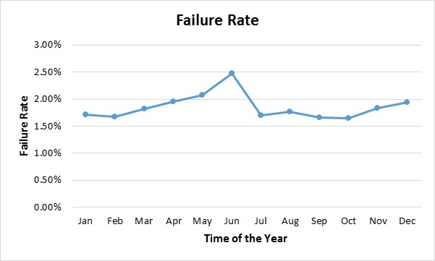
Sensors
 | Temperature Range | Records | Unique Tools
Failure | <= -60F | 9 | 3
Warning | -60 F to - 40 F | 293,080 | 510
Normal | -40F to -140F | 20,556,114 | 11,596
Warning | 140F to 160F | 54,054 | 2,677
Failure | >=160F | 395,892 | 1,412
 |  | 21,299,149 | 11,631
Many observations of failures/ non-failures
Good number of unique failed tools
Failure events/tools spread over time
Note: The conclusions about data adequacy are very much dependent on the exact definition of the ‘Failure’
The tools here are both chargers as well as testers.
Objective: to predict the likelihood the next transaction of that tool will have a likely failure of the temperature sensor, given the history thus far.
Location X Month -> Weather
Some other variables such as Last Measured Voltage show varied distributions across Failure v non-Failure

Slide 7
Clamp
Observations
Clamp non-Failure | Below 500 micro-ohms in both Positive and Negative Resistance | 210,015 | 99.72%
Clamp Failure | '>=500 mico-ohms in either Positive or Negative Resistance | 594 | 0.28%
 |  | 210,609
Unique Tools
Never experienced clamp failure |  | 33
At least one instance of clamp failure |  | 40
 |  | 73
Data available for only Client 12
Number of unique tools is minimal
# Transactions till Failure for replaced clamp= 14
i.e. ‘within tool’ history is minimal
Some variability observed by time and Location

Slide 8
Stop Cases
Objective: predict the likelihood that the next charging transaction of the battery will return a StopCase 18
As a proxy for the battery we used the vehicle identification number.
The number of unique Vin numbers that have experienced stop case 18 are 5918
Here we calculated the average number of times we can expect to see a battery per year, in the data:
• Only 17% of the Vins have appeared more than once at all!
• The average no. of days between two charging sessions for the same battery is around 150 days.
There is insufficient enough history at a battery (Vin Number) level.
Total Count of Stop Cases | Count | %
Stop Case 18 | 9,216 | 1.3%
Stop Case 0 | 332,462 | 45.4%
Rest of the Stop Cases | 390,019 | 54.3%
 | 731,697 | 100%

Slide 9
MODEL STRUCTURE

Slide 10
Model Structure – Sensor Failure
Model output: a score that is proportional to the likelihood of Sensor Failure (i.e. Temperature falling in the range of either <= -60 F or >= 160F)
Model Type: logistic regression model (or a Random Forest Model, to be chosen based on what model type will be most predictive and stable)
Input Variables: Historical (up until the current week’s) values of Temperature readings, voltage, CCA, State of Charge, Location, Temperature etc
Look-Ahead: model uses information available to predict the imminent failure of the sensor in the week after the next.
i.e. data till the week ending 7th Jan 2017 will be used to predict sensor failures in the week beginning 15th Jan 2017
Score Threshold: a pre-decided threshold score over which the sensor’s next transaction will likely fail.
Technique: Logistic or RF are preferred over techniques such as decision trees
Objective here is to not only classify (likely failure and non-failure) but come up with a score-based ordering
Gives flexibility for the business to vary thresholds as needed.
Logistic regression or RF is more accommodative of transformation of basic variables to features
Threshold:
decided based on the acceptable trade-off between detection of failures vs false-positives.
can be revised in production with no change to the underlying model.

Slide 11
Model Structure - Clamps and Stop Cases
Clamp Failure
Stop Cases
Model output = a score that is proportional to the likelihood of Clamp Failure (i.e. Positive of Negative Resistance >= 500 micro-ohms)
Model structure similar to Sensor Failure
Data for more clients needed for a ‘good’ model
Observe more unique tools
More patterns of failures/non-failures
Too few observations/battery for a look-ahead model at the battery level
Any model will need to update the score based on updates on other charging transactions of other batteries
such a model possible only if batteries can be grouped
Based on Stop Case 18 occurrence
No such pattern was discernible

Slide 12
Recommendation & Solution

Slide 13
Phase II Recommendation
Temperature Sensor Failure: We recommend that we proceed to Phase II.
Clamp Failure: cannot expect to have a reasonable model for Clamp Failure
If we are able to collect data of Clamp Failure across multiple clients
to make it as rich as the data of Temperature Sensors
then we will be able to build a good Clamp Failure Model.
Stop Case: We do not see a scope for a good predictive.
Limitation: Structure of the Problem

Slide 14
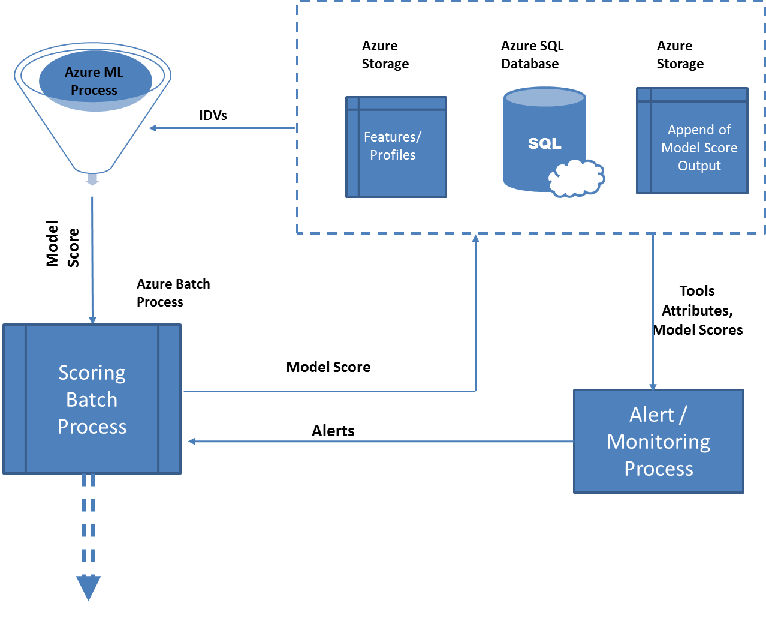
Solution Approach
ML Process – Final Model Equations
Features – derived variable calculated from data
Scoring – weekly batch
Model scores- appended back to the tools
Used for model/alerts monitoring
Model Monitoring
Model is dynamic – will take into account latest values
But the relationships are as captured in modelling
Monitoring helps observe any gradual deterioration → Model refresh

Slide 15
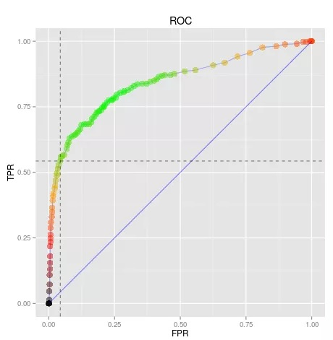
Operating Threshold
For an ordering of model scores each threshold gives
A detection rate (True Positive Rate)
i.e. % failed sensors the model will catch
The Interdiction rate
i.e. the highest scoring n % tools to be flagged
% of population

Slide 16
Other Analysis
There is scope for an after-the-fact analytics study as far as Stop Case 18 is concerned
Such a study would analyze:
The nature of occurrence of Stop-Case 18
Segments in Time X Location X Client where there has been disproportionate triggering of stop cases.
i.e., while we cannot predict which batteries are likely to fail, we can analyze if there is a pattern in failures based on all the variables
Note: a preliminary analysis of this kind, based on the basic variables, directly discernable from the data, was completed. And not much pattern was observed. However a detailed analysis, deriving more variables from the data can be done to see if there are any patterns to the failures

