Slide 1
Technology
Vijay Kumar Thummanapelly

Slide 2
Technology Topics
DevOps
GIT
KAFKA
DOCKER
REST API
NOSQL DB
COUCH BASE
Open source framework
JIRA
Ginger
Jenkins

Slide 3
Technology Topics
Web server
Application Server
Plug-Ins
IoT
REST API
SOAP API
Micro Services

Slide 4
Technology Topics
Web server
Application Server
Plug-Ins
IoT
REST API
SOAP API
Micro Services

Slide 5
Technology Topics
{more topics to be added}

Slide 6
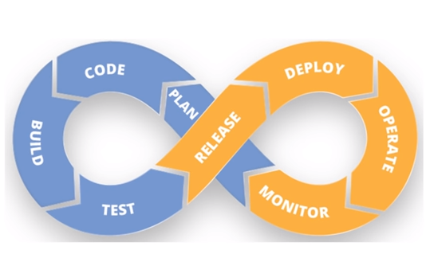
DevOps

Slide 7
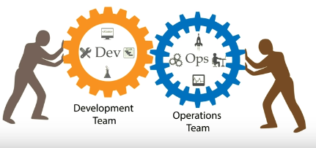
DevOps
DevOps is a software development Strategy which bridges the gap between the Dev and the Ops side of the company.
Ops team want agility where as Dev team wants ability.

Slide 8
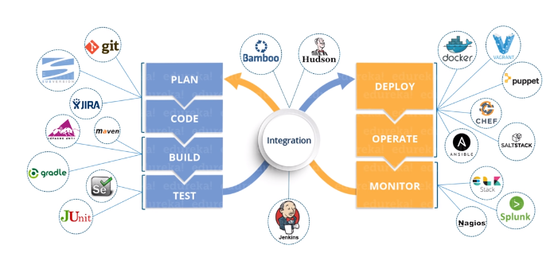
DevOps - Phases

Slide 9
DevOps – Dev side
Plan / Code:
Version control:
GIT: De centralized version control tool.
Build:
Maven (for Java application)
JIRA
Test:
Selenium
JUnit

Slide 10
DevOps – Ops side
Deploy & Operate : These are the configuration management tools for deployment
Docker
Vagrant
Puppet:
Can replicate the whole configuration. We can easily roll back to the previous configuration.
CHEF
SaltStack
Ansible
Monitor:
Stack
Splunk
Nagios

Slide 11
DevOps - Integration
Integration: Integrating all the phases from Dev and Ops Side
Jenkins
Will pull the code and build it, and send for testing, then deploy, and also send for monitoring, and based on the responses from monitoring it will intimate required teams.
Bamboo
Hudson

Slide 12
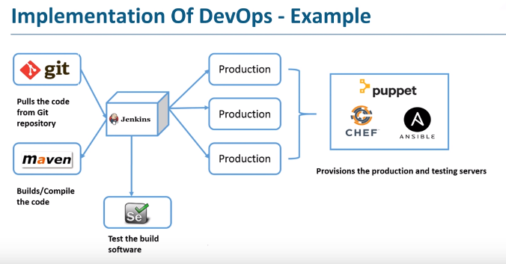
DevOps – Implementing Example

Slide 13
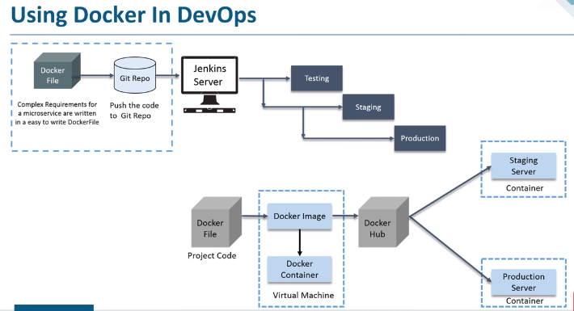
DevOps – Implementing Example

Slide 14
DevOps – Implementing Example

Slide 15
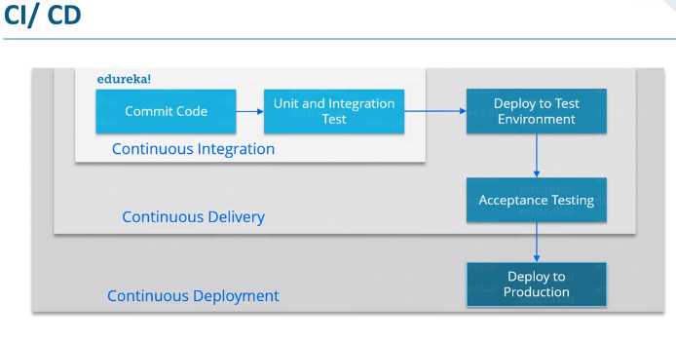
DevOps – Continuous integration/delivery/deployment

Slide 16
DevOps – Continuous integration/delivery/deployment
Code + UT + ST = Continous Integration
Continuous Integration + Acceptance testing = Continuous Delivery
Continuous Delivery + Deploy to Production = Continuous Deployment

Slide 17
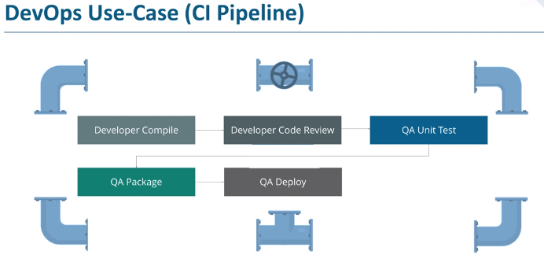
DevOps – CI Pipeline

Slide 18
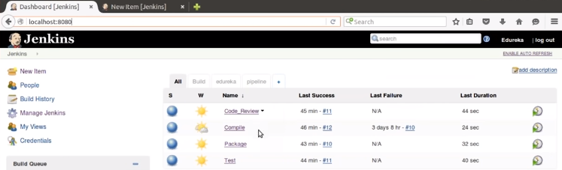
DevOps – CI Pipeline

Slide 19
GIT

Slide 20
GIT
Distributed version control system
Created by Linus Torvald
Efficient in maintaining the version, and merging
Capabilities:
Maintain Version control
Versions with Branching
Merging in efficient way automatically
Can get the contributor files, and analyze and merge or reject the changes.
We can easily move to the previous versions
As it is distributed version control, the whole repository will reside on your machine. So that we can work on the changes with or without internet. When you are able to connected to server, you can sync with server.
Youtube: #0 Git Tutorial | What is Git? | Github

Slide 21
KAFKA

Slide 22
KAFKA
Kafka server or Kafka broker
Behavior:
Mediator or broker between Producer and Consumer
Distributed
Maintain cluster (combination of multiple systems)
Maintain the data as partition in multiple systems
Each producer, must have a topic name, so that consumer can request the topic to Kafka.
Producer:
Who will fetch data from database, and send as messages to Kafka.
Consumer:
Who request the message (with a topic name) which is sent by a producer.

Slide 23
KAFKA
Cluster:
Combination of systems working together
Kafka is a cluster distributed system.
Partition:
Kafka will partition the data and distribute in the cluster.
Partition is decided by Developer.
Offset:
Sequence for message in a partition.
Offset are local to partition.
Topic name ->Partition number->Offset number will locate a message
Consumer group:
Group of consumers acting as single unit.
The consumers under consumer group are distributed with number of partition.
Youtube: Kafka Tutorial - Core Concepts

Slide 24
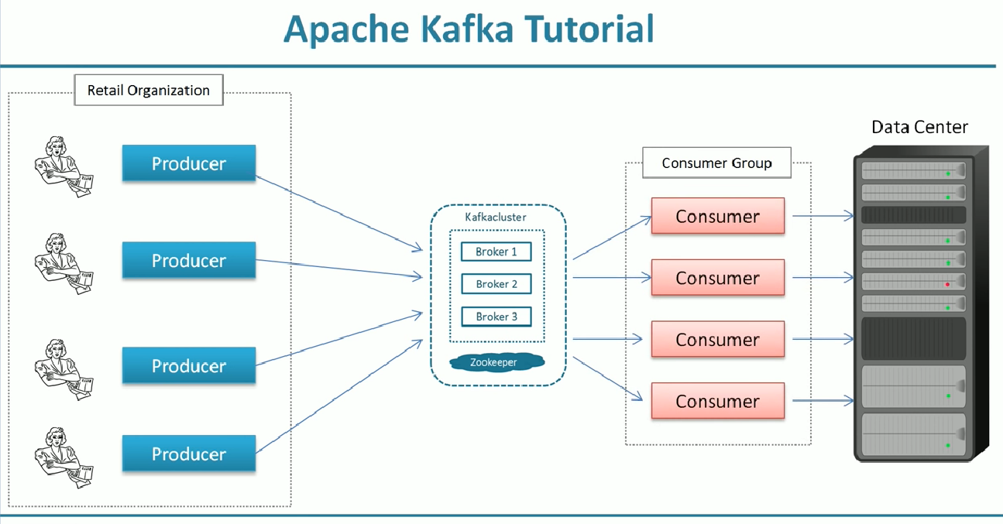
KAFKA

Slide 25
DOCKER

Slide 26
DOCKER

Slide 27
JIRA

Slide 28
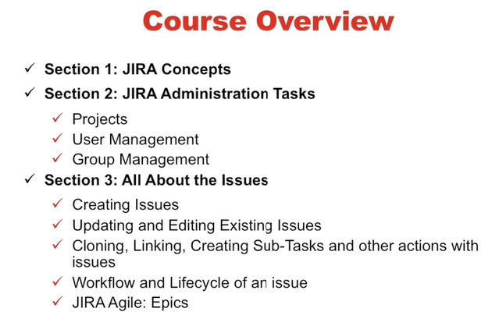
JIRA

Slide 29
JIRA
JIRA is to manage the project issues, tasks,
Projects
Issues
Components
Workflows
Projects:
Collection of Issues
Issue belongs to a Project
Each Project will have name and Key
Key will be used for each Issue name with prefix

Slide 30
JIRA
Issues:
Building block f the project
Represent:
A Software Bug
A project task
A helpdesk ticket
A product improvement
A leave request from client
Components:
Sub sections of the project
Issues will be mapped to one of the components

Slide 31
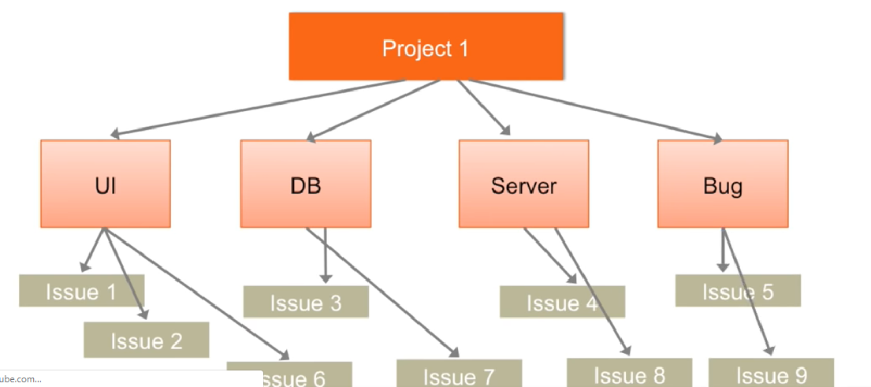
JIRA – Project/Component/Issues

Slide 32
JIRA
Workflow:
Set of status and transitions that issue goes through during its life cycle
Represents business process
Can come with default workflow and can be customized
Possible status: Open, In-progress, Resolved, Closed, Reopened
Possible transitions: Start progress, Stop progress, Resolve, Reopen, Resolve &Close

Slide 33
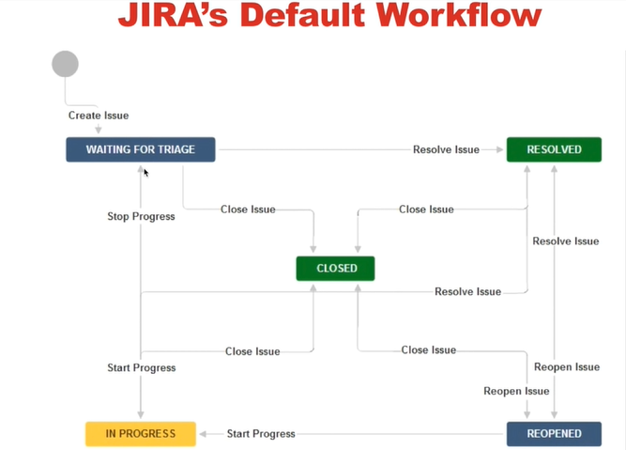
JIRA

Slide 34
NO SQL

Slide 35
NO SQL

Slide 36
WEB SERVER

Slide 37
Web Server
A web server is server software, or hardware dedicated to running said software, that can satisfy World Wide Web client requests. A web server can, in general, contain one or more websites. A web server processes incoming network requests over HTTP and several other related protocols.^{[1]}
The primary function of a web server is to store, process and deliver web pages to clients.^{[2]} The communication between client and server takes place using the Hypertext Transfer Protocol (HTTP). Pages delivered are most frequently HTML documents, which may include images, style sheets and scripts in addition to the text content.

Slide 38
APPLICATION SERVER

