Slide 1
Bell Inequality Test CSC 791 Quantum Communications and Network
Presenter: Thinh Le
April 11 2025
Implementation: https://github.com/tvle2/Bell-Inequality-Test.git

Slide 2
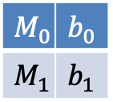
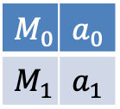
Bell Inequality
Imagine a two-qubit system and two measurements, $M_{0}$ and $M_{1}$
Space-like separated, so no cross-coordination
$M_{0}$ | $a_{0}$
$M_{1}$ | $a_{1}$
$M_{0}$ | $b_{0}$
$M_{1}$ | $b_{1}$
Define: $A_{0}={\left(−1\right)}^{a_{0}}$, $A_{1}={\left(−1\right)}^{a_{1}}$, $B_{0}={\left(−1\right)}^{b_{0}}$, $B_{1}={\left(−1\right)}^{b_{1}}$
Bell / CHSH inequality: $A_{0}B_{0}+A_{0}B_{1}+A_{1}B_{0}−A_{1}B_{1}≤2$
Notes:
Today, I’d like to introduce you to the Bell Inequality, a fundamental result in quantum mechanics that highlights the contrast between classical notions of locality and the quantum world.
First, let’s imagine we have a two‐qubit system shared between two parties—often called Alice and Bob. Each party can choose between two different measurements; on Alice’s side we label them M0 and M1, and on Bob’s side M0 and M1. Concretely, you can think of each measurement setting as measuring the qubit in a particular direction or basis.
Because Alice and Bob are space‐like separated, they can’t signal or coordinate with each other during the measurement. In other words, once each party decides on one of their two measurements, they obtain outcomes without knowing the other’s choice or result. The Bell Inequality we see here is often phrased in terms of these outcomes labeled as ±1. We define:
A0=(−1)a0,A1=(−1)a1,B0=(−1)b0,B1=(−1)b1,A_0 = (-1)^{a_0 where a0,a1 are Alice’s measurement outcomes for M0,M1 and b0,b1 are Bob’s measurement outcomes for M0,
Under local realism—the idea that all measurement outcomes are predetermined and unaffected by space‐distant choices—one can show the following Bell (CHSH) inequality must hold:
A0B0+A0B1+A1B0−A1B1 ≤ 2.
Intuitively, if the results at each side are determined by local hidden variables (with no faster‐than‐light influence), we cannot exceed the value of 22 However, quantum mechanics predicts—and experiments confirm—that with certain entangled states and well‐chosen measurements, the above sum can exceed 2. In fact, quantum theory sets an upper limit of 2≈2.8282\sqrt{2}\approx2.828, known as the Tsirelson bound.

Slide 3
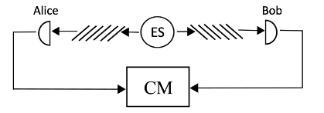



Project Objective
Given the following states:
Goal: Simulate Bell tests with noise to answer:
Which states violate Bell inequality ?
How do detector imperfections impact S, fidelity, and coincidence rates ?

Slide 4



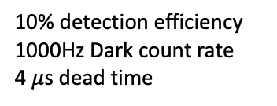
Simulation Setup
Generate entangled photons at average 15000 pairs/s
10% detection efficiency
1000Hz Dark count rate
4 $μ$s dead time
{0, $π/4$}
{$π/8$, 3$π/8$}
1 $n$s coincidence window

Slide 5
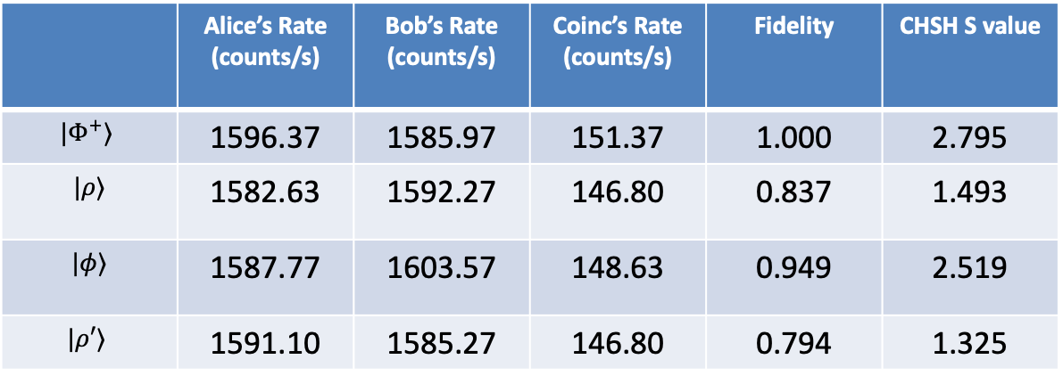
Simulation Results
 | Alice’s Rate (counts/s) | Bob’s Rate (counts/s) | Coinc’s Rate (counts/s) | Fidelity | CHSH S value
$$|Φ^{+}⟩$$ | 1596.37 | 1585.97 | 151.37 | 1.000 | 2.795
$$|ρ⟩$$ | 1582.63 | 1592.27 | 146.80 | 0.837 | 1.493
$$|φ⟩$$ | 1587.77 | 1603.57 | 148.63 | 0.949 | 2.519
$$|ρ′⟩$$ | 1591.10 | 1585.27 | 146.80 | 0.794 | 1.325

Slide 6
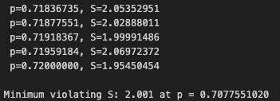
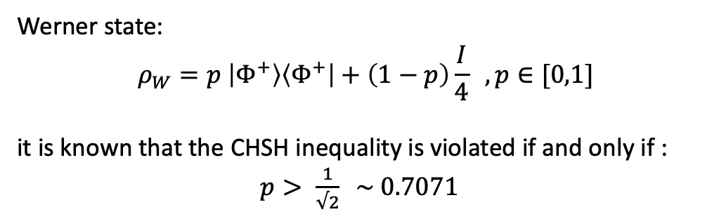
Finding state with minimum S value
Werner state:
$$ρ_{W}=p \left|Φ^{+}\right\rangle \left\langle Φ^{+}\right|+\left(1−p\right)\frac{I}{4} , p∈[0,1]$$
it is known that the CHSH inequality is violated if and only if :
$p> \frac{1}{√2} \sim 0.7071$

