Slide 1
Bell Inequality Test CSC 791 Quantum Communications and Network
Presenter: Thinh Le
April 11 2025
Implementation: https://github.com/tvle2/Bell-Inequality-Test.git

Slide 2
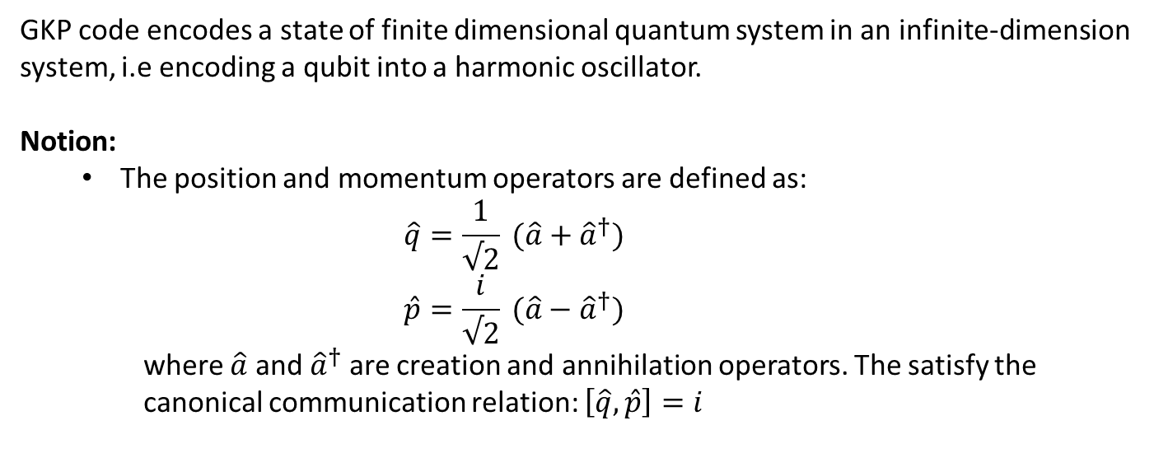
Ideal GKP Code States
GKP code encodes a state of finite dimensional quantum system in an infinite-dimension system, i.e encoding a qubit into a harmonic oscillator.
Notion:
The position and momentum operators are defined as:
$$\hat{q}=\frac{1}{√2} (\hat{a}+{\hat{a}}^{†})$$
$$\hat{p}=\frac{i}{√2} (\hat{a}−{\hat{a}}^{†})$$
where $\hat{a}$ and ${\hat{a}}^{†}$ are creation and annihilation operators. The satisfy the canonical communication relation: $\left[\hat{q}, \hat{p}\right]=i$

