Slide 1
Lending Club Case Study Analysis
KRISHNA CHITRAK
ANURADHA VIJAYAKUMAR

Slide 2
Problem Statement
◆ Need to analyse the Lending club data which has the information of loan status for the year 2007 to 2011.
◆ Need to analyse the data and find insight that which types of borrowers use to pay full
loan and which type of borrowers are charged off.
◆ This will help the company to grow the business by approving loan to eligible
borrowers and rejecting those who can’t pay(charged off)

Slide 3
Approach of Analysis
◆ Data Cleaning
◆ Deriving Metrics
◆ Univariate Analysis
Segmented Univariate Analysis
◆ Bivariate Analysis
◆ Multi-variate Analysis

Slide 4
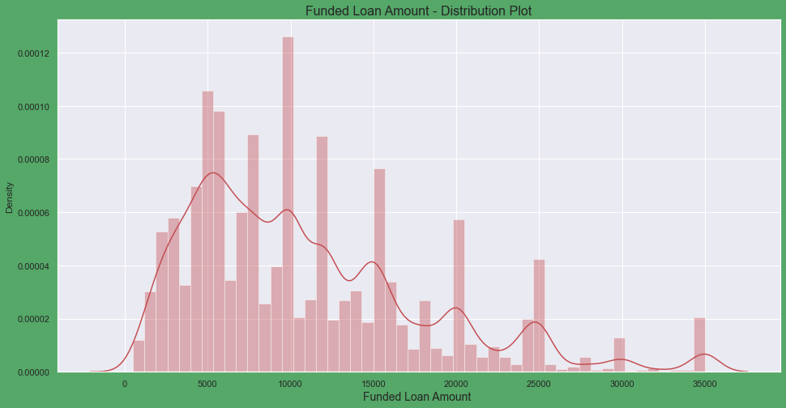
Univariate Analysis
◆ # Observation : Majority of borrowers funded_amount is between 5000-10000.

Slide 5
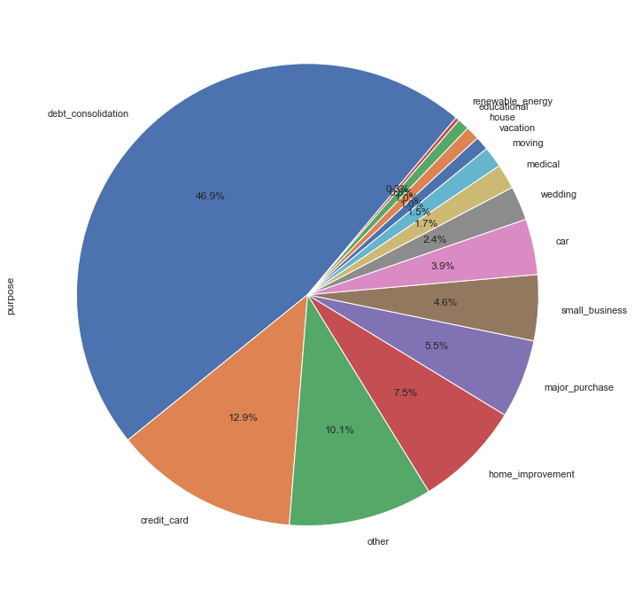
Univariate Analysis
# Observation : From the above pie_chart we observed 46.9% borrower have taken loan for "Debt_consolidation" followed by 12.9% for "credit_card"

Slide 6
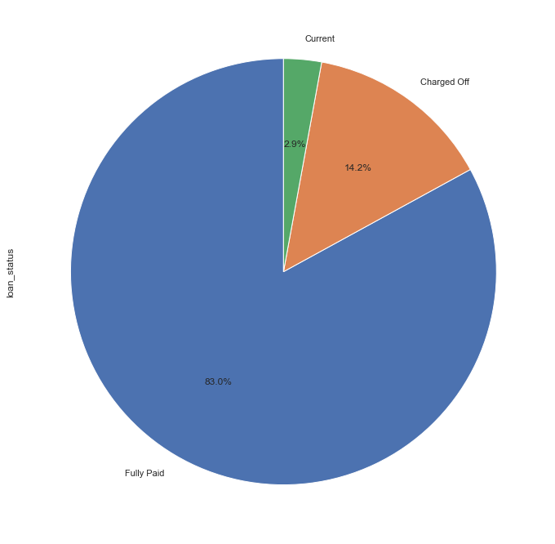
Univariate Analysis
# Observation : Maximun borrowers paid their full loan ie:83%, while 14.2% of borrowers are charged off and 2.9% borrowers still paying their loan.

Slide 7
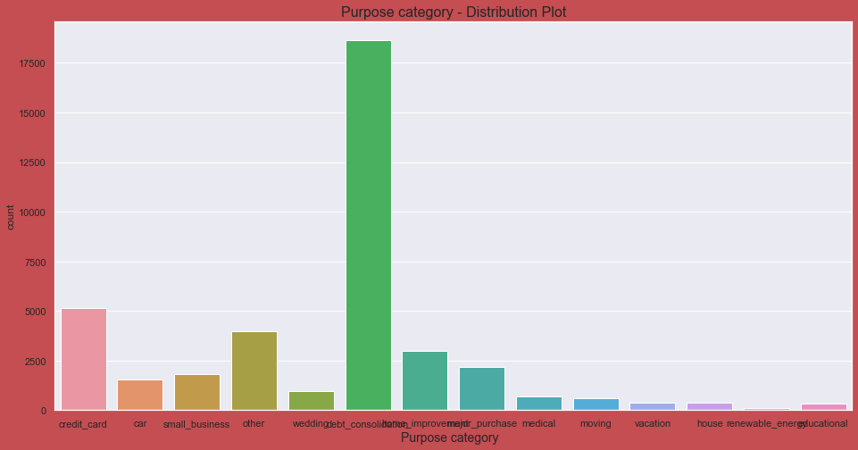
Univariate Analysis
# Observation : From above count plot maximum people take loan for debt_consolidation purpose followed by credit card

Slide 8
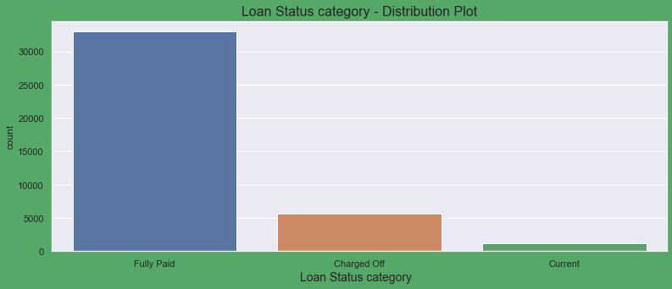
Univariate Analysis
# Observation : From the above countplot we can observe that around 32000 borrower has Fully_paid their loan while around 6000 borrower are Charged_off(debt is overdue) and around 500 borrower loan is still in processes.

Slide 9
Segmented Univariate Analysis
 | loan_amnt | int_rate | annual_inc | dti | revol_util
emp_length
0 | 8625.139535 | 10.897842 | 45986.771163 | 12.956456 | 42.708967
1 | 9869.417103 | 11.980584 | 61599.257190 | 12.769702 | 48.589496
2 | 10262.374658 | 12.074045 | 63274.654284 | 13.103719 | 48.636190
3 | 10738.278388 | 12.019673 | 66787.176313 | 13.163175 | 48.216542
4 | 10977.408324 | 12.173417 | 66583.750873 | 13.187616 | 49.412937
5 | 11287.035344 | 12.035268 | 68225.197441 | 13.421825 | 48.331106
6 | 11494.952894 | 12.070314 | 68184.612831 | 13.821350 | 49.591449
7 | 11739.495206 | 12.174969 | 69153.087986 | 13.674473 | 49.686317
8 | 11887.998648 | 11.906302 | 74590.461799 | 13.773793 | 48.318404
9 | 12011.625596 | 11.913060 | 74474.421304 | 13.540310 | 48.783935
10 | 13089.970717 | 12.094797 | 81706.525735 | 13.716438 | 49.584756
Observation : With the increase of the working experience the annual income of the borrower increases along with loan amount

Slide 10
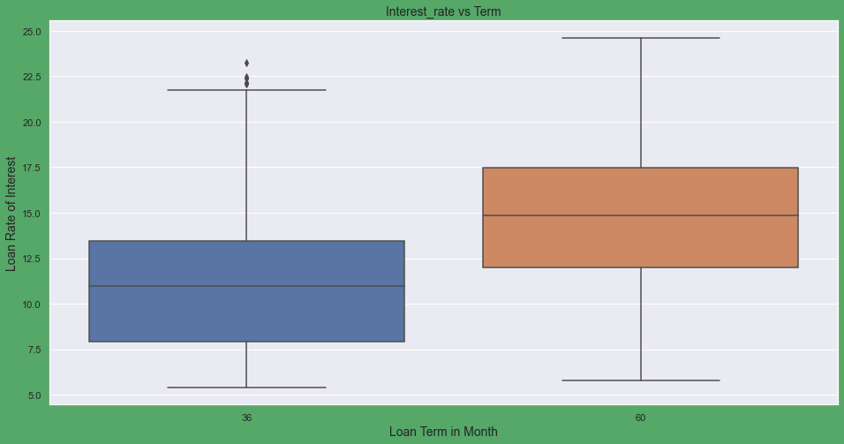
Bivariate Analysis
# Observation : From the box plot we observe that borrower taken loan for longer duartion i.e:60_months have assign high interest_rate as compare to 36_months.

Slide 11
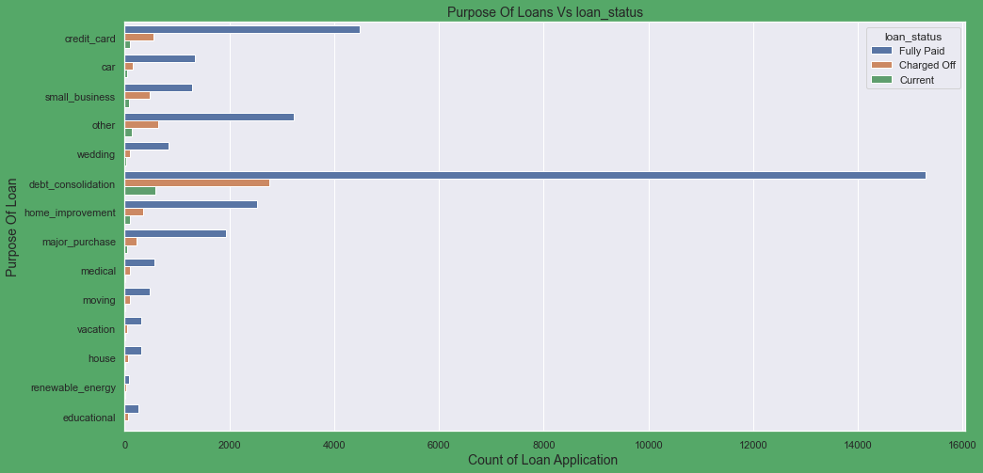
Bivariate Analysis
# Observation : As most borrower have taken loan for debt_consolidation there is a high number of Fully_Paid status in debt_consolidation and Charged_Off.

Slide 12
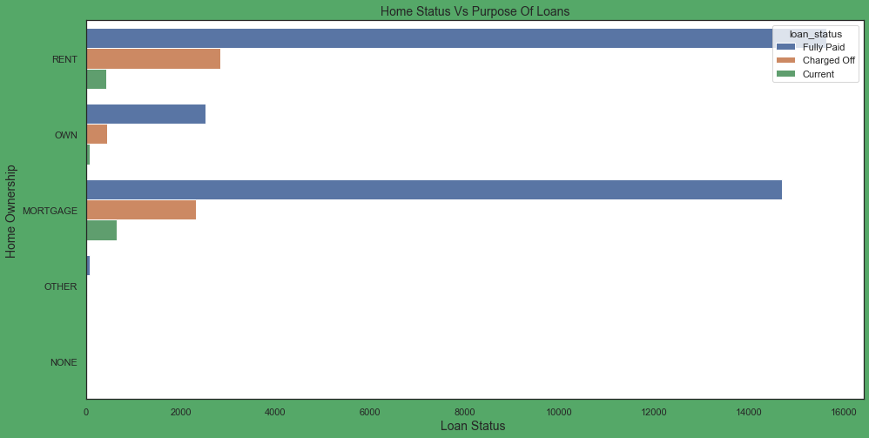
Bivariate Analysis
# Observation :
1) The highest proportion of the borrowers use to live in rented housing followed by mortgage house
2) Maximum charged of borrowers lives in a rented house
3) Borrowers with own house takes less number of loans in comparision to rented and mortgage borrowers

Slide 13
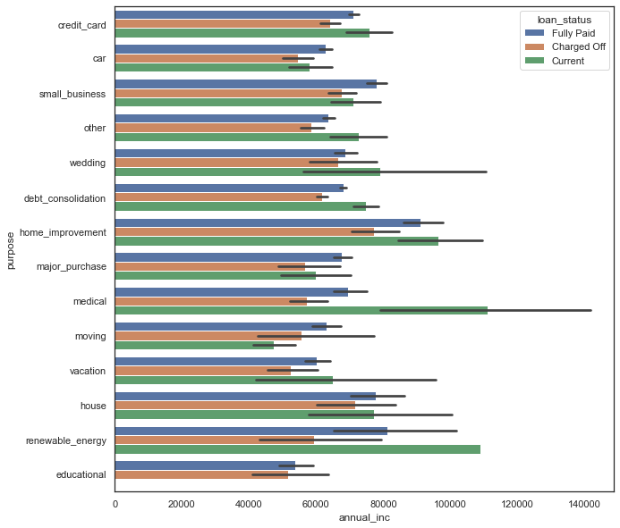
Multivariate Analysis
Observation : Borrower with higher salary mostly applied loans for "home_improvment", "house", "renewable_energy" and "small_businesses"

Slide 14
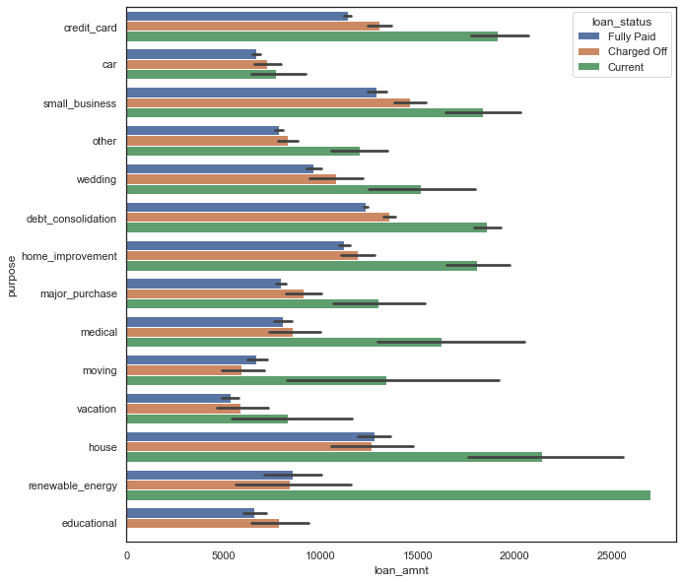
Multivariate Analysis
Observation : Among all the purpose of loan the majority of the loan are there in current state, with higher loan amount in comparison to other purposes

Slide 15
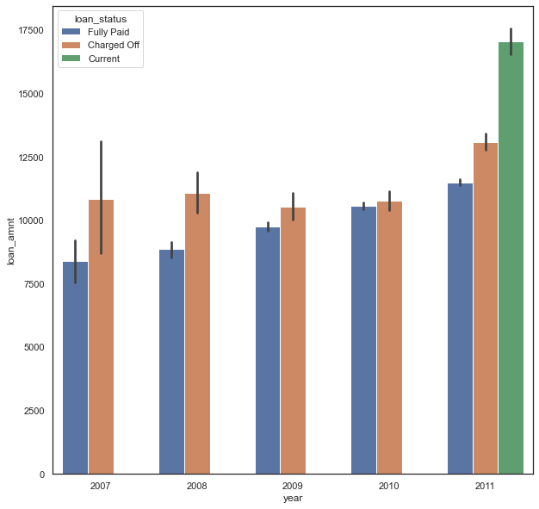
Multivariate Analysis
# Observation :
1) The fully_paid borrowers increases continously increase from year 2007 to 2011.
2) It has been observed every yeat between 2007 to 2011 the number of charged off borrower is more than the number of fully paid borrowers

