Slide 1
From Robots To Cobots

Slide 2
Robots
Complex machine
Helps industries and humans
Perform different tasks
  Complex medical surgeries
  Defence operations
  Complete control not to robots

Slide 3
Cobots
Collaborative robots
Work with people
Work with other robot
Focus on coorperation and involvement

Slide 4
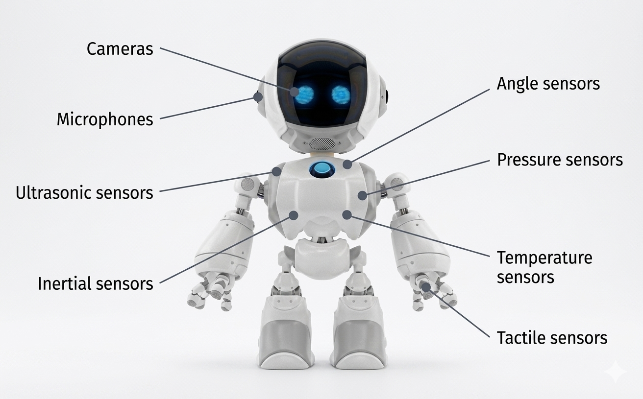
Robots with sensors

Slide 5
Machines
Designed to perform specific tasks
Operations of machines are predefined
They work based on
  Mechanical
  Electrical
  Software design

Slide 6
Example of machine
Washing machine
  Designed to clean clothes
  Controlled by small program written on them

Slide 7
Robots
Complex machine
Perform different task on their own
With the help of human

Slide 8
Basic Structure of Robots
Sensors
Actuators
Processors
Outer body

Slide 9
Use of componets of Robots
Help robot to sense environment
Take decision
Perform desired actions
Robots can
  learn from environment and
  update themselves

Slide 10
Example of Robots
Survillence Dogs
Designed to perform tasks like a watch man
Machines designed to perform
  One task
Robots more than one task

Slide 11
Robots
Are machines
  That can move around
  Perform more than one tasks
  Sense its surrounds
To do these
  It needs --> Actuators, Sensors,Controllers

Slide 13
Sensors
Use sensors to learn about there environment
Move around surroundings
Avoid obstacles
Interact with objects
Commonly used sensors -> cameras,lasers,ultrasonic sensors

Slide 14
Actuators
Move and do things with help of actuators
Commonly used actuators
  Motors
  Gears
  connections

Slide 15
Controllers
Robots brain is controller
Gives instruction to perform a specific tasks
Based on sensor input
Works based on prewritten set of instructions

