Slide 2
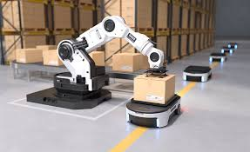
Warehouse Robots
Designed to work in warehouse
Major Task
Picking objects
Arrange shelf
Sorting Objects
Packaging Items
Popular in → Large Scale Logistic Operations

Slide 3
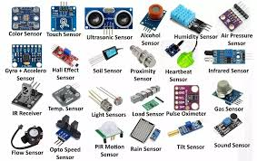
Parts of Warehouse Robots
Sensors
Controller Software
Actuators Robotic Arms

Slide 4
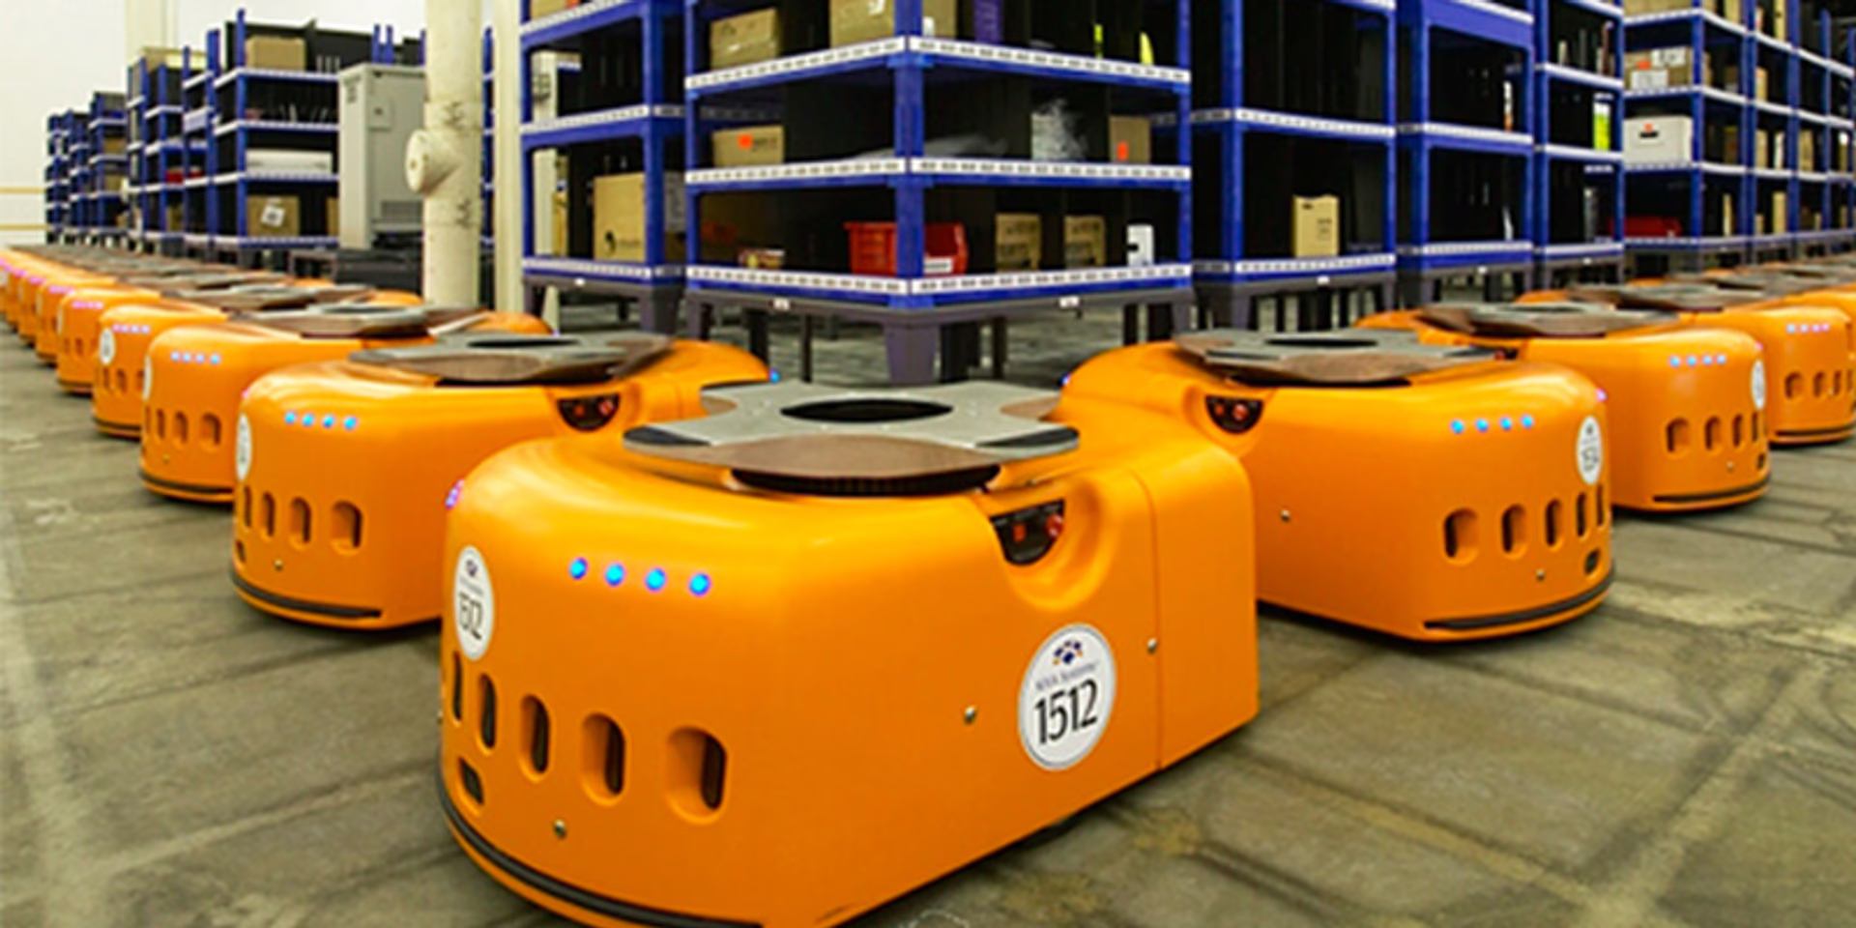
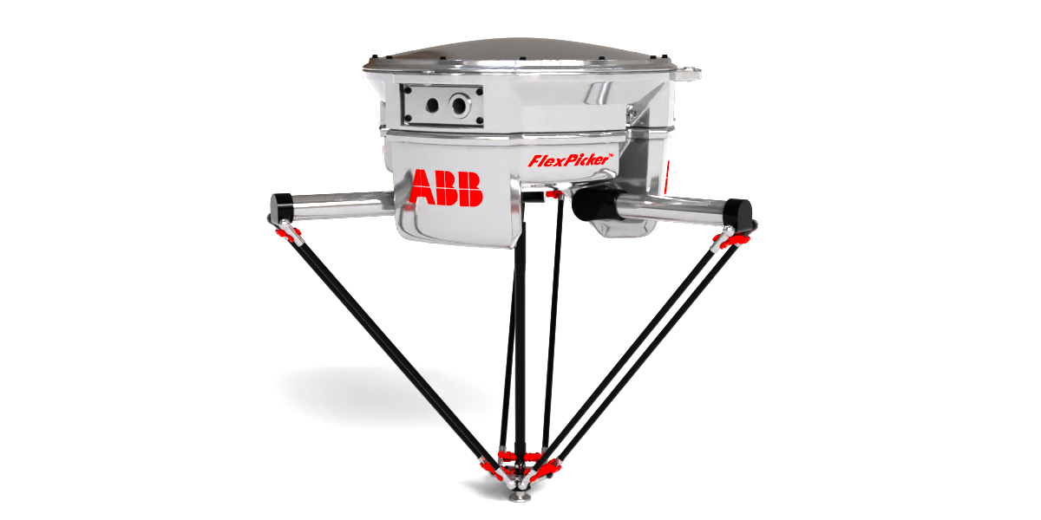
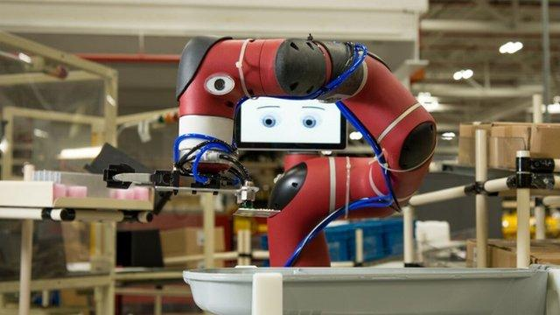
Real Life Examples
Kiva System Robots → Amazon Warehouse
ABB Flex Picker → Advanced Pick and Place Robots
Swayer Robots → Toyota Assembly plants

Slide 5
Assistant Robots
Work as assistance to human
Used in home,industry,education,hospital
Variety of tasks
Cleaning
Inventory management, cooking ,surgery,Disaster management

Slide 6
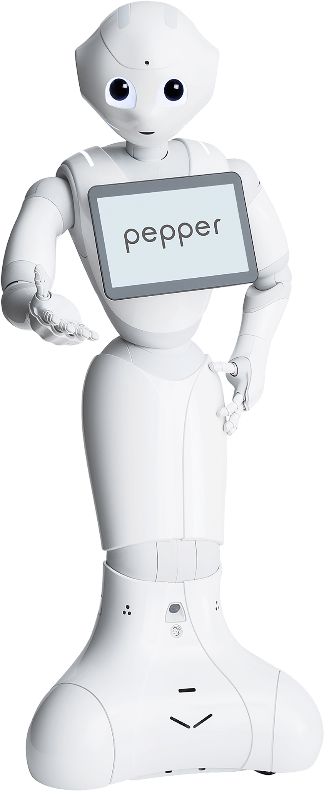
Pepper Robots

Slide 7
Advantage
Increase productivity
Reduce Risk of Injury
Improve Quality of Life

Slide 8
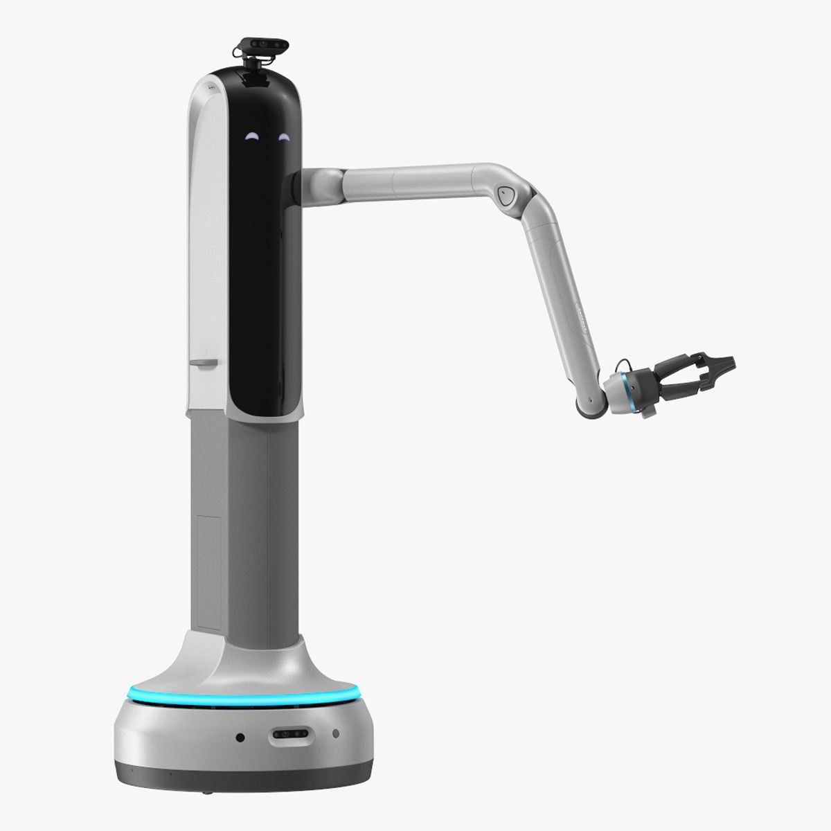
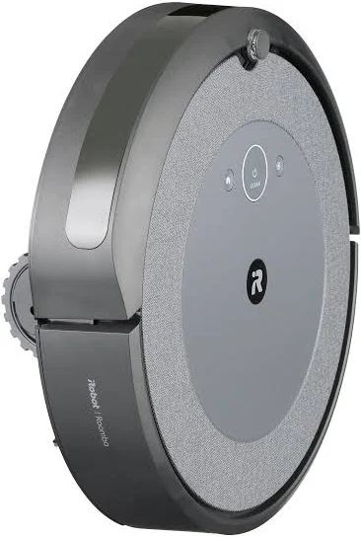
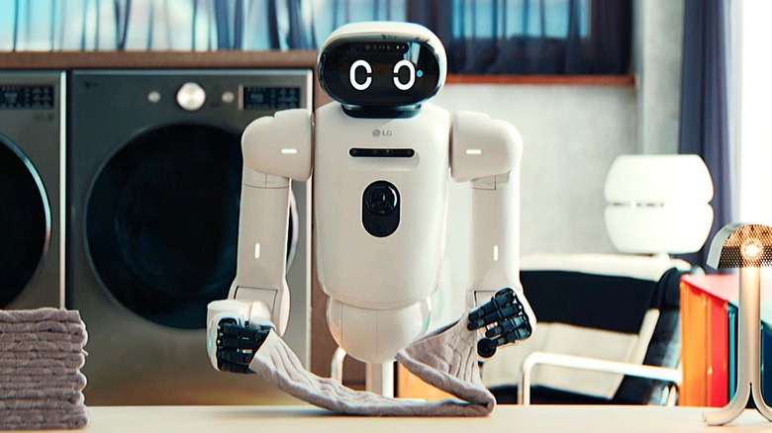
Examples
Samsungs Bot Handy
LGS Coi Home Bot
iRobots Roomba

Slide 9
Smart Homes
Helps in automation of routine tasks
Smart phone or tablets used to control the functions
Eg :Amazon echo plus
  Turns on lights
  Adjust Thermostat
  Lock the door at your voice

Slide 10
Features of smart homes
Smart security
Automated lighting
Automated Thermostats

Slide 11
Advantages of Smart Homes
Convenience
Security
Energy Efficiency
Comfort

Slide 12
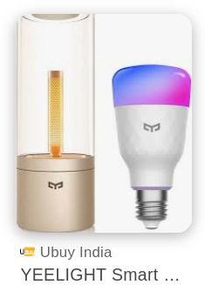
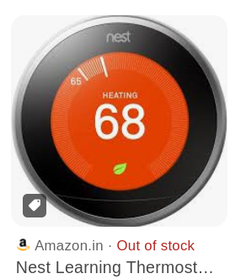



Real Life examples of smart homes
Yeelight -Smart light bulb
Nest -Smart Thermostat
Ring smart Doorbell
SimpliSafe Home Security System
August Smart Lock

Slide 13
Smart Schools

Slide 16
Smart Mobility
Tools to make transportation fast
Equipped with sensors
AI software are there to provide good movements
Helps in improve
  Speed
  Efficiency
  Convenience
  Safety of transport

Slide 17
Features
Transportation
Enhanced Security

Slide 18
Real-life examples of Smart Mobility
Delivery Robots
  Deliver goods and services
  Useful for short distances
  Used for delivering foods or packages
Play important role in
  Disaster situations
  Flood
  Earth quake
  Sending relief materials etc

Slide 19
Autonomus Cars
Level 1(Driver Assistance)
Level 2 (Partial Automation)
Level 3(Conditional Automation)
Level 4(High Automation)
Level 5 (Full Automation)

Slide 20
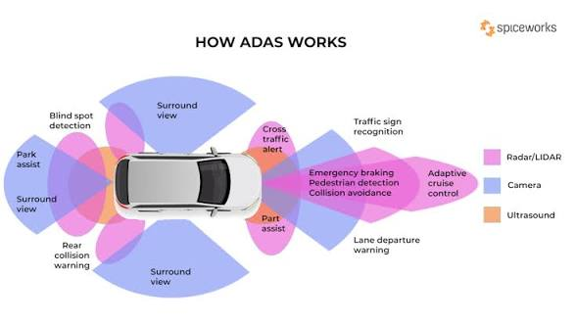

Slide 21
Driver Assisted Cars
Driver monitoring
Lane keeping assists
Driver monitoring
Emergency Assistance
Autonomous parking

Slide 23
NARS
New Age Robotic Systems

Slide 24
Possibility Of Nars
Hardware improvements
Artificial Intelligence

Slide 25
Relevance Of Nars
Manufacturing
Agriculture
Health Care
Hazardous Environment
Enhanced Efficiency
Adaptable

Slide 26
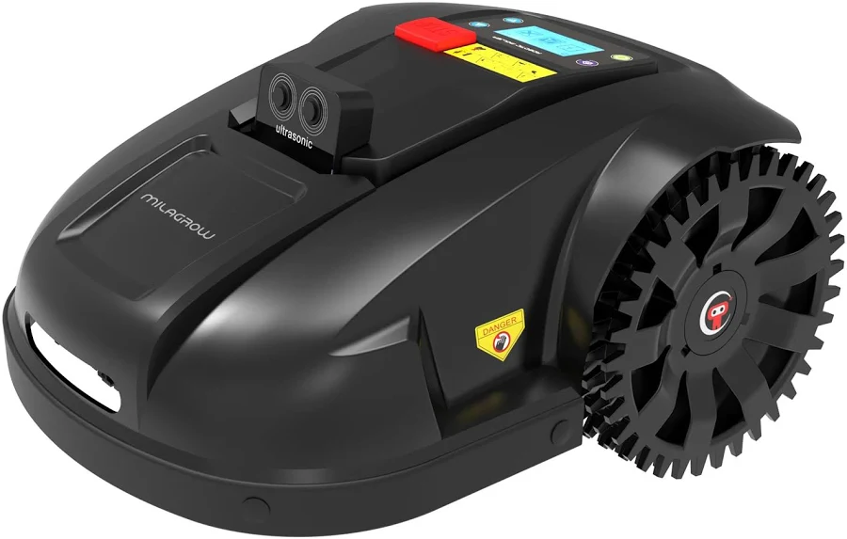

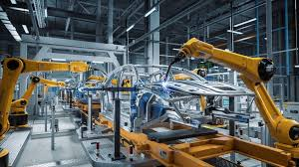
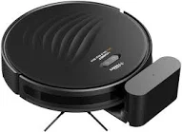
Some Common Examples of Robots
Robotic Lawn Mover
Robotic Vacuum Cleaner
Automated Manufacturing System
Robotic arm for assistance

Slide 27
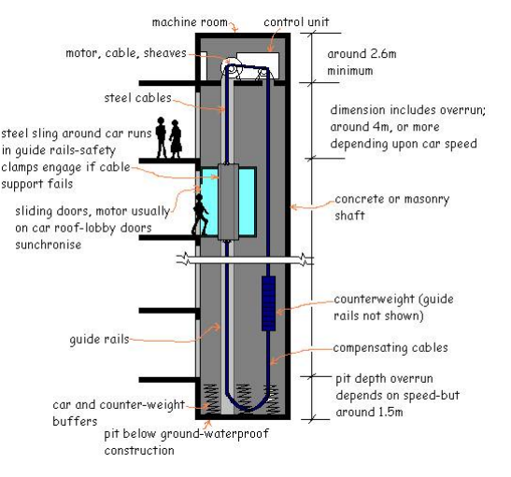
Elevators

