Slide 1
Quiz Bot
Members:
Prathyush Pulla (R11905239)
Talha Jabbar (R11914715)
Aditya Bhargav Polamarasetty (R11900414)
Rahul Goud Pabba (R11900413)
Bharath Bommala (R11901465)
Venkata Nikhil Thanikella (R11904730)
Sree Akhil Akula (R11890463)
Nikhil Kotturi (R11905225)
Group 2

Slide 2
Project Statement
The task is to build a quiz bot based on a network security course using the open-source alternatives to ChatGPT that can be run on a local machine.
The quiz will include multiple-choice questions (MCQs), true/false questions, and open-ended questions, with answers sourced from a network security database.

Slide 3
Proposed Solution: Architecture
LLM used: llama 3.1-8B with ollama
Embedding used: nomic-embed-text:latest
Vector database: chromaDB
Knowledge base: NS lectures (slides) converted to text using PyMuPdf
Simple UI is built to take user i/p and display output.

Slide 4
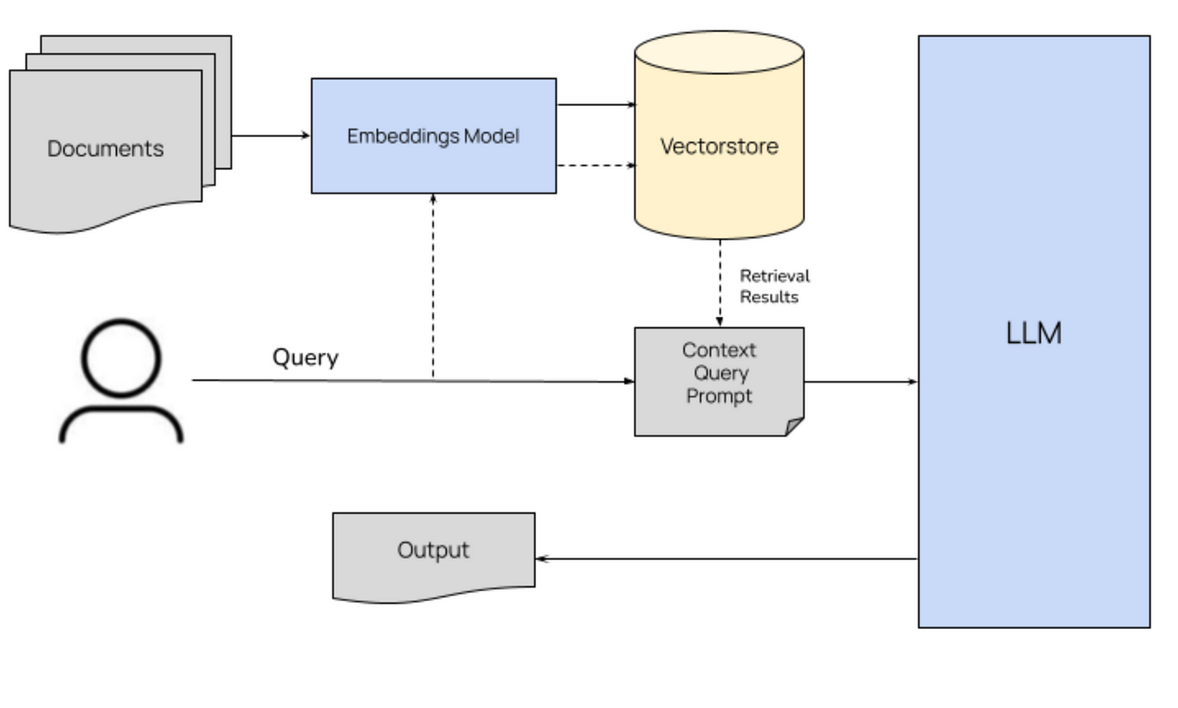
Software Architecture

