Slide 1
Bowl Type Classification (Status Report)
POCs: Tharun, Shubham, Shobhankitha

Slide 2
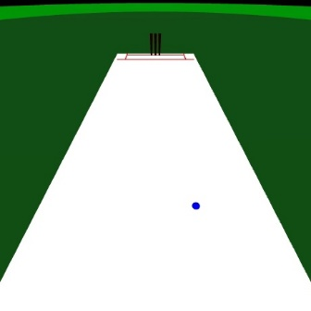
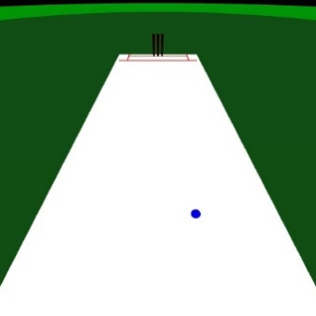

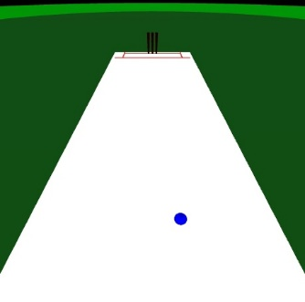
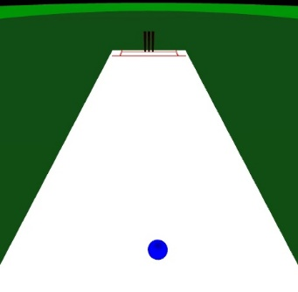
Dataset
Synthetic data of various bowling styles generated from the Cricket game(Webapp)
t
t+1
t+2
t+3
t+4

Slide 3
Tasks
Ball trajectory coordinate extraction from 2D images(CV/Object detection)
Bowl type classification from video inputs( Context retrieval using Conv3d)
Bowl type classification from ball trajectory coordinates(images-CNN/Time-series data-RNN)

Slide 4

Ball trajectory coordinate extraction from 2D images
Input: Video clipping of bowling( from batsman POV)
Output: Trajectory of the bowl in the form 2D coordinates
Status: Completed
CV Color detection / Object Detection

Slide 5
Bowl type classification from video inputs
Input: Video clipping of bowling( from batsman POV)
Output: Bowl type
Accuracy: 98.16%
Status: Completed
Conv-3D Model
Label: Off spin

Slide 6
Bowl type classification from ball trajectory coordinates(Images-CNN)
Input: Ball Trajectory plot
Output: Bowl type
Accuracy: 96.16%
Status: Completed
Convolutional Neural Network
Label: Off spin

Slide 7
Bowl type classification from ball trajectory coordinates(Time Series Data-RNN(LSTM/GRU))
Input: Ball Trajectory coordinates
Output: Bowl type
Status: Model Training
(x1,y1),(x2,y2),(x3,y3)…(xn,yn)
Bidirectional-RNN/LSTM/GRU
Label: Off spin

Slide 8
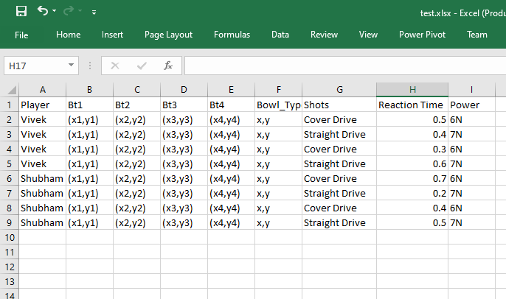
Milestone #1
Bowl Type 1
Bowl Type 3
New Ball
Sequence modelling + Clustering
Bowl Type 2
Data Analytics
Analysis Report
Bowl Type: Leg Spin with ~3 units Swing
75% chance of Straight Drive
80% chance of getting bowled
Ideal shot: Cover Drive ( 3 Players have a success rate of >=75%)

Slide 9
Customer Interaction Point
Playing the cricket game with the HTC Vive
Bowling with predefined parameters and viewing an extended analysis report.
Technology Stack
AI : RNN, CNN, Conv3D, Object Detection
CV : Color Contour detection
Synthetic Data generation

