Slide 1
Cricket Game-POV (Realization Ideas)

Slide 2
Bare-minimum requirements for the POC:
A cricket game where all the internal elements trackable
Hard fixed parameters that could uniquely define a bowl(or bat) type
Eg: for bowling, the ball speed, ball swing could be the parameters
Implementation:
Assuming the aim is to skill twin a batsman,
Make the target player play our game where he has to face 6 distinct balls
Let the 2 parameters available for the player to change be power of the shot and tilt of the bat.
Upon completion of all the 6 attempts by a player, a detailed report can be generated about the batting style of the player.
The average of the Shot-power and mode of the Bat-tilt for 6 attempts if translated to a model,
could behave like a simple skill approximator of the target player.

Slide 3
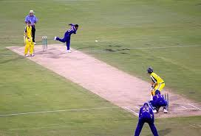
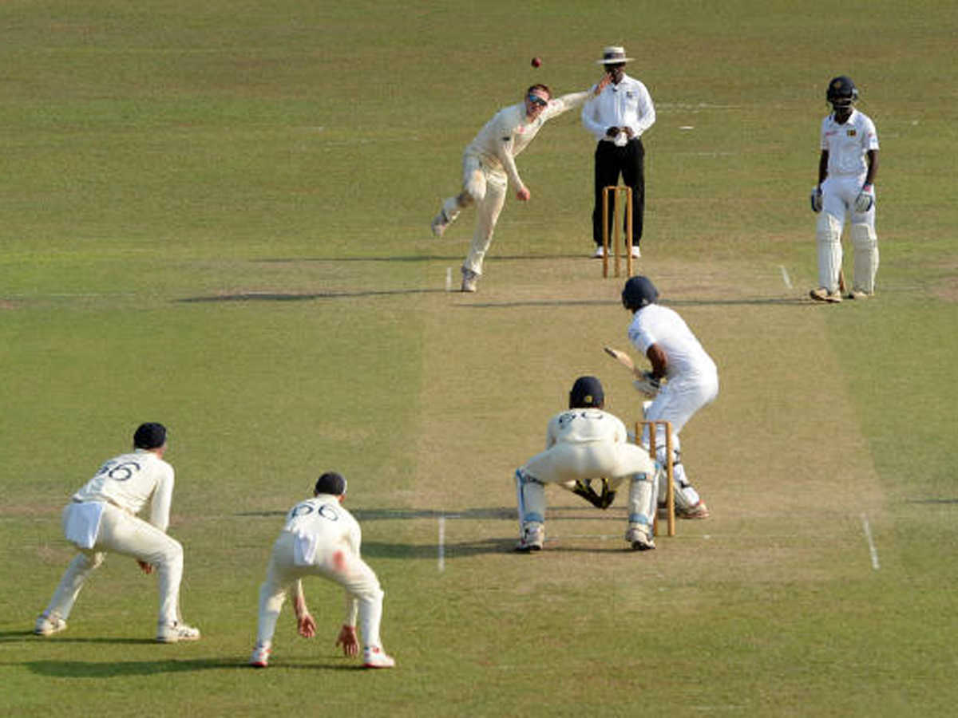
How to define the bowl?
With parameters that can distinctly identify one bowl from the other.
Eg: Bowl type and Trajectory
For the very reason that players garner all the necessary inputs that determines their action decisions from the visual stimuli, all the inputs used to train the batsman model must ideally come from visual inputs.
Input : 2D frames of fixed dimensions captured at the line of sight of the batsman.
Data Modelling: Generate and record subsequent frames from the release to the hit of the ball.
Output: Bowl Type and Ball trajectory coordinates
t + 4
t+ 3
t+2
t+1
t

Slide 4
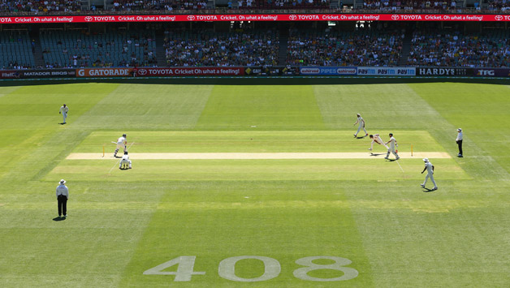
What the batsman(or made to) see(s)?
SIMULATION
ENVIRONMENT
Visual inputs for the batsman model
Ball Trajectory Coordinates
Batsman model
Bowl Type
REAL
GAME

