Slide 1
Cricket Game-POV (Discussion-III)
Date: 02/07/2020
Attendees: Tharun, Shubham, Shobhankitha, Amit, Sreeni M, Srini Marappa

Slide 2
Main Objectives:
Skill Twinning
RL based training simulator(not addressed in this presentation)

Slide 3
Skill Twinning
Primary Task:
Define an ML algorithm that can mimic and learn the targeted skillsets of a person.
Sub Tasks:
Dataset generation for model training.
Bowl type classification

Slide 4
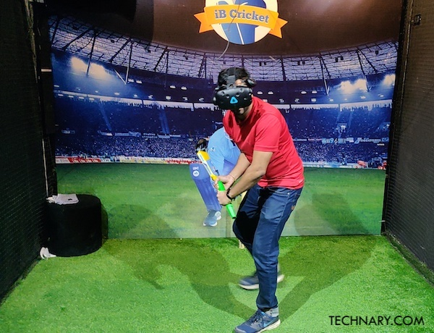
Dataset generation for model training
For Batsman:
VR Game using HTC vive handle
Sensors attached physical bat
For Bowler:
Video analytics
Sensors attached physical ball

Slide 5
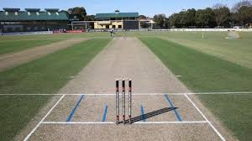
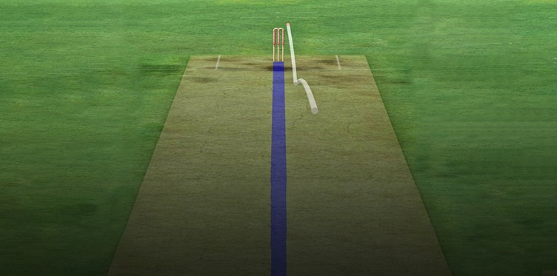
Bowl type classification
VR game
Camera position from Batsman POV.
Setup predefined bowling types with augmentations in bowling parameters.
Ball coordinate tracking and recording for respective frames
(x1,y1,z1)
(x2,y2,z2)
(x3,y3,z3)
Visual frames for bowling dataset

Slide 6
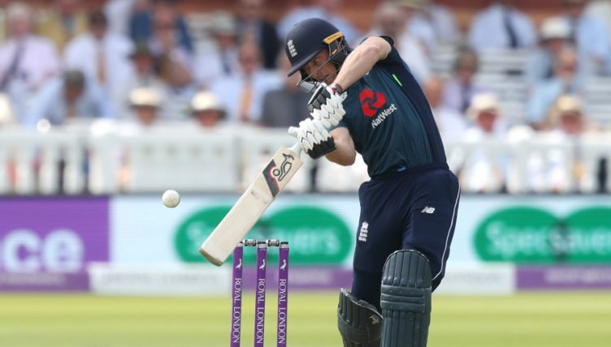
Problems to be addressed:
VR game modifications and possibilities.
Bat-Ball mapping
Batting style for defined bowling style can be predicted but real-time bat placement as per the ball position coordinates is a challenge.
(x_{bat},y_{bat},z_{bat})
Hit Condition:
Approx.(|x_{bat}-x_{ball}|) <= 0.5 units
Approx.(|y_{bat}-y_{ball}|) <= 0.5 units
Approx.(|z_{bat}-z_{ball}|) <= 0.5 units
(x_{ball},y_{ball},z_{ball})

Slide 7
QnA:
Why not from bowler POV?
Ans. Dataset generation is difficult. Video analytics is difficult(Unstable frames from videos). Sensor based physical ball is hard to manufacture.
Why VR game ?
Ans. Easier way to generate dataset as per requirement. Easily translatable datasets. Utilization of TC strength and existing resources.
3. Why visual inputs for training the model?
Ans. Best way to mimic how humans perceive a stimulus in the real world. Batsman sees only the ball in motion before he attempts his strike.

Slide 8
Conclusions:
The batsman model requires two inputs:
Bowl type
Predicted ball trajectory coordinates before the strike
An alternative method for validation to be tried out for bowl type classification.
Bowl type classification to be considered as the (T-1)^{th} step.
Yet to find out a way to calculate the ideal Bat-Ball strike timing.
Agreed
Subjected to further discussion
Hold

