Slide 1
UI SCREEN FLOW

Slide 2
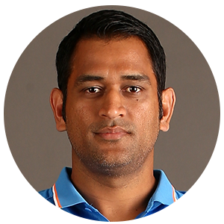

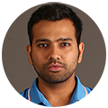

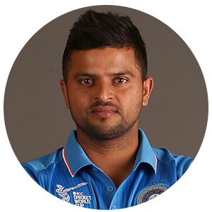

Select your Player
AI Coaching Assistant
Select your Delivery
On hover, a preview of the video should play

Slide 3
Select your Player
AI Coaching Assistant

Slide 4
AI COACH
On hover, a preview of the video should play
Select your Delivery

Slide 5
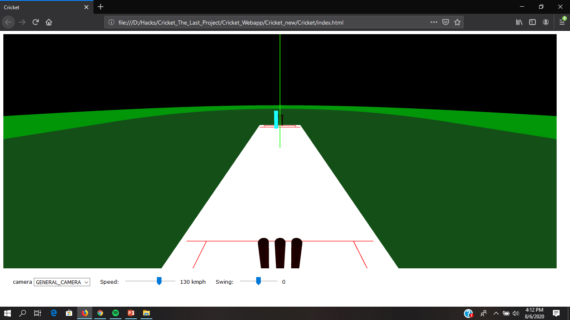
Score:98%
Shot #1
Shot #2
Shot #3

Slide 6
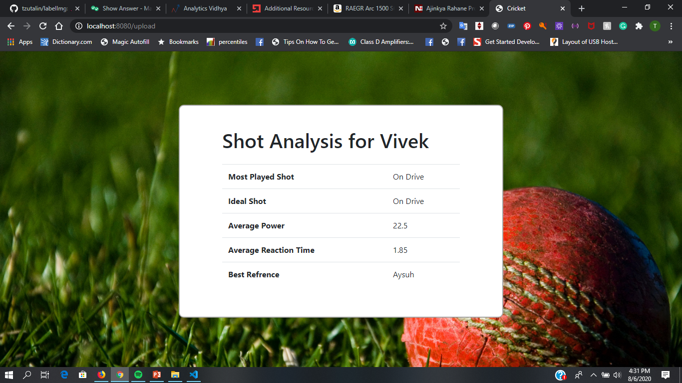
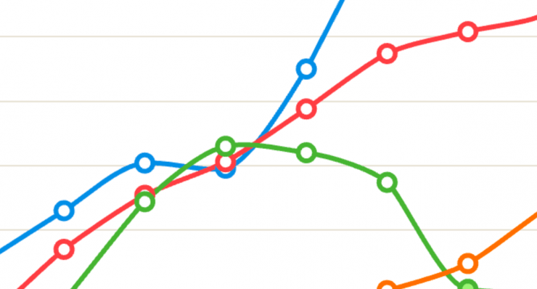

Coach Me

