Slide 1

Travis Hall
Bhadresh Patel
Michael Persons
CS 447/547: Computer Game Design Project 2
Washington State University Vancouver
December 02, 2009

Slide 2
Overall Concept
Arcade style battle Tank action game
Multiplayer mode
Play against human opponents
Join team and destroy the other teams base
Single player mode
Against computer controlled opponents
Death-match style where the goal is to kill all of the enemy tanks

Slide 3
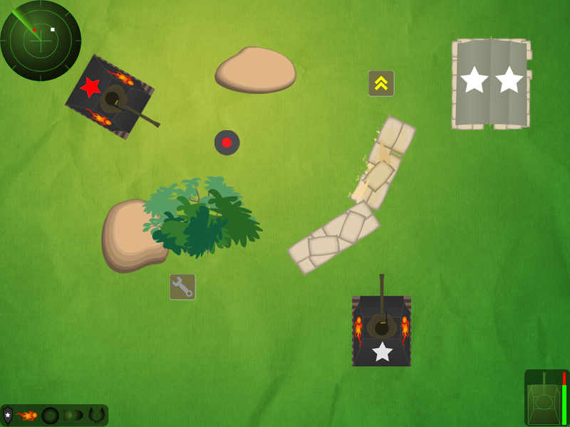
Mockup

Slide 4
What We Started With
HedgeRunner
Multi-direction collision detection using SAT
Screen to screen navigation
Text rendering
Tank Battle
The basic game concept
Techniques: Bullet handling, Tank movement…
Timbre
Scrolling Screen concept
Mouse handling
Github - for source code hosting and collaborative development

Slide 5
What We've Built So Far
A single player game that can be won or lost
Graphics (Logo, Splash, background, sprites…)
GUI Utilities (Button, Toolbar, Textbox…)
Game configuration/setup screens
Map editor (ongoing)
Loading maps (ongoing)
Collision detection between entities
Health, destroyable obstacles, non destroyable obstacles, bullets …
Various types of Tanks, Upgrades (Shields, Cannons, Armor)
Tank movement using keyboard and mouse
Random movement for computer controlled Tank

Slide 6
Technical Issue
Migrating single player into client/server based game which would work for multiplayer as well
Challenge
Identify and separate the messages required so that the game architecture will work for both gameplay
Plan
Capture the relevant inputs (commands) and route them via “dummy” interfaces that loop back into the game until the real server and messaging implementations can be integrated
Iterative “agile" approach where we attempt to keep the game playable at all times while creating the necessary connection points for the final implementations

Slide 7
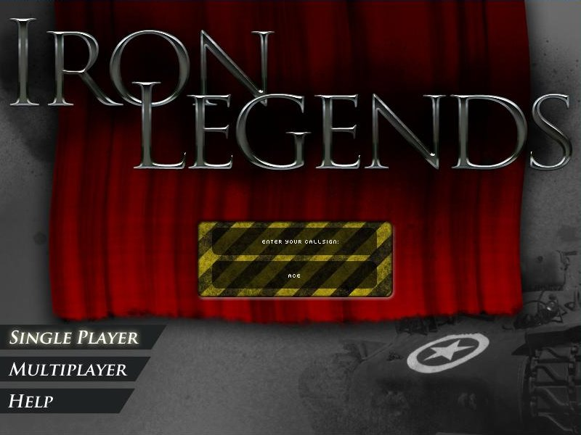
Splash Screen

Slide 8
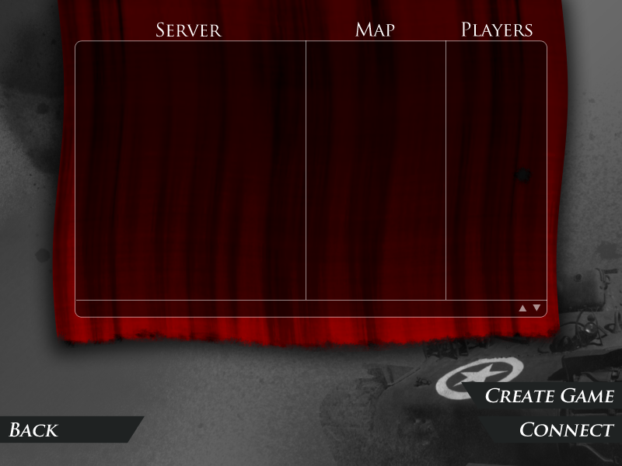
Lobby

Slide 9
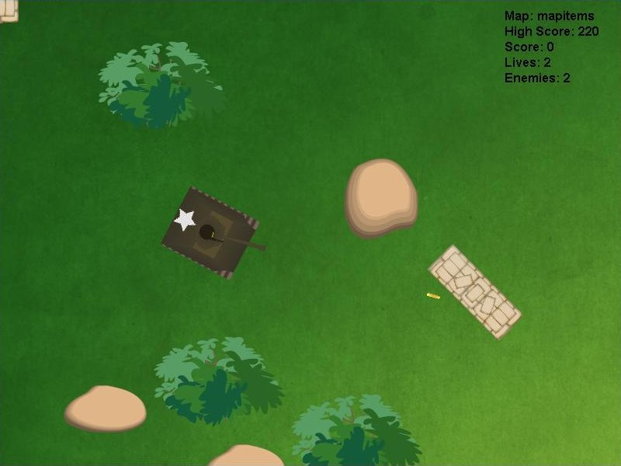
Gameplay

Slide 10
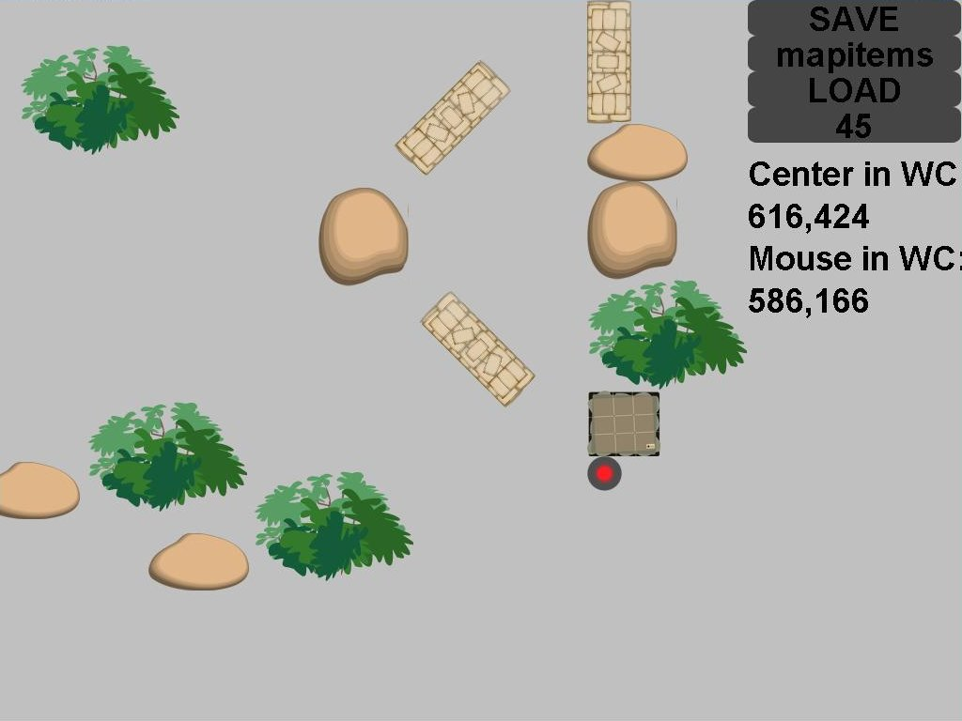
Map Editor

Slide 11
???
Thank You

