Slide 1









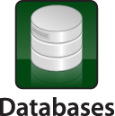

The Only Pioneer Vendor focused on Data Center Security for Applications and Databases!
Web Application Firewall
Database Security
File Security
Tech. Attack
Protection
Usage
Audit
Logic Attack
Protection
User Rights
Management
Fraud
Prevention
Access
Control
External Attacks
Customers
Staff, Partners
Hackers
Internal Attacks
Employees
Malicious Insiders
Compromised Insiders
Vulnerability
Scanning
Data Center
Systems and Admins
Discovery &
Classification
Virtual
Patching
Privileged User
Monitoring

