Slide 1
LENDING CLUB CASE STUDY
Tanikella V S S Pavan Kumar
Hari Haran J

Slide 2
Problem Statement
The client is consumer finance company which specializes in lending various types of loans to urban customers
Approving loans to customers who are likely to default, will lead to financial loss to the company
The company has provided historical data of applicants whose loans were approved and their respective consumer and loan attributes
The aim of this analysis is understand driving factors which indicate whether a person is likely to default, using historical data

Slide 3
Approach
Data Cleaning
Drop constant columns
Impute missing values
Remove irrelevant rows [Ex: loan status = ‘current’]
Ensure proper datatypes
Create Derived Metrics
Credit History, Issue Year etc
Univariate Analysis
Bar plot for categorical variables
Histograms for Numeric variables
Segmented Univariate Analysis
Bi Variate Analysis
Correlation Analysis
100% bar plots against Loan status etc

Slide 4
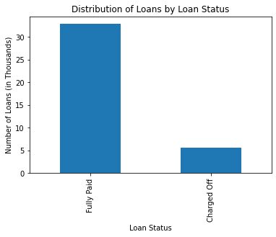
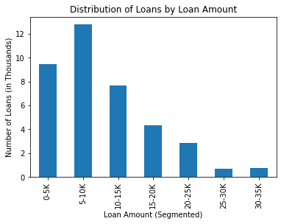
Univariate Analysis 1/3
Nearly 30K (~85%) of the loans are fully paid
Most of the loan are for less than 15K Amount

Slide 5
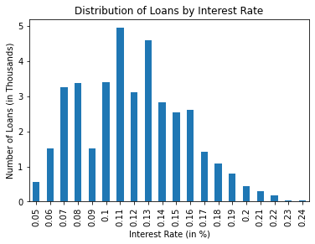
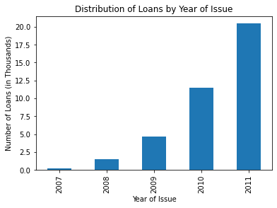
Univariate Analysis 2/3
>50% of loans are approved at rates between 10 and 15 %
>60% of loans are issued in 2011

Slide 6
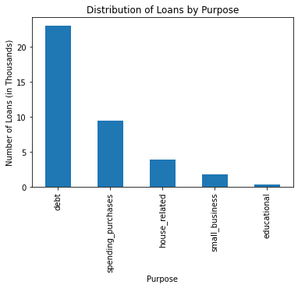
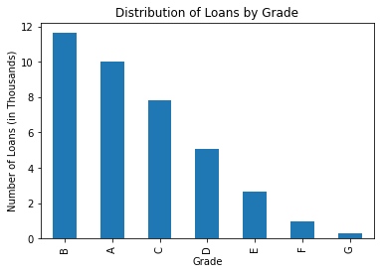
Univariate Analysis 3/3
>50% of loans are for debt consolidated purposes
Most of the loans are issues for Grades A and B

Slide 7
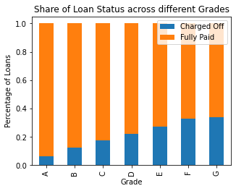
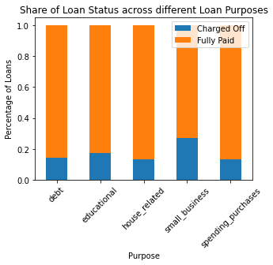
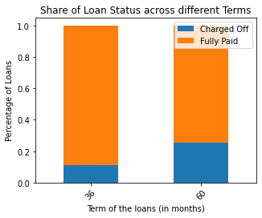
Multi Variate Analysis – 1/4
Loans with low quality grades are more likely to default
Loans for small businesses are more likely to default
Loans for longer terms are more likely to default

Slide 8
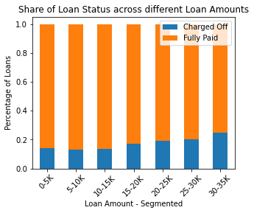
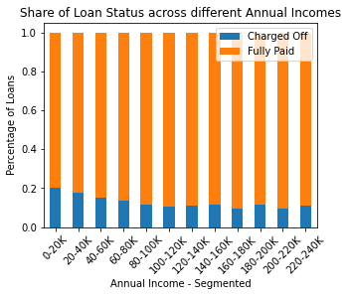
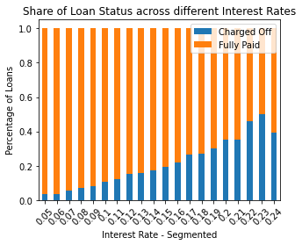
Multi Variate Analysis – 2/4
Loans with higher loan amount or interest rate are more likely to default
Loans wit lower Annual Incomes are more likely to default

Slide 9
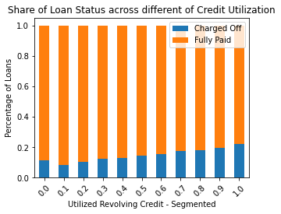
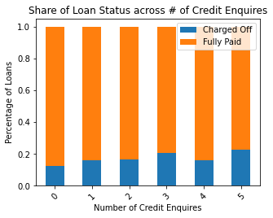
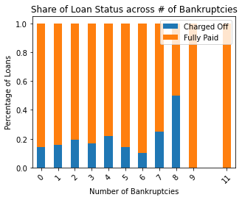
Multi Variate Analysis – 3/4
Loans with higher credit utilisation, credit enquires and number of bankruptcies are at higher risk to default

Slide 10
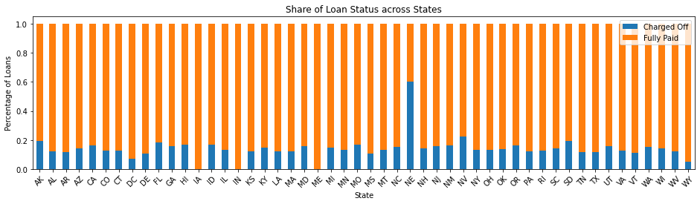
Multi Variate Analysis – 4/4
Neveda in particular, seems to have a very high default rate, this need localised deep drive to understand the local trends

