Slide 1








Slide 2
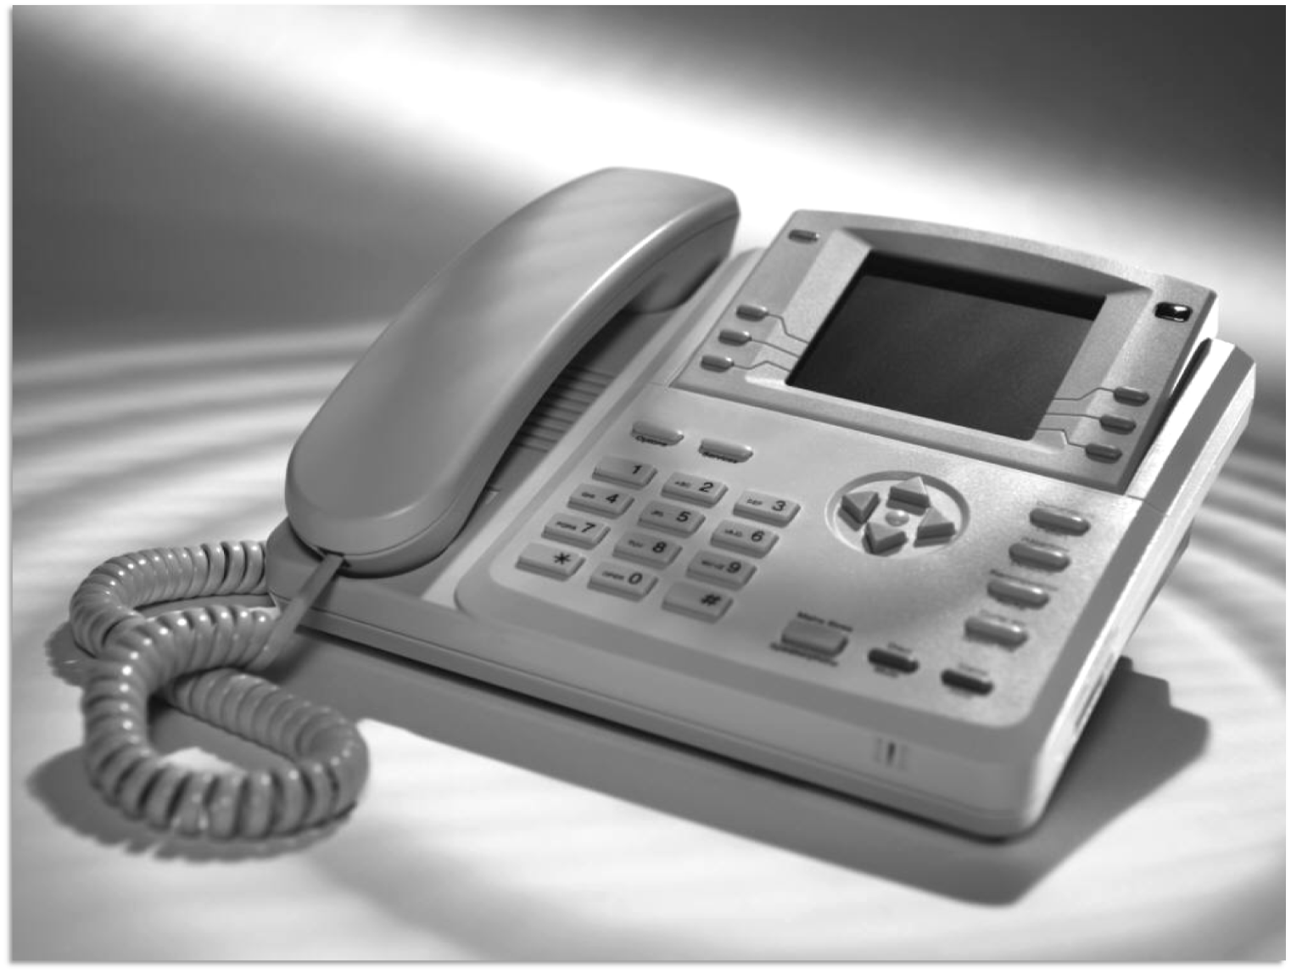


Slide 3

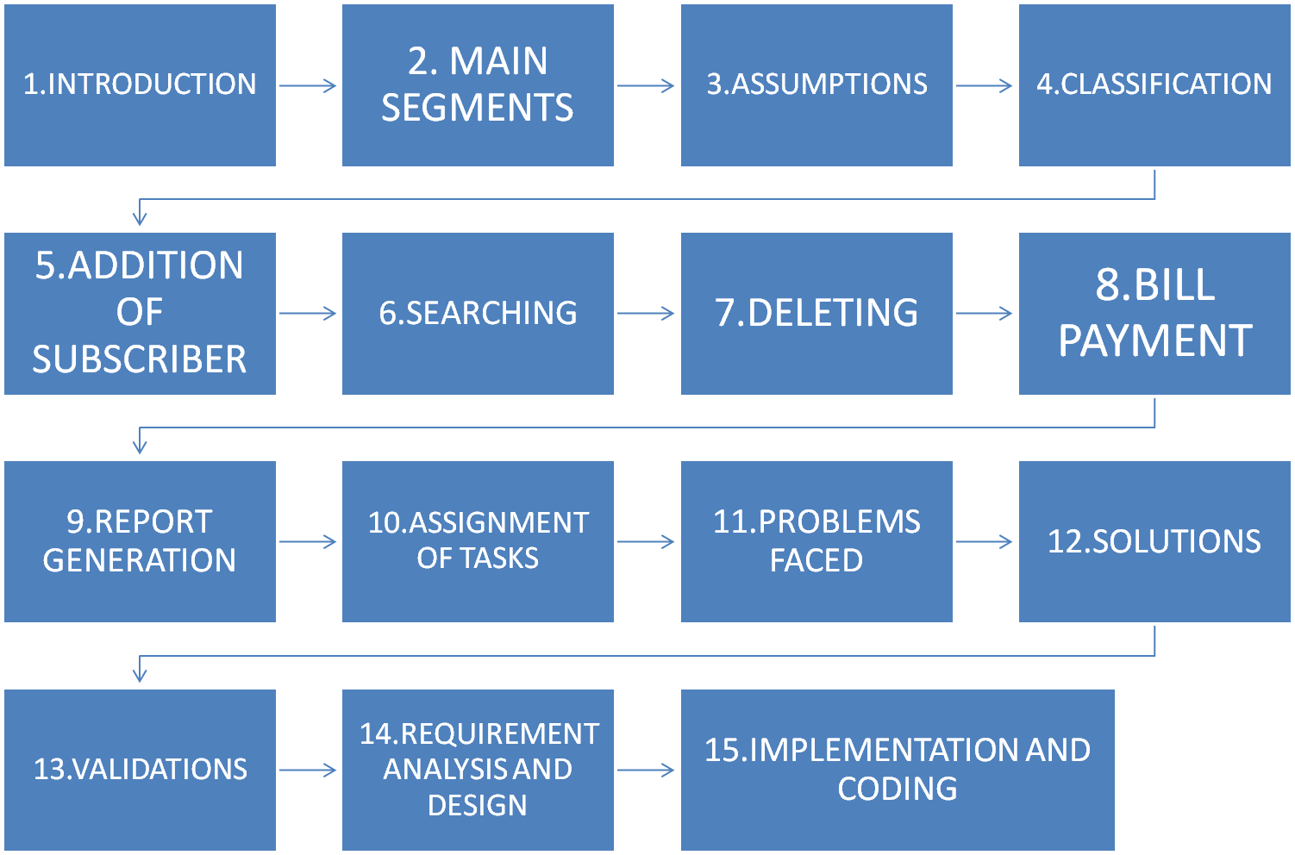

Slide 4



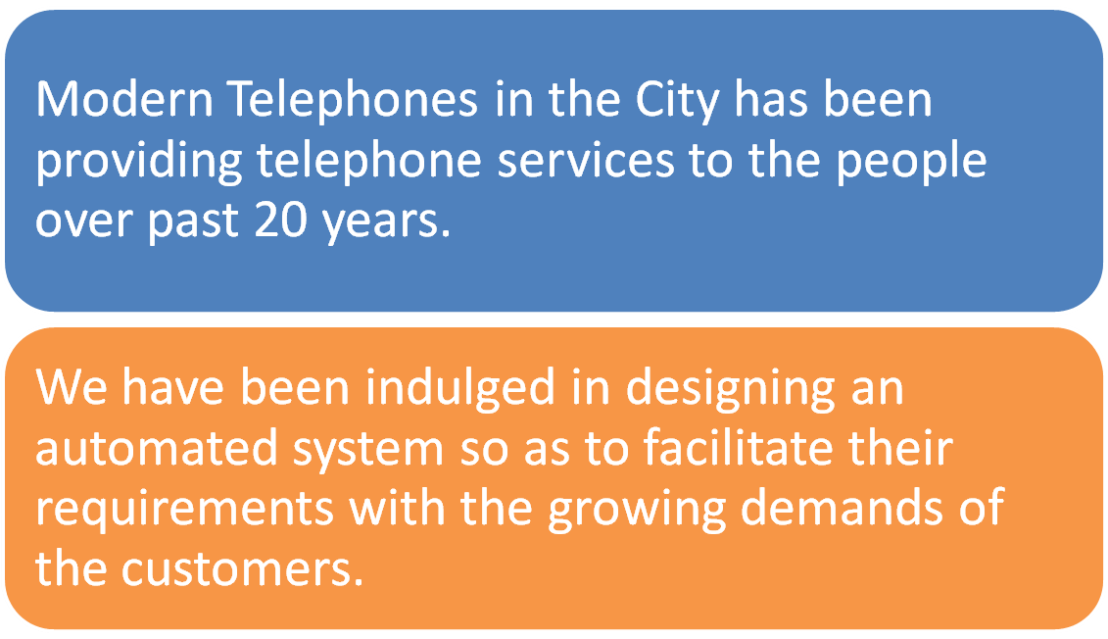


Slide 5

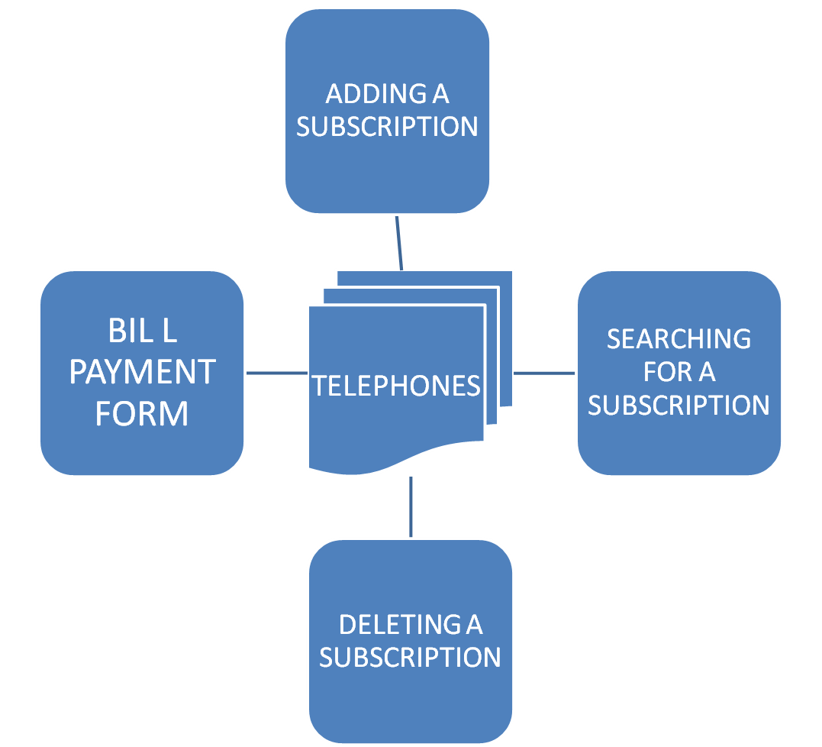


Slide 6

All the variables used throughout are declared as character but for the amount paid.
Login user name is case insensitive.
Login user password is case sensitive.
The field address proof accepts any valid proof given by the subscriber .
The Date Accepts any Year From 1000 to 9999.
Subscription Numbers like 001 and 01 are treated as different from each other.
?

Slide 7

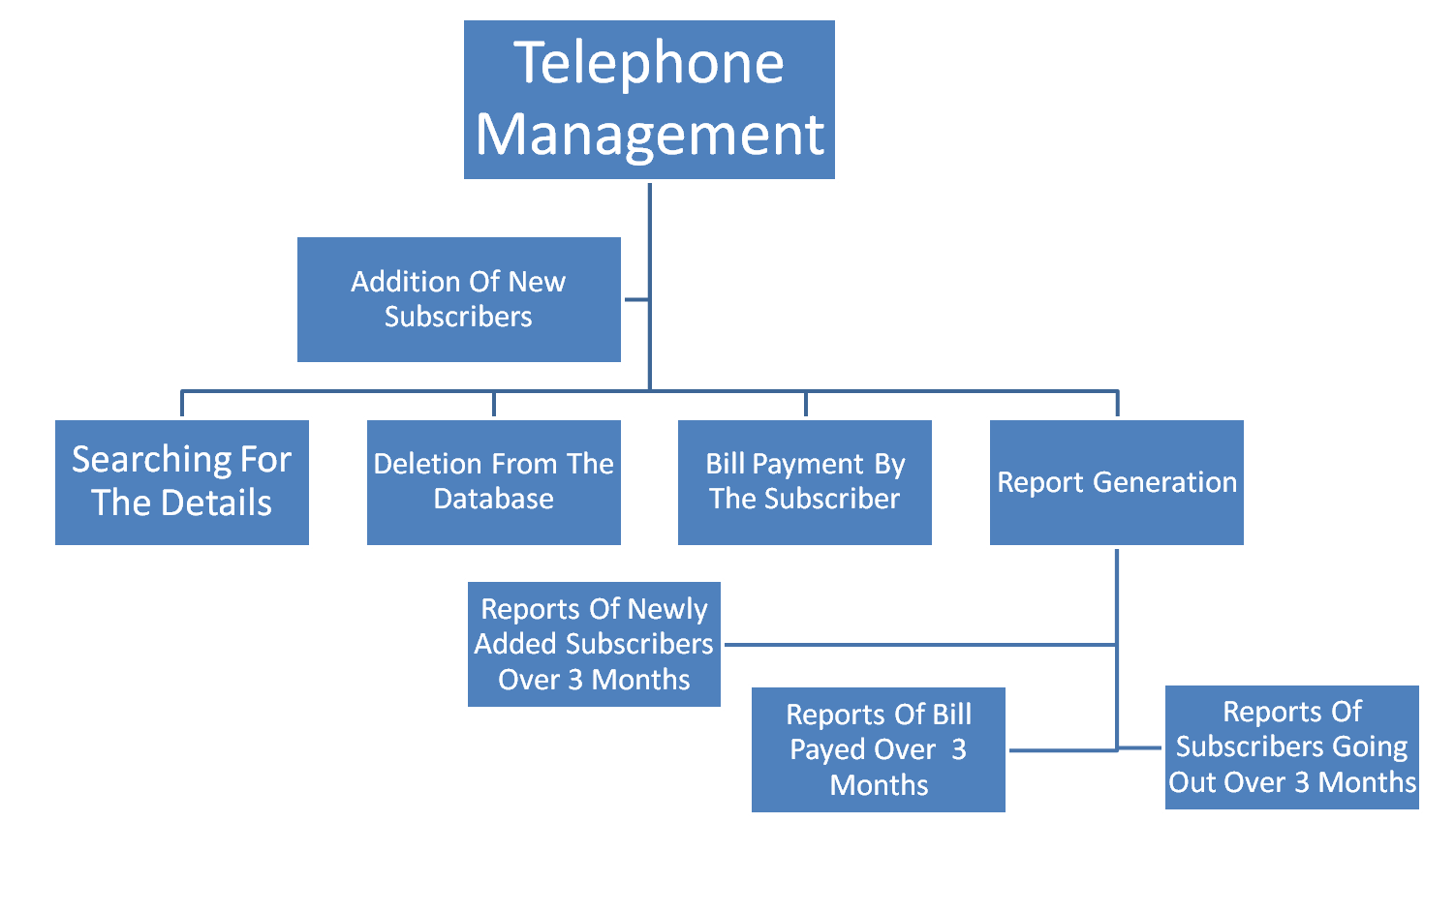

Slide 8





This module consists of addition of new subscriptions.
This module contains an inventory register which accepts the particulars of the subscriber .

Slide 9


This module searches the details of the subscriber and displays the details corresponding to the subscription number entered by the subscriber.

Slide 10



This module deletes the details of an existing Subscriber.
The Telephone Department has an Inventory register in which the entry of the subscriber, who wants to cancel the subscription for telephone service, must be removed.

Slide 11



The entry for the bill payment by the subscriber is made upon the receiving the bill amount from the subscriber.
The entry is made only if the name and subscription number matches with the existing details given by the user

Slide 12


Subscriptions added in the quarter:
Generates report for the quarterly review. This report lists all the new subscriptions added in the specified quarter.
Subscriptions deleted in the quarter:
Generates report for the quarterly review. This report lists all the cancelled subscriptions in the specified quarter.
Transactions made in the quarter:
Generates this report for the quarterly review. This report lists all the bills and the amount paid and total amount paid in the specified quarter.

Slide 13


V.SUNDARAKRISHNAN
Searching of a subscription
R.SHIVANI
Deletion of a subscription
T.V.VIGNESH
ADDITION
ADDITION REPORT
BILL PAYMENT REPORT
V.GAYATHRI
Bill Payment
A.SOWMYA
Deletion Report

Slide 14


PASSWORD
Replacing the characters entered , by ‘*’
MENU (CHOICE)
The system gets hanged when a character is entered.
DATE VALIDATION
Checking the correctness of the Date.
STRING-INTEGER CONVERSION
Converting the accepted string to an Integer.
PINCODE
Checking for a 6-digit Pin Code.
CURRENT DATE
Extracting the current Date from the system.

Slide 15



Usage of shortcuts such as sscanf to split the date into integer variables.
Usage of commands like atoi to convert character to integer.
Use of header files like <time.h> to extract the current system date.
Commands such as getch() was used in an advanced way so as to correct the errors.

Slide 16


DATE
E-MAIL ID
PINCODE
TYPE OF SERVICE
MAIN MENU(CHOICE)
MOBILE NO.
NAME (SUBSCRIBER,STATES,COUNTRIES)
FIELDS MARKED WITH ‘*’ ARE MANDATORY FIELDS.

Slide 17


This Software can be used without any installation..
This Software is free from any of the VIRUSES..
Will Run On Any Windows Platform.
The Software is efficient enough to run on any Processor..

Slide 18


Use of concepts like:
POLYMORPHISM
INHERITANCE
DATA ENCAPSULATION
DATA ABSTRACTION

Slide 19

THANK YOU

