Slide 1
Big Mountain Case Study
Alice Wang

Slide 2
Problem Statement
What opportunities exist for Big Mountain Resort to effectively develop and implement capitalization in their facilities investments to offset their recent additional operating cost by 1.54M this season?

Slide 3
Resort Story
Big Mountain Resort offers spectacular views of Glacier National Park and Flathead National Forest, with access to 105 trails. Every year about 350,000 people ski or snowboard at Big Mountain. The business expressed a desire for some guidance on how to select a better value for their ticket price. by considering number of changes hoping to reduce cost without reducing ticket price or increasing ticket price.

Slide 4
Recommendation & Key Findings
Compared to other resorts in our dataset, Big Mountain Resort is currently undercharging. The modelled price is $95.87, and the actual price is $81.00.
Increasing the vertical drop by adding a run to 150 feet and installing an additional chair lift without additional snow making coverage (scenario 2):
Increases ticket price by $1.99.
Over the season, this could be expected to amount to $3,474,638
Increasing the vertical drop by adding a run to 150 feet and installing an additional chair lift with 2 acres of snow making coverage (scenario 3):
Increases ticket price by $1.99.
Over the season, this could be expected to amount to $3,474,638
Such a small increase in snow making area makes no differences!

Slide 5
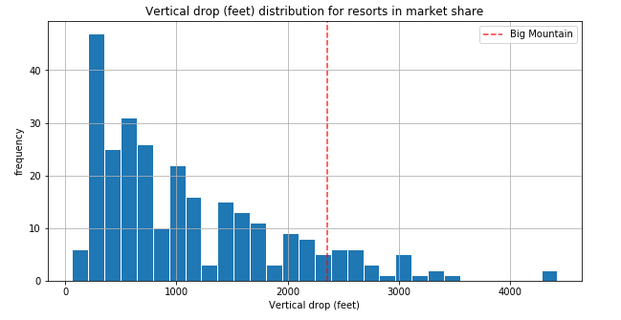
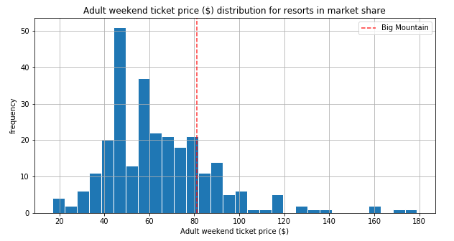
Modeling Analysis
Big Mountain is doing well for vertical drop,
but there are still quite a few resorts with greater drops.
Big Mountain’s Ticket Price vs other Resorts Ticket Price.

Slide 6
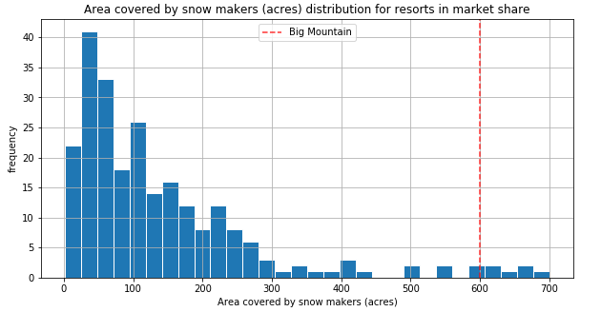
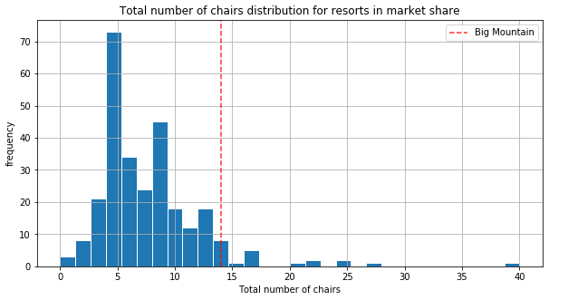
Modeling Analysis
Big Mountain is very high up the
league table of snow making area
Big Mountain has amongst the
highest number of total chairs

Slide 7
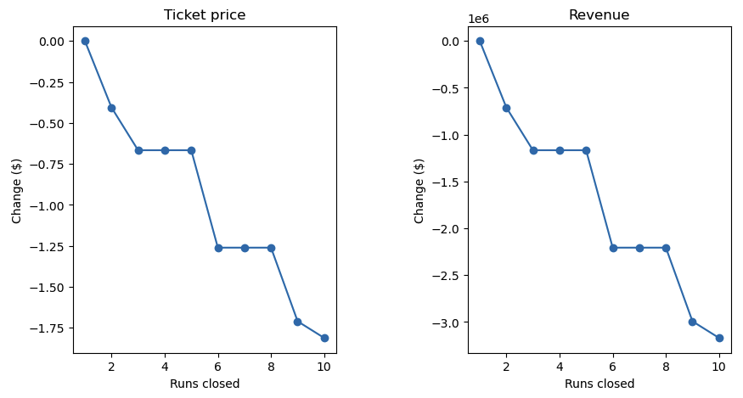
Modeling Scenario Result: Scenario 1: Closing up to 10 Runs
Closing 1 run reduce revenue by $0
Closing 2 runs reduce revenue by ~ $700,000
Closing 3 - 5 runs reduce revenue by ~$1.2M
Closing 6 - 8 runs reduce revenue by ~$2.2M
Closing 9 runs reduce revenue by ~$3M
Closing 10 runs reduce revenue by > $3M
Since we don’t know the operating cost per used run, we can’t determine how much cost saving will be offset the loss in revenue after closing more than one run.

Slide 8
Modeling Scenario Result: Scenario 4: Increasing the longest run by 0.2 mile and adding 4 acres of snow making coverage
This scenario makes no difference
Although the longest run feature was used in the linear model, the random forest model (the one we chose because of its better performance) only has longest run way down in the feature importance list

Slide 9
Conclusion
After Applying our model for ski resort ticket price and leverage it to explore Big Mountain Resort’s potential scenarios for increasing revenue, we can conclude that:
The best scenario where we managed to gain the higher revenue increase possible way was by increasing the vertical drop by adding a run to 150 feet, adding an additional chair lift without additional snow making coverage. This will increase the ticket price by $1.99, thus increase the revenue by ~$3.5M resulting in a bottom-line increase by $2M (after deducting operating costs $1.5M)
Due to lack of data in regards of operating cost per used run and weekdays ticket price, our model cannot recommend closing down used runs.

