Slide 1
Ames House Price Prediction
Data Science Project – Advanced Regression
Alice Wang
Feb 2023 More details in my github

Slide 2
Problem Statement
How much are the residential homes in Ames, Iowa given all aspects/attributes of the properties?

Slide 3
Goal
To build regression models to leverage attributes of properties to predict sales price
To provide useful house price prediction for setting data-driven budgets for buyers
Insightful tool for setting more reasonable prices when selling properties

Slide 4
Dataset
Ames House Dataset with 79 attributes and sales prices of 1,460 properties.
Features examples:
Exterior features: exterior material quality, foundation type, masonry veneer type
Interior features: heat condition, central air conditioning, kitchen quality
Location feature: zoning classification, slope of property, physical location within city limits

Slide 5
Data Wrangling
Major Steps
Check for duplicates: There are 0 duplicates for this dataset
Impute missing values
Transform numerical features to categorical when they are true categorical
Encode some categorical features as ordered numbers when there is information in the order

Slide 6
Exploratory Data Analysis

Slide 7
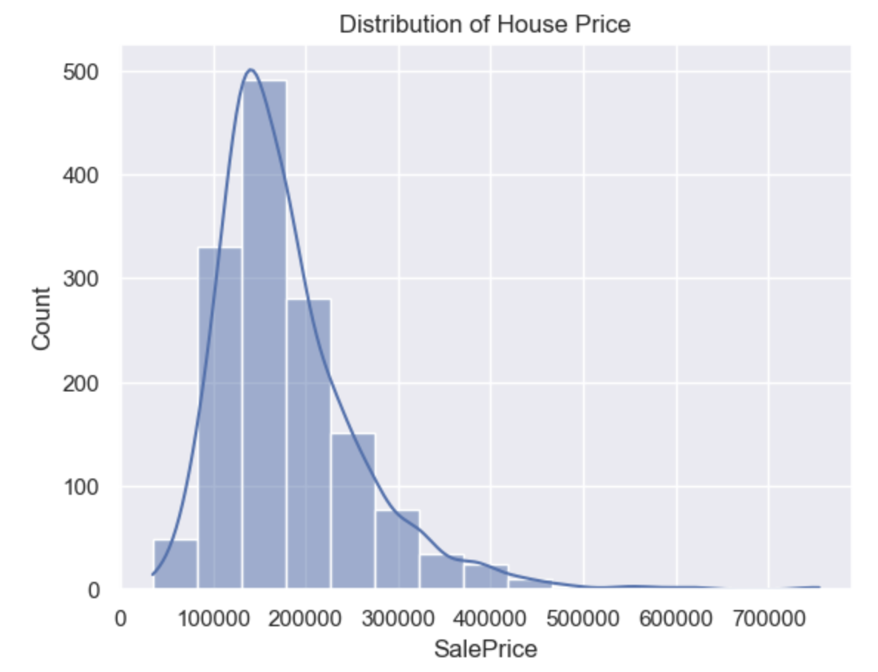
Price of Properties
Average house sale price is around $ 180,000 in Ames.
There are a few properties over $500,000. But majority of houses are priced under $214,000.

Slide 8
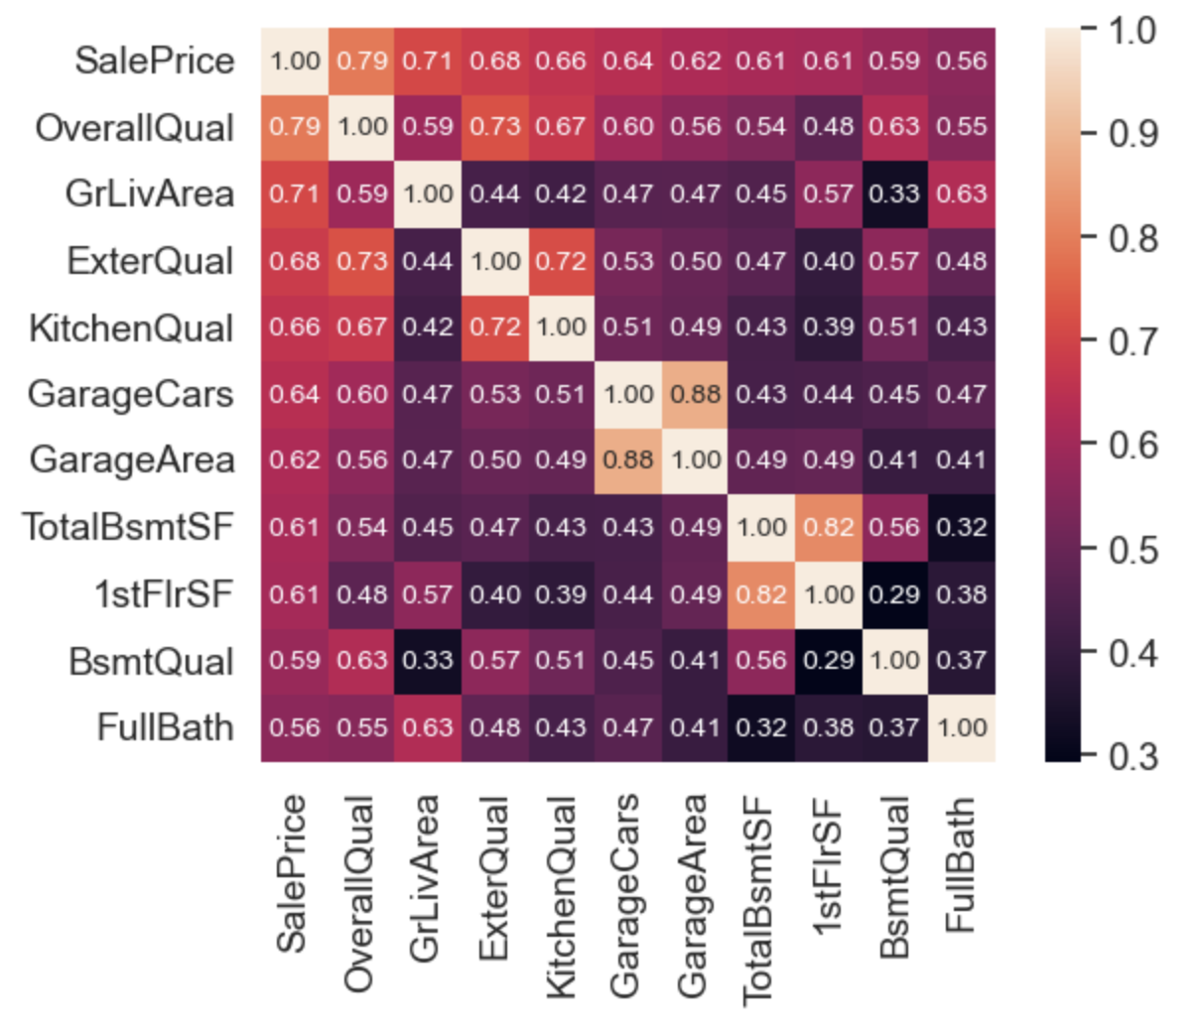
Numeric Attributes Most Correlated with Sale Price
Top Significant Categorical Attributes Discovered via heatmap

Slide 9
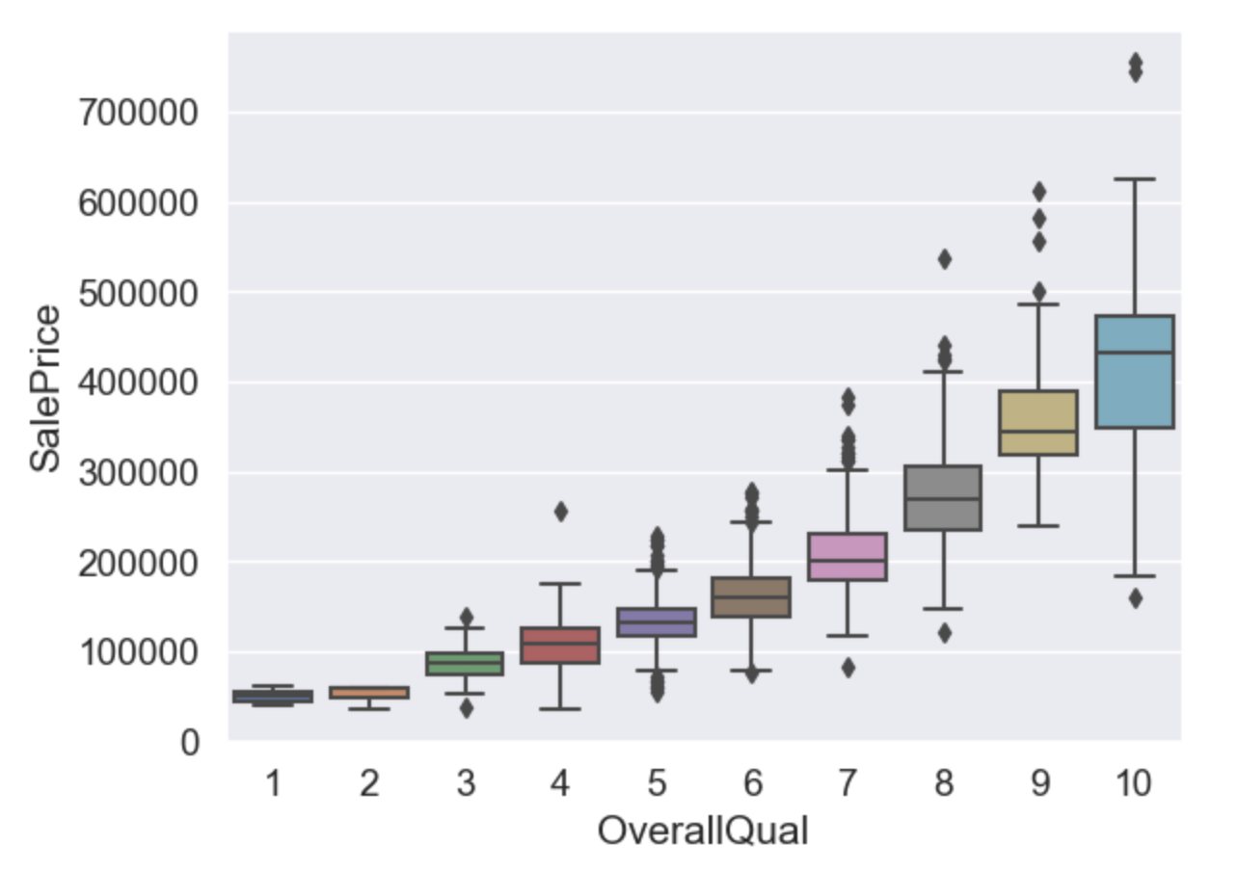
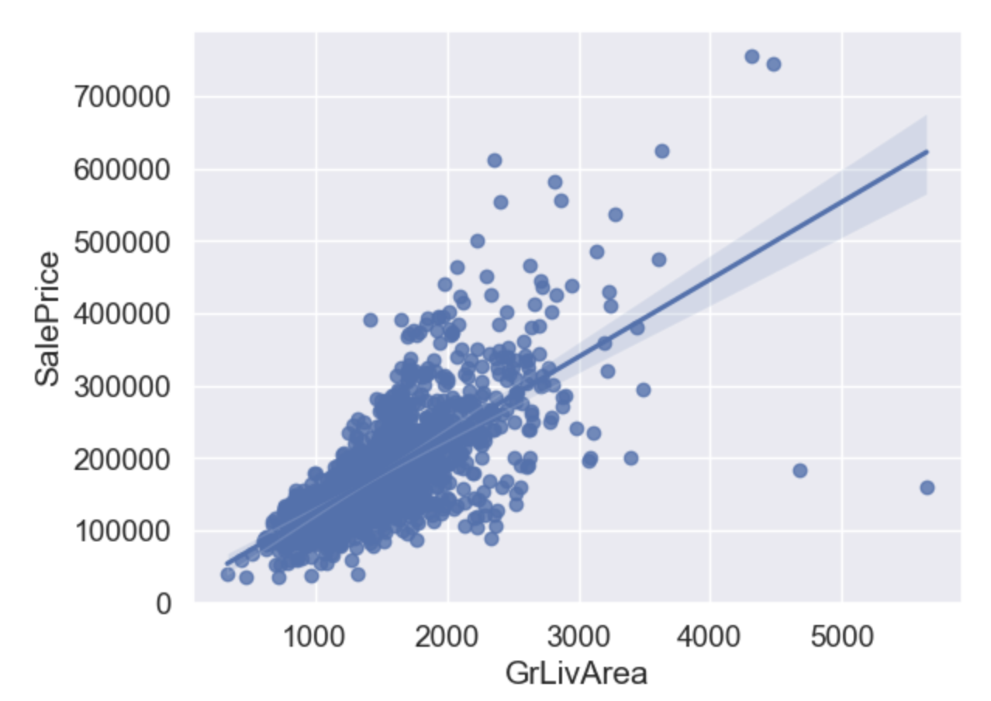
Attributes Most Correlated with Sale Price
Top Significant Categorical Attributes via Correlation Analysis (R Squared & Scatter Plot) :
Overall Quality: The higher the quality score, the higher the sale price
GrLivArea: Above ground living Area in Square Feet

Slide 10
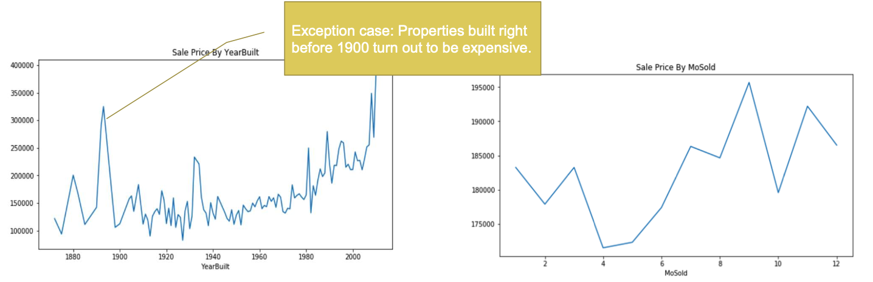
Time vs Sale Price
In general, the more recent the property was built or remodeled, the more expensive it would be.
The properties sold during second half of the years were more expensive on average than properties sold in the beginning of the years.

Slide 11
Feature Engineering & Modeling

Slide 12
Feature Engineering
Feature Engineering Major Steps:
Encode some categorical features as ordered numbers when there is information
Create new features
Log transform of the skewed numerical features to lessen impact of outliers
Transformation of categorical features vis one-hot encoding
Split into testing and training datasets
Standardize the magnitude of numeric features using a scaler
Model Optimization:
Randomized Search & Grid Search for Hyperparameter Tuning

Slide 13
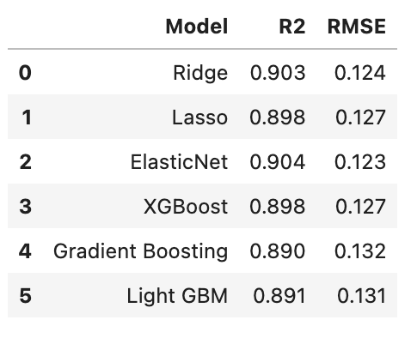
Modeling
Modeling Major Steps:
Lasso
ElasticNet
XGBoost
Gradient Boosting Regression
Light GBM
Stacking Model with ElasticNet as the metamodel
Model Validation Metric:
RMSE
R Squared

Slide 14
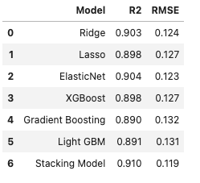
Model Accuracy Improvement
Pick the most accurate base model: ElasticNet has the lowest RMSE and the best R2 score
Stack all the base models by taking the average of the predictions from the base models: Stacked model predictions are more accurate than any single base model.

Slide 15
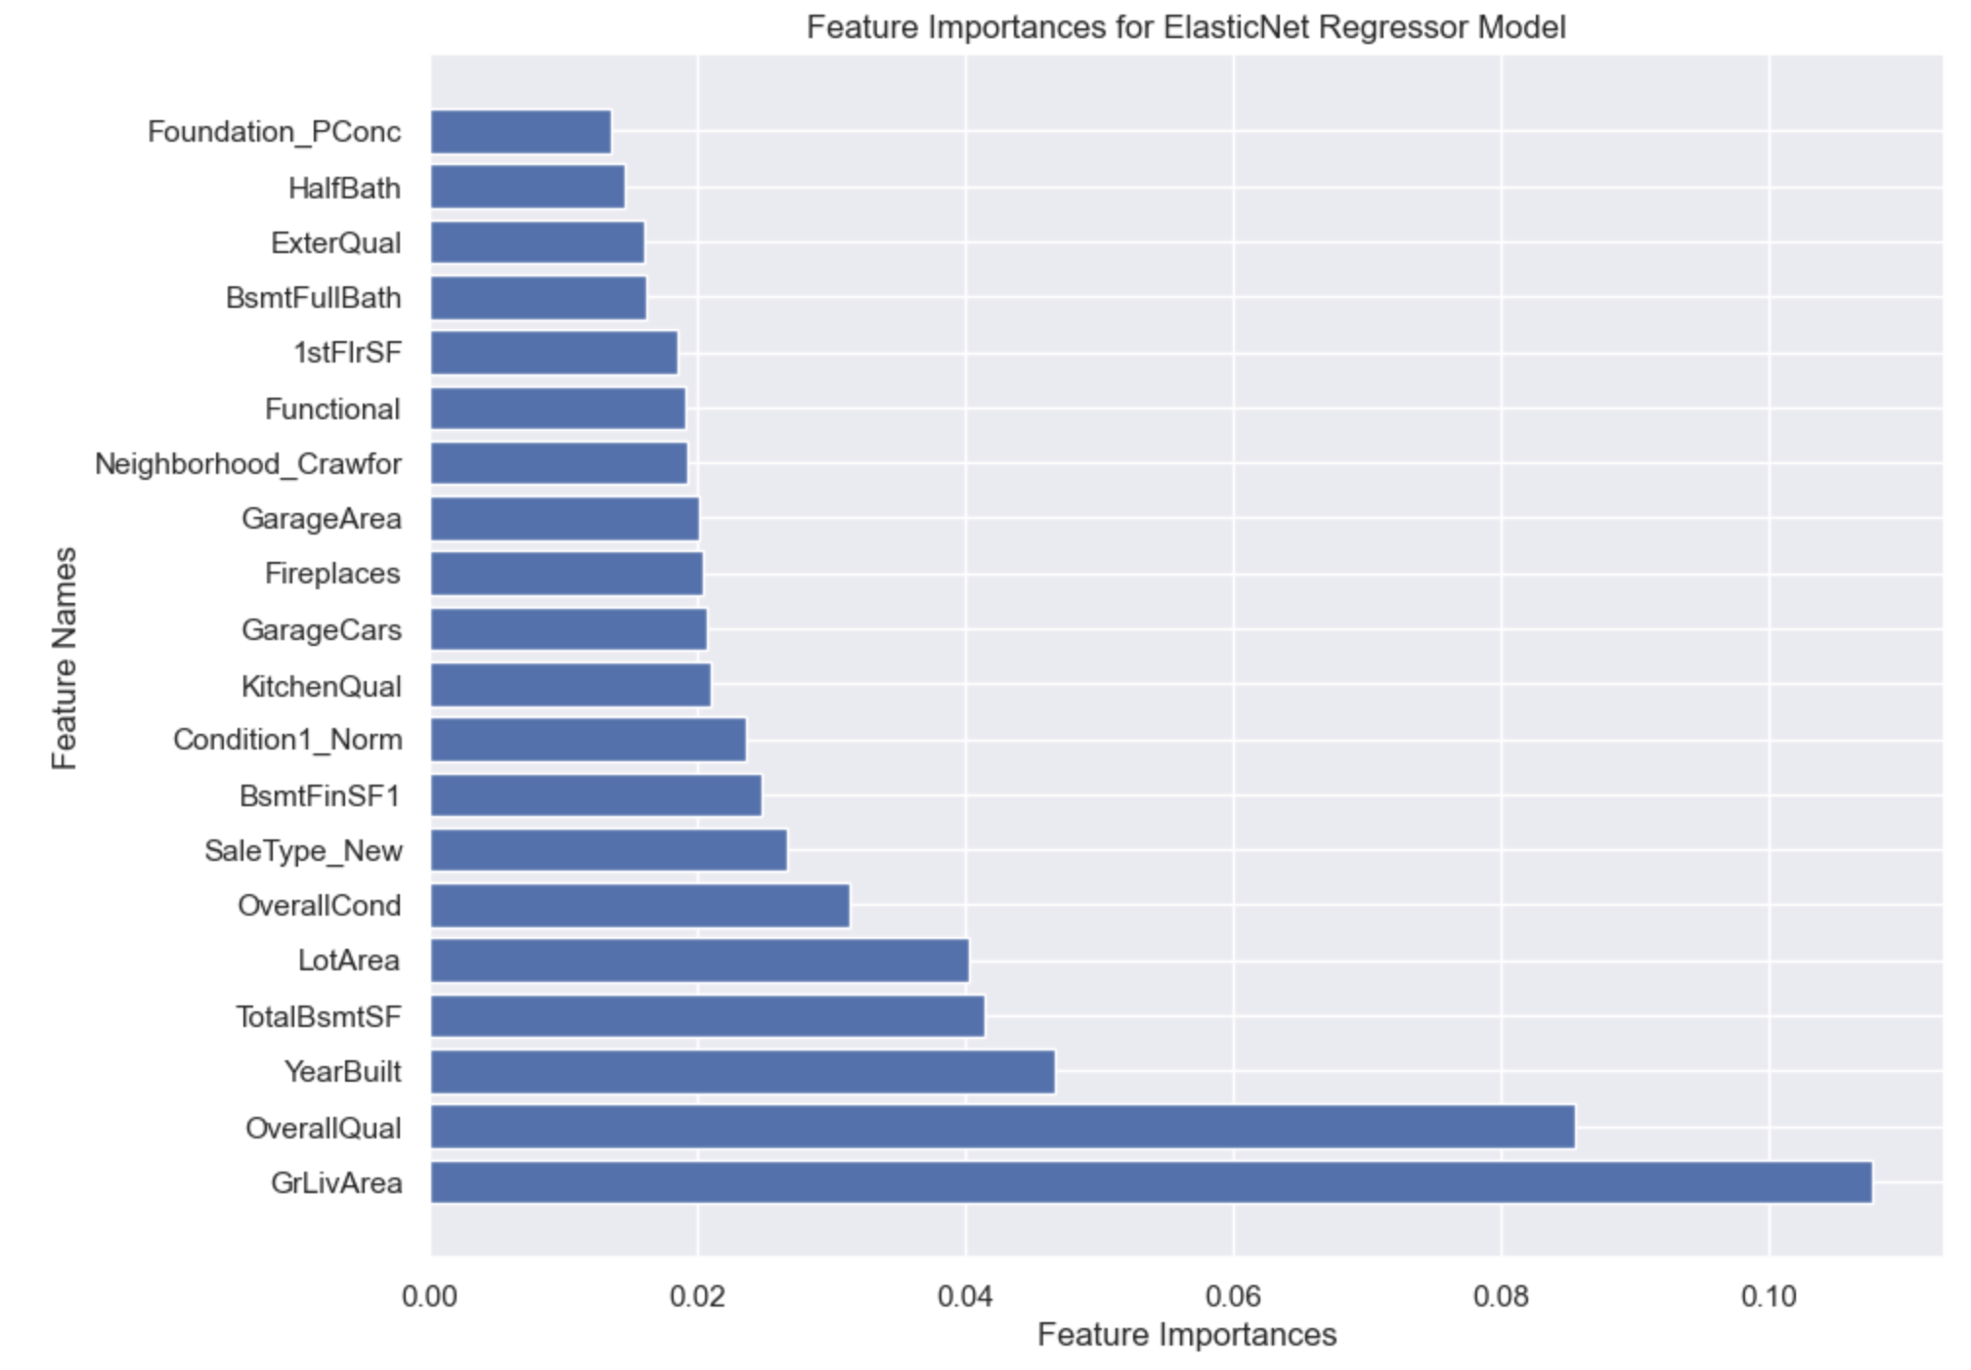
Top 20 Features by ElasticNet
Most of the features are closely related to the area
(in square feet)

Slide 16
Future Scope / Next Step
Test new hyperparameters
Test different modeling methods to predict the sale price even more accurately

Slide 17
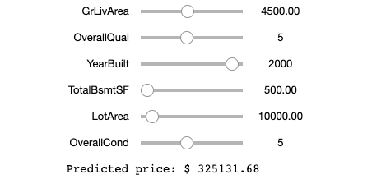
Prediction Tool
Use important features (input) to predict sale price (output)
House Price Prediction Tool created by IPyWidget
Input values for features on the left
Output prediction price

Slide 18
THANK YOU

