Slide 1
Final Project
Quick & Draw

Slide 2
Quick, Draw
https://quickdraw.withgoogle.com/
AI can draw doodle
Classification
Generation
Dataset
contains 50M drawings encompassing 340 label categories

Slide 3
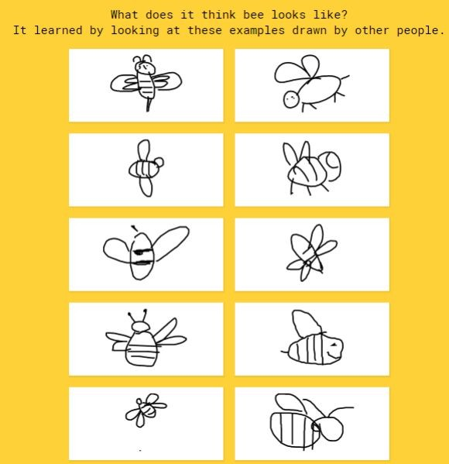
You need to do
Train a doodle AI
Basic
Classiﬁer (Guess)
Given a doodle draw, classify what the image it is

Slide 4
Database
TAs provide simpliﬁed dataset
30 label categories
Avoid some problems during training models
Link
https://github.com/tw40210/AI_course

Slide 5
Evaluation
40% Classiﬁer
500 Questions
30% Presentation
Presentation 1/16
30% Report

Slide 6
Classiﬁer
Input
csv
Another 500 unlabeled test data “exam.csv” to test accuracy
Output
csv
An output data with one predict label in the same order of the testing.csv.
Report.

Slide 7
Report
Methodology
Classiﬁer
How to train your model
Parameter Setting
Optimizer
Evaluation
etc
Demo Result
Discussion
Conclusion
Less than 2 pages to summarize your project

Slide 8
Presentation
1/16
Each team should make a presentation less than 5 minutes to present your work and there will be a brief QA after it.
Make sure your content include
Methodology
Evaluation
Discussion
Conclusion

Slide 9
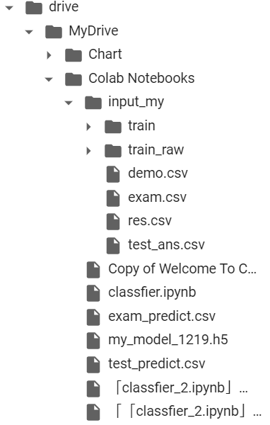
Data Path
GoogleDrive根目錄
放Code的資料夾
訓練集資料夾
訓練集資料夾 & Code
務必放在同一資料夾內
Code

Slide 10
Update
Each team should update a zip file(teamXX.zip) with
Exam_answer.csv
Report.pdf
Code.ipynb
to the following Google drive link before 1/15
Link:
https://drive.google.com/drive/folders/1FUTkr2j3w9mc_fK31MCanEVWB_xXjKyc?usp=sharing

