Slide 1
Final Project
Quick & Draw

Slide 2
Quick, Draw
https://quickdraw.withgoogle.com/
AI can draw doodle
Classification
Generation
Dataset
contains 50M drawings encompassing 340 label categories

Slide 3
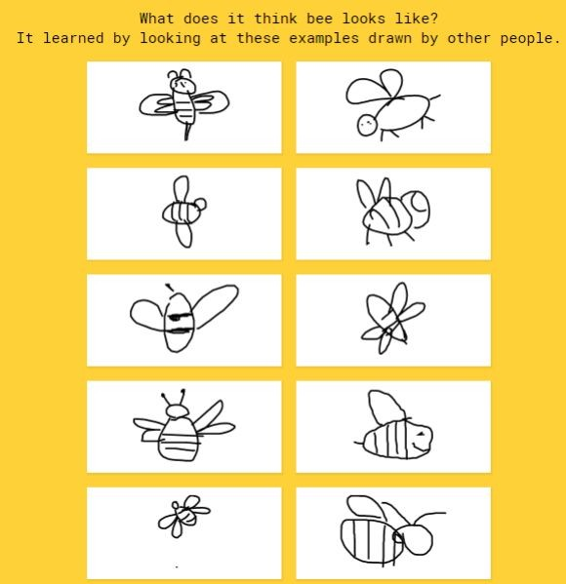
You need to do
Train a doodle AI
Basic
Classiﬁer (Guess)
Given a doodle draw, classify what the image it is

Slide 4
Database
TAs provide simpliﬁed dataset
30 label categories
Avoid some problems during training models
Link
https://github.com/tw40210/AI_course

Slide 5
Evaluation
40% Classiﬁer
500 Questions
30% Presentation
Presentation 1/16
30% Report

Slide 6
Classiﬁer
Input
csv
Another 500 unlabeled test data “exam.csv” to test accuracy
Output
csv
An output data with one predict label in the same order of the testing.csv.
Report.
You are also encouraged to implement data argumentation by your generating data.

Slide 7
Report
Methodology
Classiﬁer
How to train your model
Parameter Setting
Optimizer
Evaluation
etc
Demo Result
Discussion
Conclusion
Less than 2 pages to summarize your project

Slide 8
Presentation
1/16
Each team should make a presentation less than 5 minutes to present your work and there will be a brief QA after it.
Make sure your content include
Methodology
Evaluation
Discussion
Conclusion

Slide 9
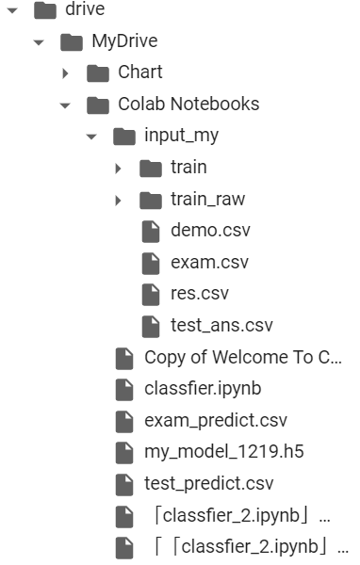
Data Path
GoogleDrive根目錄
放Code的資料夾
訓練集資料夾
訓練集資料夾 & Code
務必放在同一資料夾內
Code

Slide 10
Update
Each team should update a zip file(teamXX.zip) with
Exam_answer.csv
Report.pdf
Code.ipynb
to the following Google drive link before 1/15
Link:
https://drive.google.com/drive/folders/1FUTkr2j3w9mc_fK31MCanEVWB_xXjKyc?usp=sharing

