Slide 1
C++ PROGRAMMING
BEST PRACTICES
GOOGLE TEST

Slide 2

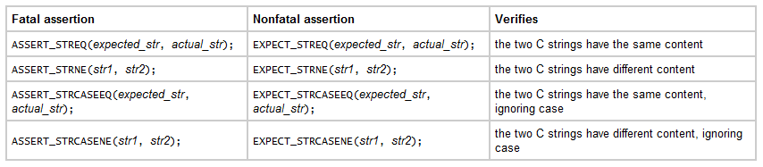
Cheat Sheet
  Basic Assertions
  String Comparison

Slide 3
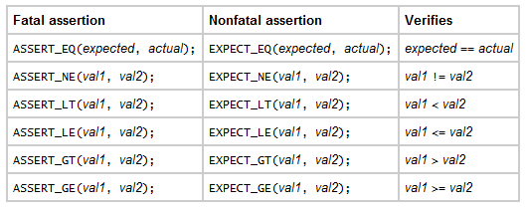
Cheat Sheet
  Binary Assertions

