Slide 1
Sprint 2025
DENV serotype imputation
09/07/2025

Slide 2
Sprint challenge
Three possible approaches that will yield a fast result:
Port Bayesian Hierarchical NC Influenza model w/o immunity linking, seeding linking, climate, etc. (compartmental)
Pros: Tried and true (code on hand)
Cons: Probably won’t perform well w/o extensions (requires TLC), code-heavy (clunky), redundant effort (Rita)
Build a Bayesian statistical timeseries model (SAR(p) + CAR per serotype)
Pros: Mathematically, computationally & coding-wise undemanding, novel, can leverage our newly found serotyped timeseries
Cons: Not likely to outperform a well thought out hybrid model; cannot truly incorporate immunity
Build a suite of “baseline” models for the challenge
Pros: Low hanging fruit, methodologically import to the challenge, easy to implement
Cons: Requires more communication to justify why would submit such models to the challenge
Examples: Constant mean baseline, Weekly mean baseline, Sinusoidal fit, seasonal AR model. → Kalman filter to ensemble

Slide 3
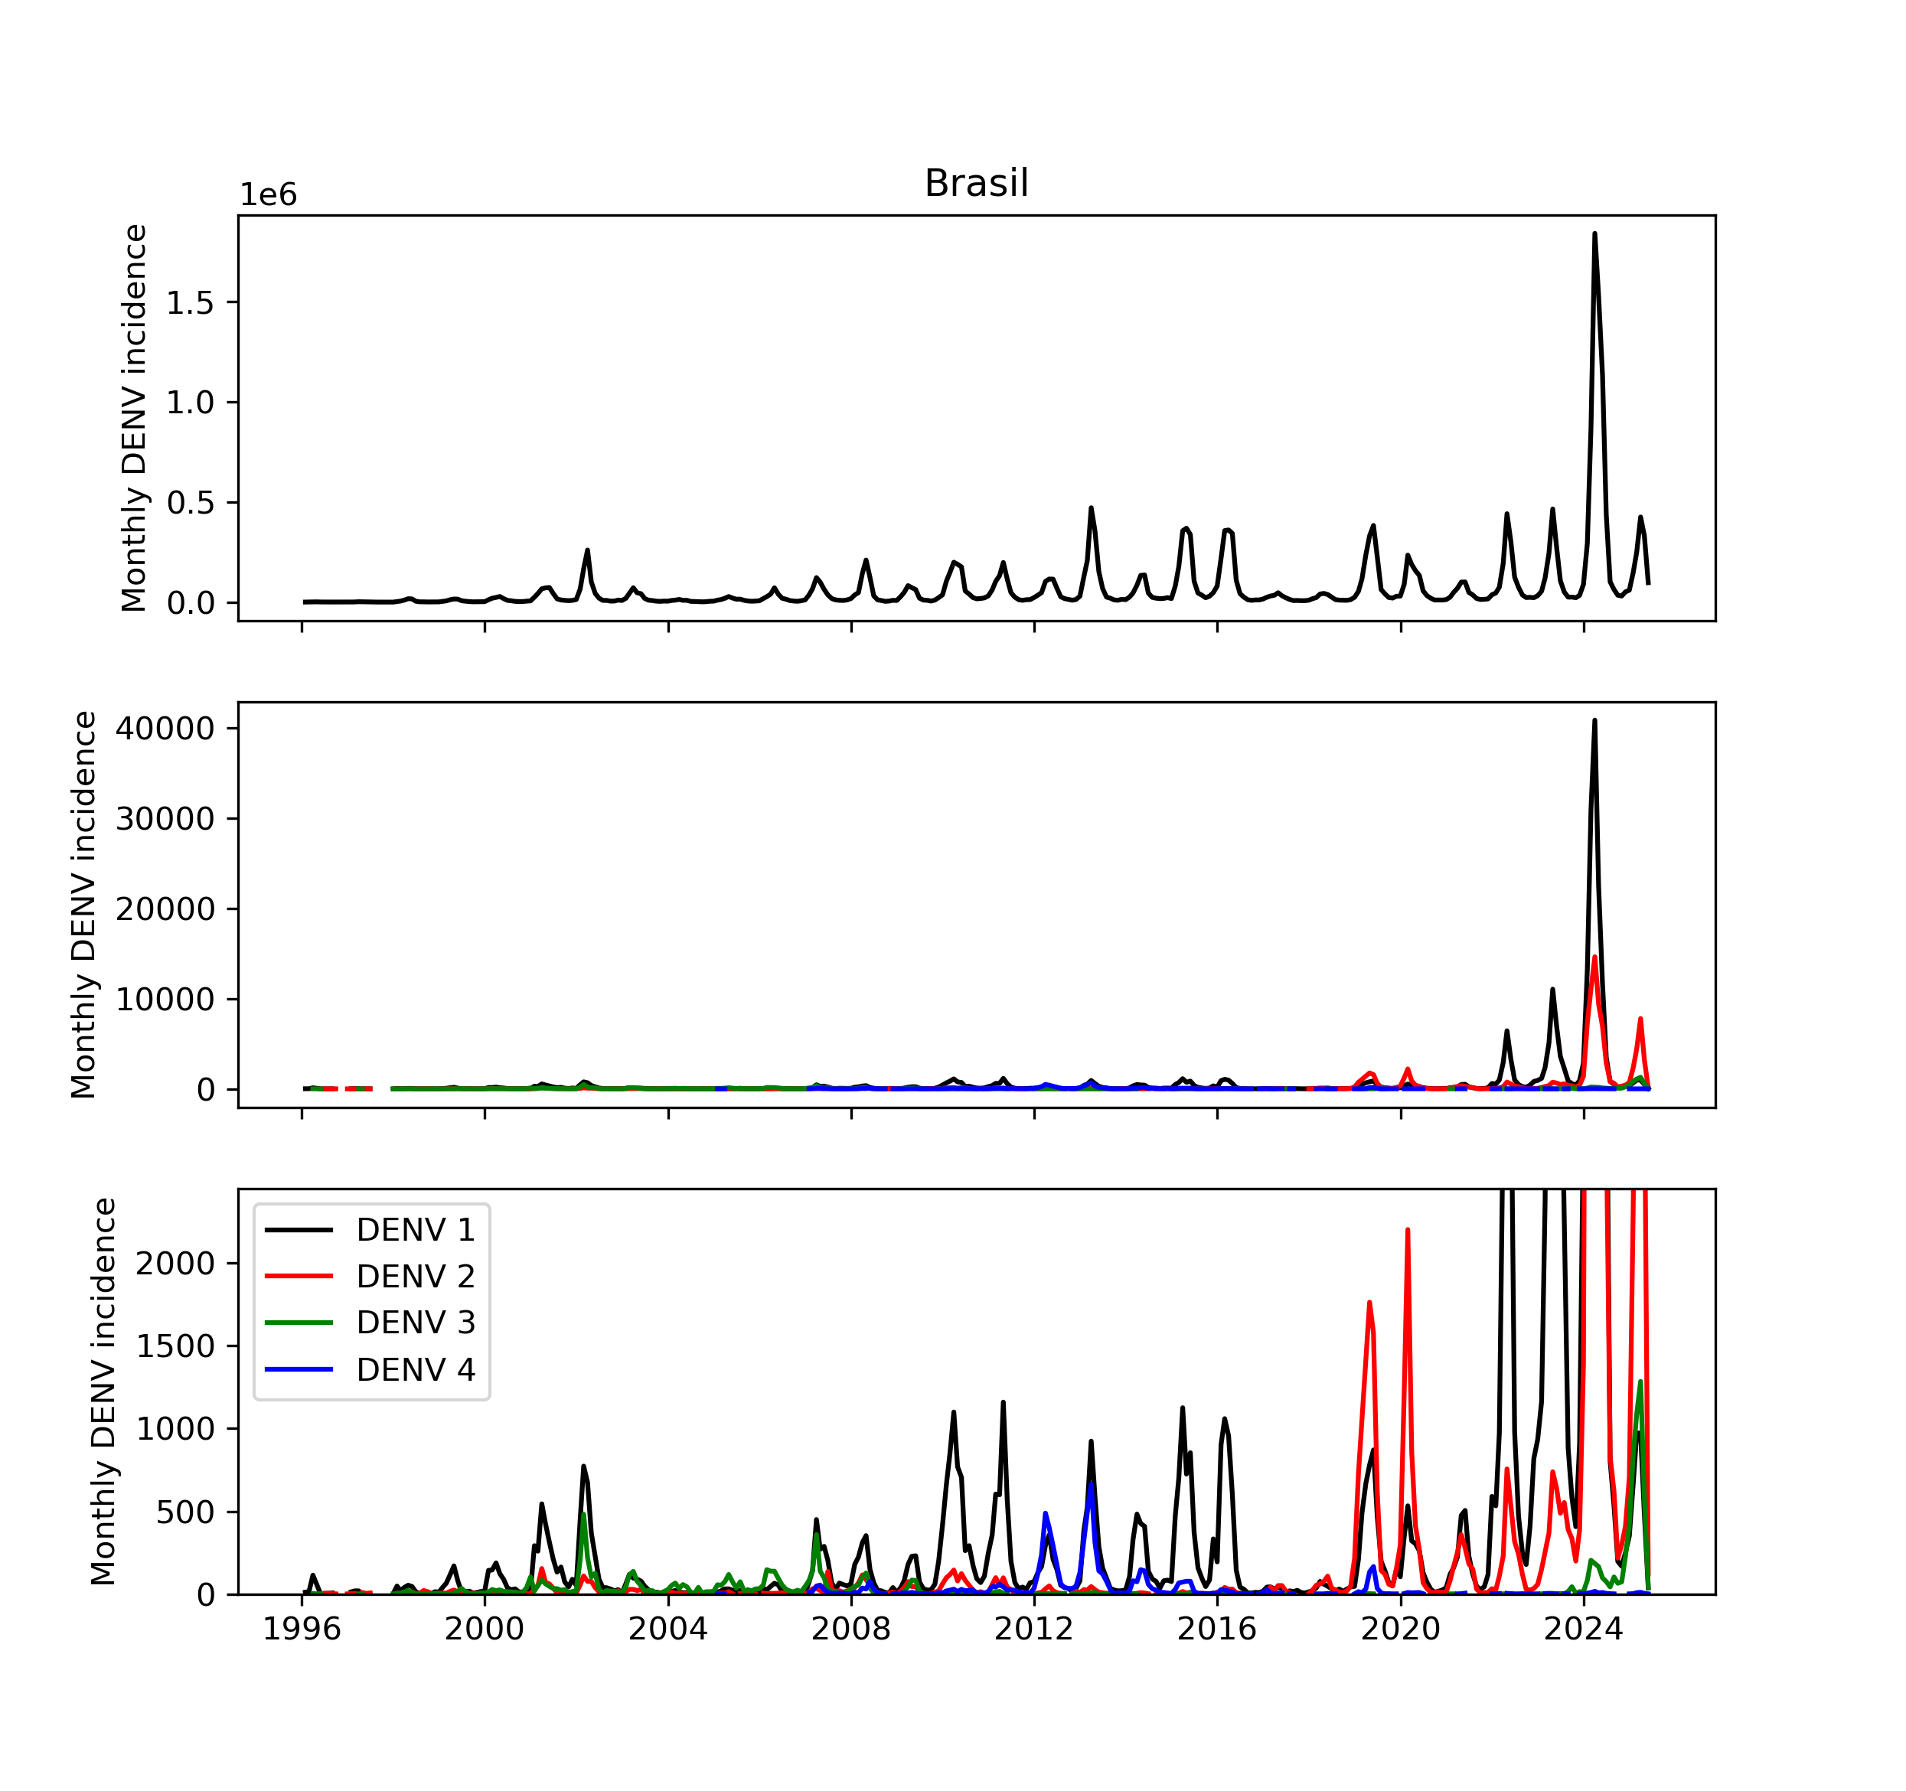

Linelist data from DATASUS
Excerpt from formatted dataset:
UF | date | DENV_1 | DENV_2 | DENV_3 | DENV_4 | DENV_total
AC | 2000-12-31 |  |  |  |  | 419.0
AC | 2001-01-31 | 2.0 |  |  |  | 1299.0
AC | 2001-02-28 | 12.0 |  | 2.0 |  | 355.0
AC | 2001-03-31 | 12.0 |  |  |  | 144.0
AC | 2001-04-30 | 2.0 |  |  |  | 76.0
AC | 2001-05-31 | 1.0 |  |  |  | 27.0
AC | 2001-06-30 | 1.0 |  |  |  | 44.0
AC | 2001-07-31 |  |  |  |  | 8.0
AC | 2001-08-31 |  |  |  |  | 9.0
AC | 2001-09-30 |  |  |  |  | 9.0
AC | 2001-10-31 | 1.0 |  |  |  | 14.0
AC | 2001-12-31 |  |  |  |  | 56.0
AC | 2002-01-31 |  |  |  |  | 58.0
AC | 2002-02-28 | 1.0 |  |  |  | 136.0
AC | 2002-03-31 |  |  |  |  | 322.0
AC | 2002-04-30 |  |  |  |  | 77.0
AC | 2002-05-31 |  |  |  |  | 35.0
Formatted to monthly serotyped DENV 1-4 incidence per Brazilian state (27) + total DENV cases
`DENV_total`: reliable and complete
`DENV_1-4`: sparse – reliable ~ state
DENV_total
DENV_1-4
DENV 1 cases
DENV 2 cases
DENV 3 cases
DENV 4 cases
Total serotyped DENV cases
$$≪$$
Total DENV cases

Slide 4
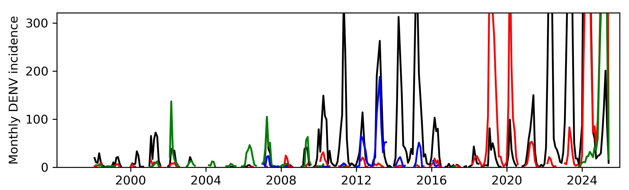
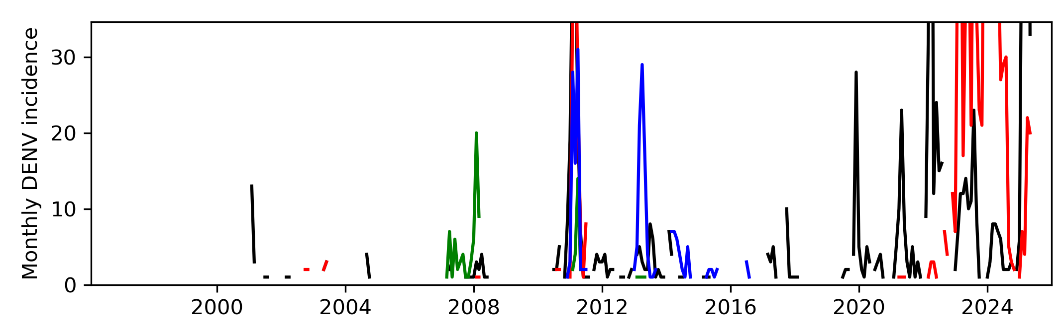
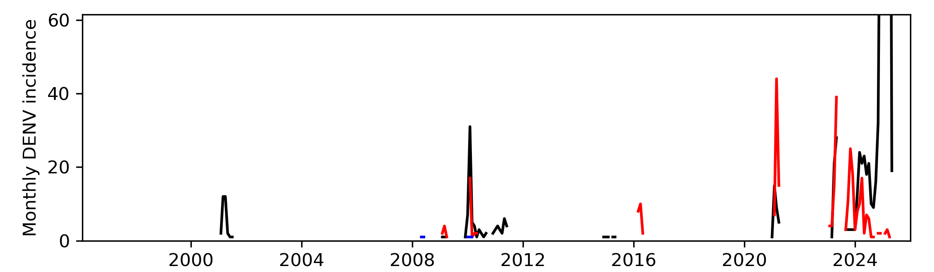
Linelist data from DATASUS
High # serotyped cases + low temporal sparseness
SP
AM
Low # serotyped cases + great temporal sparseness
AC

Slide 5
Linelist data from DATASUS
Agreement between DENV_total and serotyped DENV cases is hazy
Macro trend: Peaks and throughs overlap, if there’s a lot of DENV then cases get serotyped
Micro trend:
Pre-2020: little correlation between peak height of DENV_total and the serotyped cases indicating collection was ad-hoc
Overall serotyping capacity (fraction of column DENV_total captured in DENV1-4) increased over the years
Autocorrelograms suggest long memory AR(p) process in subtyping ratios
DENV_total
DENV_1-4

Slide 6
Linelist data from DATASUS
Did I use the estimated serotype proportions to make these?
HQ data suggest AR(12)-AR(18) process at play
DENV 1
DENV 2
DENV 3
DENV 4
High # serotyped cases + low temporal sparseness
SP
AM
Low # serotyped cases + great temporal sparseness
AC

Slide 7
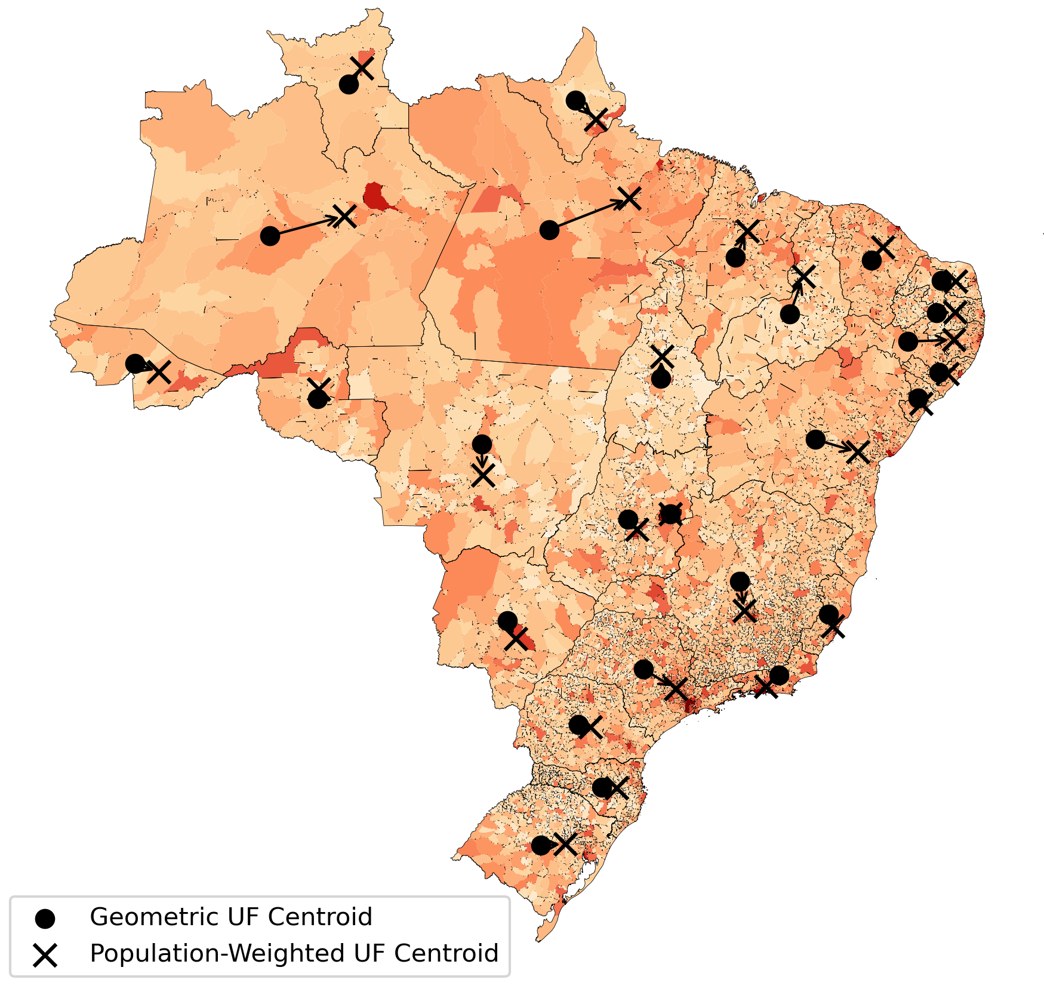
Covariates & distance matrix
Built a dataset of potential state-level covariates
Built a demographically-weighted state distance matrix D (origin-destination type, square)
uf | population | population_density | gini_population | hospital_beds_per_1000 | rel_humid_med | precip_med | temp_med | population_weighted_latitude
AC | 765021 | 4.47 | 0.61 | 2.03 | 84.04 | 17.98 | 25.31 | -9.57
AL | 3131625 | 107.66 | 0.59 | 2.19 | 75.64 | 8.45 | 25.00 | -9.54
AM | 3551196 | 2.23 | 0.67 | 1.80 | 86.30 | 25.26 | 26.17 | -3.37
AP | 686987 | 4.81 | 0.73 | 1.72 | 82.85 | 22.89 | 25.93 | 0.64
BA | 14187523 | 24.56 | 0.57 | 2.30 | 71.50 | 7.80 | 24.04 | -12.89
Number of urban centers, GDP/income, census, toilets per household, water containers

Slide 8
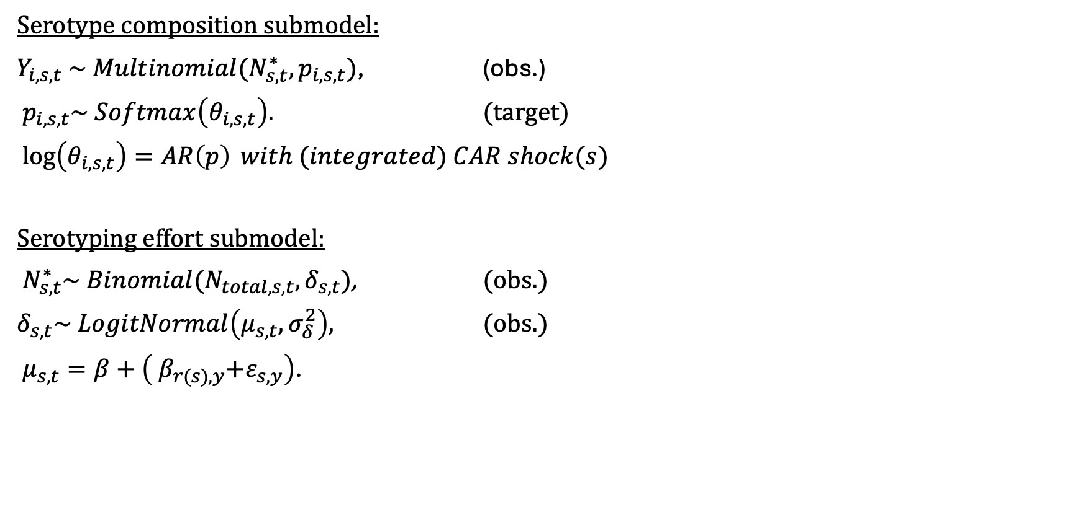
Bayesian hierarchical model
Serotype composition submodel:
$Y_{i,s,t} \sim Multinomial(N_{s,t}^{∗},p_{i,s,t})$, (obs.)
$p_{i,s,t}\sim Softmax\left(θ_{i,s,t}\right).$ (target)
$\log\left(θ_{i,s,t}\right)=AR\left(p\right) with (integrated) CAR shock(s)$
Serotyping effort submodel:
$N_{s,t}^{∗}\sim Binomial(N_{total, s,t},δ_{s,t})$, (obs.)
$δ_{s,t}\sim LogitNormal\left(μ_{s,t}, σ_{δ}^{2}\right),$ (obs.)
$μ_{s,t}=β+\left({ β}_{r(s),y}+ε_{s,y}\right)$.

Slide 9


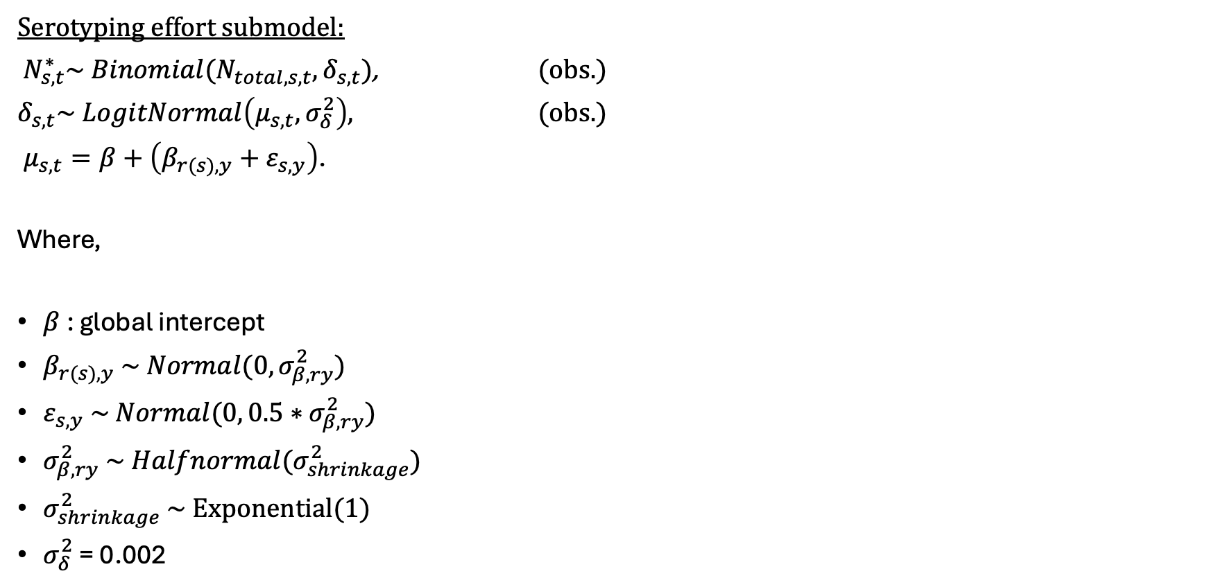



Bayesian hierarchical model
Ana: N^*_{s,t} ~ NegBinomial() ?
Serotyping effort submodel:
$N_{s,t}^{∗}\sim Binomial(N_{total, s,t},δ_{s,t})$, (obs.)
$δ_{s,t}\sim LogitNormal\left(μ_{s,t}, σ_{δ}^{2}\right),$ (obs.)
$μ_{s,t}=β+\left(β_{r(s),y}+ε_{s,y}\right)$.
Where,
$β$ : global intercept
$β_{r(s),y} \sim Normal(0,σ_{β,ry}^{2})$
$ε_{s,y} \sim Normal(0, 0.5∗σ_{β,ry}^{2})$
$σ_{β,ry}^{2} \sim Halfnormal(σ_{shrinkage}^{2})$
$σ_{shrinkage}^{2} \sim Exponential(1)$
$σ_{δ}^{2}$ = 0.002

Slide 10
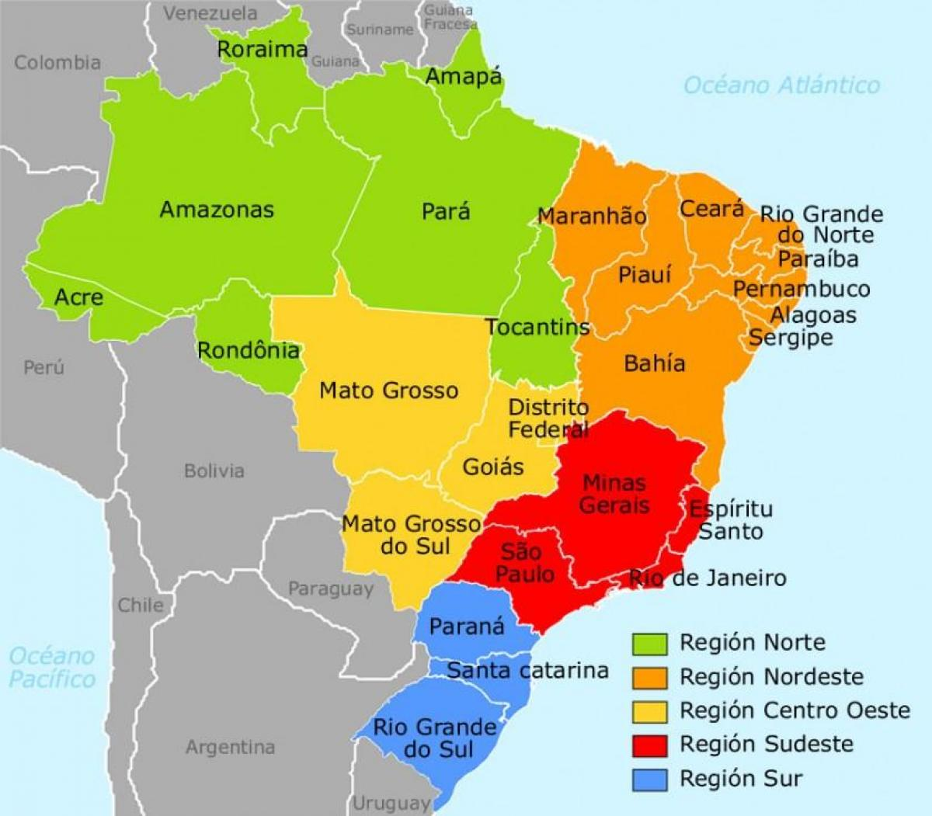
Close up of serotyped cases
Choice to have state-level noise = 0.5 * regional noise is arbitrary and might have to relaxed

Slide 11

Bayesian hierarchical model
Ana: Maybe we relax linear assumption by GAMM fit?
Cannot fit both perfect because of linearity assumption!
Serotyping effort submodel:
$N_{s,t}^{∗}\sim Binomial(N_{total, s,t},δ_{s,t})$, (obs.)
$δ_{s,t}\sim LogitNormal\left(μ_{s,t}, σ_{δ}^{2}\right),$ (obs.)
$μ_{s,t}=β+\left(β_{r(s),y}+ε_{s,y}\right)$.
Where,
$β$ : global intercept
$β_{r(s),y} \sim Normal(0,σ_{β,ry}^{2})$
$ε_{s,y} \sim Normal(0, 0.5∗σ_{β,ry}^{2})$
$σ_{β,ry}^{2} \sim Halfnormal(σ_{shrinkage}^{2})$
$σ_{shrinkage}^{2} \sim Exponential(1)$
$σ_{δ}^{2}$ = 0.002
$σ_{δ}^{2}$ = 0.002

Slide 12
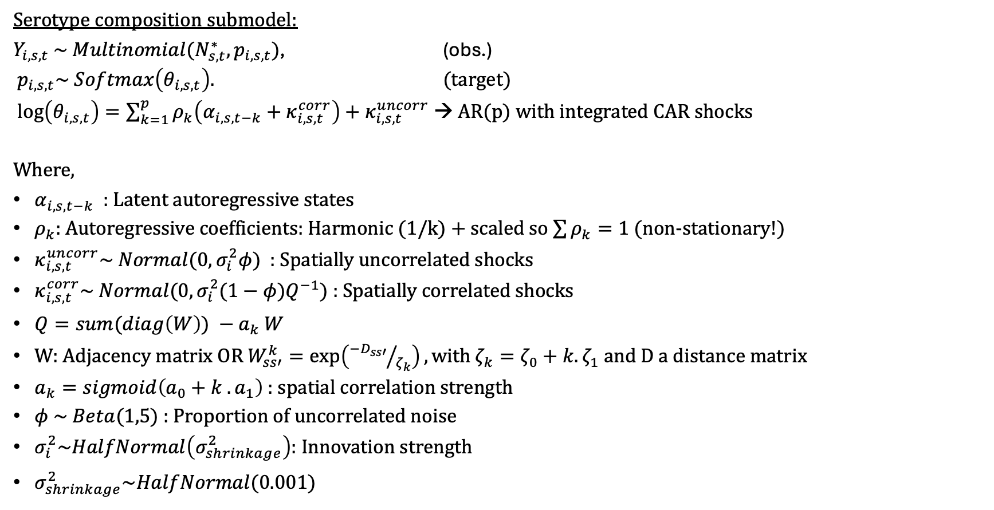
Bayesian hierarchical model
Ana:
Can we include fitness costs in the AR process?
Stochastic harmonic coefficients? Take the random noise and put it in the coefficients?
Serotype composition submodel:
$Y_{i,s,t} \sim Multinomial(N_{s,t}^{∗},p_{i,s,t})$, (obs.)
$p_{i,s,t}\sim Softmax\left(θ_{i,s,t}\right).$ (target)
$\log\left(θ_{i,s,t}\right)=\sum_{k=1}^{p}{ρ_{k}\left(α_{i,s,t−k}+κ_{i,s,t}^{corr}\right)+κ_{i,s,t}^{uncorr}}$ → AR(p) with integrated CAR shocks
Where,
$α_{i,s,t−k}$ : Latent autoregressive states
$ρ_{k}:$ Autoregressive coefficients: Harmonic (1/k) + scaled so $\sum{ρ_{k}}=1$ (non-stationary!)
$κ_{i,s,t}^{uncorr}\sim Normal(0, σ_{i}^{2}φ)$ : Spatially uncorrelated shocks
$κ_{i,s,t}^{corr}\sim Normal(0,σ_{i}^{2}(1−φ)Q^{−1})$ : Spatially correlated shocks
$Q=sum(diag\left(W\right)) −a_{k} W$
W: Adjacency matrix OR $W_{ss′}^{k}=\exp\left({−D_{ss′}}/{ζ_{k}}\right),with ζ_{k}=ζ_{0}+k.ζ_{1}$ and D a distance matrix
$a_{k}=sigmoid\left(a_{0}+k . a_{1}\right)$ : spatial correlation strength
$φ \sim Beta(1,5)$ : Proportion of uncorrelated noise
$σ_{i}^{2}\sim HalfNormal\left(σ_{shrinkage}^{2}\right)$: Innovation strength
$σ_{shrinkage}^{2}\sim HalfNormal(0.001)$

Slide 13



Sensitivity to innovation noise levels
$σ_{shrinkage}^{2}=0.001$
$σ_{shrinkage}^{2}=0.0001$
$σ_{shrinkage}^{2}=0.00005$

Slide 14
Sensitivity to innovation noise levels
$σ_{shrinkage}^{2}=0.001$
$σ_{shrinkage}^{2}=0.0001$
$σ_{shrinkage}^{2}=0.00005$

Slide 15
Influence of AR(p) order
Clustering based on attainable resolution?
AR(18)
AR(6)

Slide 16
Influence of AR(p) order
AR(18)
AR(6)

Slide 17
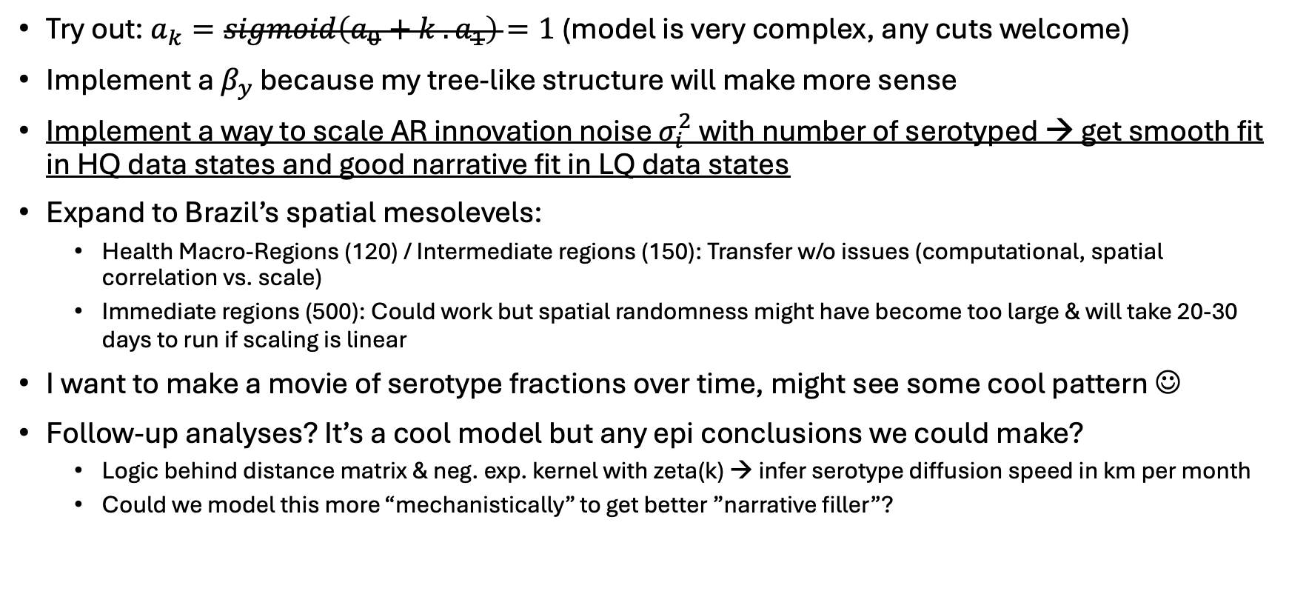
Prospects
Try out: $a_{k}=sigmoid\left(a_{0}+k . a_{1}\right)=1$ (model is very complex, any cuts welcome)
Implement a $β_{y}$ because my tree-like structure will make more sense
Implement a way to scale AR innovation noise $σ_{i}^{2}$ with number of serotyped → get smooth fit in HQ data states and good narrative fit in LQ data states
Expand to Brazil’s spatial mesolevels:
Health Macro-Regions (120) / Intermediate regions (150): Transfer w/o issues (computational, spatial correlation vs. scale)
Immediate regions (500): Could work but spatial randomness might have become too large & will take 20-30 days to run if scaling is linear
I want to make a movie of serotype fractions over time, might see some cool pattern ☺
Follow-up analyses? It’s a cool model but any epi conclusions we could make?
Logic behind distance matrix & neg. exp. kernel with zeta(k) → infer serotype diffusion speed in km per month
Could we model this more “mechanistically” to get better ”narrative filler”?

Slide 18
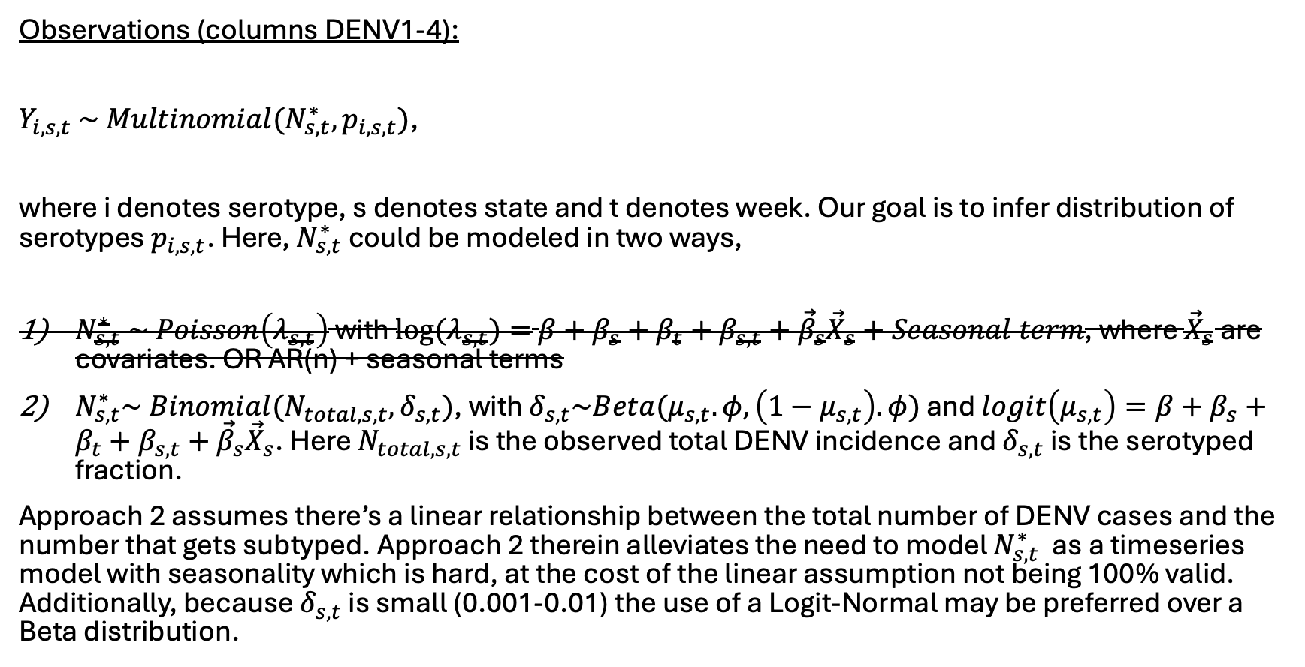
Things that were considered and discarded
Observations (columns DENV1-4):
$Y_{i,s,t} \sim Multinomial(N_{s,t}^{∗},p_{i,s,t})$,
where i denotes serotype, s denotes state and t denotes week. Our goal is to infer distribution of serotypes $p_{i,s,t}$. Here, $N_{s,t}^{∗}$ could be modeled in two ways,
$N_{s,t}^{∗} \sim Poisson\left(λ_{s,t}\right)$ with $\log{(λ_{s,t})}=$ $β+β_{s}+β_{t}+β_{s,t}+{\vec{β}}_{s}{\vec{X}}_{s}+Seasonal term$, where ${\vec{X}}_{s}$ are covariates. OR AR(n) + seasonal terms
$N_{s,t}^{∗}\sim Binomial(N_{total, s,t},δ_{s,t})$, with $δ_{s,t}\sim Beta(μ_{s,t}.φ,\left(1−μ_{s,t}\right).φ)$ and $logit\left(μ_{s,t}\right)=β+β_{s}+β_{t}+β_{s,t}+{\vec{β}}_{s}{\vec{X}}_{s}$. Here $N_{total, s,t}$ is the observed total DENV incidence and $δ_{s,t}$ is the serotyped fraction.
Approach 2 assumes there’s a linear relationship between the total number of DENV cases and the number that gets subtyped. Approach 2 therein alleviates the need to model $N_{s,t}^{∗}$ as a timeseries model with seasonality which is hard, at the cost of the linear assumption not being 100% valid. Additionally, because $δ_{s,t}$ is small (0.001-0.01) the use of a Logit-Normal may be preferred over a Beta distribution.

