Slide 1
DENV Serotype Historical Reconstruction Update
Notes:
Post mortem:
- Mainly nervousness in the beginning, and deflecting/not processing the questions of the audience correctly. Caused by not knowing enough about DENV + the work being preliminary.
In general, read more about Dengue to build a “holistic epidemiology/ecology side” so I’m a little less shacky during the intro/questions.
Elvira: Try to repeat/rephrase the question to give you more time to think.
Generally, presentation was very clear and model explanation well tailored to the audience.

Slide 2
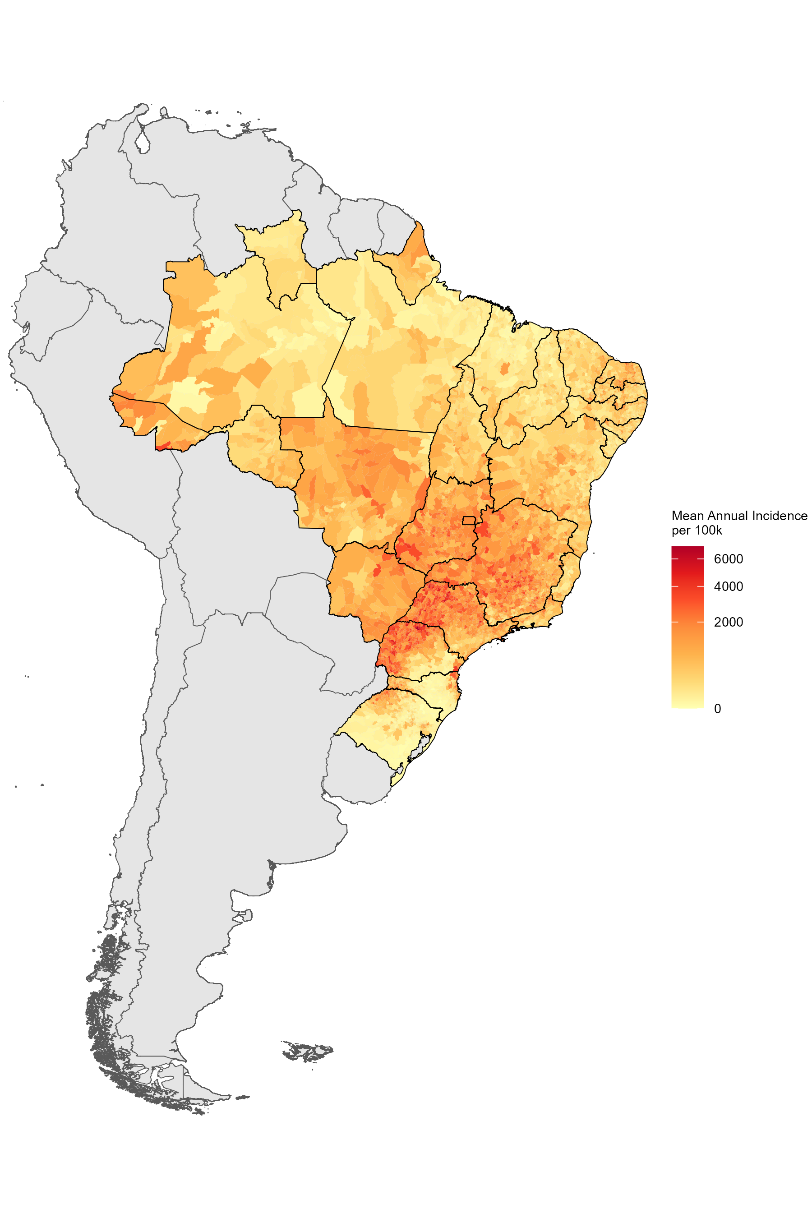
Drivers of Dengue Transmission
Strongly seasonal within-year
Highly variable across-years
Intrinsic vs. extrinsic drivers
Intrinsic: immunity landscape ←→ serotype cycling
Extrinsic: climate, vectors, behavior
What is the role of these drivers in shaping DENV epidemics?
How can we understand the DENV immunity landscape more fully?
Notes:
Figure:
Brazil has high endemicity in most parts of the country.
People trained on endemic diseases like measles would expect predictable cycles.
Yet that is not the case for DENV dynamics, even at more fined grained levels, although within a year the dynamics are clearly seasonal, across years the magnitude of epidemics is highly unpredictable.
This is because the magnitude of the epidemic is driven by a complex combination of extrinsic drivers like climate and vectors, and by intrinsic drivers like the immunity landscape and its interaction with the dengue serotypes cycling.
The role of these drivers in DENV dynamics are unknown, so we set out to study the DENV immunity landscape.

Slide 3
Drivers of Dengue Transmission
Strongly seasonal within-year
Highly variable across-years
Intrinsic vs. extrinsic drivers
Intrinsic: immunity landscape ←→ serotype cycling
Extrinsic: climate, vectors, behavior
What is the role of these drivers in shaping DENV epidemics?
< 1%
How can we understand the DENV immunity landscape more fully?
Notes:
Figure:
Brazil has high endemicity in most parts of the country.
People trained on endemic diseases like measles would expect predictable cycles.
Yet that is not the case for DENV dynamics, although within a year the dynamics are clearly seasonal, across years the magnitude of epidemics is highly unpredictable.
This is because the magnitude of the epidemic is driven by a complex combination of extrinsic drivers like climate and vectors, and by intrinsic drivers like the immunity landscape and its interaction with the dengue serotypes cycling.
The role of these drivers in DENV dynamics are unknown, so we set out to study the DENV immunity landscape.

Slide 4
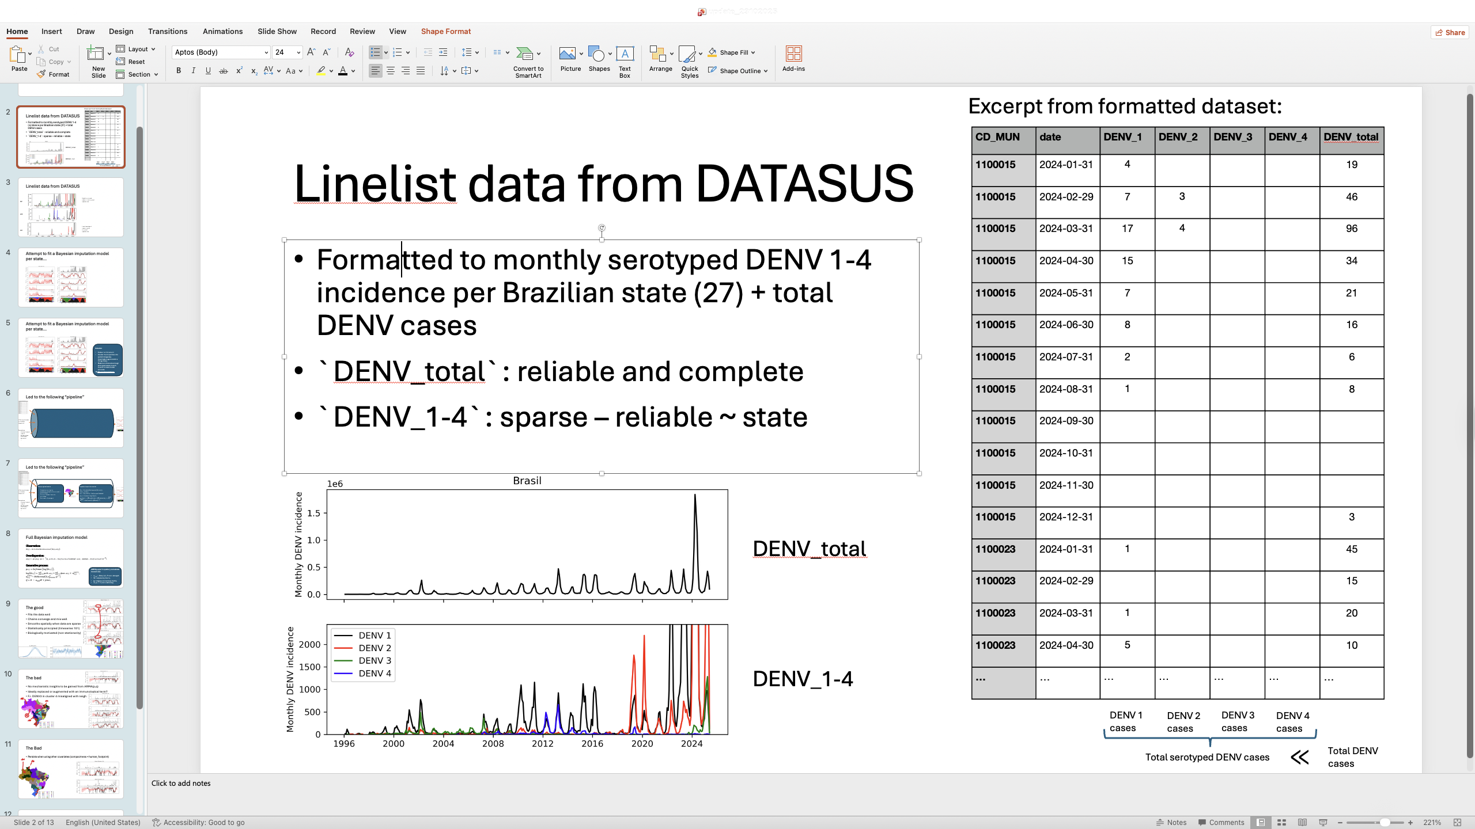
Drivers of Dengue Transmission
SINAN sample
Strongly seasonal within-year
Highly variable across years
Intrinsic vs. extrinsic drivers
Intrinsic: immunity landscape ←→ serotype cycling
Extrinsic: climate, vectors, behavior
What is the role of these drivers in shaping DENV epidemics?
< 1%
How can we understand the DENV immunity landscape more fully?
Notes:
Figure:
Brazil has high endemicity in most parts of the country.
People trained on endemic diseases like measles would expect predictable cycles.
Yet that is not the case for DENV dynamics, although within a year the dynamics are clearly seasonal, across years the magnitude of epidemics is highly unpredictable.
This is because the magnitude of the epidemic is driven by a complex combination of extrinsic drivers like climate and vectors, and by intrinsic drivers like the immunity landscape and its interaction with the dengue serotypes cycling.
The role of these drivers in DENV dynamics are unknown, so we set out to study the DENV immunity landscape.

Slide 5
Serotype Reconstruction
Reconstruct historical serotype distributions from sparse data using a Bayesian hierarchical imputation model
Sparse municipality-level serotyped data
Total DENV cases
Impute
Serotype imputation pipeline
Cluster
Bayesian imputation model
Spatial covariates
Municipality-level timeseries of DENV-1 … DENV-4
Serotype distributions

Slide 6
Why cluster?
Low # serotyped cases + great temporal sparseness
High # serotyped cases + limited temporal sparseness
Notes:
Hence, running an imputation model at the state level makes no sense.
We will cluster municipalities into epidemiologically meaningful regions where serotype dynamics align.

Slide 7
Why cluster?
Low # serotyped cases + great temporal sparseness
State = artificial
Cluster municipalities into epidemiologically meaningful regions before fitting imputation model
Sufficient serotyped cases in each cluster to make model accurate
➔ Max-p regionalization
High # serotyped cases + limited temporal sparseness
Notes:
Hence, running an imputation model at the state level makes no sense.
We will cluster municipalities into epidemiologically meaningful regions where serotype dynamics align.

Slide 8
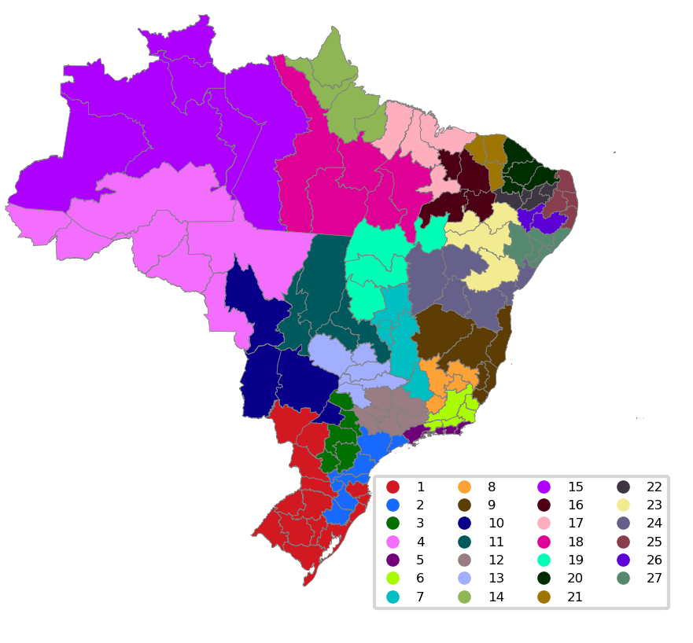

Serotype imputation pipeline
Sparse spatiotemporal serotyped data
Bayesian imputation model
$Y_{t, i, j} \sim DirichletMultinomial(N_{t, i},α_{t, i, j})$,
$α_{t, i, j}= φ_{i} p_{t,i,j},$
$φ_{i}= 1/{d_{i}} with d_{i} \sim Halfnormal\left(d_{shrink}\right)$
$p_{t, i, j}=Softmax\left(log\left(θ_{t,i,j}\right)\right),$
$log\left(θ_{t,i,j}\right)= \sum_{k=1}^{p}{ρ_{k}}θ_{t−k,i,j}+\sum_{k=1}^{q}{ψ_{k}κ_{t−k,i,j}}+ κ_{t,i,j}^{(corr)} ,$
$κ_{t,i,j}^{(corr)}\sim MvNormal\left(0, σ_{process}^{2} Q^{−1}\right)$
Max-p regionalization
Guarantees contiguity
Guarantees threshold is crossed in every cluster
Clusters “biased” towards covariates
Stochastic → averaged
Minimum serotyped cases per cluster
Covariates
Human footprint
Index P
Koppen class.
DTW DENV dynamics
…

Slide 9
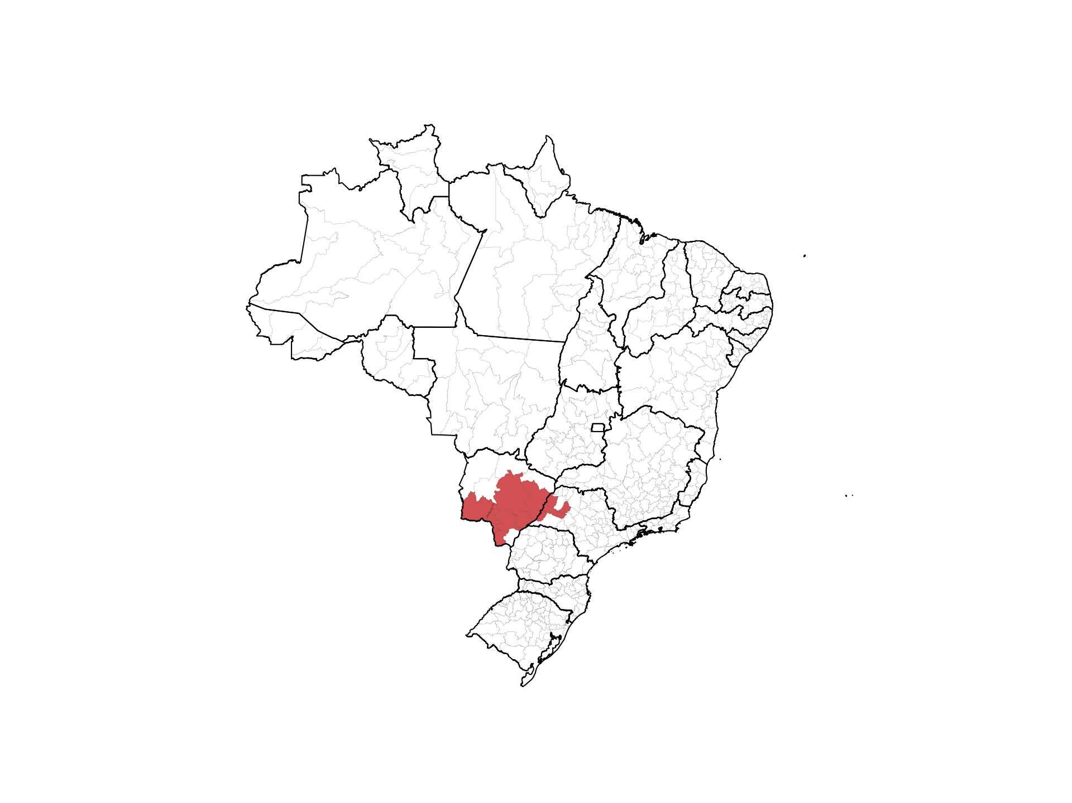
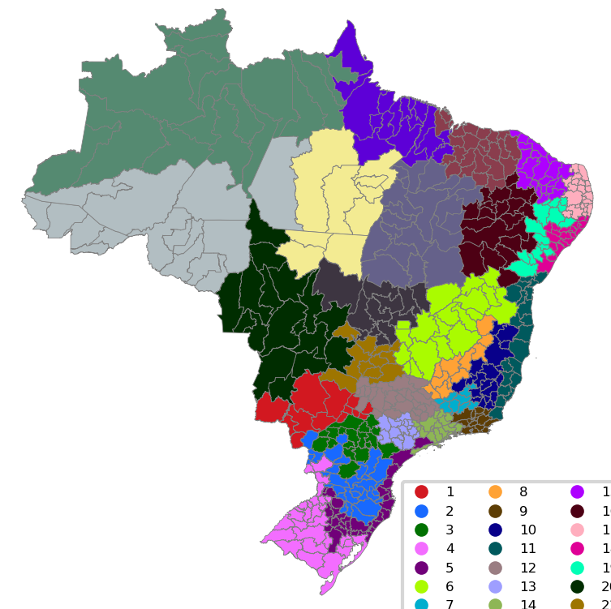

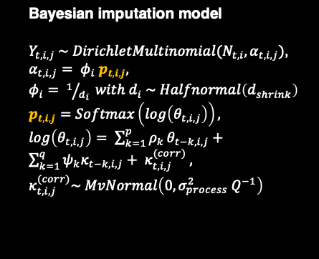
Serotype imputation pipeline
Sparse spatiotemporal serotyped data
Bayesian imputation model
$Y_{t, i, j} \sim DirichletMultinomial(N_{t, i},α_{t, i, j})$,
$α_{t, i, j}= φ_{i} p_{t,i,j},$
$φ_{i}= 1/{d_{i}} with d_{i} \sim Halfnormal\left(d_{shrink}\right)$
$p_{t, i, j}=Softmax\left(log\left(θ_{t,i,j}\right)\right),$
$log\left(θ_{t,i,j}\right)= \sum_{k=1}^{p}{ρ_{k}}θ_{t−k,i,j}+\sum_{k=1}^{q}{ψ_{k}κ_{t−k,i,j}}+ κ_{t,i,j}^{(corr)} ,$
$κ_{t,i,j}^{(corr)}\sim MvNormal\left(0, σ_{process}^{2} Q^{−1}\right)$
Max-p regionalization
Guarantees contiguity
Guarantees threshold is crossed in every cluster
Clusters “biased” towards covariates
Stochastic → averaged
Minimum serotyped cases per cluster
Aggregate data
$$p_{t,i,j}$$
Covariates
Human footprint
Index P
Koppen class.
DTW DENV dynamics
…
Change to fitness + underlying immunity model in progress
Notes:
Bayesian model
DirichletMultinomial → Modeling overdispersion
Latent distribution modeled using AR (autoregressive) and MA (moving average) model
Spatially correlated innovations

Slide 10
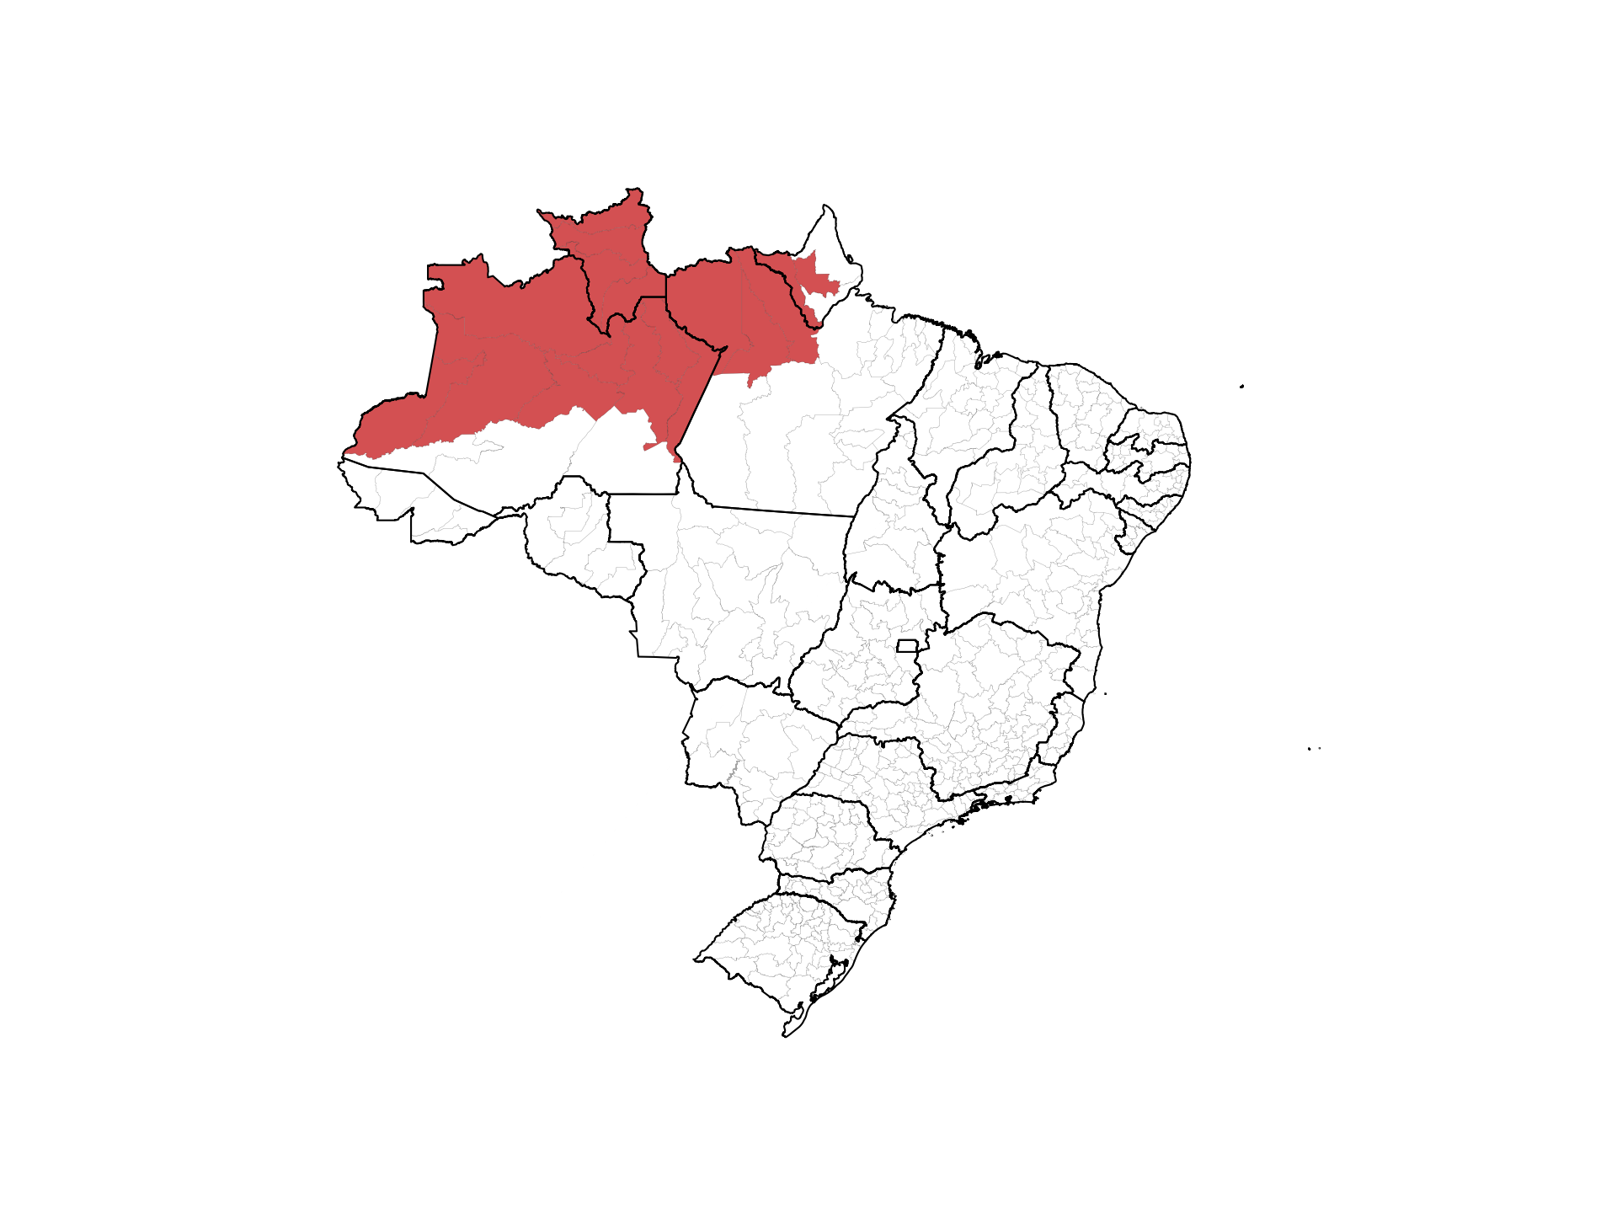
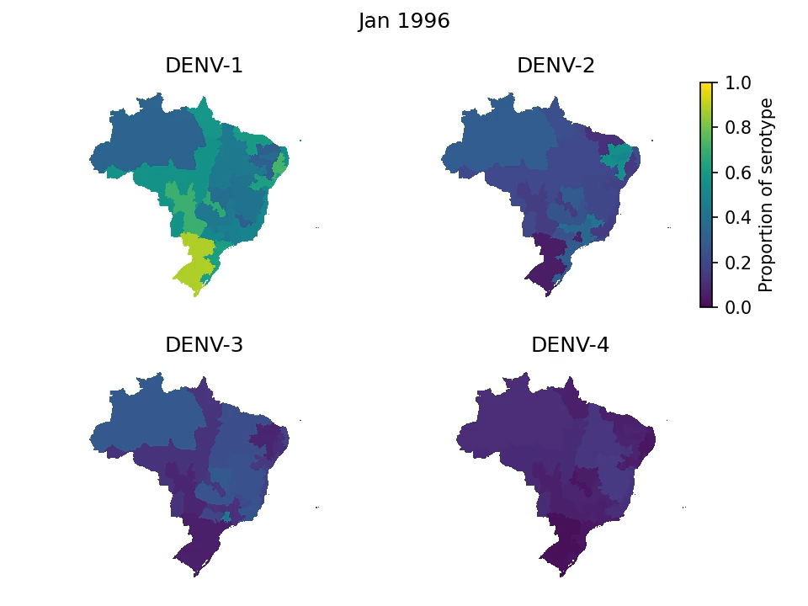
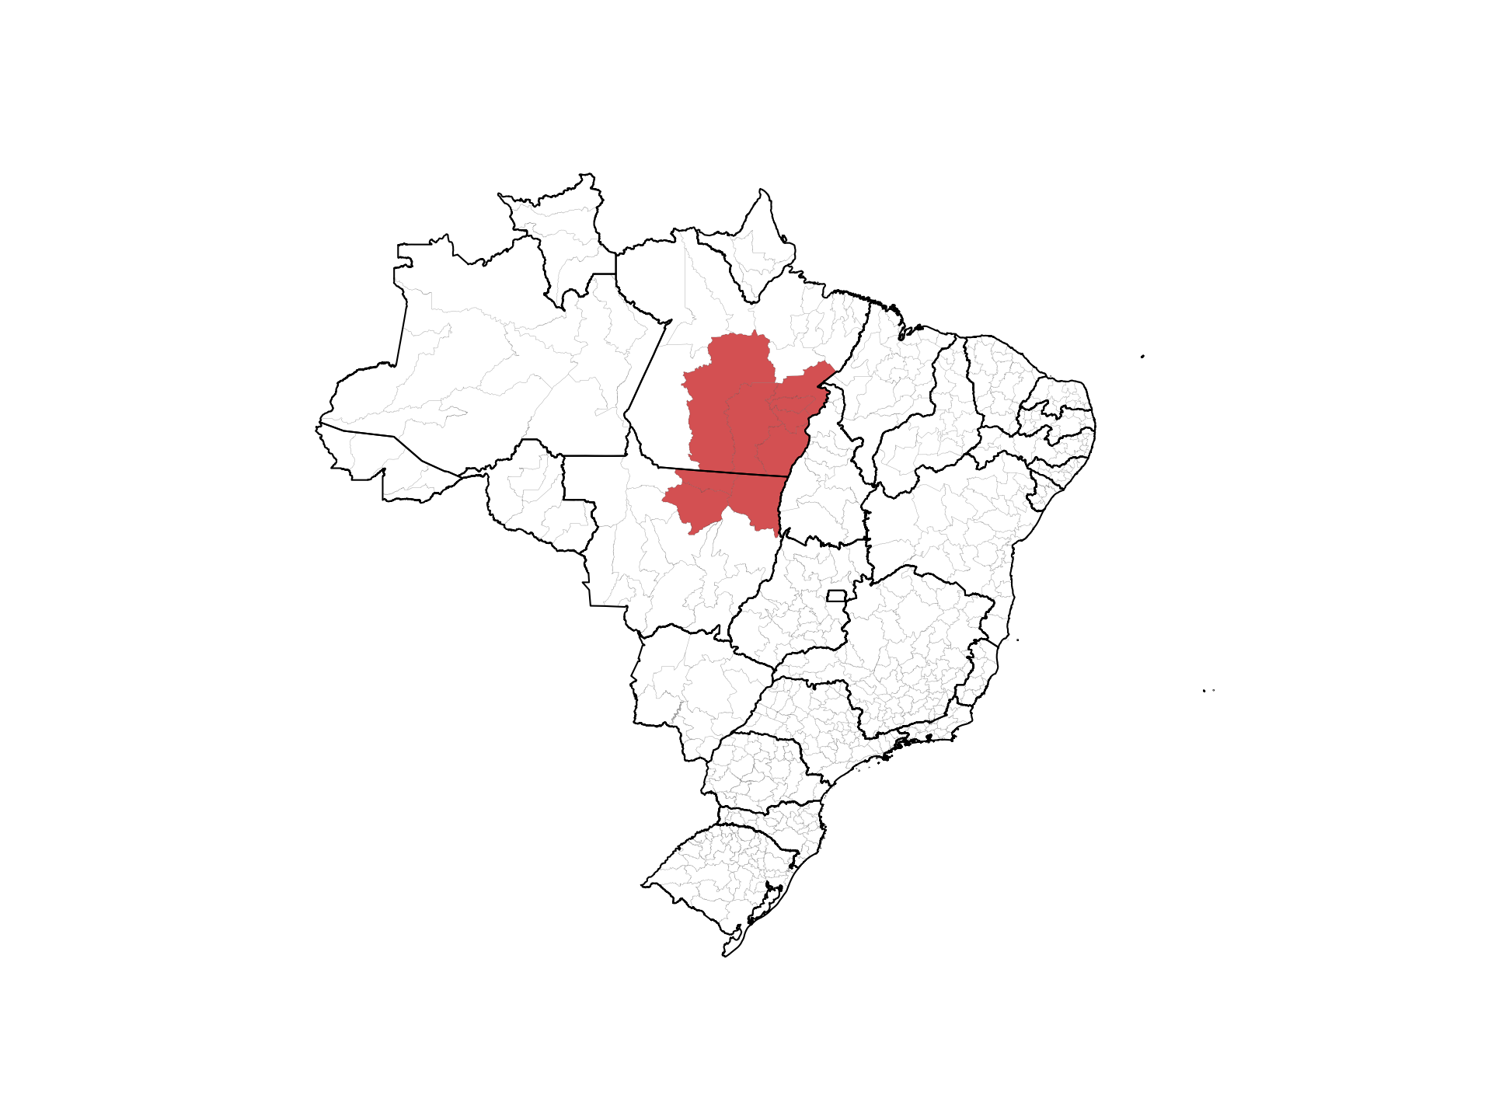
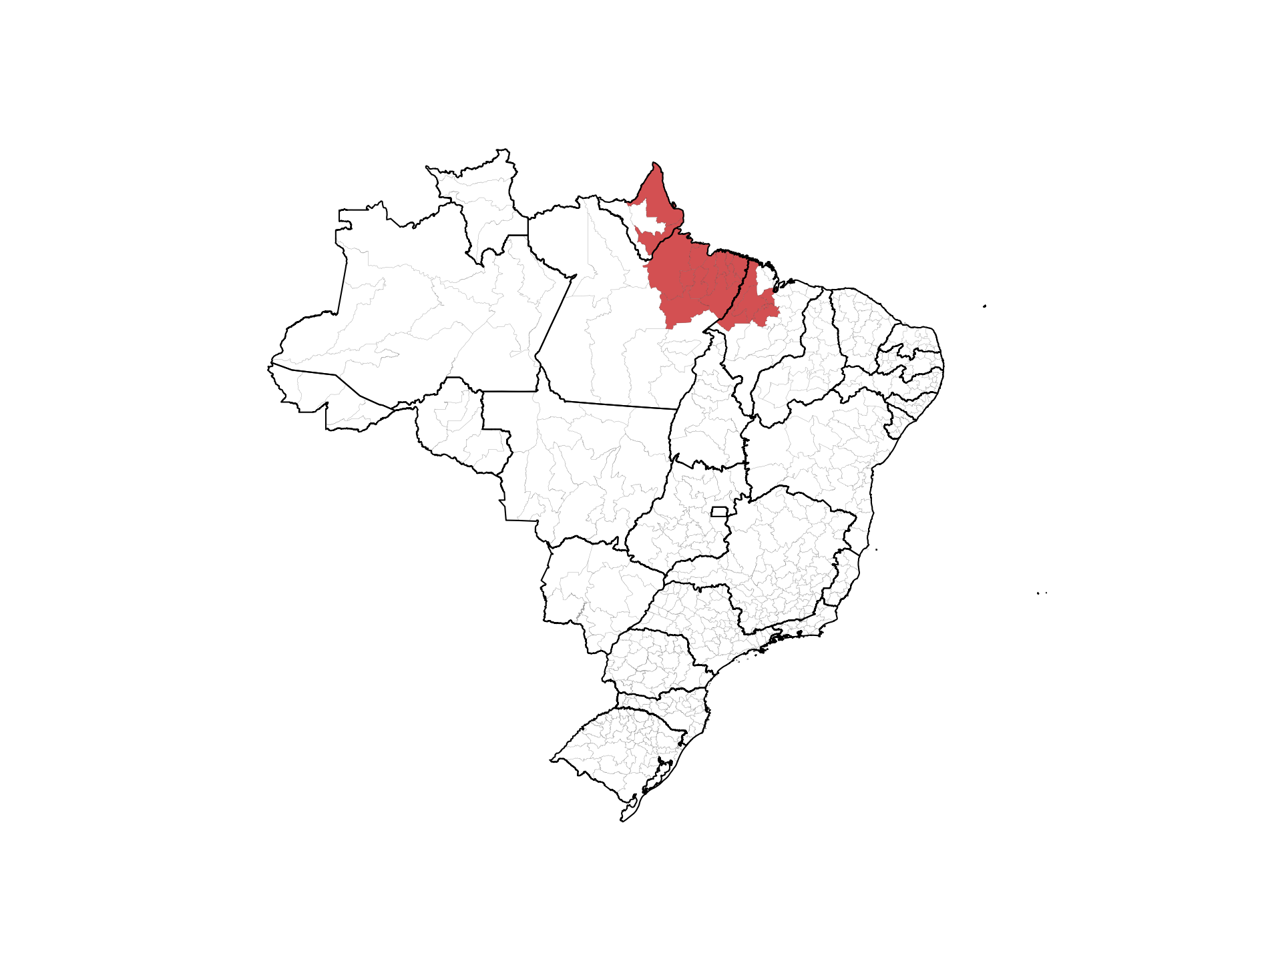
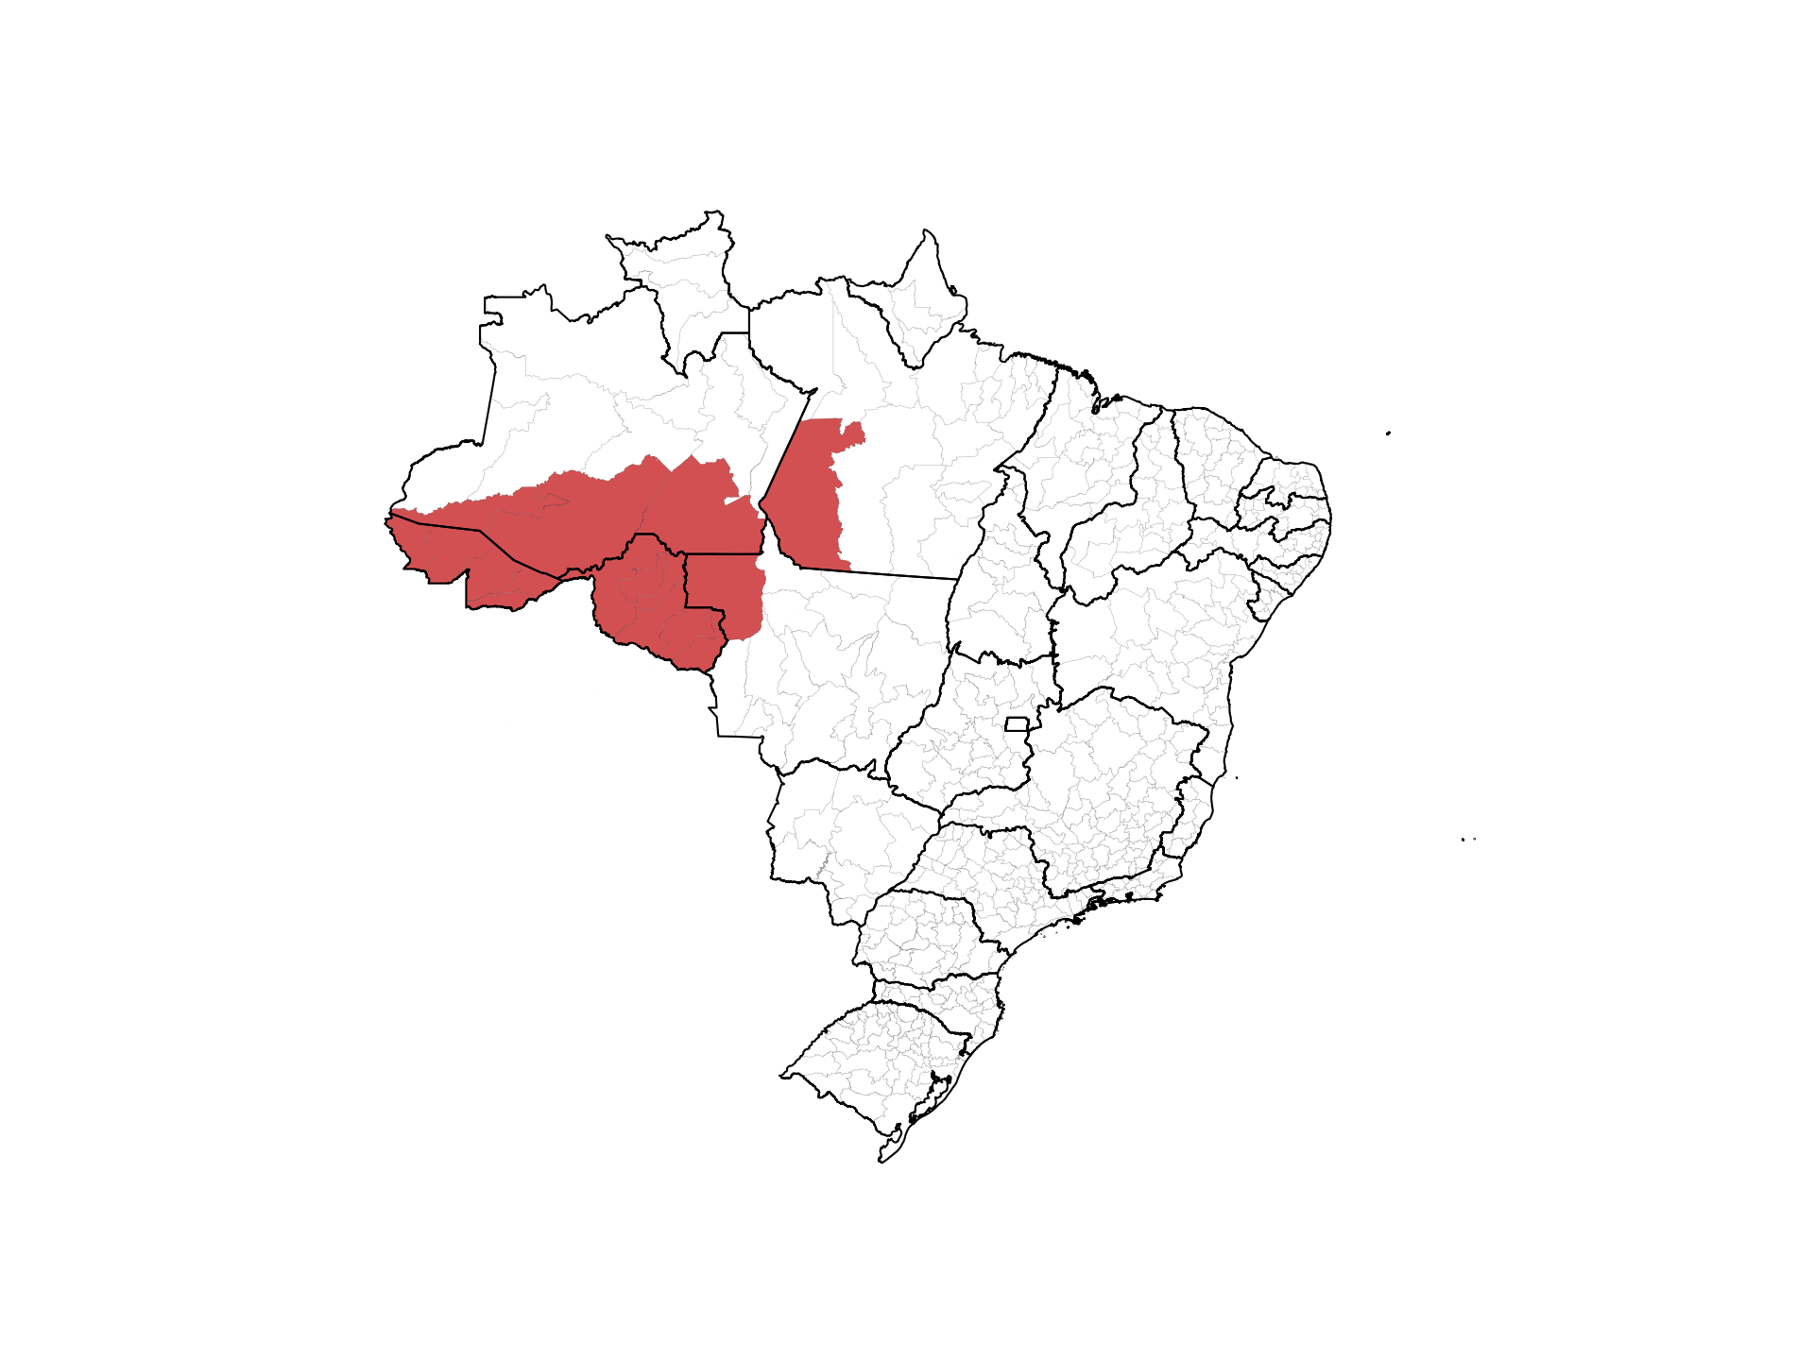
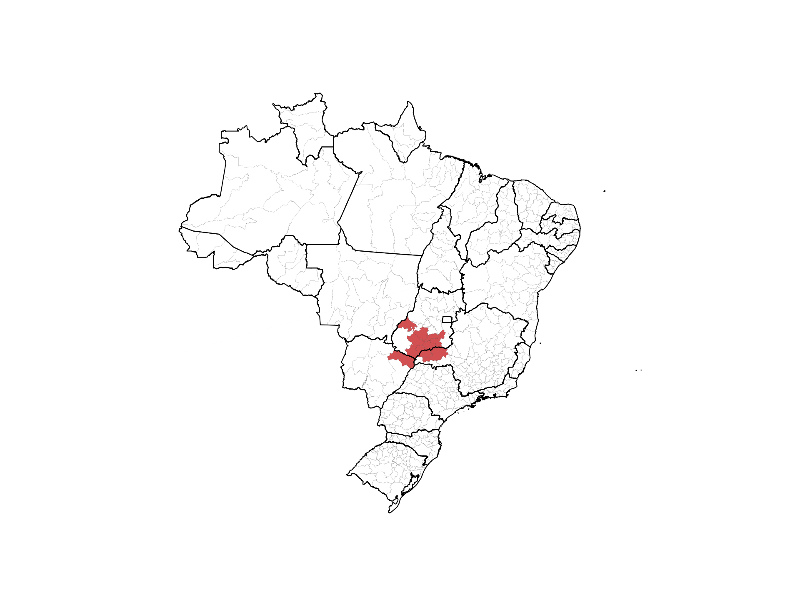
DENV-3 Introduction in Roraima
Notes:
Left-hand side
General, mostly DENV-1
DENV-3 started to creep around 2000, cycling most of DENV-1 out by 2004
Currently, DENV-3 creeping up so expecting to see potential cycling, or maybe DENV-1 may overtake first gain.
DENV-4 creeping around 2008, but DENV-1 gaining strength, came back around 2012-2014

Slide 11
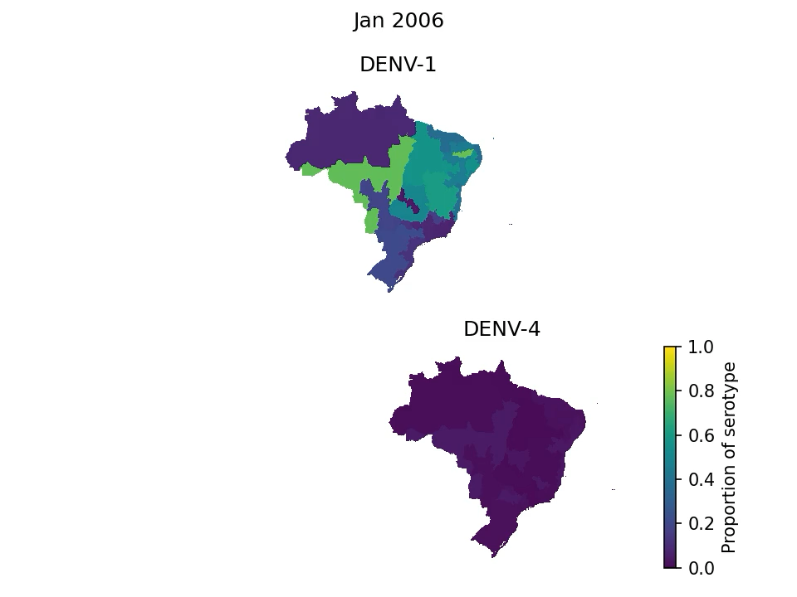
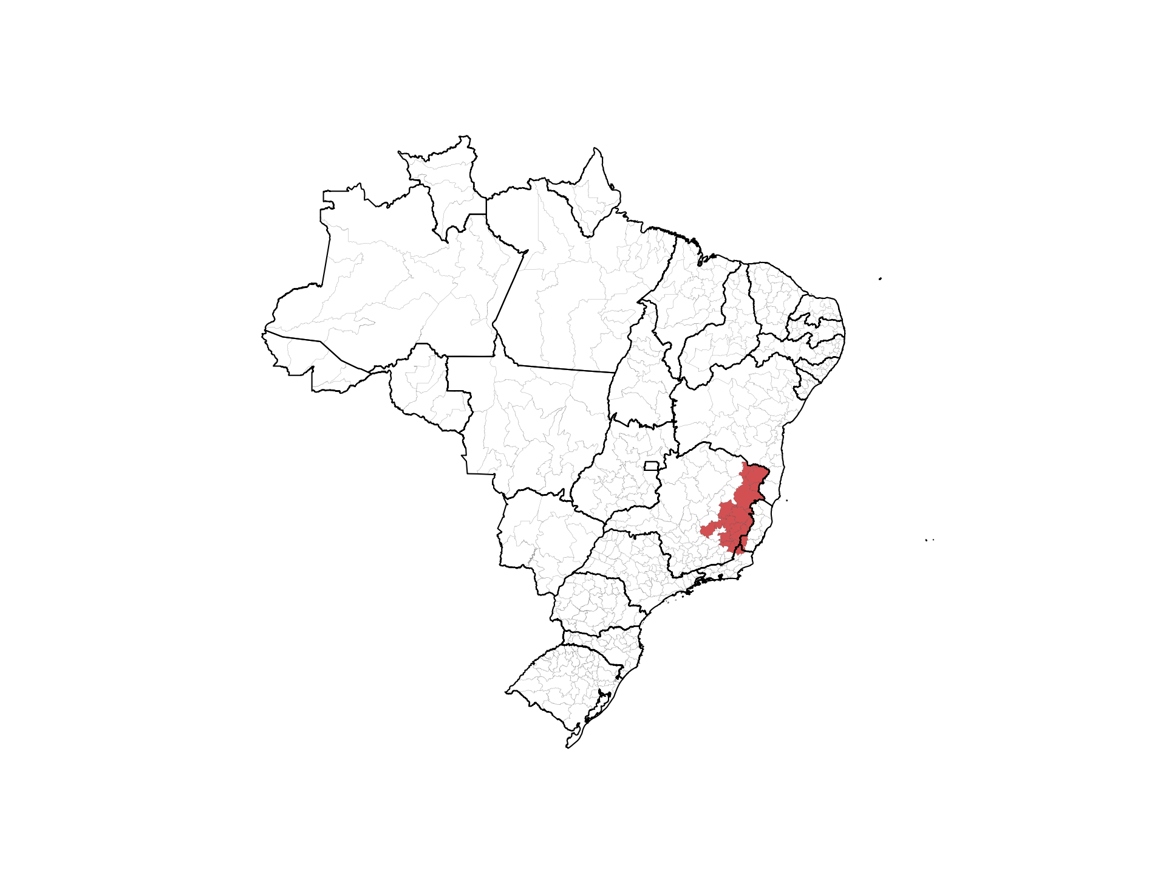
Serotype cycling
Notes:
Left-hand side
General, mostly DENV-1
DENV-3 started to creep around 2000, cycling most of DENV-1 out by 2004
Currently, DENV-3 creeping up so expecting to see potential cycling, or maybe DENV-1 may overtake first gain.
DENV-4 creeping around 2008, but DENV-1 gaining strength, came back around 2012-2014

Slide 12
A two-step approach
Reconstruct historical serotype distributions from sparse data using a Bayesian hierarchical imputation model
Model the dynamics of DENV with a four-serotype sequential infection compartmental model with climate modifier
Imperfect serotyped data
Total DENV cases
Weather data
Impute
Compartmental model
Four serotypes
Climate modifier
Fitness advantage
Serotype imputation pipeline
Cluster
Bayesian imputation model
Disentangle
Spatial covariates
Serotype distributions
drivers

Slide 13
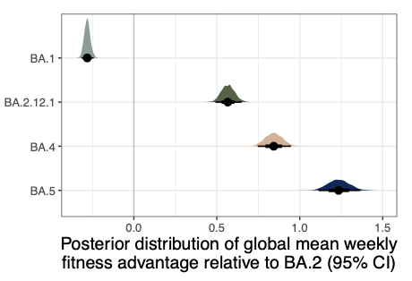
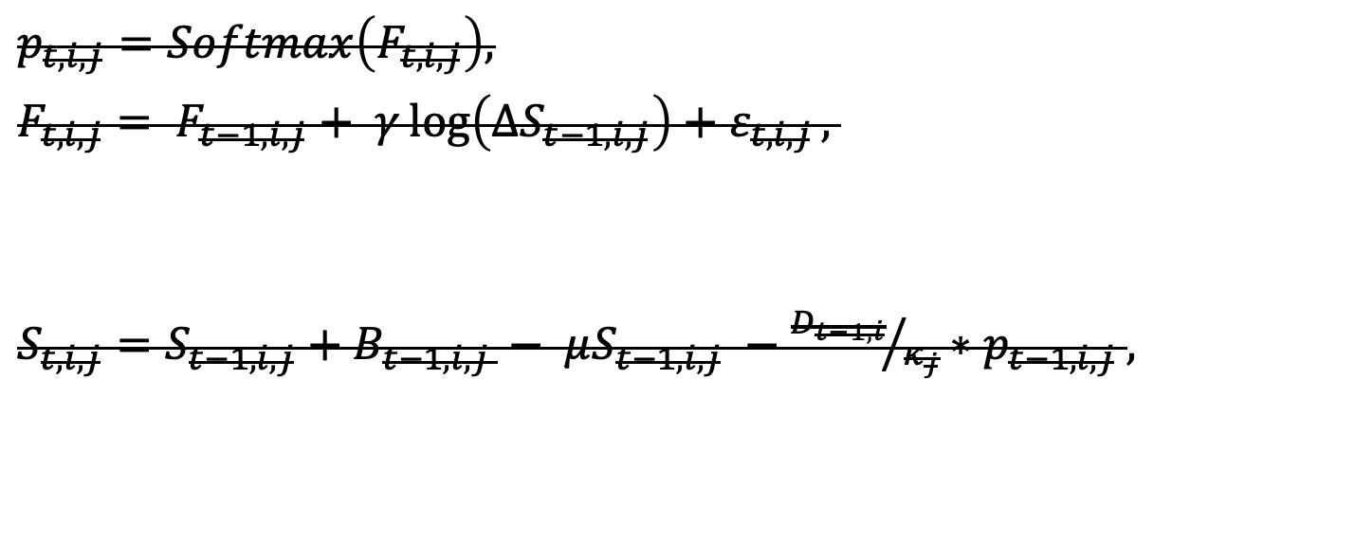

WIP: Fitness-Catalytic model
$p_{t, i, j}=Softmax\left(F_{t,i,j}\right),$
$F_{t,i,j}= F_{t−1,i,j}+ γ\log\left({∆S}_{t−1,i,j}\right)+ε_{t,i,j},$
$S_{t,i,j}=S_{t−1,i,j}+B_{t−1,i,j }− μS_{t−1,i,j} −{D_{t−1,i}}/{κ_{j}}∗p_{t−1, i, j} ,$
RW(1)
Population immunity
Residual
Births-Deaths
Infections
Notes:
Negative frequency dependent selection models → Read literature: Sylvain Gandon (Montpellier), Curt Lively
Sara Kada, Dengue paper from Puerto
Maybe related literature in Influenza drift? → Trevor Bedford, Sarah Cobey, Katia Koelle + David Rasmussen, Pej Rohani + Rebecca Borchering (Influenza A + B)
Cross-protection?

Slide 14
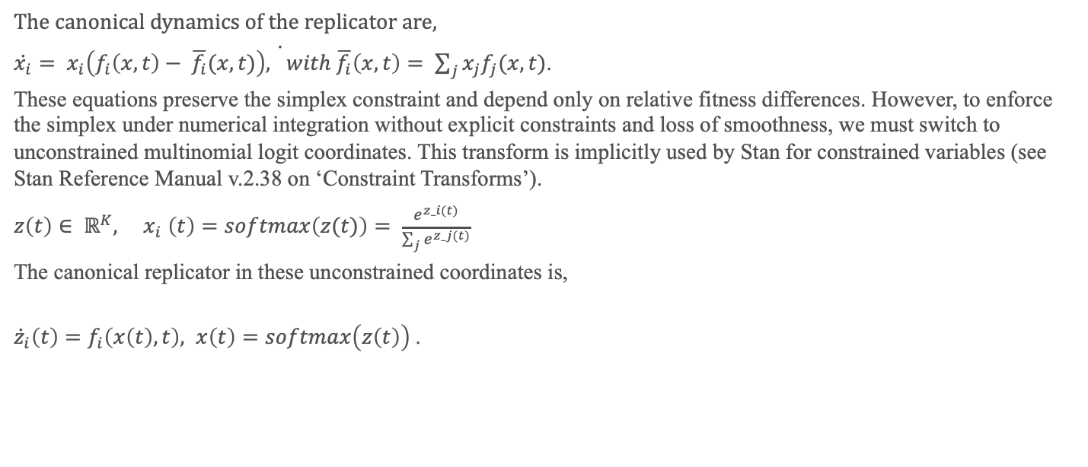
WIP: Replicator-Catalytic model
The canonical dynamics of the replicator are,
$\dot{\dot{x_{i}}= x_{i}\left(f_{i}\left(x,t\right)− \overline{f_{i}}(x,t)\right), with \overline{f_{i}}\left(x,t\right)= \sum_{j}{x_{j}f_{j}(x,t)}}$.
These equations preserve the simplex constraint and depend only on relative fitness differences. However, to enforce the simplex under numerical integration without explicit constraints and loss of smoothness, we must switch to unconstrained multinomial logit coordinates. This transform is implicitly used by Stan for constrained variables (see Stan Reference Manual v.2.38 on ‘Constraint Transforms’).
$z\left(t\right)∈ ℝ^{K}, { x}_{i}\left(t\right)=softmax\left(z(t)\right)= \frac{e^{z_i(t)}}{\sum_{j}{e^{z_j(t)}}}$
The canonical replicator in these unconstrained coordinates is,
${\dot{z}}_{i}\left(t\right)=f_{i}\left(x\left(t\right), t\right), x\left(t\right)=softmax\left(z\left(t\right)\right)$.
Notes:
https://mc-stan.org/docs/reference-manual/transforms.html#simplex-transform.section

Slide 15
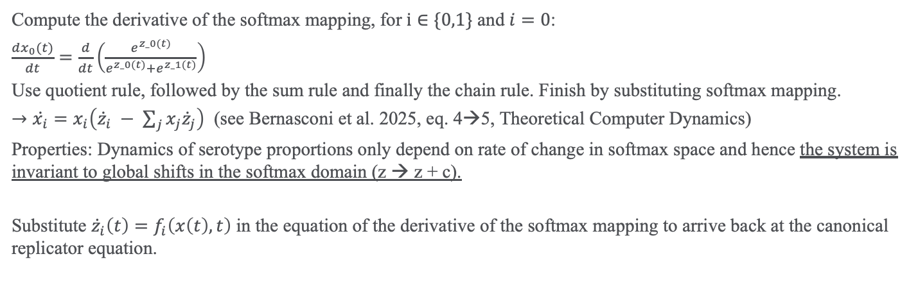
Equality between projections
Compute the derivative of the softmax mapping, for $i∈\{0,1\}$ and $i=0$:
$\frac{dx_{0}(t)}{dt}=\frac{d}{dt}\left(\frac{e^{z_0(t)}}{e^{z_0(t)}+e^{z_1(t)}}\right)$
Use quotient rule, followed by the sum rule and finally the chain rule. Finish by substituting softmax mapping.
$→\dot{x_{i}}=x_{i}\left({\dot{z}}_{i} − \sum_{j}{x_{j}{\dot{z}}_{j}}\right)$ (see Bernasconi et al. 2025, eq. 4→5, Theoretical Computer Dynamics)
Properties: Dynamics of serotype proportions only depend on rate of change in softmax space and hence the system is invariant to global shifts in the softmax domain (z → z + c).
Substitute ${\dot{z}}_{i}\left(t\right)=f_{i}\left(x\left(t\right), t\right)$ in the equation of the derivative of the softmax mapping to arrive back at the canonical replicator equation.

Slide 16
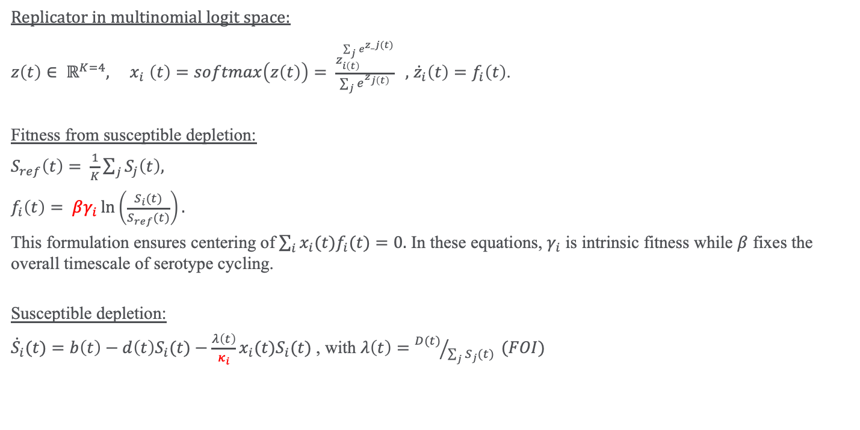

WIP: Replicator-Catalytic model
Replicator in multinomial logit space:
$z\left(t\right)∈ ℝ^{K=4}, { x}_{i}\left(t\right)=softmax\left(z\left(t\right)\right)= \frac{z_{i\left(t\right)}^{\sum_{j}{e^{z_j(t)}}}}{\sum_{j}{e^{z_{j\left(t\right)}}}} ,$ ${\dot{z}}_{i}\left(t\right)=f_{i}\left(t\right)$.
Fitness from susceptible depletion:
$S_{ref}\left(t\right)= \frac{1}{K}\sum_{j}{S_{j}\left(t\right),}$
$f_{i}\left(t\right)= βγ_{i}\ln\left(\frac{S_{i}(t)}{S_{ref}(t)}\right).$
This formulation ensures centering of$\sum_{i}{x_{i}(t)f_{i}(t)}=0.$ In these equations, $γ_{i}$ is intrinsic fitness while $β$ fixes the overall timescale of serotype cycling.
Susceptible depletion:
${\dot{S}}_{i}(t)=b\left(t\right)−d\left(t\right)S_{i}(t)−\frac{λ\left(t\right)}{κ_{i}}x_{i}(t)S_{i}(t)$ , with $λ\left(t\right)={D(t)}/{\sum_{j}{S_{j}}(t)} (FOI)$
Pop. Density as a modifier?
Observed fraction
Notes:
Simon Levin (Princeton)

Slide 17
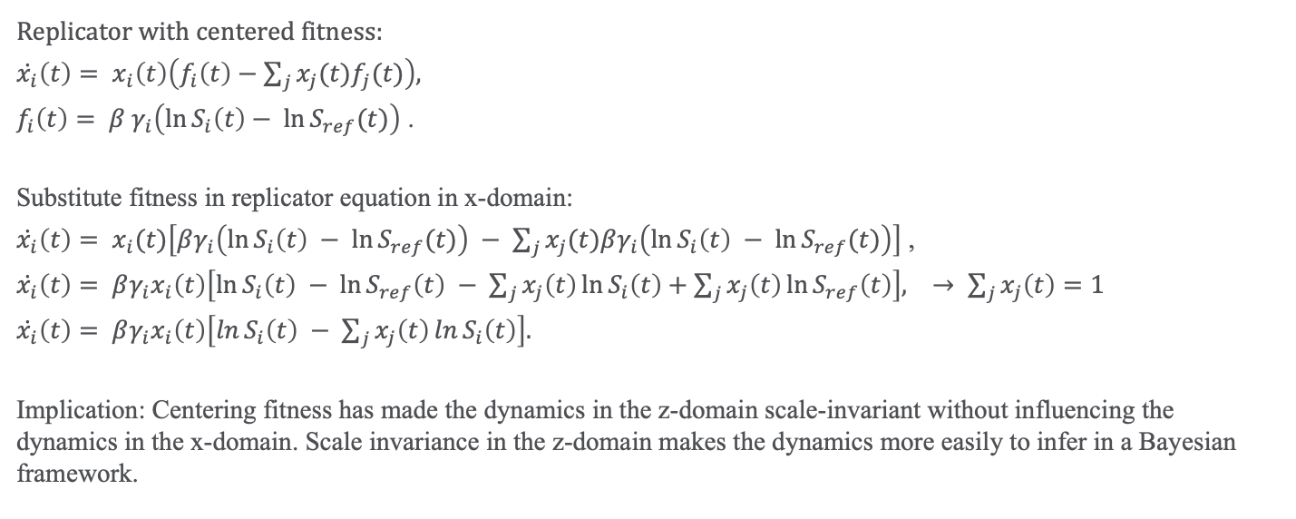
Implications of fitness centering
Replicator with centered fitness:
$\dot{x_{i}}\left(t\right)= x_{i}\left(t\right)\left(f_{i}\left(t\right)−\sum_{j}{x_{j}(t)f_{j}(t)}\right),$
$f_{i}\left(t\right)= β γ_{i}\left(\ln{S_{i}\left(t\right)− \ln{S_{ref}(t)}}\right)$ .
Substitute fitness in replicator equation in x-domain:
$\dot{x_{i}}\left(t\right)= x_{i}(t)\left[βγ_{i}\left(\ln{S_{i}\left(t\right)} − \ln{S_{ref}(t)}\right) − \sum_{j}{x_{j}(t)βγ_{i}\left(\ln{S_{i}\left(t\right)} − \ln{S_{ref}(t)}\right)}\right]$ ,
$\dot{x_{i}}\left(t\right)= βγ_{i}x_{i}\left(t\right)\left[\ln{S_{i}\left(t\right)} − \ln{S_{ref}\left(t\right)} − \sum_{j}{x_{j}\left(t\right)}\ln{S_{i}\left(t\right)}+\sum_{j}{x_{j}\left(t\right)}\ln{S_{ref}\left(t\right)}\right], → \sum_{j}{x_{j}\left(t\right)}=1$
$\dot{x_{i}}\left(t\right)= βγ_{i}x_{i}\left(t\right)\left[\ln{S_{i}\left(t\right)} − \sum_{j}{x_{j}\left(t\right)}\ln{S_{i}\left(t\right)}\right].$
Implication: Centering fitness has made the dynamics in the z-domain scale-invariant without influencing the dynamics in the x-domain. Scale invariance in the z-domain makes the dynamics more easily to infer in a Bayesian framework.

Slide 18
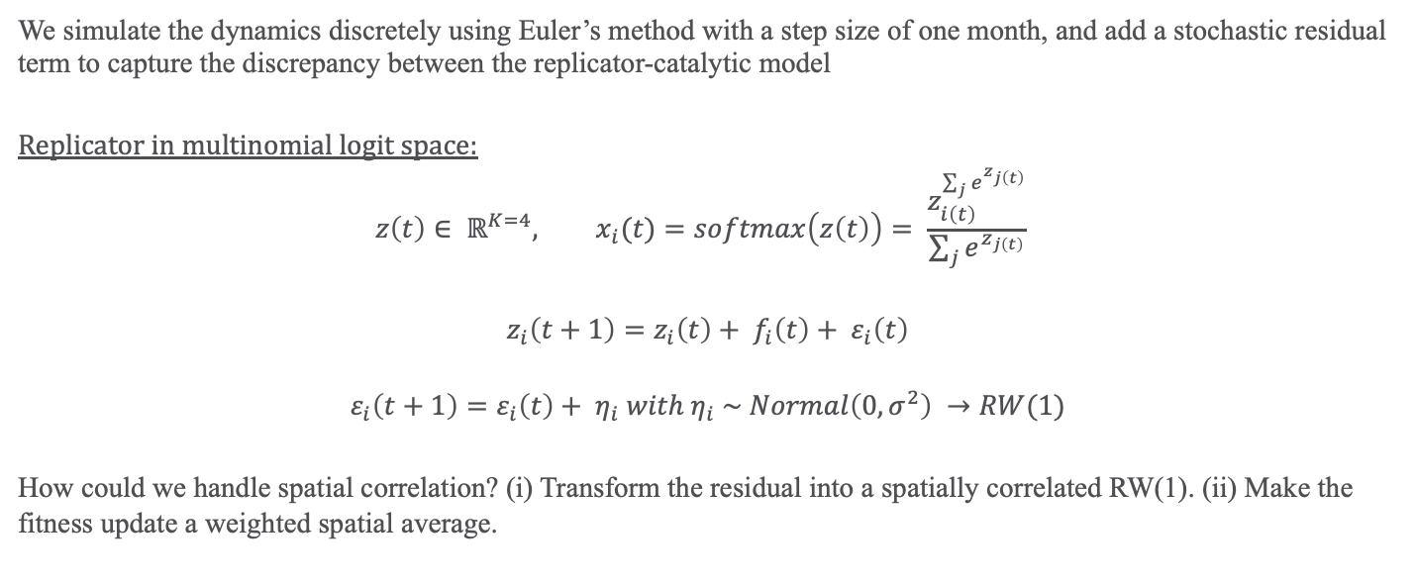
Simulation algorithm and stochasticity
We simulate the dynamics discretely using Euler’s method with a step size of one month, and add a stochastic residual term to capture the discrepancy between the replicator-catalytic model
Replicator in multinomial logit space:
$$z\left(t\right)∈ ℝ^{K=4}, x_{i}(t)=softmax\left(z\left(t\right)\right)= \frac{z_{i\left(t\right)}^{\sum_{j}{e^{z_{j\left(t\right)}}}}}{\sum_{j}{e^{z_{j\left(t\right)}}}}$$
$$z_{i}\left(t+1\right)=z_{i}\left(t\right)+ f_{i}\left(t\right)+ ε_{i}\left(t\right)$$
$$ε_{i}\left(t+1\right)=ε_{i}\left(t\right)+ η_{i} with{ η}_{i} \sim Normal\left(0, σ^{2}\right) →RW(1)$$
How could we handle spatial correlation? (i) Transform the residual into a spatially correlated RW(1). (ii) Make the fitness update a weighted spatial average.

Slide 19


Questions?
twa27@cornell.edu

Slide 21
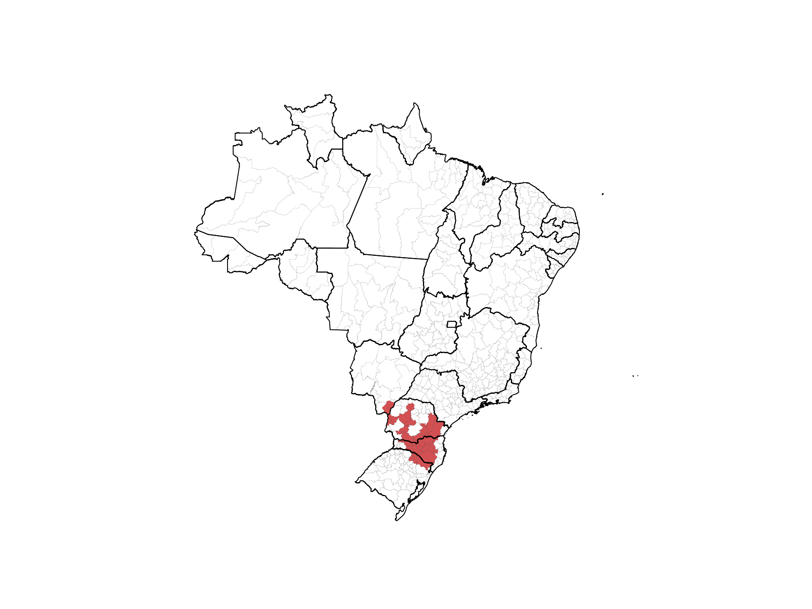

Slide 22
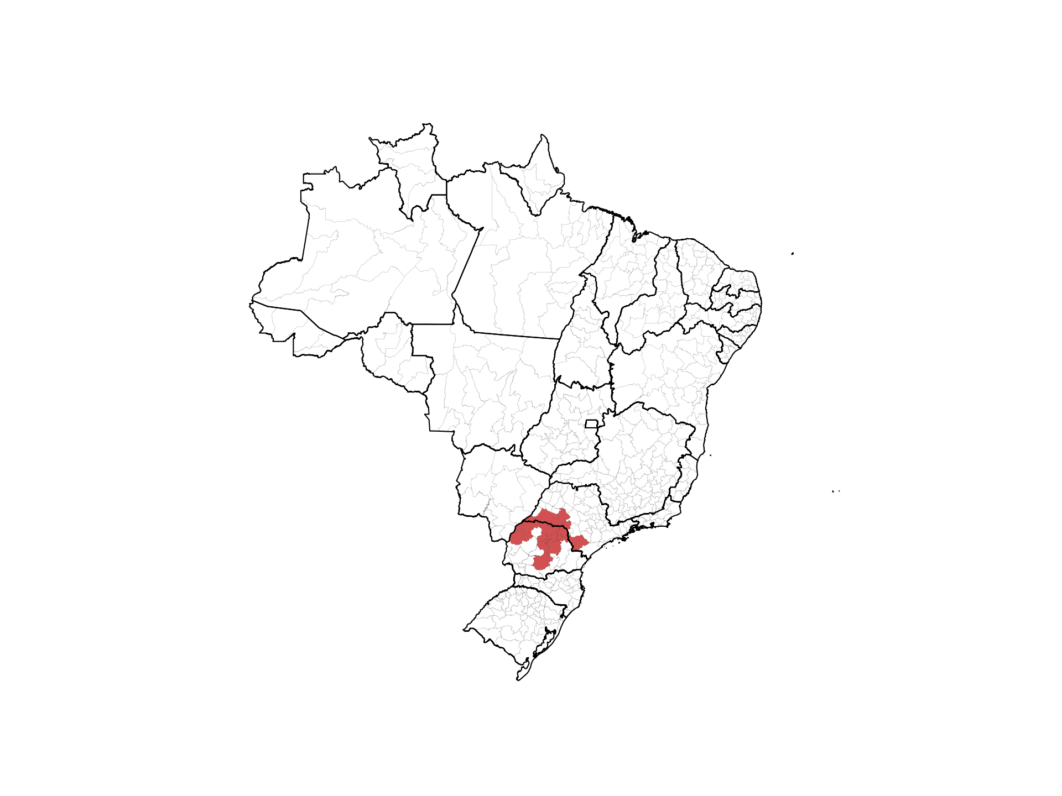

Slide 23
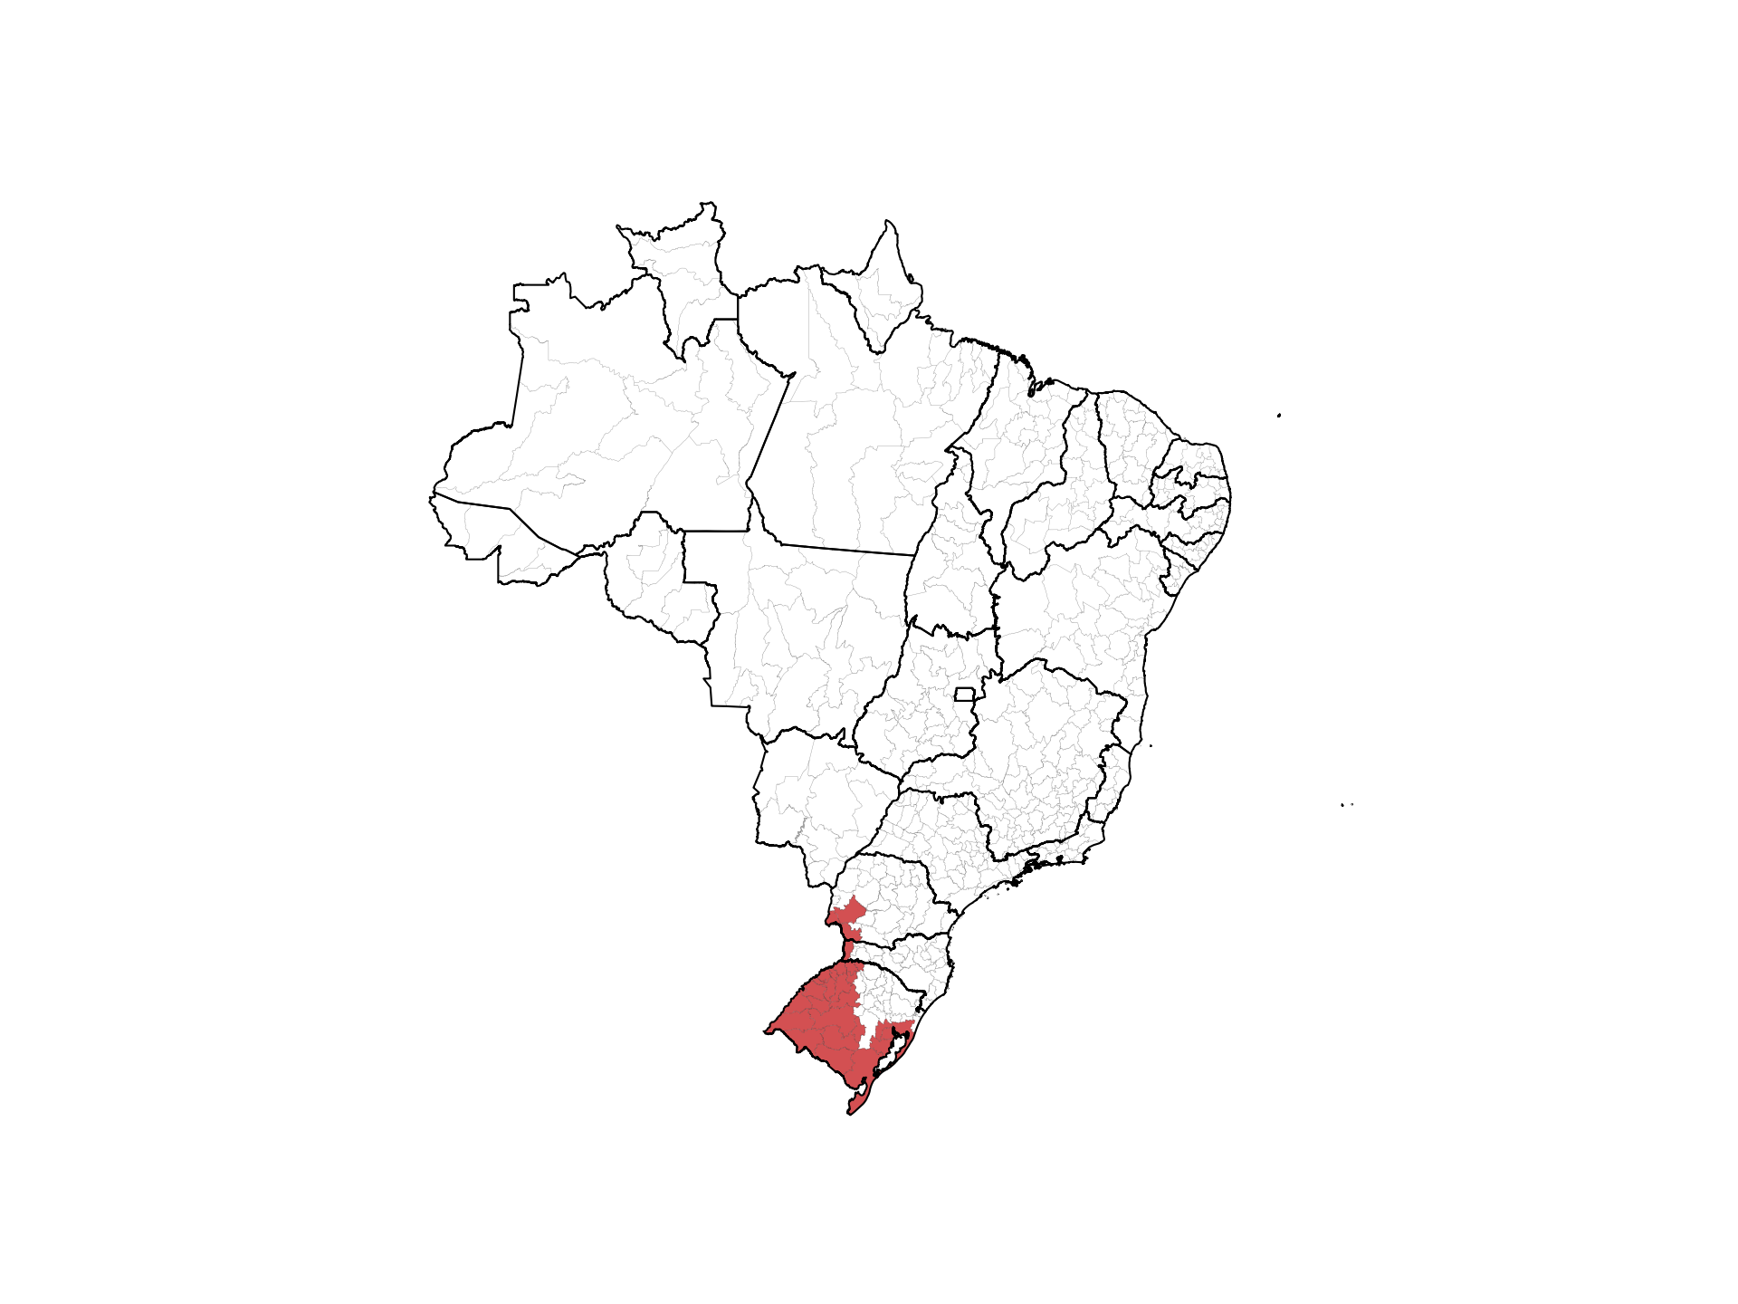

Slide 24
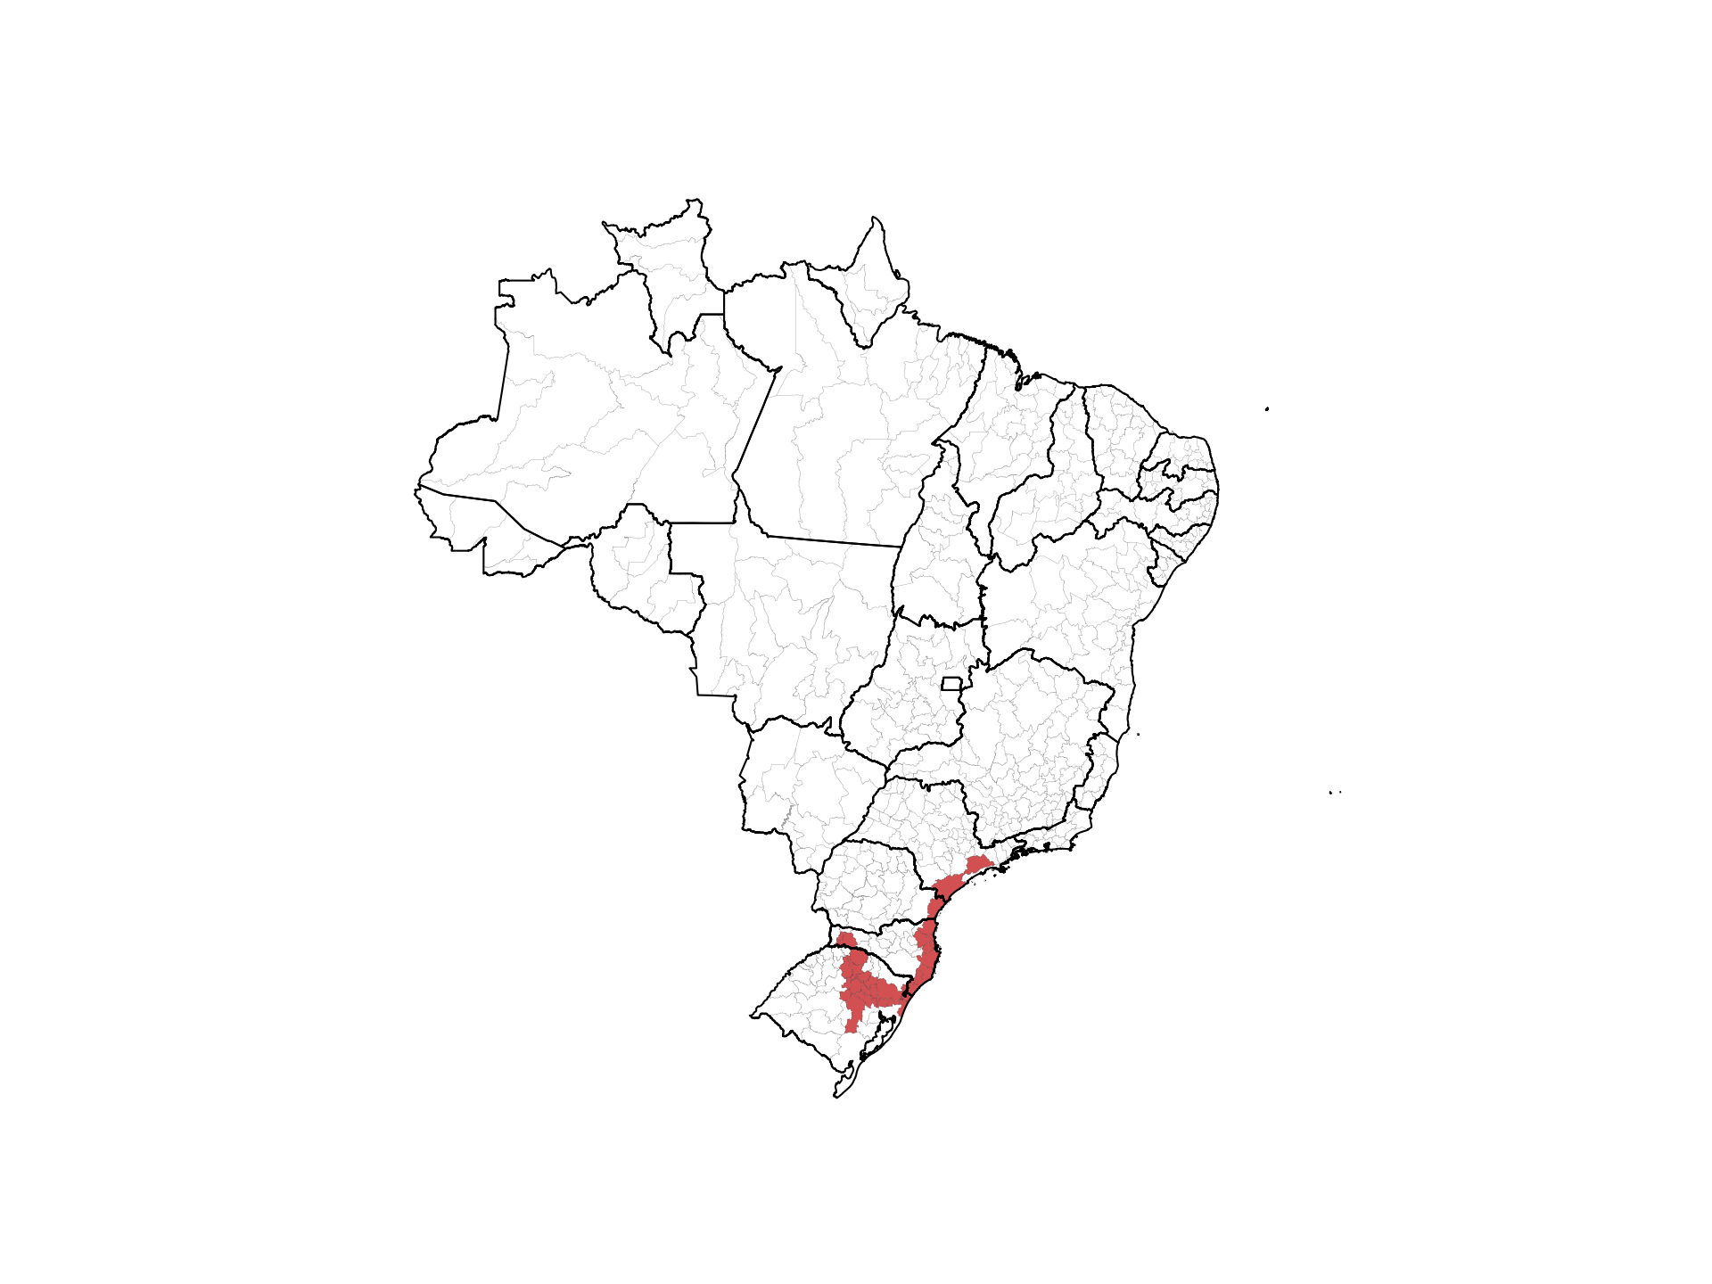

Slide 25
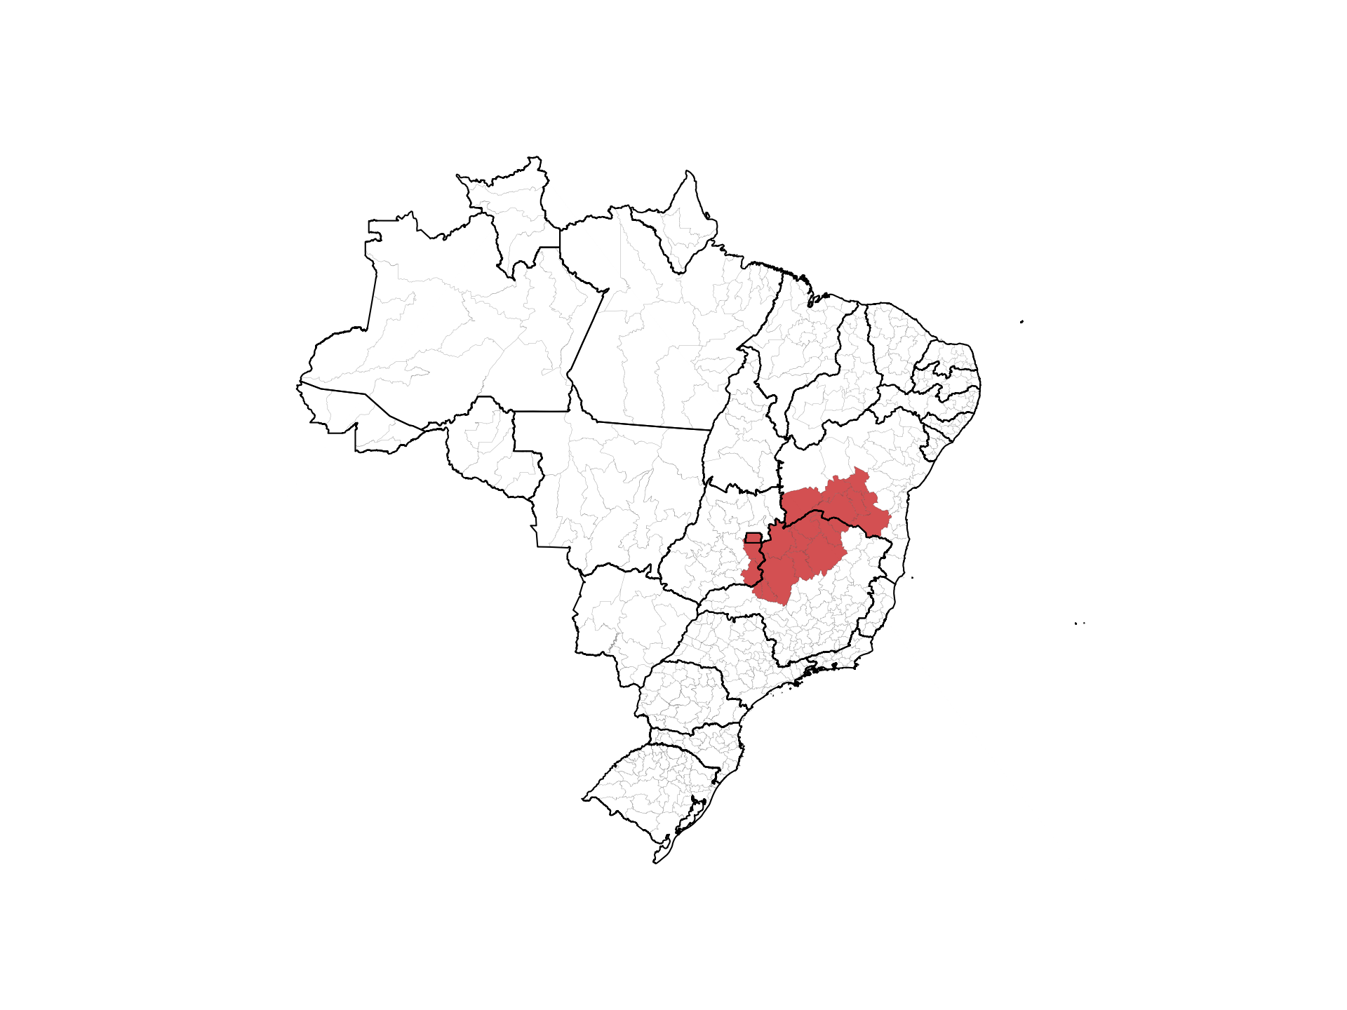

Slide 26
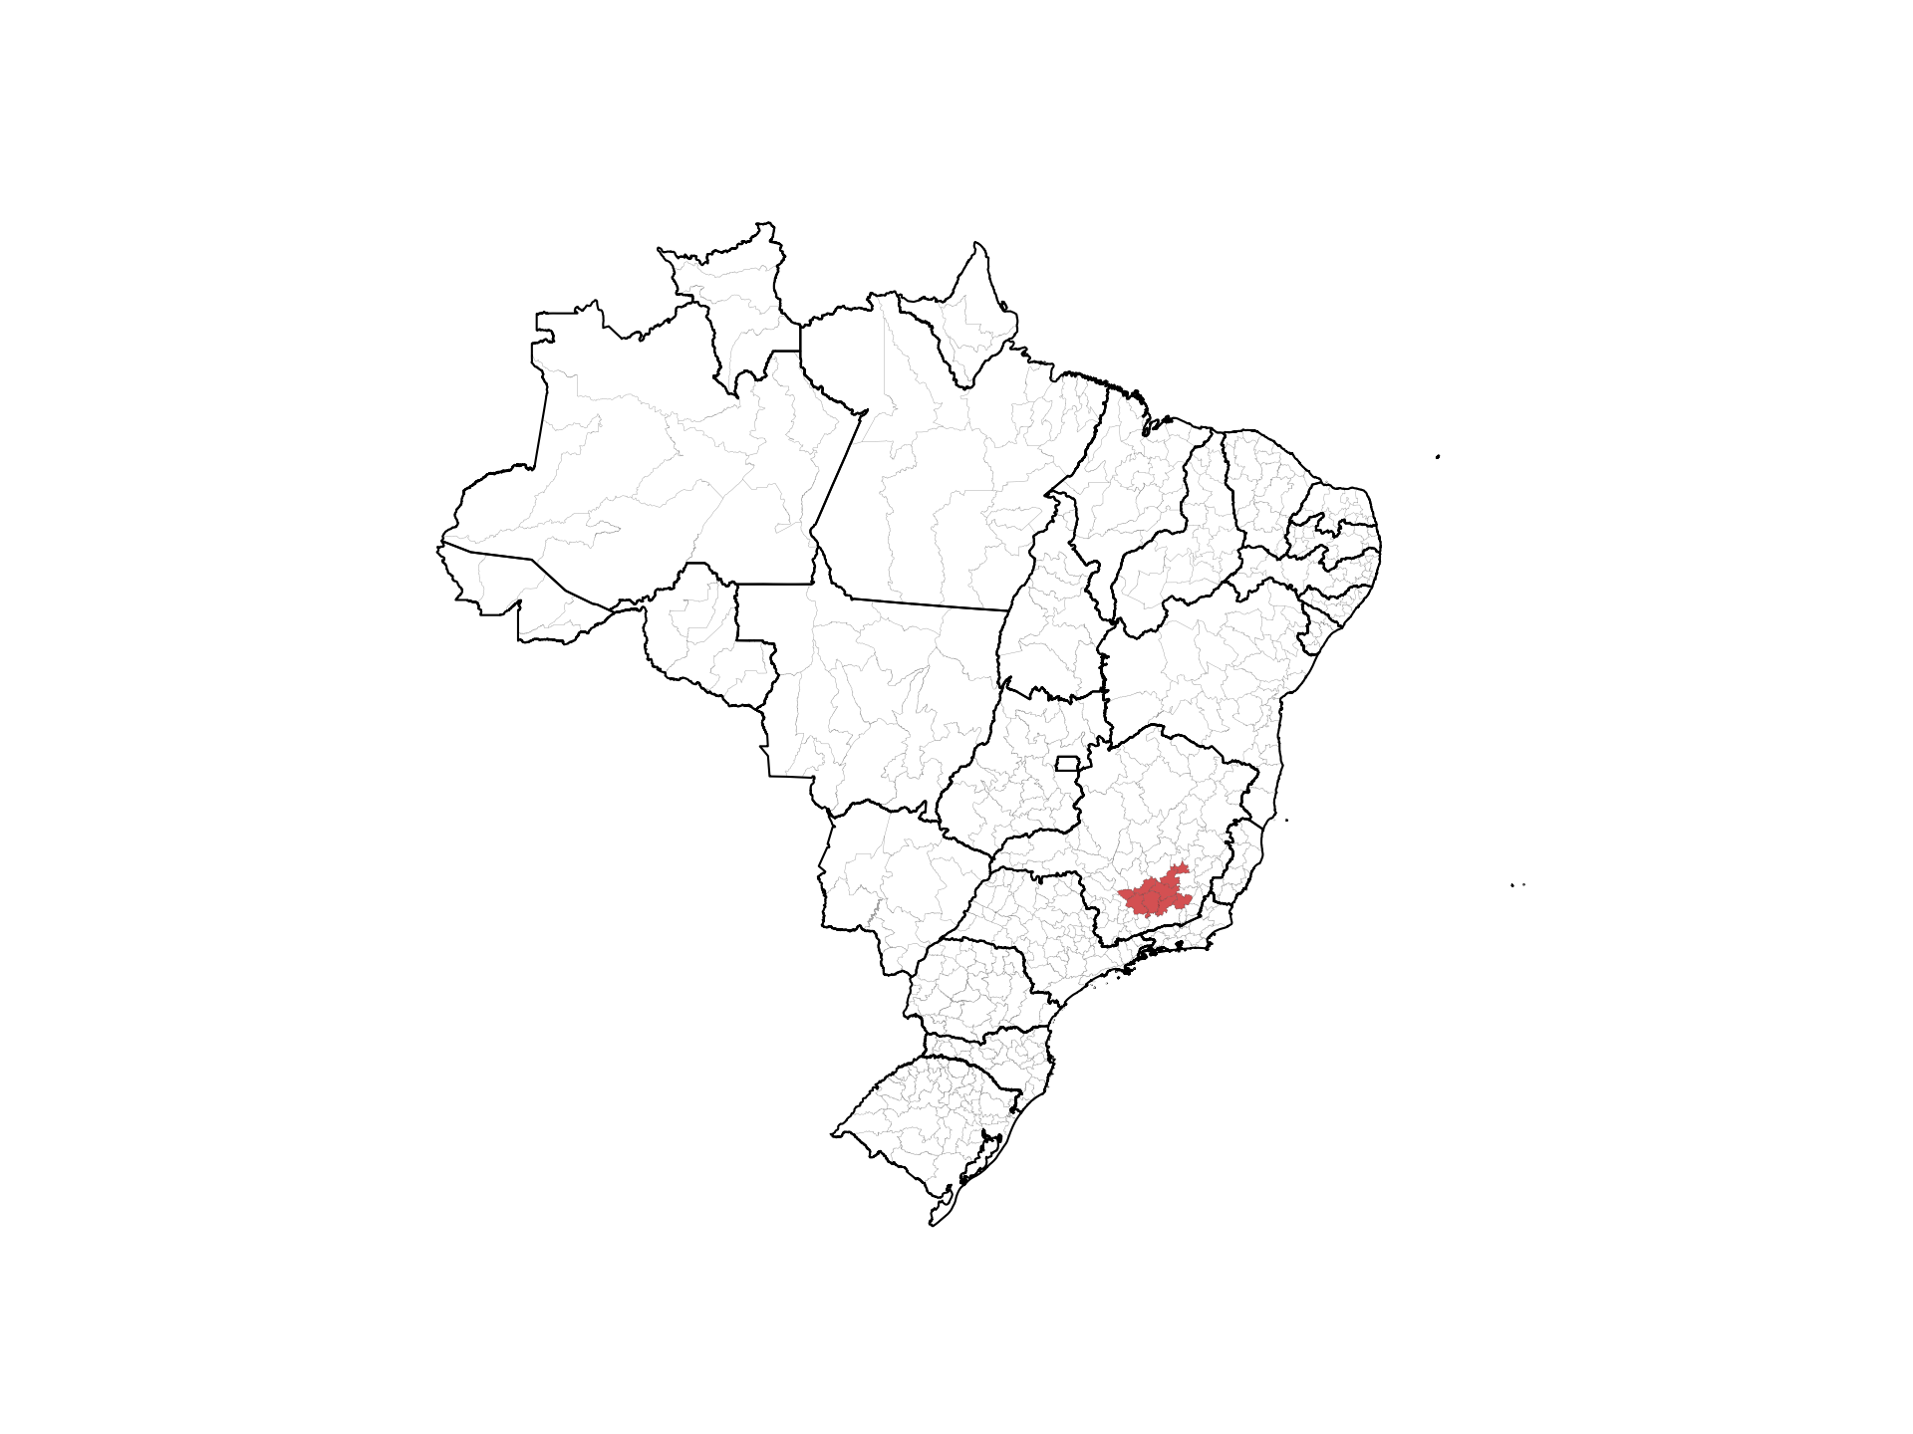

Slide 27
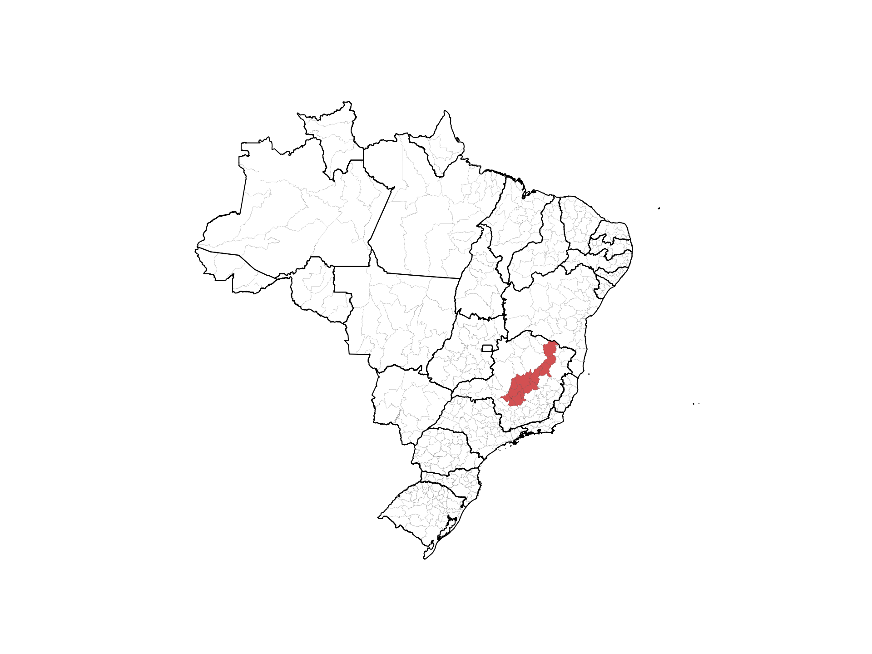

Slide 28
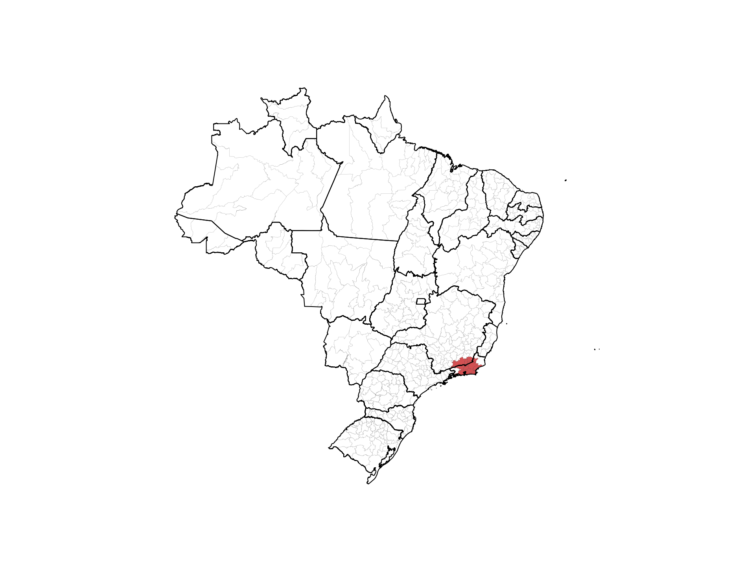

Slide 30
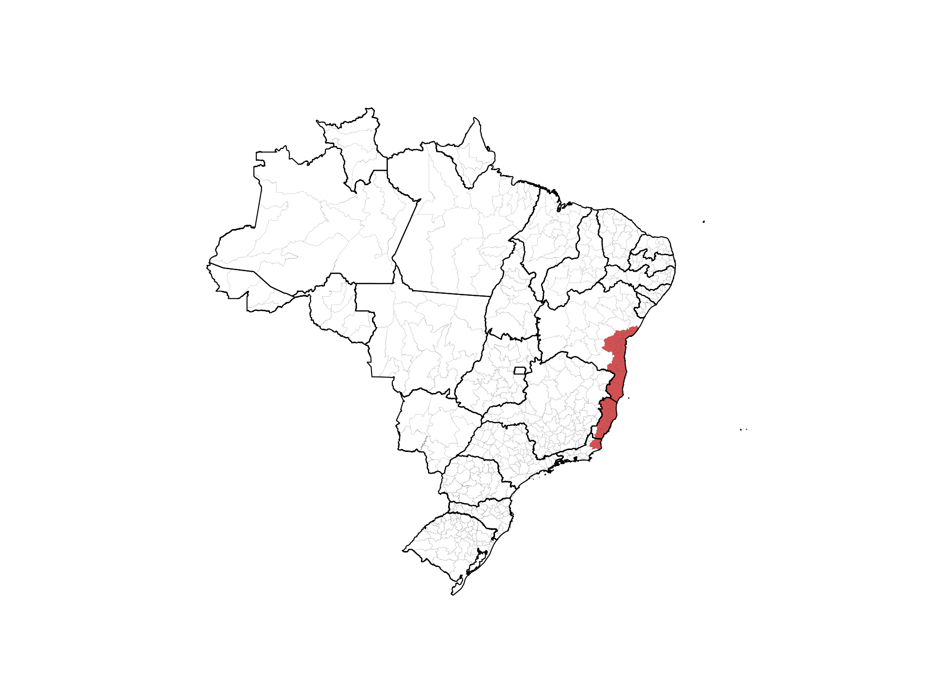

Slide 31
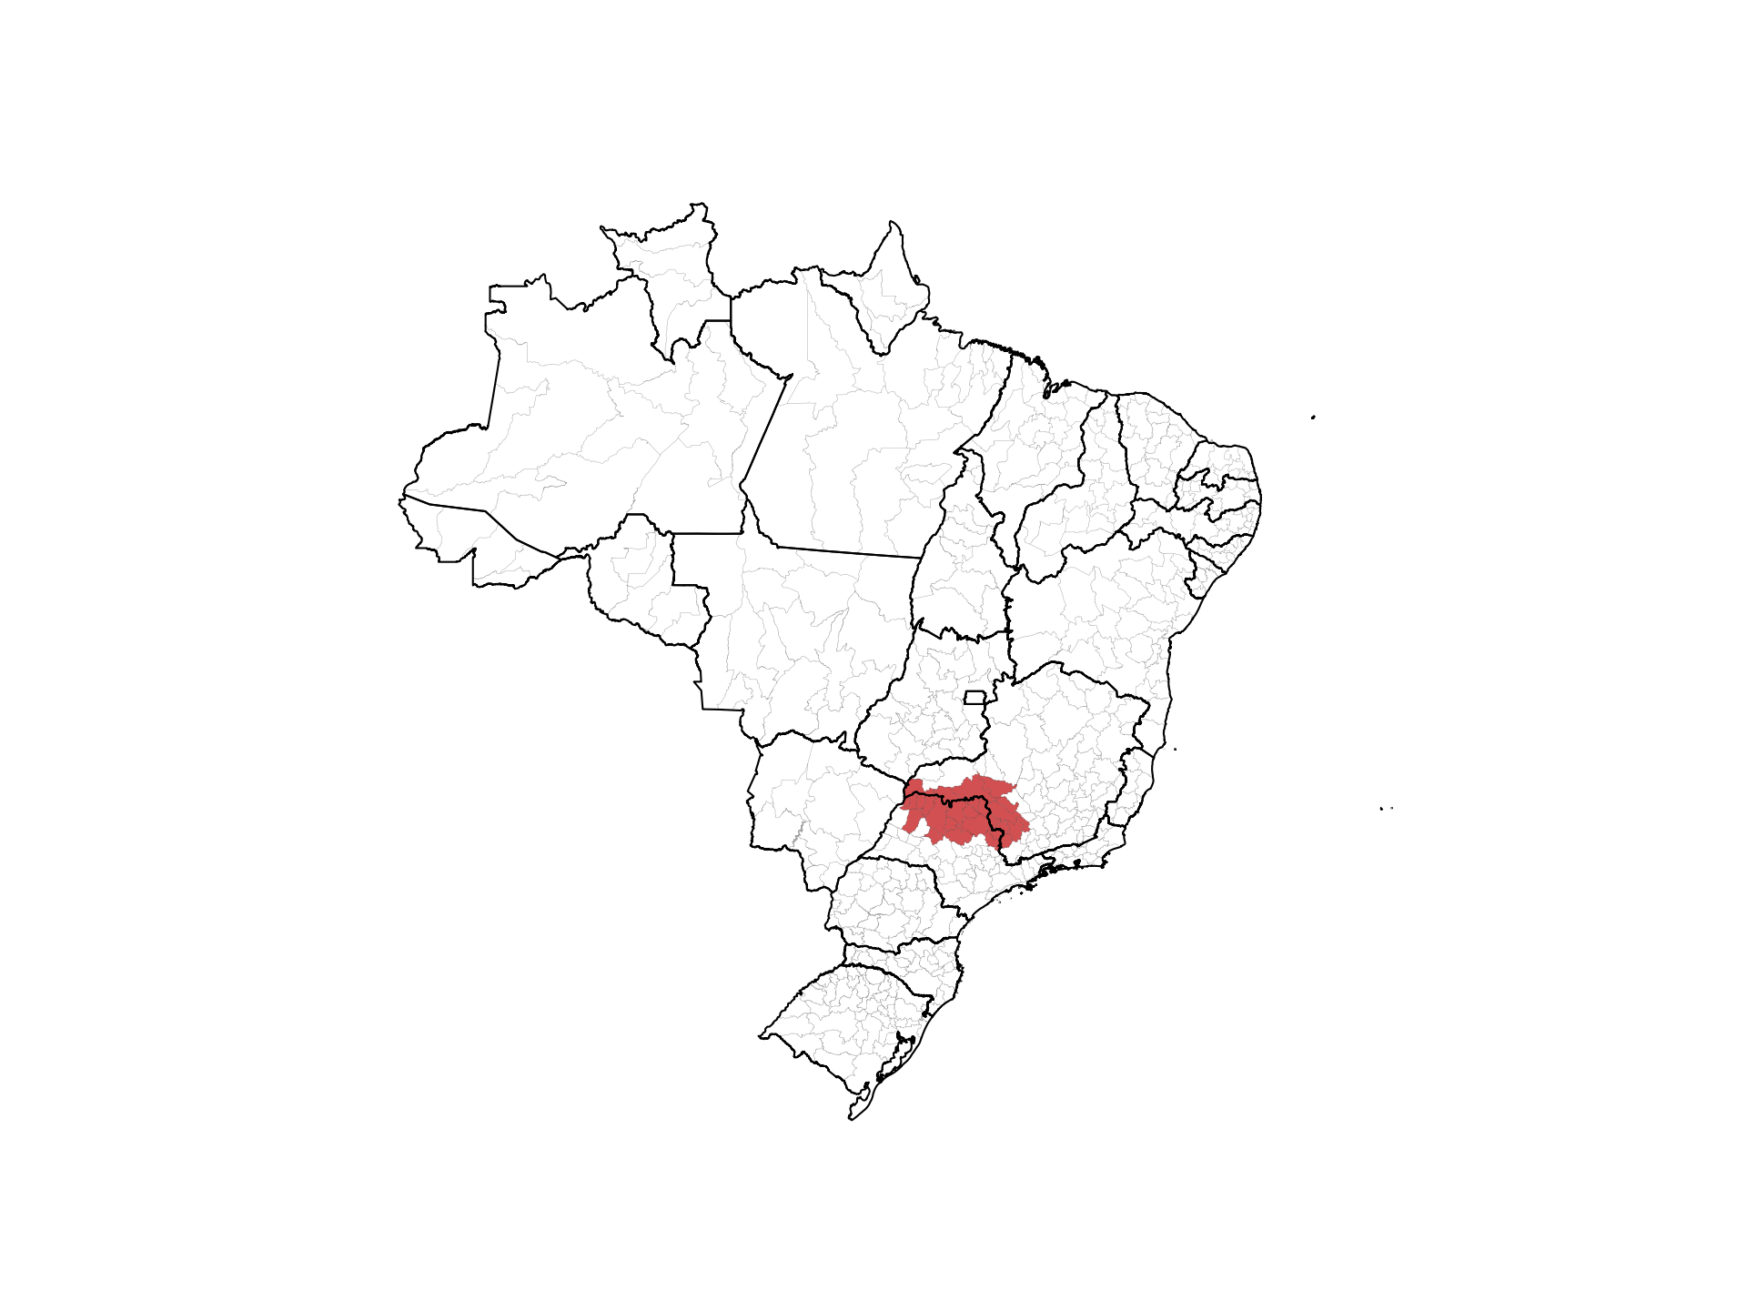

Slide 32
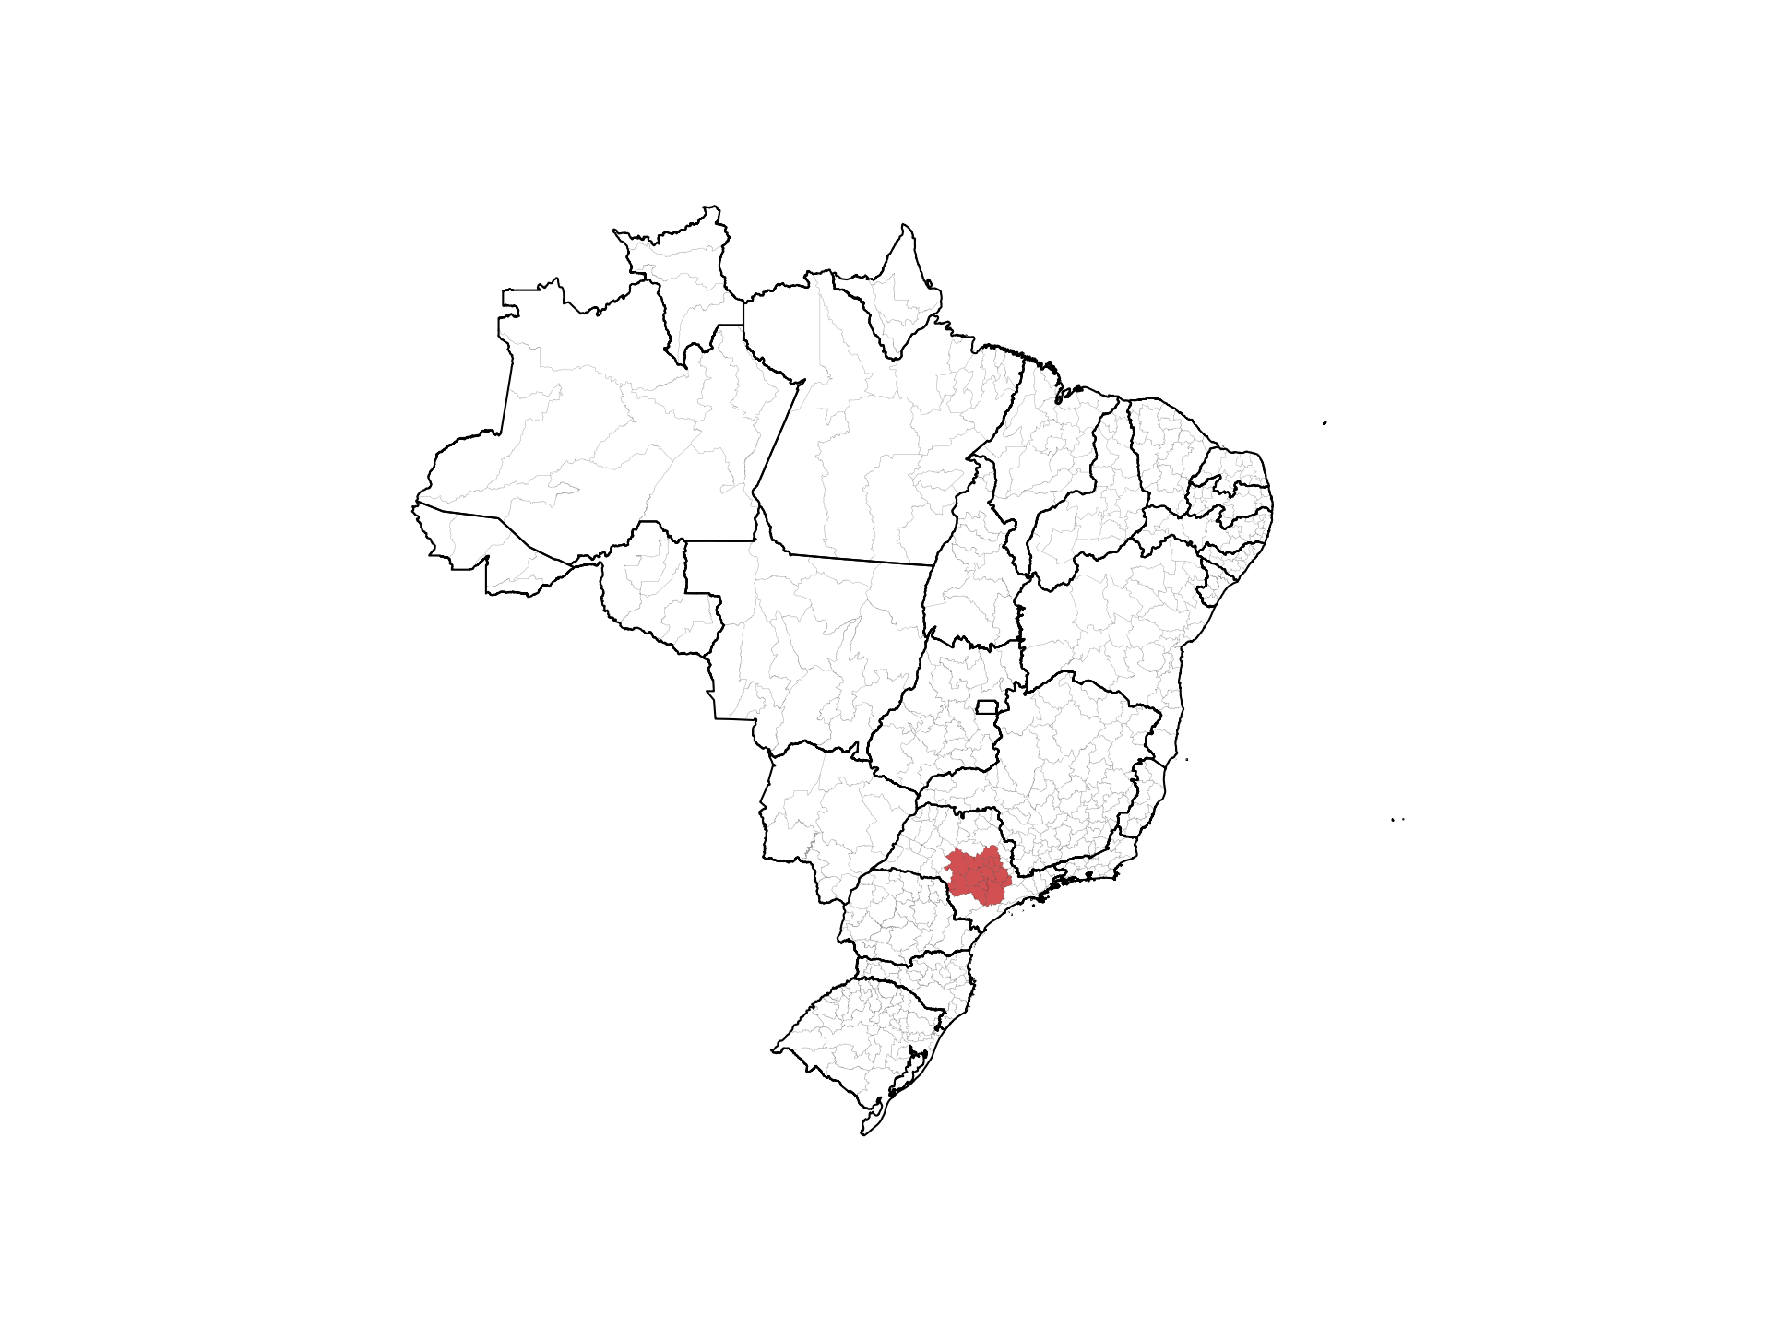

Slide 33
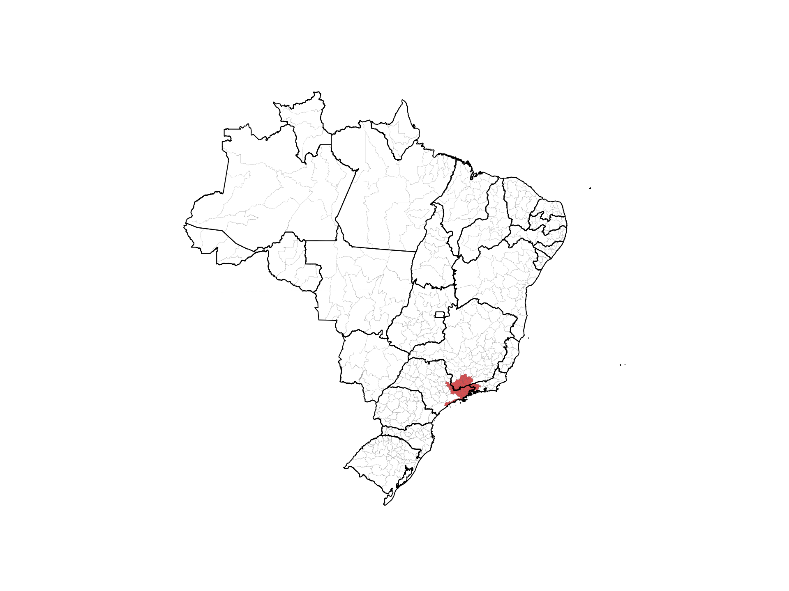

Slide 34
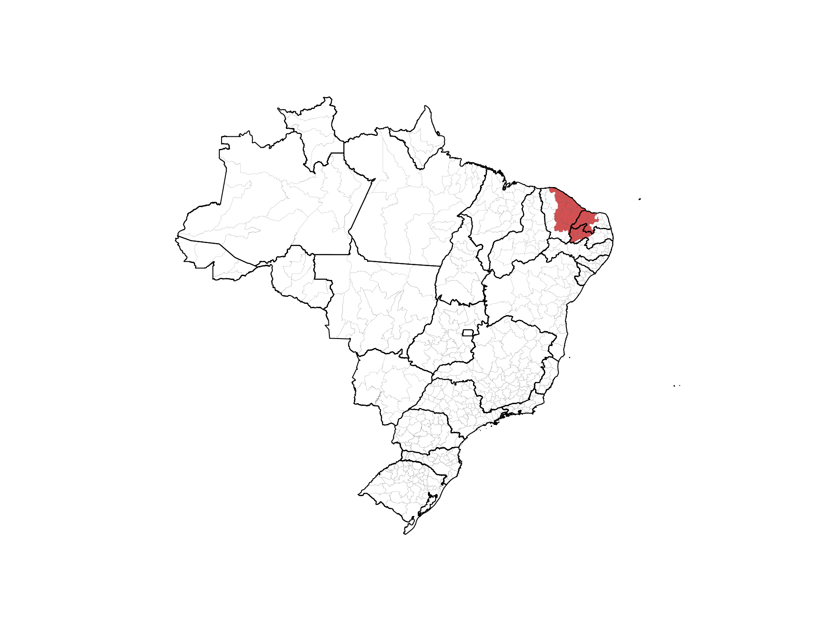

Slide 35
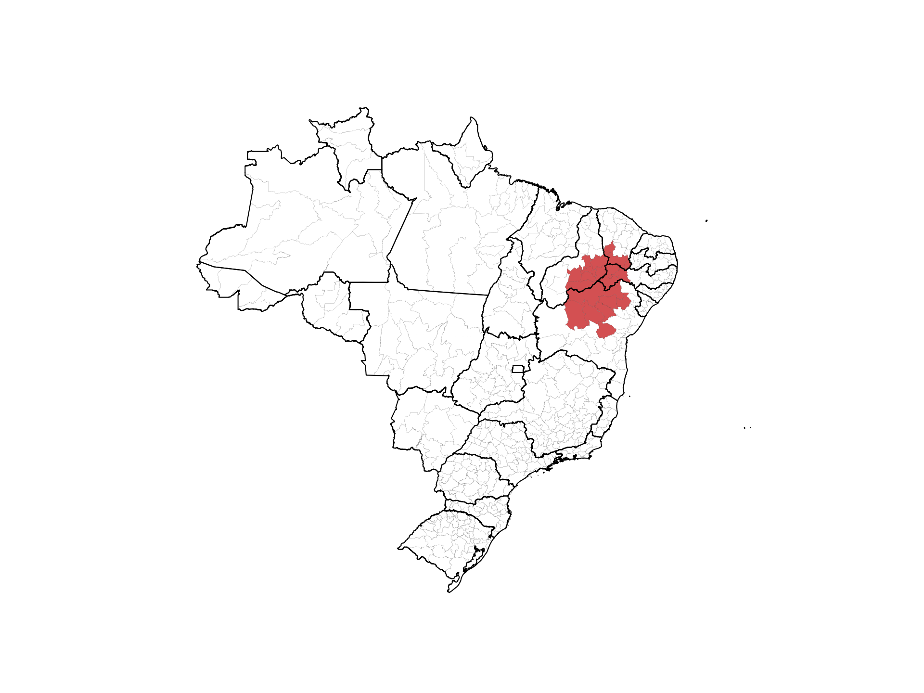

Slide 36
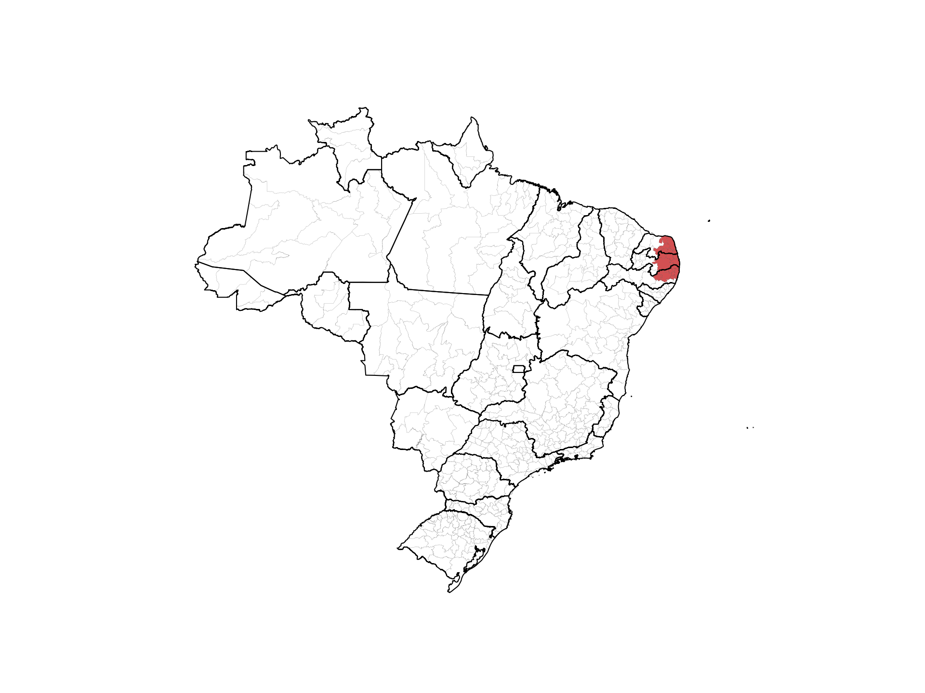

Slide 37
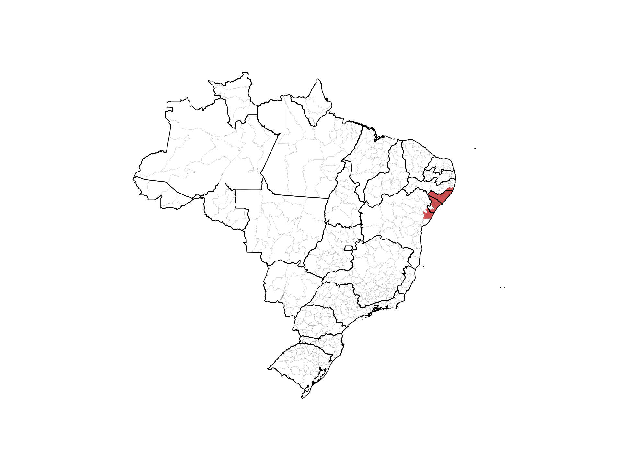

Slide 38
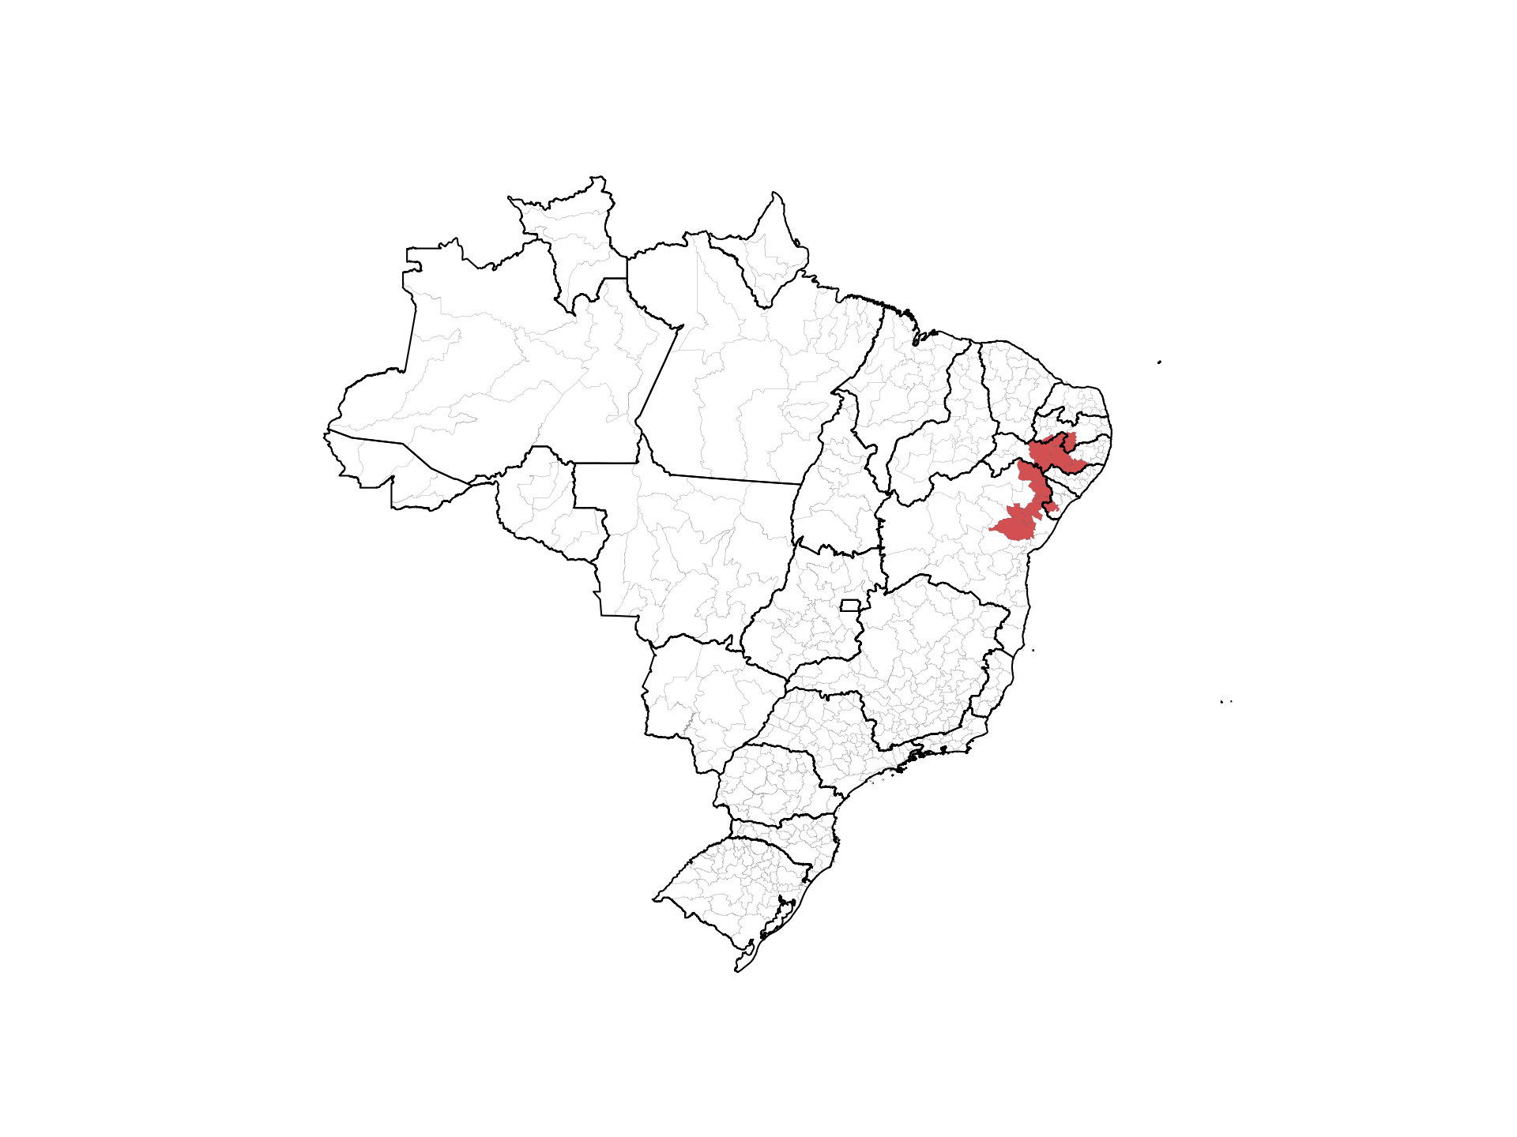

Slide 39
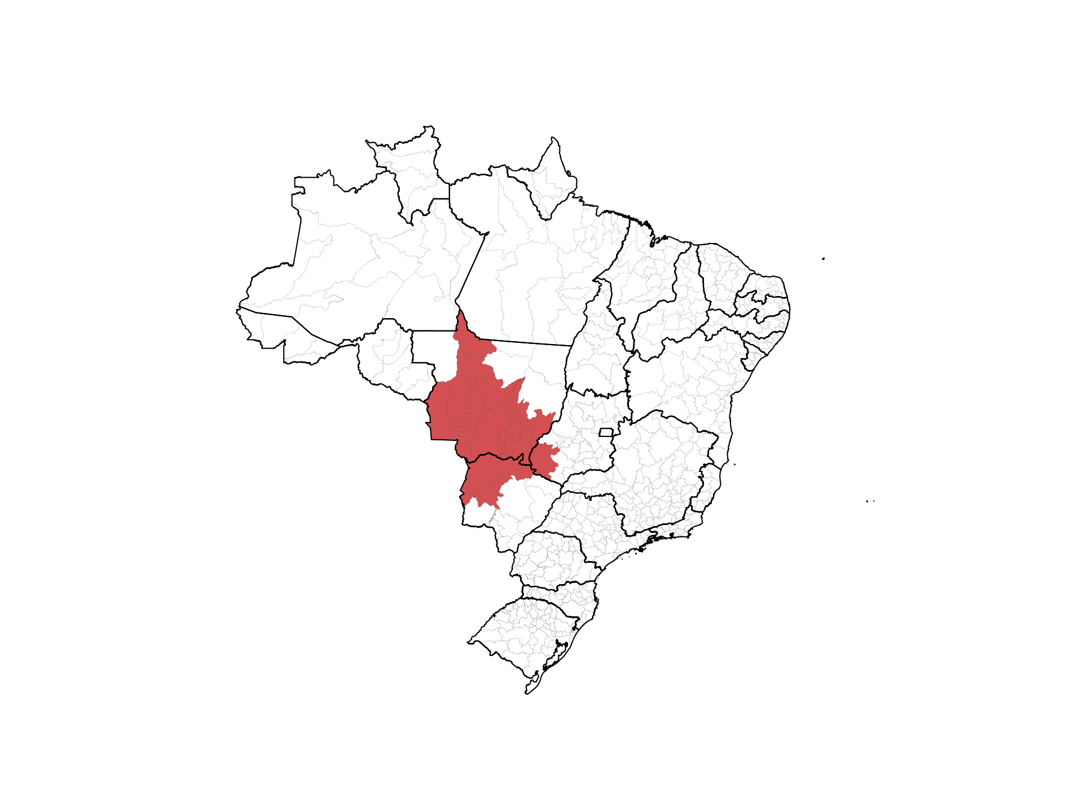

Slide 41
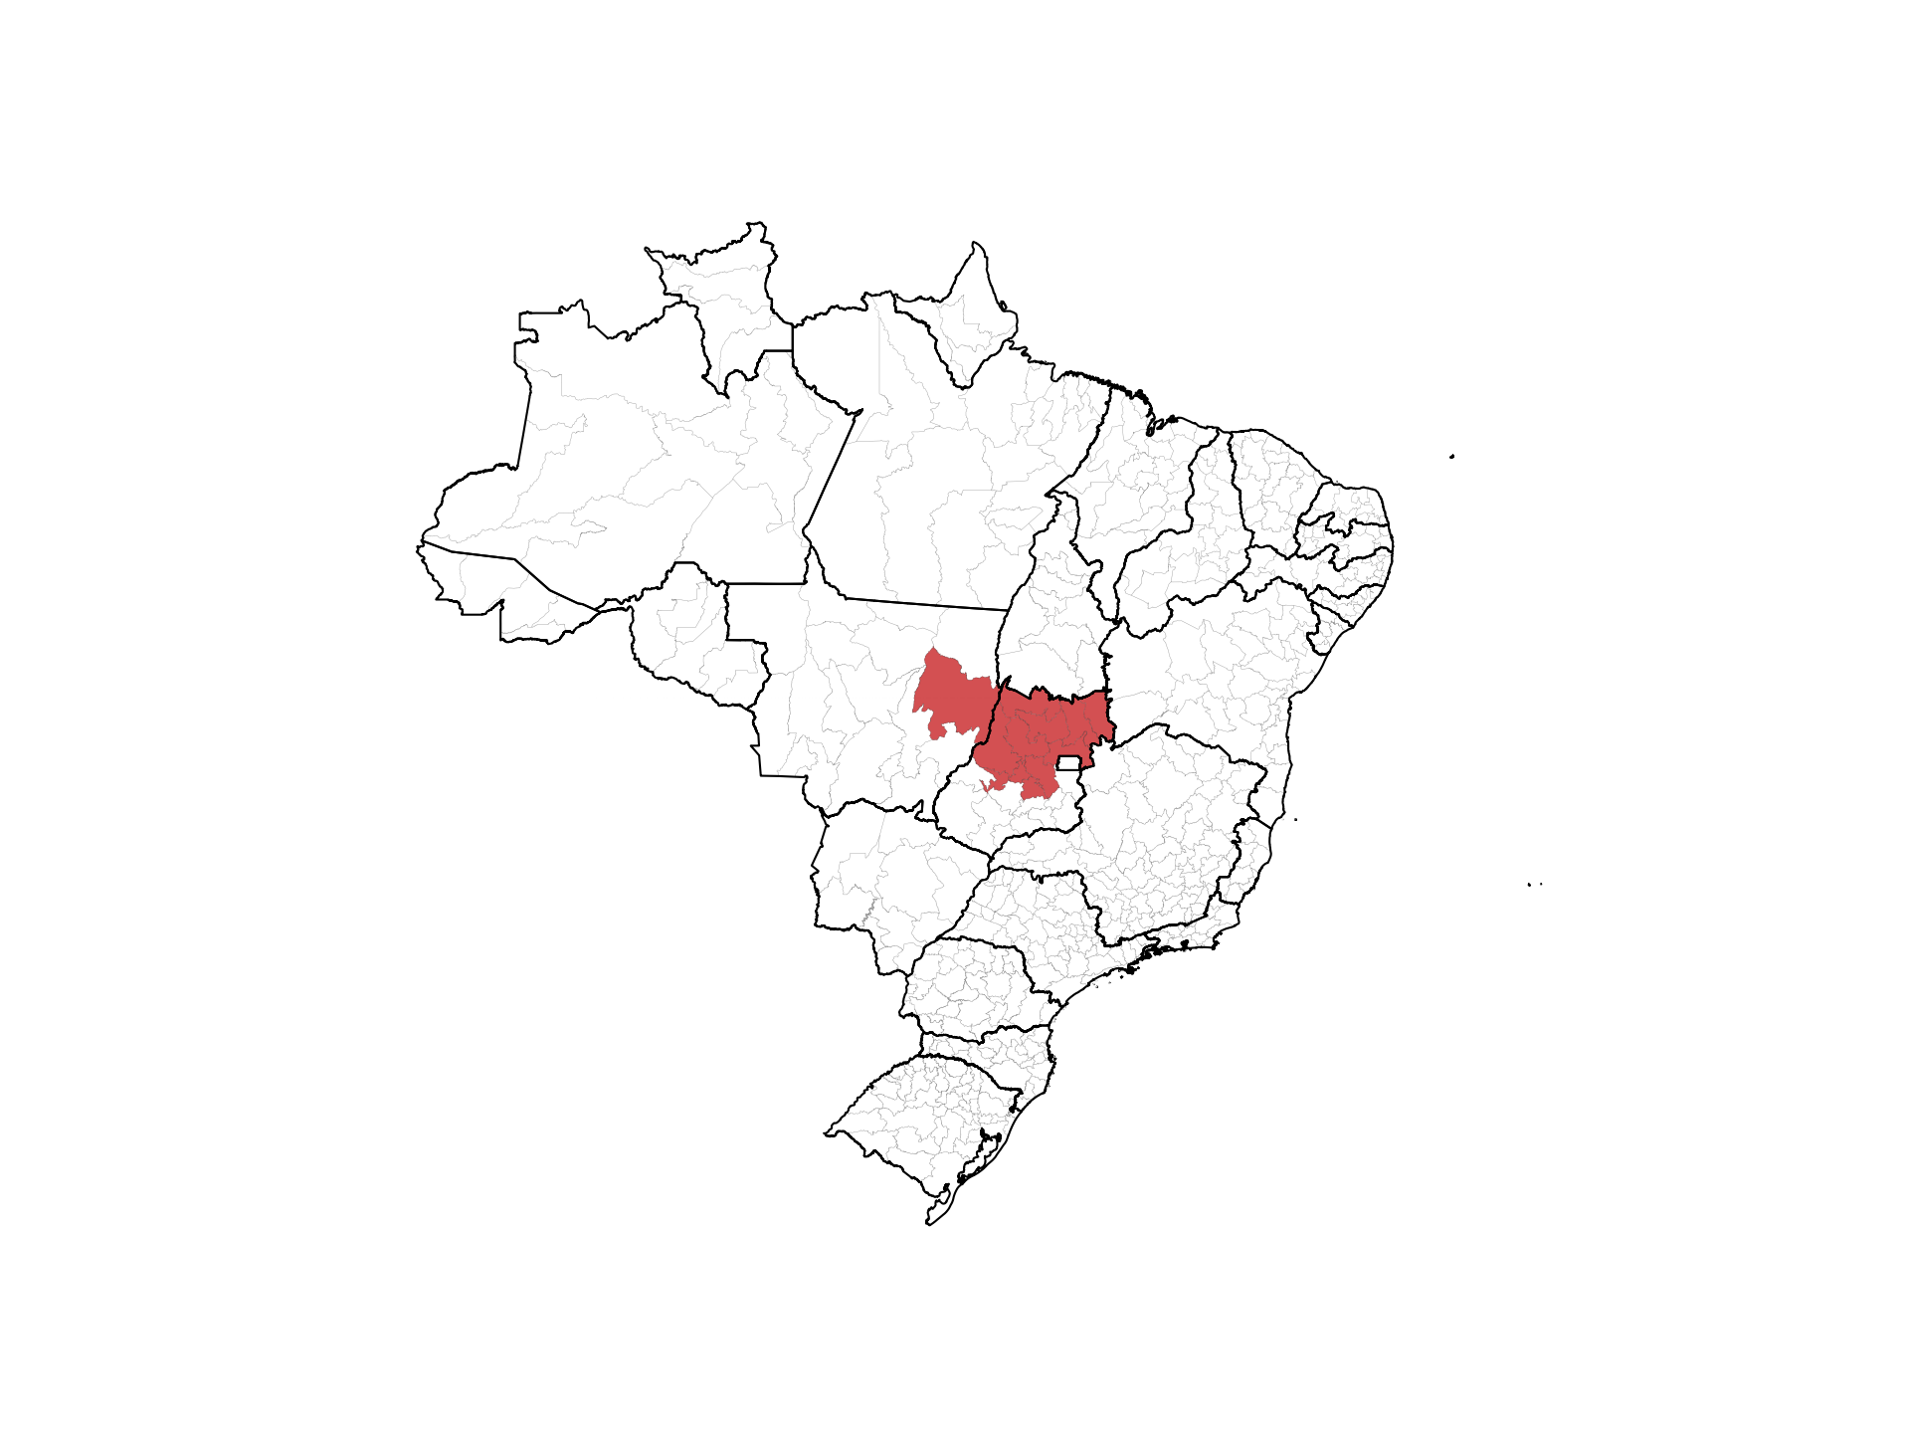

Slide 43
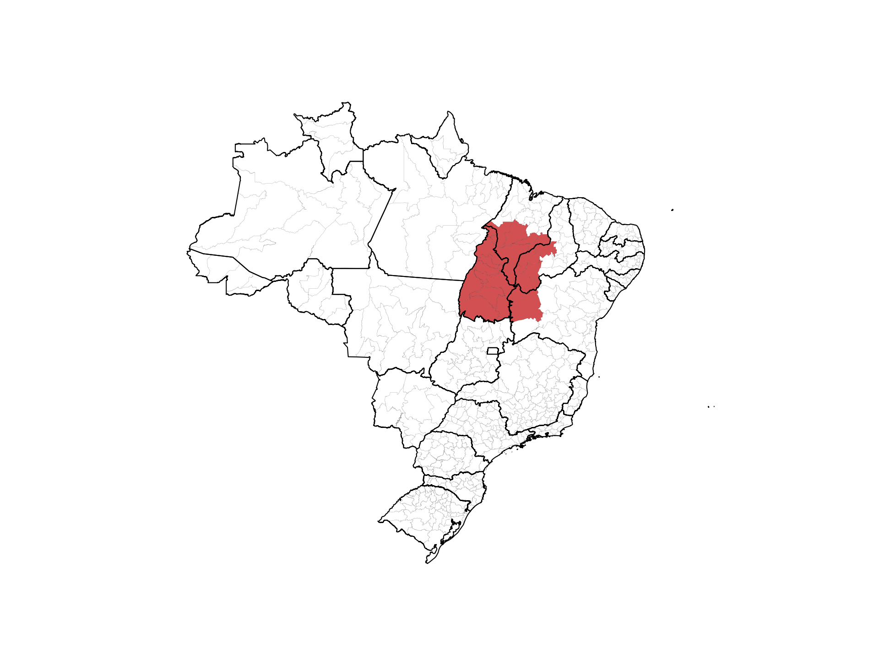

Slide 44
