Slide 1
Sprint 2025
09/06/2025

Slide 2
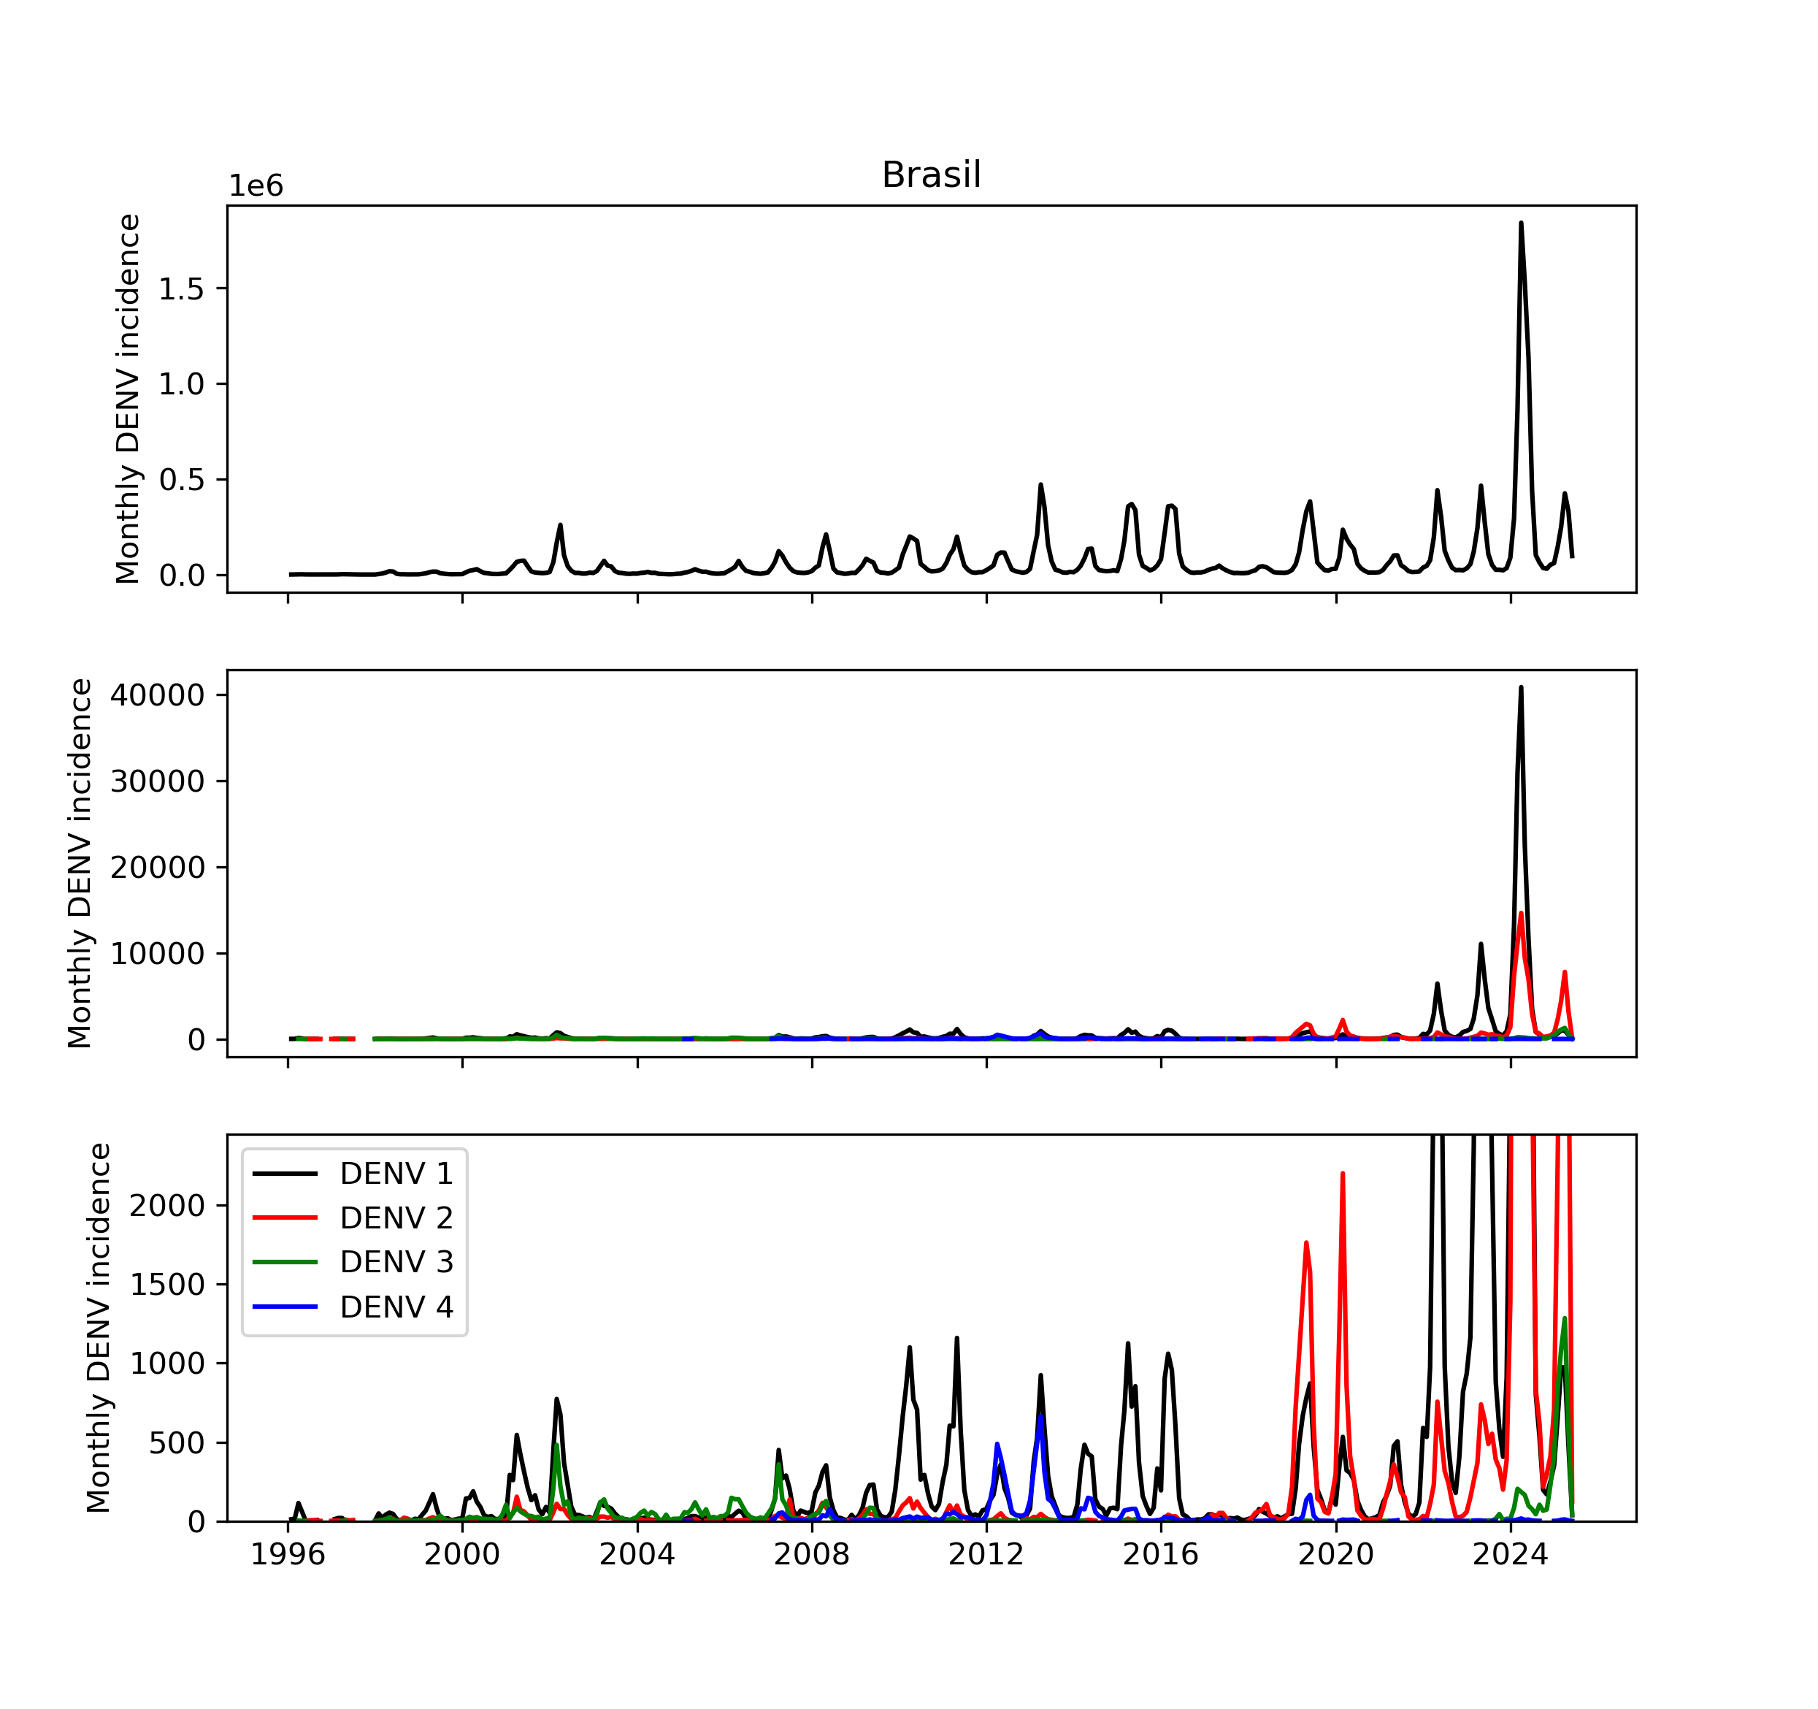
Linelist data
UF | date | DENV_1 | DENV_2 | DENV_3 | DENV_4 | DENV_total
AC | 2000-12-31 |  |  |  |  | 419.0
AC | 2001-01-31 | 2.0 |  |  |  | 1299.0
AC | 2001-02-28 | 12.0 |  | 2.0 |  | 355.0
AC | 2001-03-31 | 12.0 |  |  |  | 144.0
AC | 2001-04-30 | 2.0 |  |  |  | 76.0
AC | 2001-05-31 | 1.0 |  |  |  | 27.0
AC | 2001-06-30 | 1.0 |  |  |  | 44.0
AC | 2001-07-31 |  |  |  |  | 8.0
AC | 2001-08-31 |  |  |  |  | 9.0
AC | 2001-09-30 |  |  |  |  | 9.0
AC | 2001-10-31 | 1.0 |  |  |  | 14.0
AC | 2001-12-31 |  |  |  |  | 56.0
AC | 2002-01-31 |  |  |  |  | 58.0
AC | 2002-02-28 | 1.0 |  |  |  | 136.0
AC | 2002-03-31 |  |  |  |  | 322.0
AC | 2002-04-30 |  |  |  |  | 77.0
AC | 2002-05-31 |  |  |  |  | 35.0
Formatted to contain monthly serotyped DENV 1-4 incidence per Brazilian state + total DENV cases
`DENV_total`: reliable and complete
`DENV_1-4`: sparse
DENV_total
DENV_1-4

Slide 3
Linelist data
Agreement between DENV_total and DENV1-4 is hazy
Macro trend: Peaks and throughs overlap, if there’s a lot of DENV then cases get serotyped
Micro trend:
Pre-2020: little correlation between peak height of DENV_total and the serotyped cases indicating collection was ad-hoc
Overall serotyping capacity (fraction of column DENV_total captured in DENV1-4) increased over the years
DENV_total
DENV_1-4

Slide 4
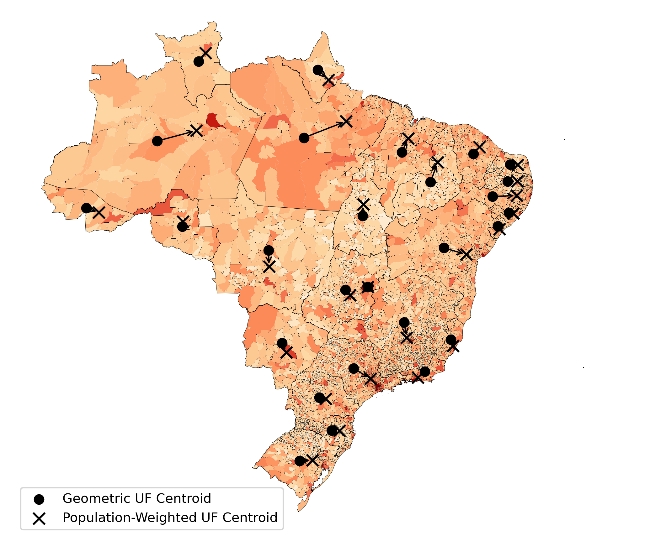
Covariates
Build a dataset of potential state-level covariates
Also a demographically-weighted state distance matrix D (origin-destination type, square)
uf | population | population_density | gini_population | hospital_beds_per_1000 | rel_humid_med | precip_med | temp_med | population_weighted_latitude
AC | 765021 | 4.47 | 0.61 | 2.03 | 84.04 | 17.98 | 25.31 | -9.57
AL | 3131625 | 107.66 | 0.59 | 2.19 | 75.64 | 8.45 | 25.00 | -9.54
AM | 3551196 | 2.23 | 0.67 | 1.80 | 86.30 | 25.26 | 26.17 | -3.37
AP | 686987 | 4.81 | 0.73 | 1.72 | 82.85 | 22.89 | 25.93 | 0.64
BA | 14187523 | 24.56 | 0.57 | 2.30 | 71.50 | 7.80 | 24.04 | -12.89

Slide 5
Serotype imputation (Laura)
Spatially hierarchical threshold method
Pool data temporally over N weeks in the past
Define a threshold number of total reported cases (sum over serotypes) needed to achieve a desired level of confidence in our estimate of the underlying population metric (see next slide)
Start at state level: IF incidence > threshold → use incidence at this level ELSE move up to the regional level and repeat this procedure.

Slide 6
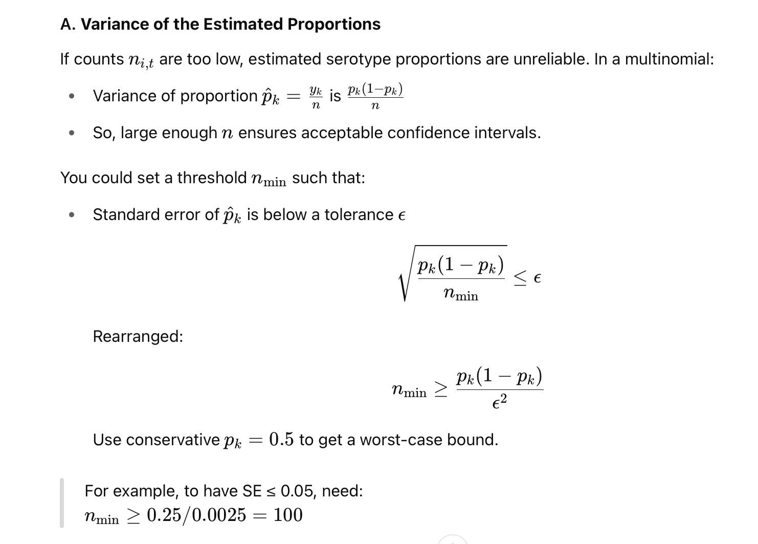
Serotype imputation (Laura)
10% SE = incidence over 25 (across all serotypes)
20% SE = incidence over 7 (across all serotypes)
ChatGPT pointer: Look into Empirical Bayes (James-Stein shrinkage) to formalize/smoothen the thresholds

Slide 7
Serotype imputation (Laura)
Compare line listed versus `banco de dengue sorotipo.csv` data
Build threshold-based spatially-hierarchical imputation procedure
Get dataframe with serotype proportion by state + week → + where it comes from (Brazil, region, state)
Investigate role of threshold value and temporal pooling length

Slide 8
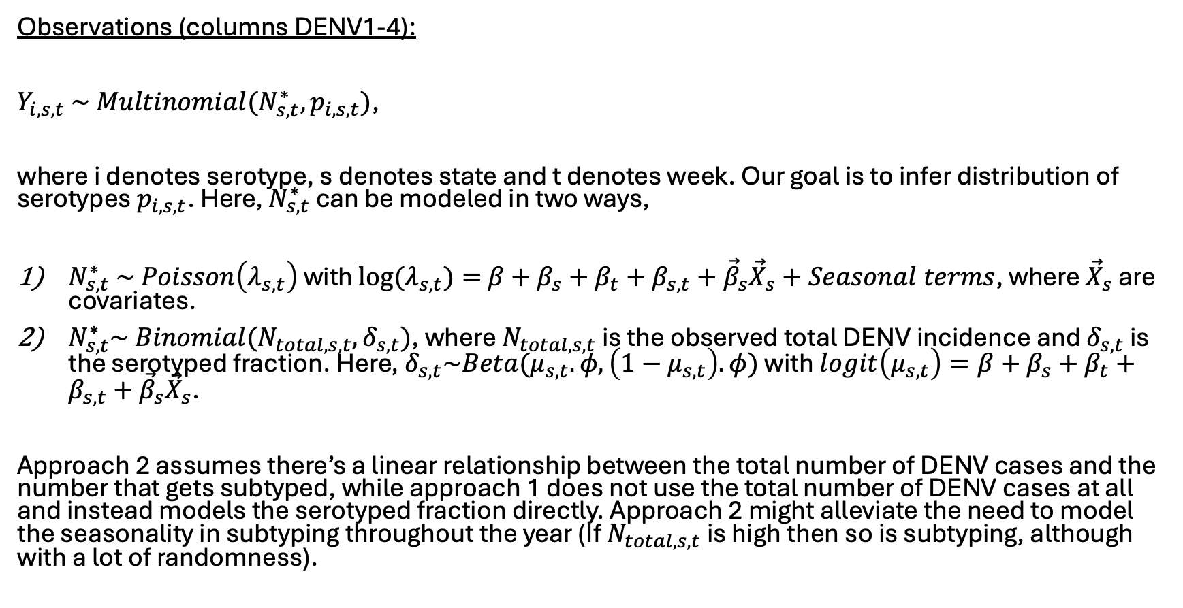
Serotype imputation: Bayesian hierarchical model
Observations (columns DENV1-4):
$Y_{i,s,t} \sim Multinomial(N_{s,t}^{∗},p_{i,s,t})$,
where i denotes serotype, s denotes state and t denotes week. Our goal is to infer distribution of serotypes $p_{i,s,t}$. Here, $N_{s,t}^{∗}$ can be modeled in two ways,
$N_{s,t}^{∗} \sim Poisson\left(λ_{s,t}\right)$ with $\log{(λ_{s,t})}=$ $β+β_{s}+β_{t}+β_{s,t}+{\vec{β}}_{s}{\vec{X}}_{s}+Seasonal terms$, where ${\vec{X}}_{s}$ are covariates.
$N_{s,t}^{∗}\sim Binomial(N_{total, s,t},δ_{s,t})$, where $N_{total, s,t}$ is the observed total DENV incidence and $δ_{s,t}$ is the serotyped fraction. Here, $δ_{s,t}\sim Beta(μ_{s,t}.φ,\left(1−μ_{s,t}\right).φ)$ with $logit\left(μ_{s,t}\right)=β+β_{s}+β_{t}+β_{s,t}+{\vec{β}}_{s}{\vec{X}}_{s}$.
Approach 2 assumes there’s a linear relationship between the total number of DENV cases and the number that gets subtyped, while approach 1 does not use the total number of DENV cases at all and instead models the serotyped fraction directly. Approach 2 might alleviate the need to model the seasonality in subtyping throughout the year (If $N_{total, s,t}$ is high then so is subtyping, although with a lot of randomness).

Slide 9
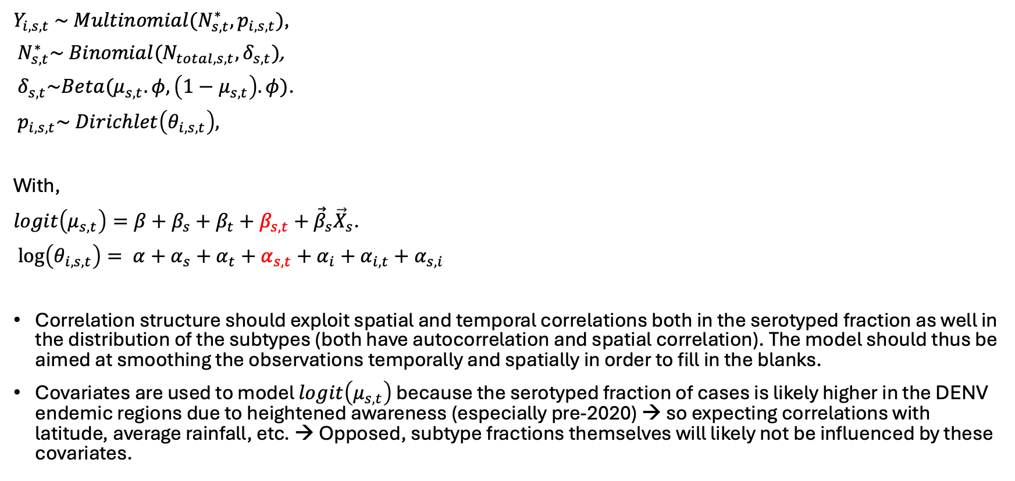
Serotype imputation: Bayesian hierarchical model
$Y_{i,s,t} \sim Multinomial(N_{s,t}^{∗},p_{i,s,t})$,
$N_{s,t}^{∗}\sim Binomial(N_{total, s,t},δ_{s,t})$,
$δ_{s,t}\sim Beta(μ_{s,t}.φ,\left(1−μ_{s,t}\right).φ)$.
$p_{i,s,t}\sim Dirichlet\left(θ_{i,s,t}\right),$
With,
$logit\left(μ_{s,t}\right)=β+β_{s}+β_{t}+β_{s,t}+{\vec{β}}_{s}{\vec{X}}_{s}$.
$\log\left(θ_{i,s,t}\right)= α+α_{s}+α_{t}+α_{s,t}+α_{i}+α_{i,t}+α_{s,i}$
Correlation structure should exploit spatial and temporal correlations both in the serotyped fraction as well in the distribution of the subtypes (both have autocorrelation and spatial correlation). The model should thus be aimed at smoothing the observations temporally and spatially in order to fill in the blanks.
Covariates are used to model $logit\left(μ_{s,t}\right)$ because the serotyped fraction of cases is likely higher in the DENV endemic regions due to heightened awareness (especially pre-2020) → so expecting correlations with latitude, average rainfall, etc. → Opposed, subtype fractions themselves will likely not be influenced by these covariates.

Slide 10
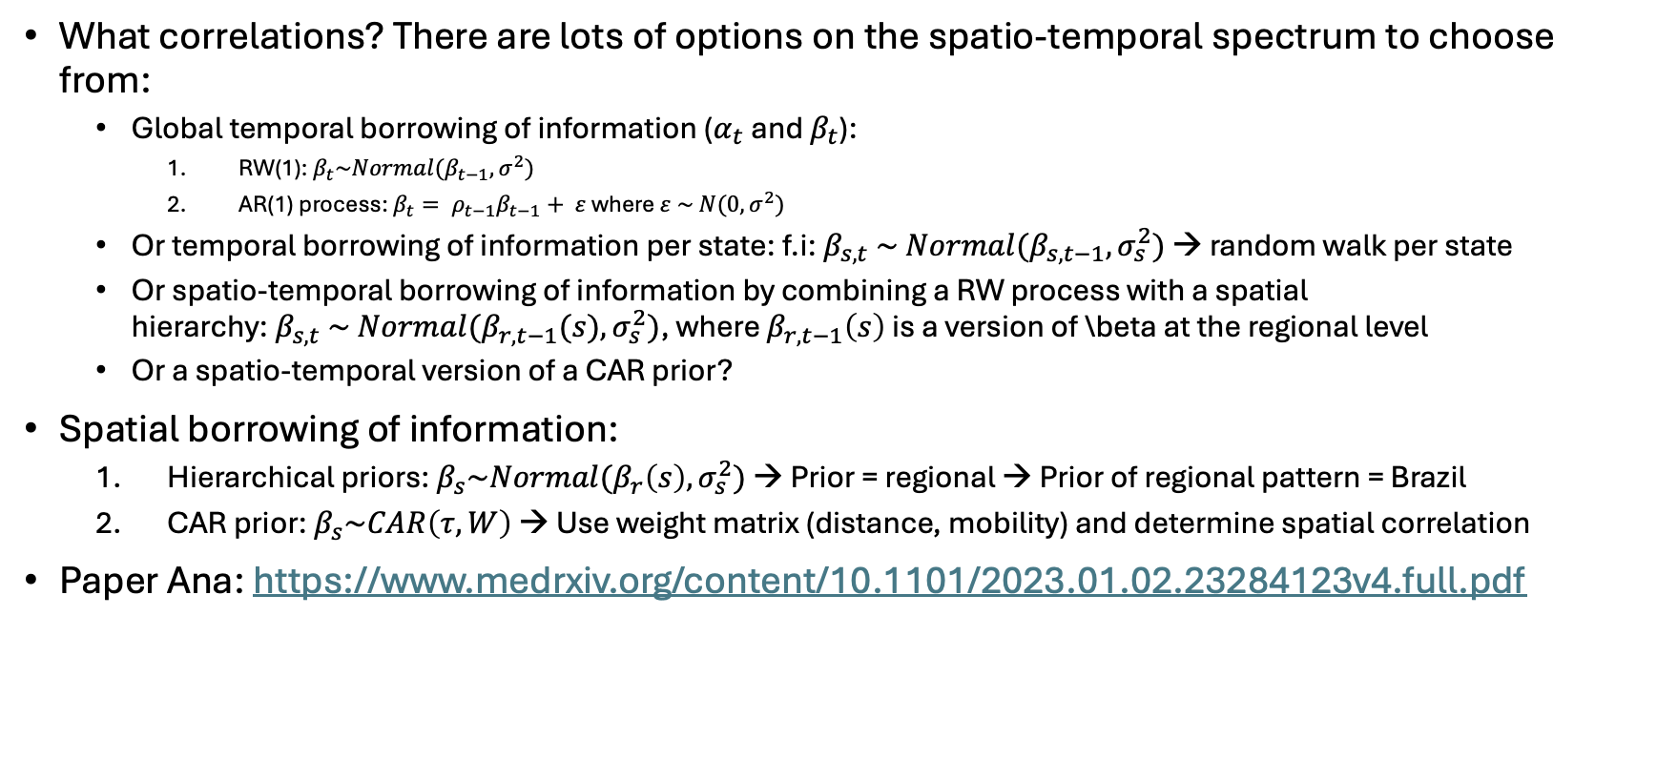
Serotype imputation: Bayesian hierarchical model
What correlations? There are lots of options on the spatio-temporal spectrum to choose from:
Global temporal borrowing of information ($α_{t}$ and $β_{t}$):
RW(1): $β_{t}\sim Normal(β_{t−1},σ^{2})$
AR(1) process: $β_{t}= ρ_{t−1}β_{t−1}+ ε$ where $ε \sim N(0,σ^{2})$
Or temporal borrowing of information per state: f.i: $β_{s,t} \sim Normal(β_{s,t−1},σ_{s}^{2})$ → random walk per state
Or spatio-temporal borrowing of information by combining a RW process with a spatial hierarchy:${ β}_{s,t} \sim Normal(β_{r,t−1}(s),σ_{s}^{2})$, where $β_{r,t−1}\left(s\right)$ is a version of \beta at the regional level
Or a spatio-temporal version of a CAR prior?
Spatial borrowing of information:
Hierarchical priors: $β_{s}\sim Normal(β_{r}\left(s\right),σ_{s}^{2})$ → Prior = regional → Prior of regional pattern = Brazil
CAR prior: $β_{s}\sim CAR\left(τ, W\right)$ → Use weight matrix (distance, mobility) and determine spatial correlation
Paper Ana: https://www.medrxiv.org/content/10.1101/2023.01.02.23284123v4.full.pdf

Slide 11
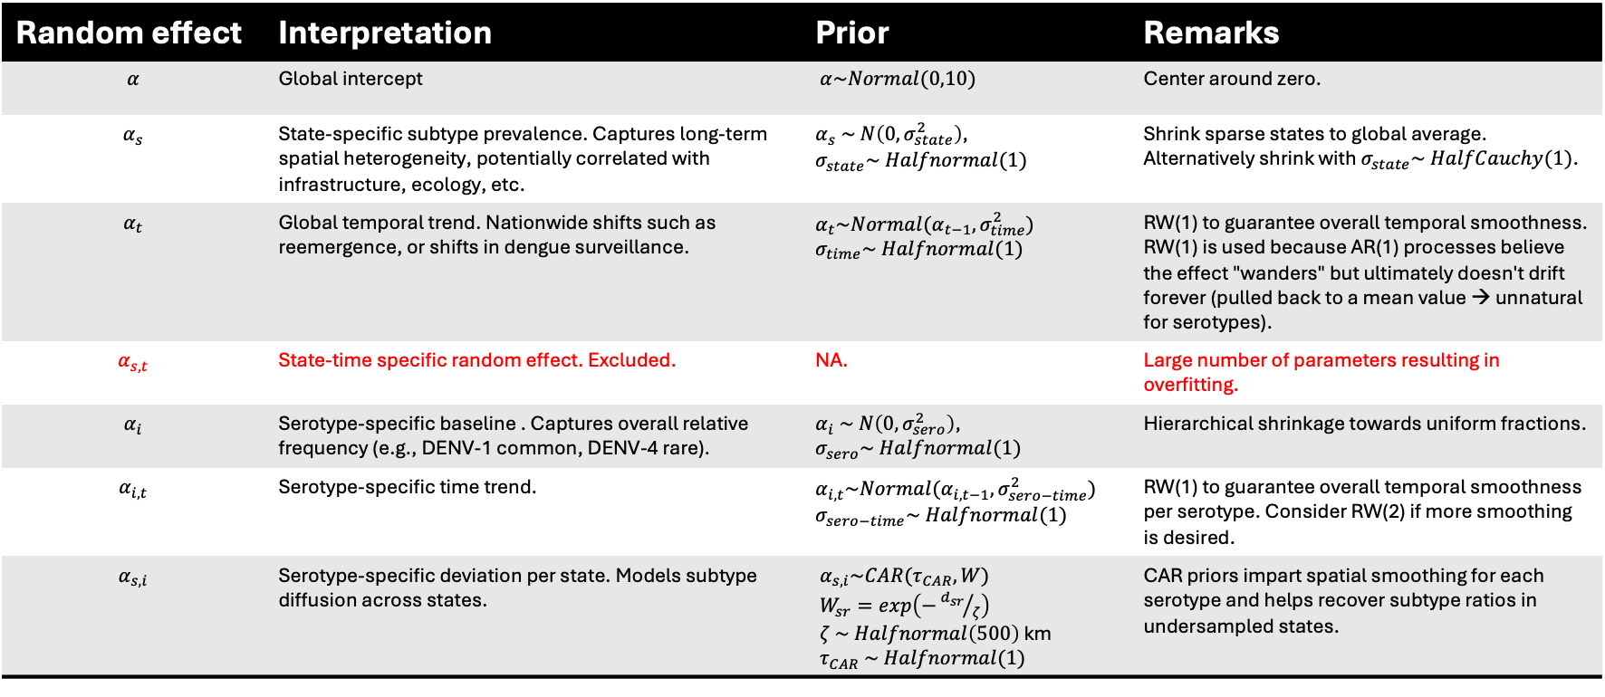

Proposed correlations
$\log\left(θ_{i,s,t}\right)= α+α_{s}+α_{t}+α_{s,t}+α_{i}+α_{i,t}+α_{s,i}$
Random effect | Interpretation | Prior | Remarks
$$α$$ | Global intercept | $α\sim Normal(0,10)$ | Center around zero.
$$α_{s}$$ | State-specific subtype prevalence. Captures long-term spatial heterogeneity, potentially correlated with infrastructure, ecology, etc. | $α_{s} \sim N\left(0,σ_{state}^{2}\right)$, $σ_{state}\sim Halfnormal(1)$ | Shrink sparse states to global average. Alternatively shrink with $σ_{state}\sim HalfCauchy(1)$.
$$α_{t}$$ | Global temporal trend. Nationwide shifts such as reemergence, or shifts in dengue surveillance. | $α_{t}\sim Normal(α_{t−1},σ_{time}^{2})$ $σ_{time}\sim Halfnormal(1)$ | RW(1) to guarantee overall temporal smoothness. RW(1) is used because AR(1) processes believe the effect "wanders" but ultimately doesn't drift forever (pulled back to a mean value → unnatural for serotypes).
$$α_{s,t}$$ | State-time specific random effect. Excluded. | NA. | Large number of parameters resulting in overfitting.
$$α_{i}$$ | Serotype-specific baseline . Captures overall relative frequency (e.g., DENV-1 common, DENV-4 rare). | $α_{i} \sim N\left(0,σ_{sero}^{2}\right)$, $σ_{sero}\sim Halfnormal(1)$ | Hierarchical shrinkage towards uniform fractions.
$$α_{i,t}$$ | Serotype-specific time trend. | $α_{i,t}\sim Normal(α_{i,t−1},σ_{sero−time}^{2})$ $σ_{sero−time}\sim Halfnormal(1)$ | RW(1) to guarantee overall temporal smoothness per serotype. Consider RW(2) if more smoothing is desired.
$$α_{s,i}$$ | Serotype-specific deviation per state. Models subtype diffusion across states. | $α_{s,i}\sim CAR(τ_{CAR}, W)$ $W_{sr}=exp\left(−{d_{sr}}/ζ\right)$ $ζ \sim Halfnormal\left(500\right)$ km $τ_{CAR} \sim Halfnormal(1)$ | CAR priors impart spatial smoothing for each serotype and helps recover subtype ratios in undersampled states.

Slide 12
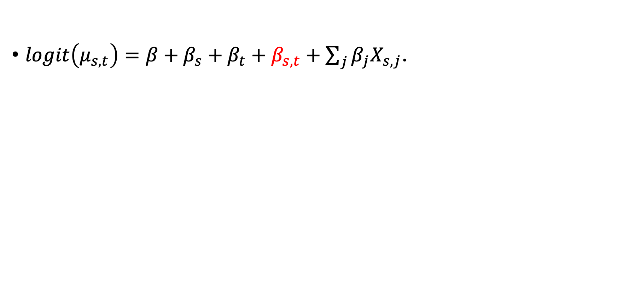
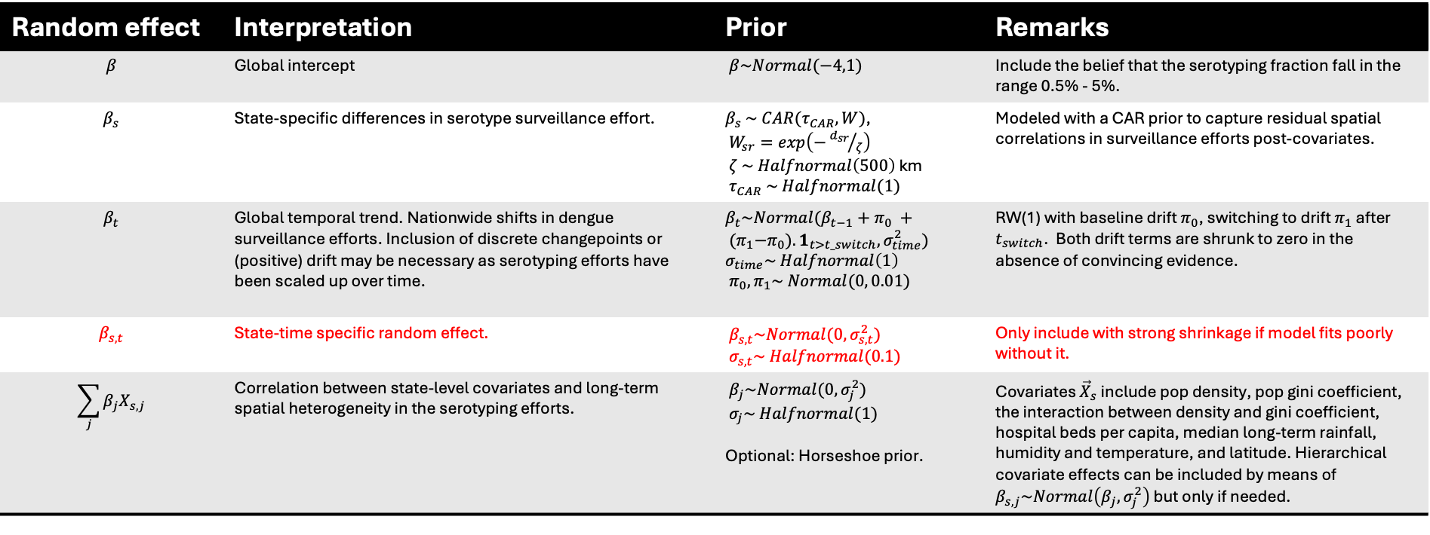
Proposed correlations
$logit\left(μ_{s,t}\right)=β+β_{s}+β_{t}+β_{s,t}+\sum_{j}{β_{j}X_{s,j}}$.
Random effect | Interpretation | Prior | Remarks
$$β$$ | Global intercept | $β\sim Normal(−4,1)$ | Include the belief that the serotyping fraction fall in the range 0.5% - 5%.
$$β_{s}$$ | State-specific differences in serotype surveillance effort. | $β_{s} \sim CAR(τ_{CAR},W)$, $W_{sr}=exp\left(−{d_{sr}}/ζ\right)$ $ζ \sim Halfnormal\left(500\right)$ km $τ_{CAR} \sim Halfnormal(1)$ | Modeled with a CAR prior to capture residual spatial correlations in surveillance efforts post-covariates.
$$β_{t}$$ | Global temporal trend. Nationwide shifts in dengue surveillance efforts. Inclusion of discrete changepoints or (positive) drift may be necessary as serotyping efforts have been scaled up over time. | $β_{t}\sim Normal(β_{t−1}+π_{0} + {(π}_{1}−π_{0}). 1_{t>t_switch},σ_{time}^{2})$ $σ_{time}\sim Halfnormal\left(1\right)$ $π_{0},π_{1}\sim Normal(0, 0.01)$ | RW(1) with baseline drift $π_{0}$, switching to drift $π_{1}$ after $t_{switch}$. Both drift terms are shrunk to zero in the absence of convincing evidence.
$$β_{s,t}$$ | State-time specific random effect. | $β_{s,t}\sim Normal(0,σ_{s,t}^{2})$ $σ_{s,t}\sim Halfnormal(0.1)$ | Only include with strong shrinkage if model fits poorly without it.
$$\sum_{j}{β_{j}X_{s,j}}$$ | Correlation between state-level covariates and long-term spatial heterogeneity in the serotyping efforts. | $β_{j}\sim Normal(0,σ_{j}^{2})$ $σ_{j}\sim Halfnormal(1)$ Optional: Horseshoe prior. | Covariates ${\vec{X}}_{s}$ include pop density, pop gini coefficient, the interaction between density and gini coefficient, hospital beds per capita, median long-term rainfall, humidity and temperature, and latitude. Hierarchical covariate effects can be included by means of $β_{s,j}\sim Normal\left(β_{j}, σ_{j}^{2}\right)$ but only if needed.

Slide 13
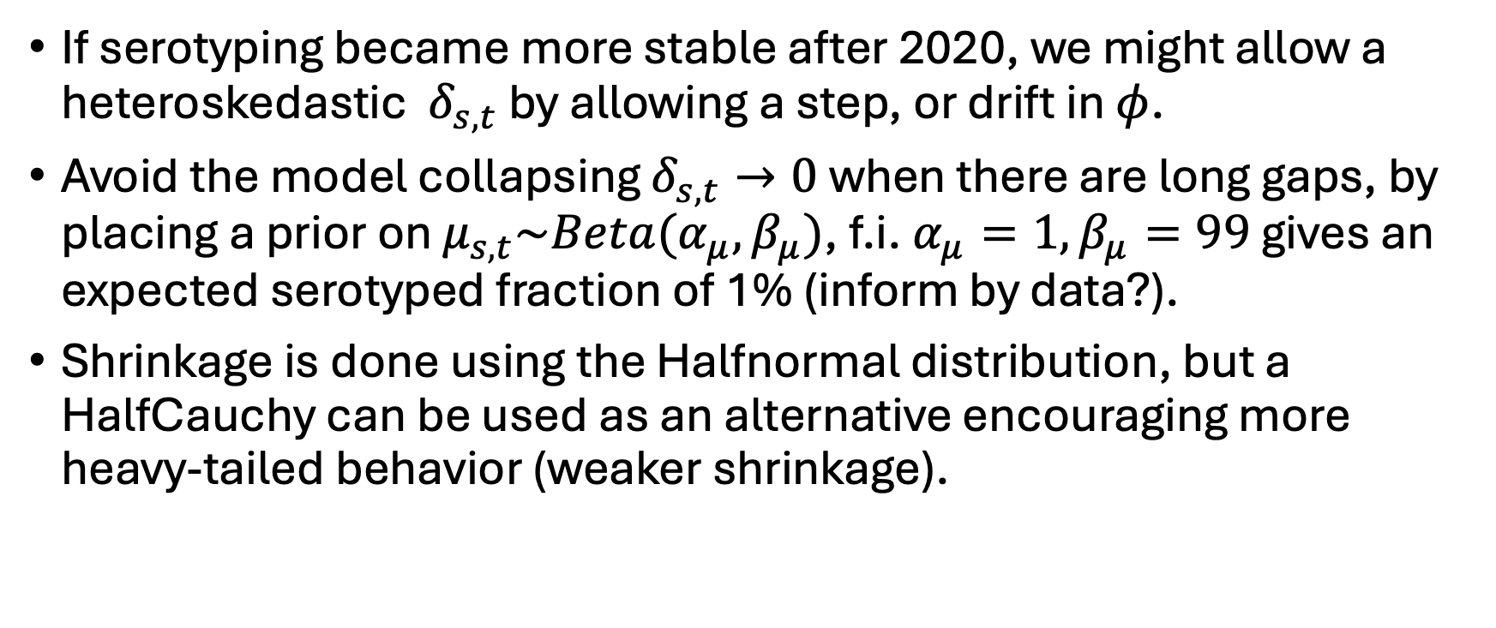
Other pointers
If serotyping became more stable after 2020, we might allow a heteroskedastic $δ_{s,t}$ by allowing a step, or drift in $φ$.
Avoid the model collapsing $δ_{s,t}→0$ when there are long gaps, by placing a prior on $μ_{s,t}\sim Beta(α_{μ},β_{μ})$, f.i. $α_{μ}=1,β_{μ}=99$ gives an expected serotyped fraction of 1% (inform by data?).
Shrinkage is done using the Halfnormal distribution, but a HalfCauchy can be used as an alternative encouraging more heavy-tailed behavior (weaker shrinkage).

Slide 14
Data preparation
UF | date | DENV_1 | DENV_2 | DENV_3 | DENV_4 | DENV_total
AC | 2000-12-31 |  |  |  |  | 419.0
AC | 2001-01-31 | 2.0 |  |  |  | 1299.0
AC | 2001-02-28 | 12.0 |  | 2.0 |  | 355.0
AC | 2001-03-31 | 12.0 |  |  |  | 144.0
AC | 2001-04-30 | 2.0 |  |  |  | 76.0
AC | 2001-05-31 | 1.0 |  |  |  | 27.0
AC | 2001-06-30 | 1.0 |  |  |  | 44.0
AC | 2001-07-31 |  |  |  |  | 8.0
AC | 2001-08-31 |  |  |  |  | 9.0
AC | 2001-09-30 |  |  |  |  | 9.0
AC | 2001-10-31 | 1.0 |  |  |  | 14.0
AC | 2001-12-31 |  |  |  |  | 56.0
AC | 2002-01-31 |  |  |  |  | 58.0
AC | 2002-02-28 | 1.0 |  |  |  | 136.0
AC | 2002-03-31 |  |  |  |  | 322.0
AC | 2002-04-30 |  |  |  |  | 77.0
AC | 2002-05-31 |  |  |  |  | 35.0
How to handle sparsity in our data?
DENV_total: reliable and practically always > 0. Except 1996-1999 in certain states.
No serotyped incidence: likely none performed → unknown
One or more serotyped incidences: performed → fill with zeros

