Slide 1
DENV serotype imputation
23/10/2025

Slide 2
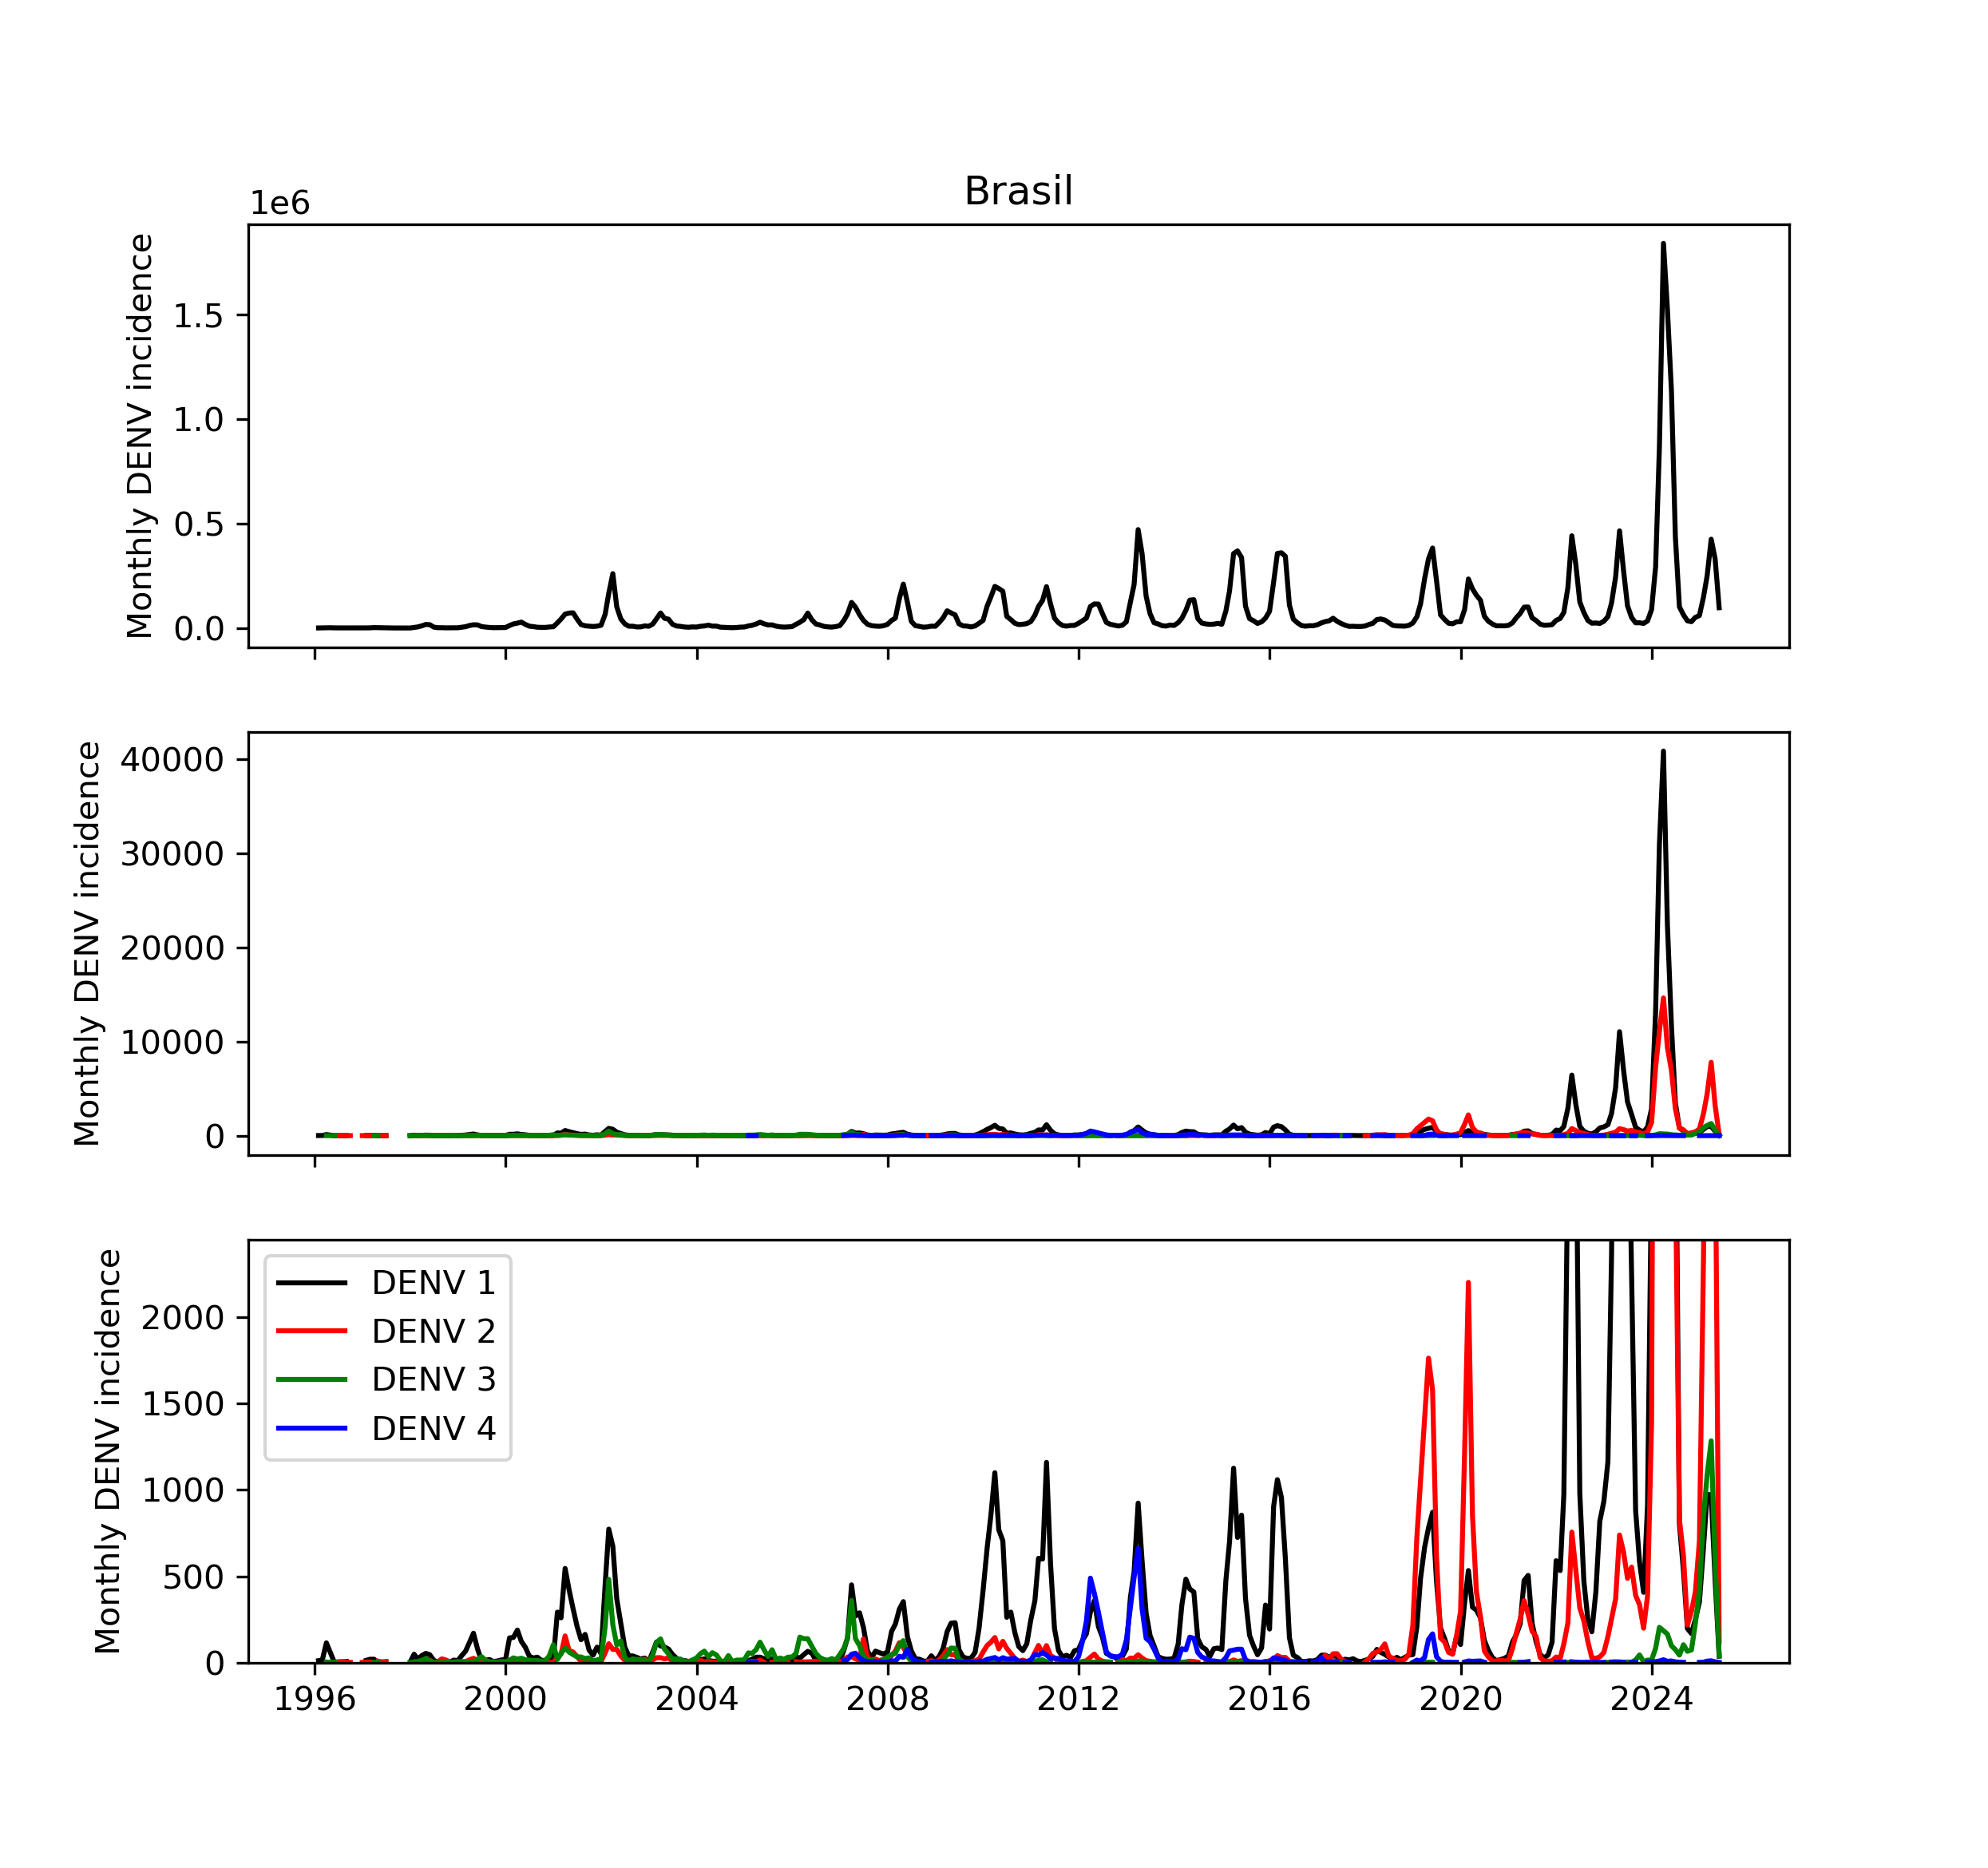

Linelist data from DATASUS
Excerpt from formatted dataset:
UF | date | DENV_1 | DENV_2 | DENV_3 | DENV_4 | DENV_total
AC | 2000-12-31 |  |  |  |  | 419.0
AC | 2001-01-31 | 2.0 |  |  |  | 1299.0
AC | 2001-02-28 | 12.0 |  | 2.0 |  | 355.0
AC | 2001-03-31 | 12.0 |  |  |  | 144.0
AC | 2001-04-30 | 2.0 |  |  |  | 76.0
AC | 2001-05-31 | 1.0 |  |  |  | 27.0
AC | 2001-06-30 | 1.0 |  |  |  | 44.0
AC | 2001-07-31 |  |  |  |  | 8.0
AC | 2001-08-31 |  |  |  |  | 9.0
AC | 2001-09-30 |  |  |  |  | 9.0
AC | 2001-10-31 | 1.0 |  |  |  | 14.0
AC | 2001-12-31 |  |  |  |  | 56.0
AC | 2002-01-31 |  |  |  |  | 58.0
AC | 2002-02-28 | 1.0 |  |  |  | 136.0
AC | 2002-03-31 |  |  |  |  | 322.0
AC | 2002-04-30 |  |  |  |  | 77.0
AC | 2002-05-31 |  |  |  |  | 35.0
Formatted to monthly serotyped DENV 1-4 incidence per Brazilian state (27) + total DENV cases
`DENV_total`: reliable and complete
`DENV_1-4`: sparse – reliable ~ state
DENV_total
DENV_1-4
DENV 1 cases
DENV 2 cases
DENV 3 cases
DENV 4 cases
Total serotyped DENV cases
$$≪$$
Total DENV cases

Slide 3
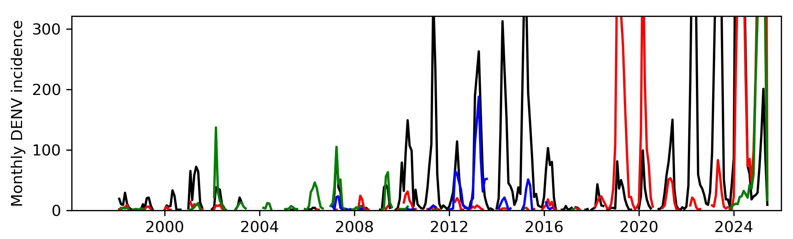
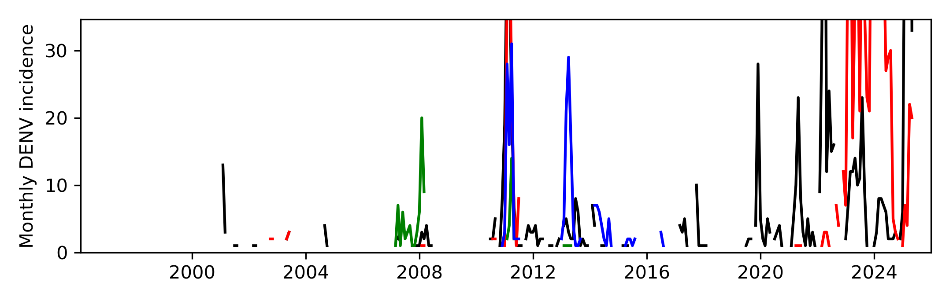
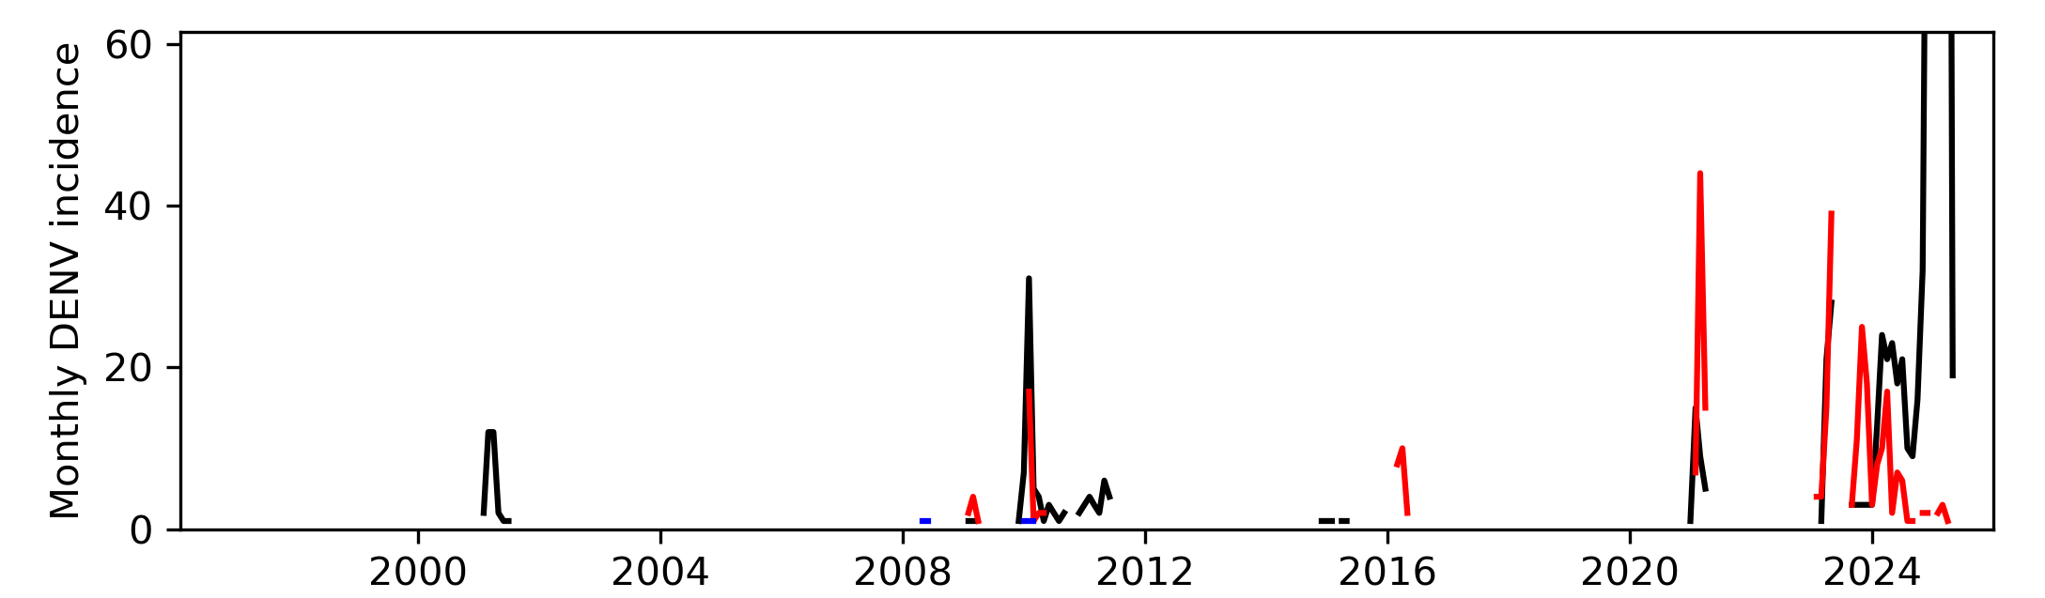
Linelist data from DATASUS
High # serotyped cases + low temporal sparseness
SP
AM
Low # serotyped cases + great temporal sparseness
AC

Slide 4
Attempt to fit a Bayesian imputation model per state…

Slide 5
Attempt to fit a Bayesian imputation model per state…
Solution
States = artificial unit
Cluster municipalities into epidemiologically meaningful regions before fitting model
Make sure there are enough serotyped cases in each cluster to make model accurate
➔ Max-p regionalization

Slide 6
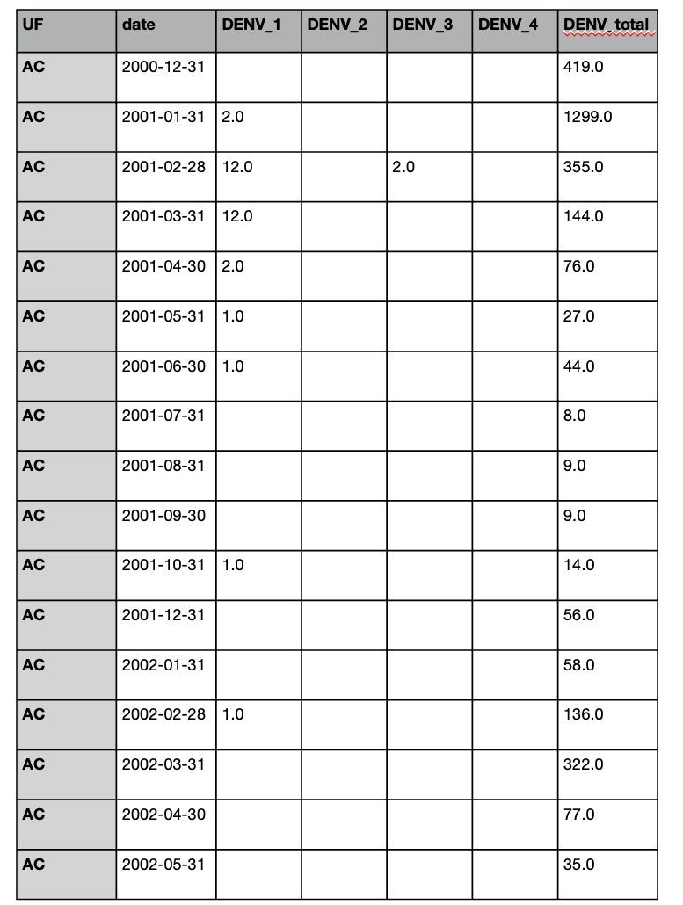
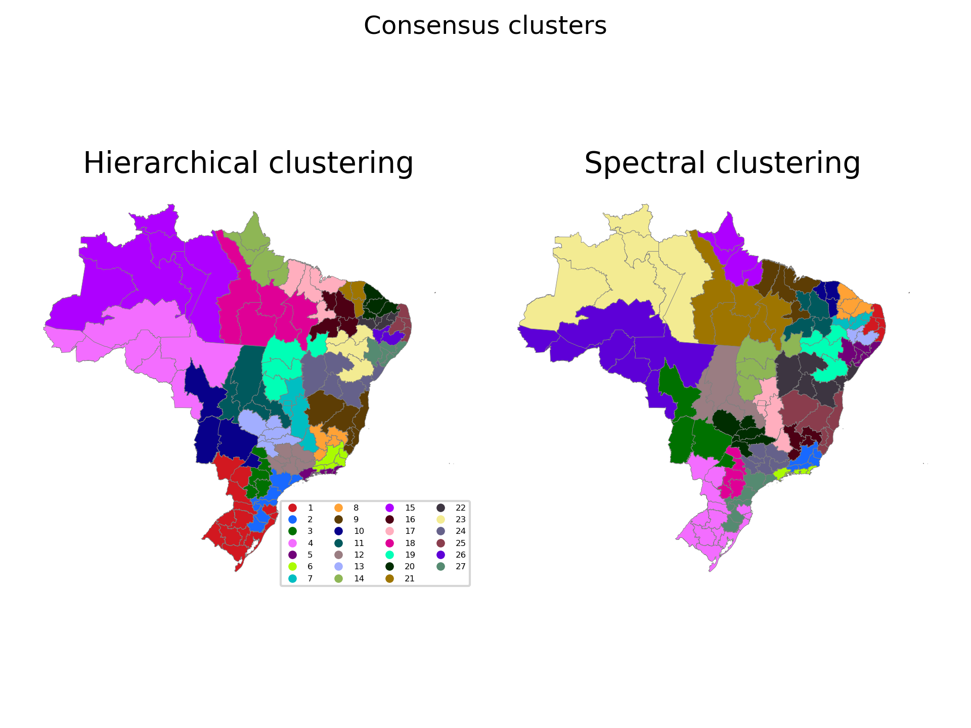

Led to the following “pipeline”
Max-p regionalization
Guarantees contiguity
Guarantees threshold is crossed in every cluster
Clusters “biased” towards covariates
Stochastic → averaged
Bayesian imputation model
$Y_{t, i, j} \sim DirichletMultinomial(N_{t, i},α_{t, i, j})$,
$α_{t, i, j}= φ_{i} p_{t,i,j},$
$φ_{i}= 1/{d_{i}} with d_{i} \sim Halfnormal\left(d_{shrink}\right)$
$p_{t, i, j}=Softmax\left(log\left(θ_{t,i,j}\right)\right),$
$log\left(θ_{t,i,j}\right)= \sum_{k=1}^{p}{ρ_{k}}θ_{t−k,i,j}+\sum_{k=1}^{q}{ψ_{k}κ_{t−k,i,j}}+ κ_{t,i,j}^{(corr)} ,$
$κ_{t,i,j}^{(corr)}\sim MvNormal\left(0, σ_{process}^{2} Q^{−1}\right)$
# Serotyped cases per cluster threshold
Covariates
Human footprint
Index P
Koppen class.
DTW DENV dynamics
…

Slide 7
Led to the following “pipeline”
Max-p regionalization
Guarantees contiguity
Guarantees threshold is crossed in every cluster
Clusters “biased” towards covariates
Stochastic → averaged
Bayesian imputation model
$Y_{t, i, j} \sim DirichletMultinomial(N_{t, i},α_{t, i, j})$,
$α_{t, i, j}= φ_{i} p_{t,i,j},$
$φ_{i}= 1/{d_{i}} with d_{i} \sim Halfnormal\left(d_{shrink}\right)$
$p_{t, i, j}=Softmax\left(log\left(θ_{t,i,j}\right)\right),$
$log\left(θ_{t,i,j}\right)= \sum_{k=1}^{p}{ρ_{k}}θ_{t−k,i,j}+\sum_{k=1}^{q}{ψ_{k}κ_{t−k,i,j}}+ κ_{t,i,j}^{(corr)} ,$
$κ_{t,i,j}^{(corr)}\sim MvNormal\left(0, σ_{process}^{2} Q^{−1}\right)$
# Serotyped cases per cluster threshold
Covariates
Human footprint
Index P
Koppen class.
DTW DENV dynamics
…

Slide 8

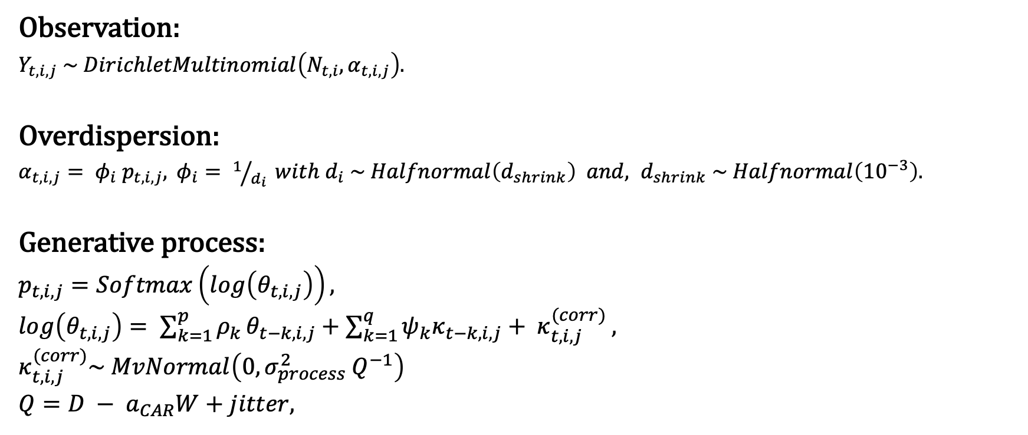
Full Bayesian imputation model
Observation:
$Y_{t, i, j} \sim DirichletMultinomial\left(N_{t, i},α_{t, i, j}\right).$
Overdispersion:
$α_{t, i, j}= φ_{i} p_{t,i,j},$ $φ_{i}= 1/{d_{i}} with d_{i} \sim Halfnormal\left(d_{shrink}\right) and, d_{shrink} \sim Halfnormal\left({10}^{−3}\right).$
Generative process:
$p_{t, i, j}=Softmax\left(log\left(θ_{t,i,j}\right)\right),$
$log\left(θ_{t,i,j}\right)= \sum_{k=1}^{p}{ρ_{k}}θ_{t−k,i,j}+\sum_{k=1}^{q}{ψ_{k}κ_{t−k,i,j}}+ κ_{t,i,j}^{(corr)} ,$
$κ_{t,i,j}^{(corr)}\sim MvNormal\left(0, σ_{process}^{2} Q^{−1}\right)$
$Q=D − a_{CAR}W+jitter,$
ARMA(p,q) with spatially correlated innovations
$a_{CAR}\sim Beta\left(1,2\right)$ → corr. strength
W = adjacency matrix,
D = degree connectivity matrix,
$\sum_{k}{ρ_{k}=1}$ (non-stationary)

Slide 9
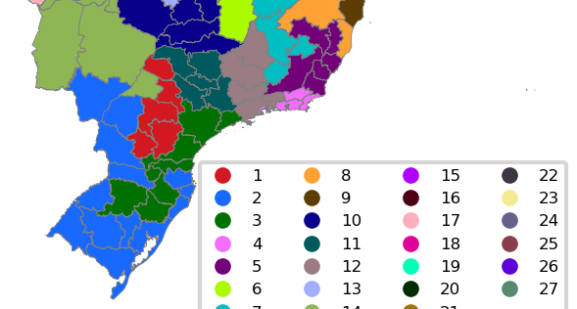
The good
Fits the data well
Chains converge and mix well
Smooths spatially when data are sparse
Statistically principled (timeseries 101)
Biologically motivated (non-stationarity)

Slide 10



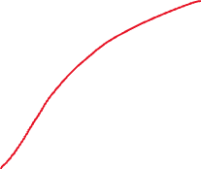
The bad
Introduction DENV 3
No mechanistic insights to be gained from ARMA(p,q)
Ideally replaced or augmented with an immunological term?
F.i. DENV3 in cluster 4 misaligned with neighbours?
Matches Amazon river?
River discharge as metric for proximity to big river?

Slide 11
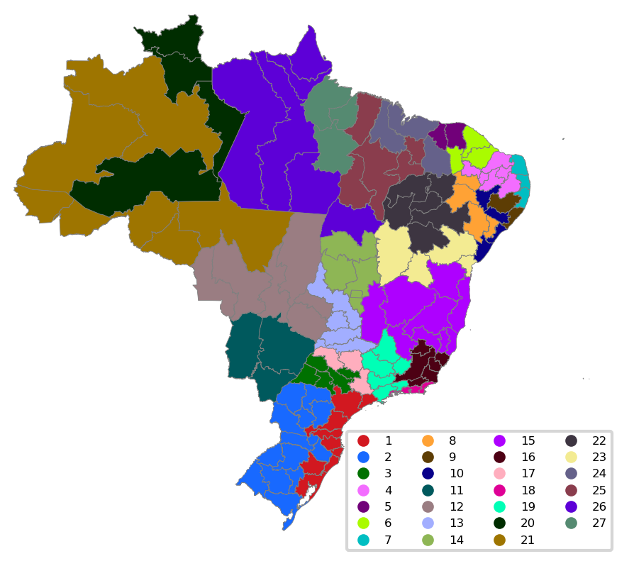
The Bad
Persists when using other covariates (compactness + human_footprint)

Slide 12
The ugly?
How to assess the “quality” of the output of this pipeline as a function of its inputs (covariates + threshold)?
Example: perform DTW on imputed serotype trajectories to quantify “similarity” → Avoid icky “Cluster 4” situations
Or maybe the “cluster 4 situation” is just a symptom of needing less clusters? (i.e. higher threshold in max-p)
However, maybe better to avoid icky situations by incorporating more knowledge in the process model (i.e. allow data to be labeled “unfeasible”)?`

Slide 13
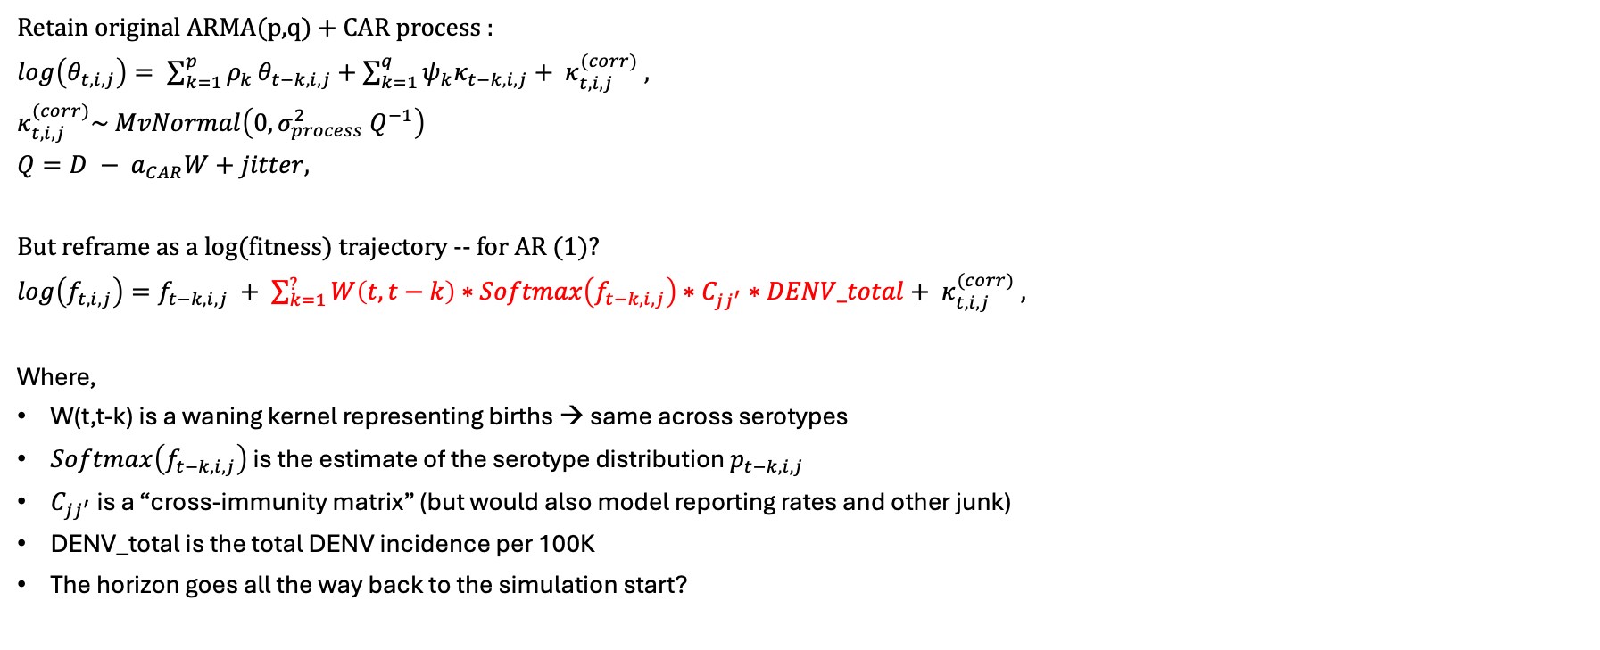
Incorporating immunological considerations
Retain original ARMA(p,q) + CAR process :
$log\left(θ_{t,i,j}\right)= \sum_{k=1}^{p}{ρ_{k}}θ_{t−k,i,j}+\sum_{k=1}^{q}{ψ_{k}κ_{t−k,i,j}}+ κ_{t,i,j}^{(corr)} ,$
$κ_{t,i,j}^{(corr)}\sim MvNormal\left(0, σ_{process}^{2} Q^{−1}\right)$
$Q=D − a_{CAR}W+jitter,$
But reframe as a log(fitness) trajectory -- for AR (1)?
$log\left(f_{t,i,j}\right)=f_{t−k,i,j} + \sum_{k=1}^{?}{W\left(t, t−k\right)∗Softmax\left(f_{t−k,i,j}\right)}∗C_{jj^{′}}∗DENV_total+ κ_{t,i,j}^{(corr)} ,$
Where,
W(t,t-k) is a waning kernel representing births → same across serotypes
$Softmax\left(f_{t−k,i,j}\right)$ is the estimate of the serotype distribution $p_{t−k,i,j}$
$C_{jj^{′}}$ is a “cross-immunity matrix” (but would also model reporting rates and other junk)
DENV_total is the total DENV incidence per 100K
The horizon goes all the way back to the simulation start?

