Slide 1
Sprint 2025
19/05/2025

Slide 2
Tentative plan
Try out a multi-serotype SIR model with immunity linking and a climate modifier on R0
Need serotype ratios per Brazilian UF to scale Sprint 2025 incidence data

Slide 3
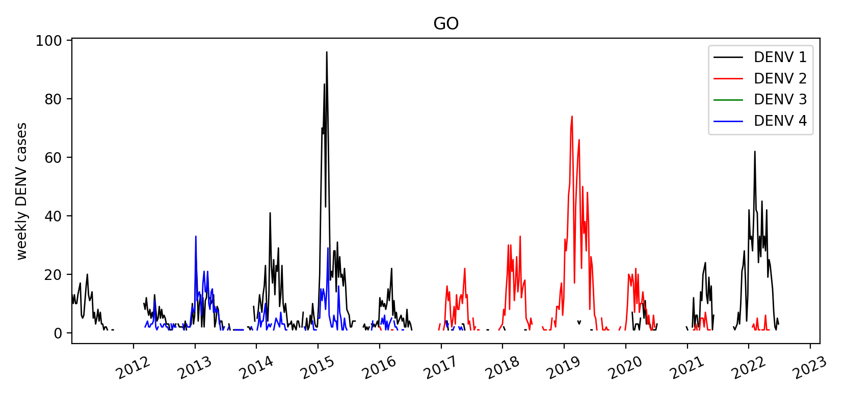
`banco de dengue sorotipo.csv`
serotypes per UF 2011-2022 (→ update?)
Good timeseries:

Slide 4
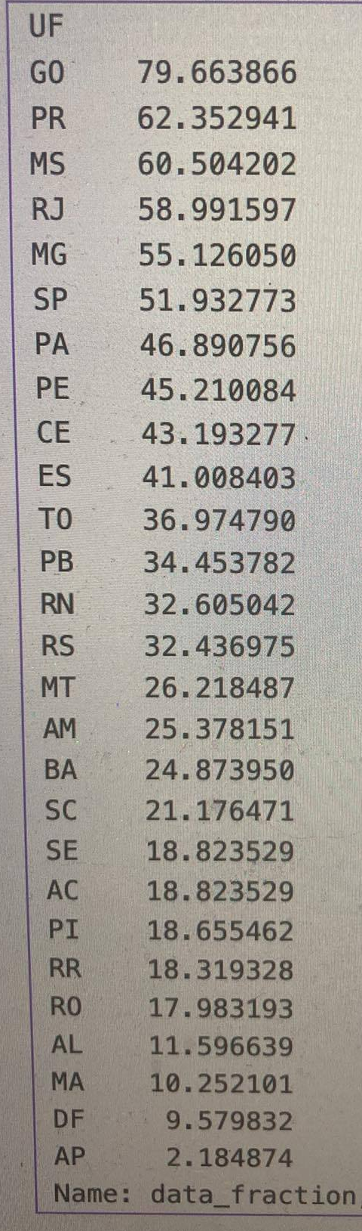
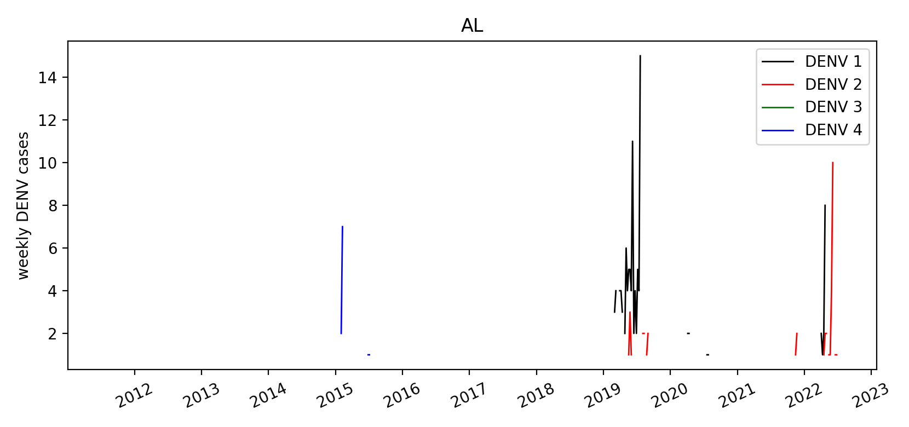
`banco de dengue sorotipo.csv`
serotypes per UF 2011-2022 (→ update?)
Bad timeseries:

Slide 5
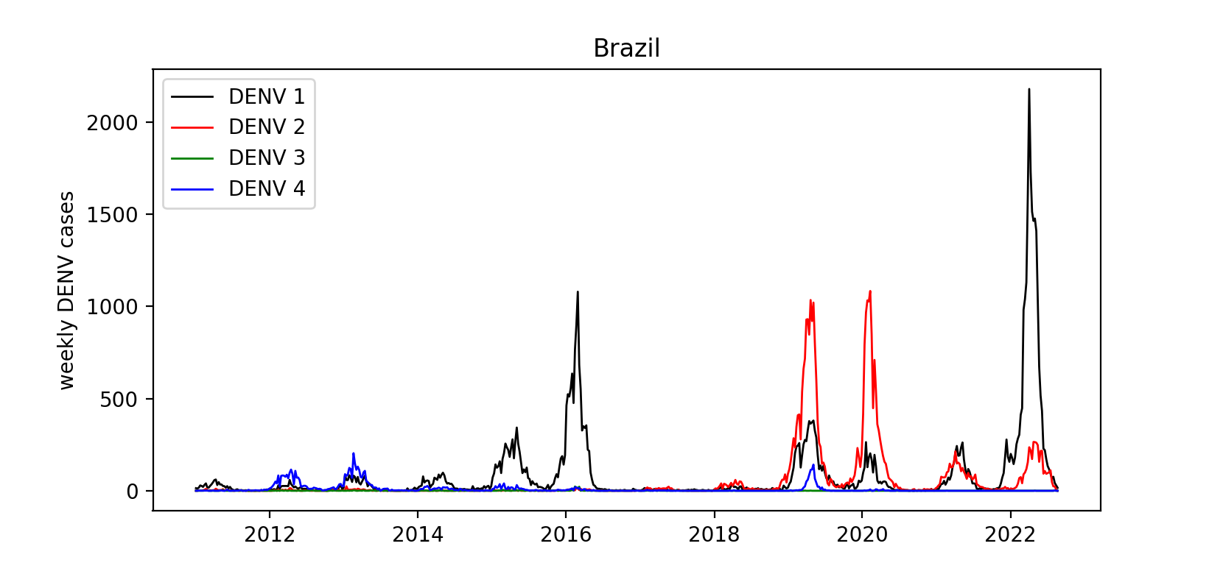
`banco de dengue sorotipo.csv`
serotypes per UF 2011-2022 (→ update?)
Overall:
No DENV3 → omit from model

Slide 6
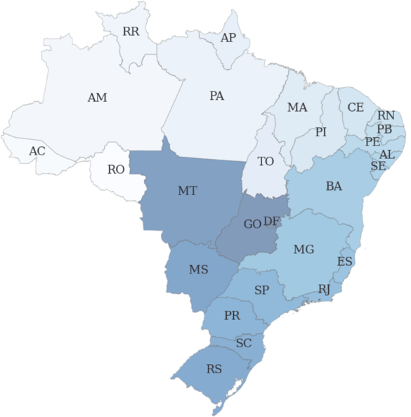
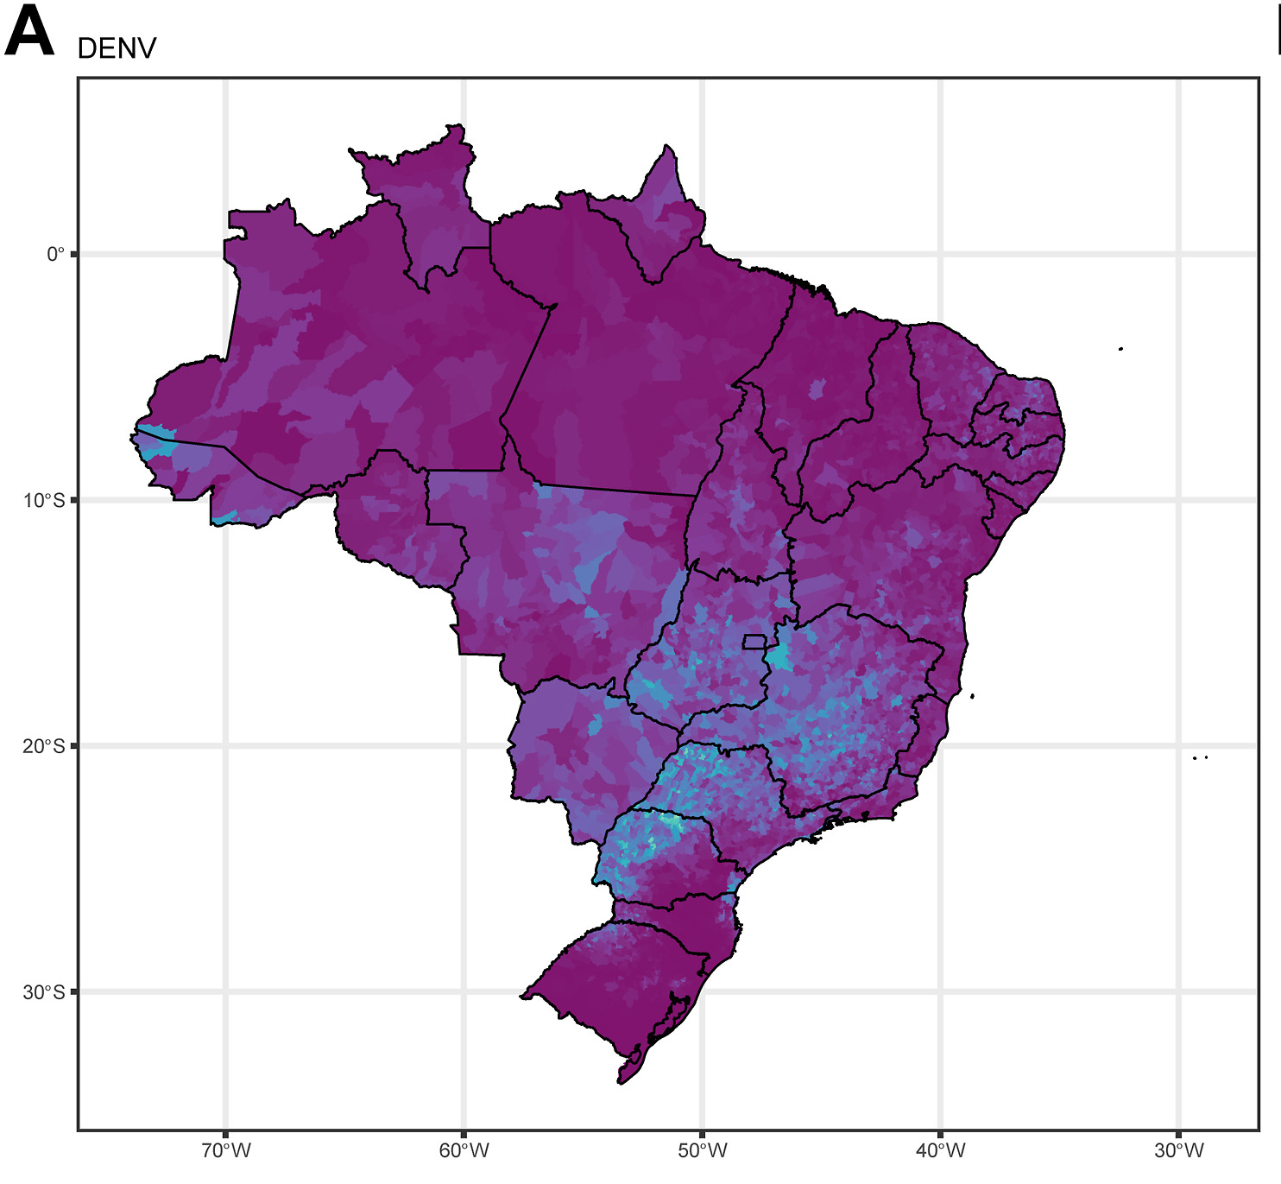



`banco de dengue sorotipo.csv`
All areas > 50% dates with serotype information → general area with most dengue

Slide 7
`banco de dengue sorotipo.csv`
serotypes per UF 2011-2022 (→ update?)
Possibility of reconstruction given reasonable assumptions?
Given a distance/connectivity matrix + demographic data + incidence data
Hierarchical model with heuristic “closer proximity = serotypes aligned” ?

Slide 8
Tentative plan
Try out a multi-serotype SIR model with immunity linking and a climate modifier on R0 (model states separately)
Need serotype ratios per Brazilian UF to scale Sprint 2025 incidence data
No need to wait? Could just try it out on a state with good data and see how well such model works?

Slide 9
Line listed data
Differences in format
“DENBR18.csv” / “DENBR09.csv”
Column “RESUL_SORO” has 65% of entries available (VAL: 1, 2, 3 or 4) → But translation Laura says this is not the serotype!
Misleading column “SOROTIPO” only has 0.2% of entries available
Also DENBR08.csv, DENBR07.csv BUT:
“DENBR02.csv” (starting in 2006)
“RESUL_VIRA” contains serotype according to translation Laura but sparsity is 1.3%

