Slide 1
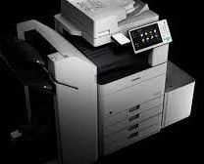






2
3
1
LAN network
Scan file is deleted (by scan author) because classified document. Please do safe scan for classified documents!!)
Scanner goes brr
Scan.pdf
Le me
PC of Le me with access to LAN scanner folder
SniffedFolderPath
Gentle pdf file is saved from scanner in LAN folder
Script sees pdf has been deleted in LAN folder
Scan.pdf
Scan.pdf
Script is nice and makes a copy to ExtractFolderPath
SniffedFolderPath
SniffedFolderPath
DestinationFolderPath
Script sees new pdf appears in folder
Script makes a copy of pdf in Le me computer
ExtractFolderPath
Le me
Casually monitoring classified files

