Slide 1
Masterclass Deep learning met TensorFlow
Informatica Studiedag
24 november 2018
Twan van Laarhoven
twan.vanlaarhoven@ou.nl

Slide 2
Machine learning terminology
Data set
  Training set
  Validation set
  Test set
Supervised learning: P(y | x)
Unsupervised learning: P(x)
Regression: y ∈ ℝ
Classification: y ∈ {0,1,2,...,k}

Slide 3
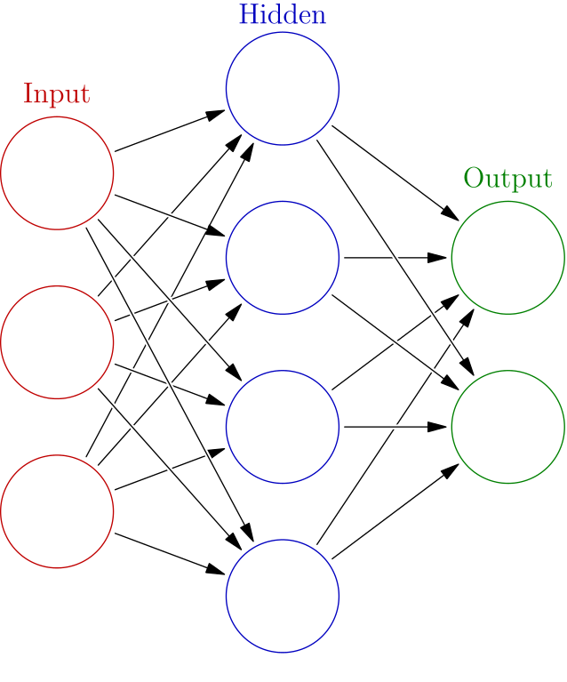
Neural networks
y = h(w1x1 + w2x2 + .. + wnxn)
image: https://en.wikipedia.org/wiki/File:Colored_neural_network.svg

Slide 4
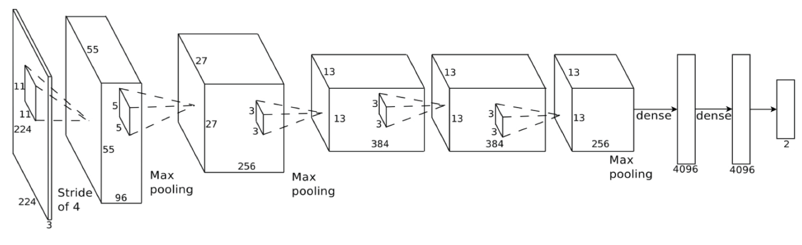
Neural network architectures
ImageNet Classification with Deep Convolutional Neural Networks; Alex Krizhevsky, Ilya Sutskever, Geoffrey E. Hinton; 2013

Slide 5
Neural network training
Minimize loss function
Tweak w to decrease L(w)
  Uses gradient ∂L/∂w
Minibatches

Slide 6
Neural network terminology
Layers
  Dense
  Convolutional
  Pooling
  Dropout
Nonlinearities
  ReLu
  Softmax
  None
Loss function
  Cross entropy
  Squared error
Optimizer
  Stochastic Gradient Descend
  Adam
  AdaMax
Parameters
  Learning rate
  Batch size
  Regularization
  Network architecture

Slide 7





Deep learning frameworks
Theano (discontinued)
TensorFlow
PyTorch
MXNet
Keras
Caffe (discontinued)

Slide 8
What a DL framework does
CPU and GPU matrix calculation
Automatic derivatives
Common neural network layers
Pre-build and pre-trained in networks

Slide 9
Static vs dynamic
Static execution
  Define a "graph" with placeholders
  Then execute with given values
  Can be optimized
Dynamic execution
  Work directly with values
  More flexible
  Gradients are tricky
  Slightly slower

Slide 10
A Taste of TensorFlow
x = tf.placeholder(tf.float32, (128,256))
w = tf.get_variable("w", (1,128))
y = 2 * tf.matmul(w,x)
dy_dw = tf.gradients(y, w)
with tf.Session() as sess:
y_value = sess.run(y, {x: actual_data})
print(y_value)

Slide 11
A Taste of Keras
model = Sequential()
model.add(Conv2D(64, (3, 3), activation='relu'))
model.add(Dropout(0.2))
model.add(Flatten())
model.add(Dense(num_classes, activation='softmax'))
model.compile(loss='categorical_crossentropy',
optimizer=RMSprop(),
metrics=['accuracy'])
model.fit(x_train, y_train, ....)
score = model.evaluate(x_test, y_test)

Slide 12
Tricks
Automatic parameter tuning
Data augmentation
Pre-training

Slide 13
Today
Google Colab
  https://colab.research.google.com
Exercises
  https://github.com/twanvl/ou-tensorflow-tutorial
  1. mnist.ipynb
  2. pretrained.ipynb
Accelerate
  Edit → Notebook settings → Hardware Accelerator → GPU

