Slide 1
Huffman coding & Java programming
Seehwan Yoo
Dankook University

Slide 2
Data Compression
Reducing size of data
Use less bits
How?
Allocate different bits according to the frequency
More frequent word → use less bits
Less frequent word → use longer bits
Allocate symbols such that total length is smaller than the original version

Slide 3
Example
Some bad case
Plain text
abcdefghijkl
Frequency
a~l appear once: frequency of a: 1, freq. of b: 1, freq of c:1
a~l
12 code word → 4 bits required to present a word
0000 → a, 0001 → b, 0010 → c, 0011→ d, …
Coded text
0000 0001 0010 0011 0100 0101 0110 …
4 bits * 12 word = 48 bits
For original text

Slide 4
Fixed-length encoding
Plaintext
abracadabraa
Frequency
a: 6, b: 2, c: 1, d: 1, r: 2
Fixed-length symbol allocation
Each code word needs 3 bits
a: 000, b: 001, c: 010, d: 011, r: 100
Coded text
000 001 100 000 010 000 011 000 001 100 000 000
3 bit * 12 = 36 bits!

Slide 5
Some good case
Plaintext
abracadabraa
Frequency
a: 6, b: 2, c: 1, d: 1, r: 2
Symbol allocation
More frequent word: less symbol
Less frequent word: longer symbol
a: 0, b: 100, r: 101, c:110, d: 111
Coded text
0 100 101 0 110 0 111 0 100 101 0 0
1 bit * 6 + 3 bit * 6 = 24 bits!

Slide 6
Huffman Tree.
Allocating code word
From a tree based on frequency
First sort all the code words in frequency order
Find the two least frequent code words, and make a subtree
Parent has the sum of children’s frequency
Sort all the nodes in frequency order
Find the two least frequent code words, and make a sub tree until all the nodes are in the tree

Slide 7
Allocating symbols
Left child gets ‘0’, right child gets ‘1’
All the code words are at the leaves
Drill down and label the code words
a₍₆₎
b₍₂₎
r₍₂₎
c₍₁₎
d₍₁₎

Slide 8
Huffman Table
Table that maps symbol and codeword
Symbols are string (usually)
Codewords are numbers (usually)
To encode, we need to find a symbol corresponding to the code word
Reading plaintext, identify a code word
Write out a symbol according to the code word

Slide 9
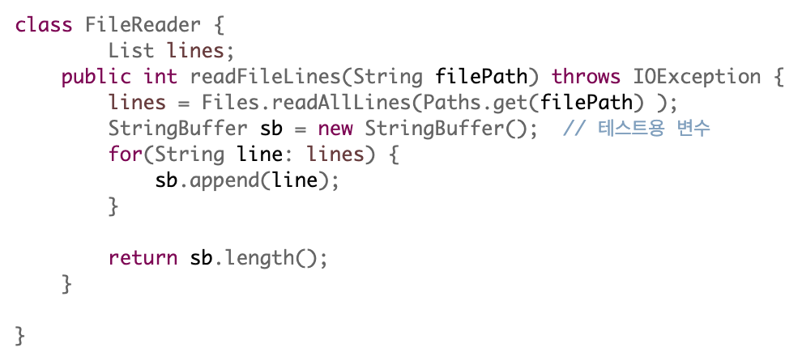
File Read
Files class has some utility functions
readAllLines() method reads file line-by-line
StringBuffer class has some utility functions
append(String input) adds input after original string
Consider public String readFileString(String filePath)

Slide 10
Sort the characters in frequency order?
Prepare frequency array (bin)
Index = code word
Gather statistics of frequency
Investigate each character, and sum up frequency array
Sort out characters in frequency order
Generic types and symbols
Consider a symbol class
Each symbol has value and string presentation, and frequency
Can be Linked List or ArrayList
Can be sorted – but how?
Type argument is not Integer

Slide 11
Implements comparable<> interface
To sort it out, you need to compare two objects
implements comparable interface
Make your class objects to be comparable
public int compareTo(Symbol o)
Now, you can use Collections.sort() method

Slide 12
To print out all the symbols in List
Iterator <Symbol> can be used
Iterator class has hasNext() method
Traverse all the Symbols in the List
Iterator class has next() method
Select a specific symbol; and print it out
Symbol class would need toString() method

Slide 13
Next time, we will build up Huffman tree
Get prepared
You can begin from scratch!
Entry into Entropy coding
Information theory
Source coding

