Slide 1
Java Programming Security and DES encoding
Seehwan Yoo
Dept. of Mobile Systems Engineering
Dankook University

Slide 2
Quick Review
Encoding/decoding changes data presentation
However, information should be identical
Bit/byte/base64/decimal/hexadecimal
Merely different information presentation
Huffman encoding for Data compression
Allocate shorter code word for frequent symbol
Reduces the average / total length of data presentation – ZIP, RAR uses the algorithm

Slide 3
Another encoding – data encryption
Cryptography
Much focus on information security, confidentiality, in particular
Do not reveal useful information to unauthorized users
Making data difficult to read /understand (get correct information)
Hiding confidential/secret information from public users
Data can be decrypted only with the feasible ‘key’
Special operation with key

Slide 4
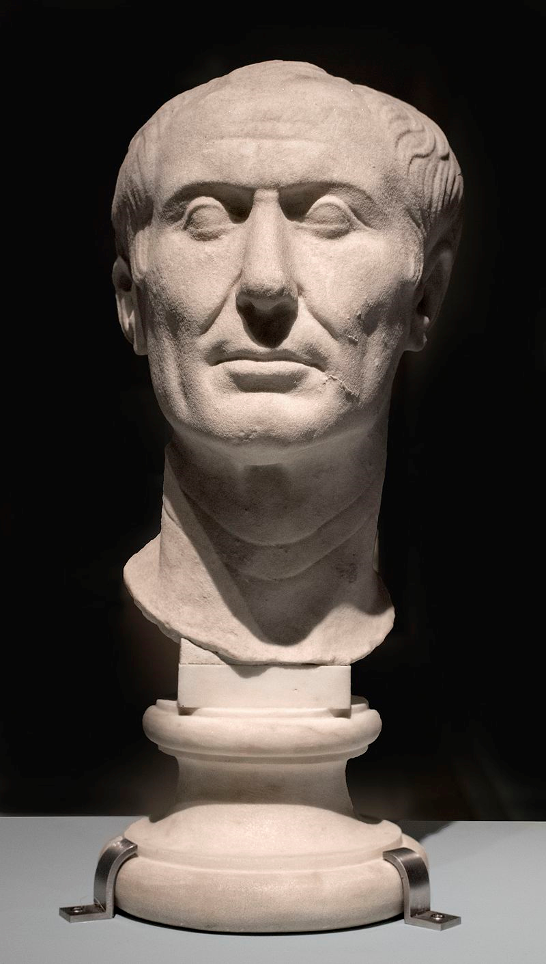
One of oldest cipher
Caesar’s code
Known to be developed by Julius Caesar
For military purpose, deliver ordering across the country (Rome)
Keep secrecy because one cannot properly comprehend meanings
Pick some number 0~25, use it as ‘shift key’
Assume that shift key is securely distributed, before use
For every letter in the plain text,
Change the alphabet character with the next N-th character, where N is shift key
E.g.) shift key = 3, input character is ‘I’ → cipher text is ‘L’

Slide 5
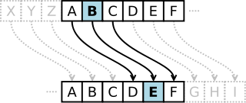
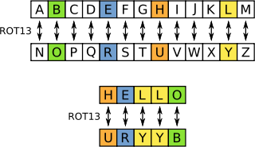
Some more examples)
Shift key is 3
Try yourself with ‘I am a boy’
Does it look like encrypted?
Variant: ROT13
WT.
How to decrypt?
Inverse operation to shift right = shift left
Shift left 3 char
Check with ‘I am a boy’
Decrypt of ROT13?
Do it once again
Plain text will be back
Same keys are used for encryption / decryption

Slide 6
Yes. Easy to break
Why and How?
Single key is used for every letter, not changed
The number of possible key is limited. How many?
You can try for all 26 keys
Brute-force algorithm
The frequency is not changed, even though characters are different
Guess the most frequent character? ‘ ’, ‘e’, ‘i’, ‘o’, etc.
Try one by one
No, do not use it with modern computers

Slide 7
Somewhat modern encryption system
DES (data encryption standard)
Developed by IBM in 1975
Now, it has been broken. So, do not use DES for any commercial/professional use
Basic idea for later generation crypto algorithms
This is what you’ll implement
Use multiple keys
Consist of multiple rounds
Pseudo-random permutation
Combination of shifting bits, XOR, operations
Give some redundancy, drop some bits
Block cipher
Every 64 bit forms the unit of encryption
Principle of Confusion and Diffusion
Confusion: make things complex enough, so that input (plain text, keys) and cipher text are irrelevant
Diffusion: small change in input leads to large & multiple changes in output
https://simple.wikipedia.org/wiki/Confusion_and_diffusion
Claude E. Shannon, "Communication Theory of Secrecy Systems", Bell System Technical Journal, vol.28-4, page 656–715, 1949

Slide 8
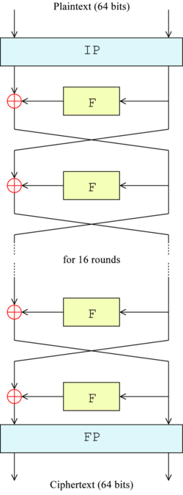
A big Picture
Two phases
Key derivation
Make subkeys, used for each encryption round
Rearrange bits in unpredictable less predictable way
Encode the input text block
Input data: 64 bits form single block, unit of encryption
Initial Permutation (rearrange bits)
Divide the word into two
Goes through Feistel Network
Final Permutation (rearrange bits)
https://en.wikipedia.org/wiki/Data_Encryption_Standard

Slide 9
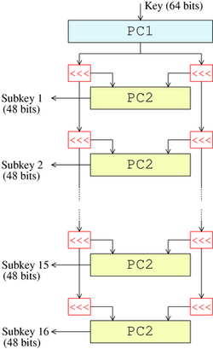
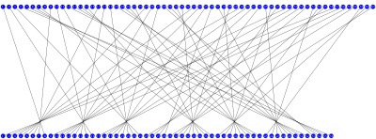
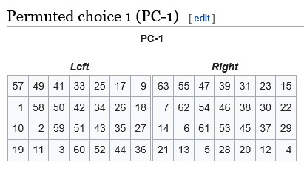
DES Key scheduling
https://en.wikipedia.org/wiki/DES_supplementary_material
Making sub keys
Two permuted choice tables: PC1, PC2
PC1 input: 64bit → output: 56 bit
56bits are divided into two parts C0, D0
C0: left half (28 bits), D0: right half (28 bits)
C, D are left rotated 1 bits or 2 bits
In round # 1, 2, 9, 16, shift 1 bit left rotate
Rest of rounds shift 2 bit left rotate
Each Cn, Dn forms 56 bit

Slide 10
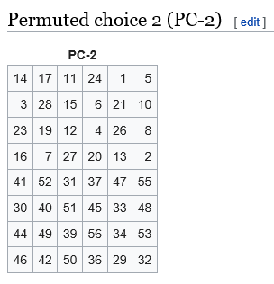

DES Key scheduling
Making sub keys
Two permuted choice tables: PC1, PC2
Each Cn, Dn forms 56 bit
PC2 input: 56bit → output: 48 bit
Further permuted; select 48 bits
The selected 48 bits form SubKeyn
Used in round n

Slide 11
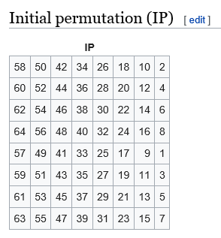
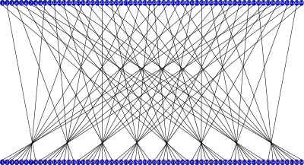
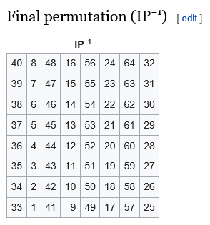
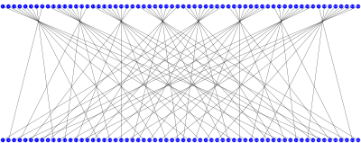
DES block encoding
Initial Permutation / Final Permutation
Rearrange bits
Permutation Table
Remembers the order of output bits
IP table’s index[0] has N, where the bit comes from
E.g.)
IP[0]=58
Output bit 0 ← Input bit 58
Input bit 58 → Output bit 0

Slide 12
A big Picture
Two phases
Key derivation
Make subkeys, used for each encryption round
Rearrange bits in unpredictable less predictable way
Encode the input text block
Input data: 64 bits form single block, unit of encryption
Initial Permutation (rearrange bits)
Divide the word into two
Goes through Feistel Network
Final Permutation (rearrange bits)
https://en.wikipedia.org/wiki/Data_Encryption_Standard

Slide 13
Feistel Network / Structure
Bit twist / XOR with SubKeyn
Divide Permuted bits into two halves
L0, R0 (32 bits each)
Right half directly goes through the next round
L1 = R0
Left half is encrypted from right half (R0)
F-box: the encryption engine
Input: R0 (32bit), SubKey0 (48bit), L0 (32bit)
Output: R1 (32bit) goes to the next round
Repeated 16 times, with different SubKeys

Slide 14
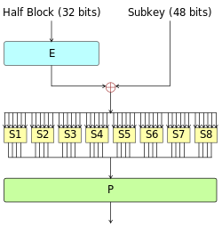
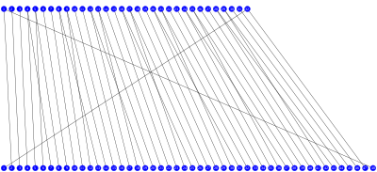
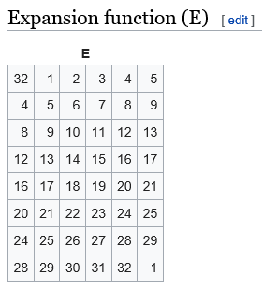
F-box, Feistel Function
F-box: the encryption engine
Input: R0 (32bit), SubKey0 (48bit), L0 (32bit)
Output: R1 (32bit) goes to the next round
R0 is expanded to make 48 bits
Some bits are repeated
The Expansion table
Now, we have two 48 bits
SubKey0, Expanded R0
XOR them → 48 bits

Slide 15
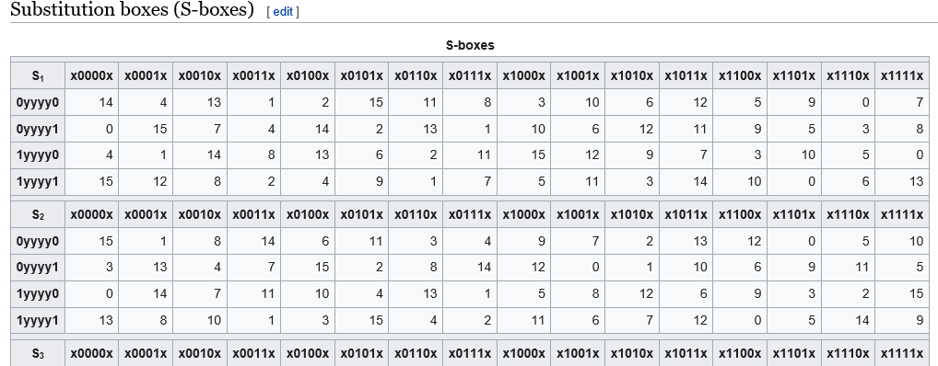
F-box, Feistel Function
F-box: the encryption engine
Input: R0 (32bit), SubKey0 (48bit), L0 (32bit)
Output: R1 (32bit) goes to the next round
48 bits are re-grouped
8 groups of 6 bits
Substitution Box, S-boxes
Each group uses Sn box
S-box encoding table
Input: 6bits → Output: 4 bits
0~63 → 0~15
4bits x 8 groups = 32 bits

Slide 16
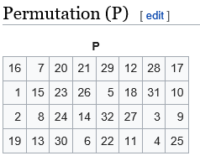
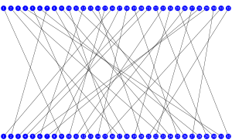
F-box, Feistel Function
F-box: the encryption engine
Input: R0 (32bit), SubKey0 (48bit), L0 (32bit)
Output: R1 (32bit) goes to the next round
S-box encoding table
Input: 6bits → Output: 4 bits
4bits x 8 groups = 32 bits
Permutation table
Another bit shuffling

Slide 17
Feistel Network / Structure
Divide Permuted bits into two halves
L0, R0 (32 bits each)
Right half directly goes through the next round
L1 = R0
R0, goes through Feistel function with SubKey0
F(R0, SubKey0) → 32 bits output
The rest of half output,
R1 = XOR (L0, F(R0, SubKey0) )
Repeat with SubKey1, SubKey2, … SubKey15
Finally Permuted

Slide 18
There are much literature on Crypto
This semester focus on practicing your programming skill
Rather than theoretical analysis
Symmetric Encryption today uses AES (Advanced Encryption System)
CPU has instruction for the encryption/decryption
Some CPU encrypts memory region to strengthen confidentiality
There are some body who tries to break crypto, always
Imitation game, Enigma
Fictions, Movies
And somehow real
There are security check tools & methodologies
Use verified tools, that’s we are using

