Slide 1
National Women’s Soccer League
Jennifer Brady
Professor Ann McDermott
CMST 301 5125
Notes:
For my presentation, I decided to use an organization that I am very familiar with and who is extraordinarily bad at digital marketing, the National Women’s Soccer League.

Slide 2
Company Information
Founding
Established 2012
1st Game: April 13, 2013
To be the top
women’s soccer league in the United States.
Goal
HQ
1556 S. Michigan Avenue, Floor 2
Chicago, IL 60605
http://www.nwslsoccer.com/
Notes:
The league was founded about halfway through 2012 and played its very first game on April 13, 2013. The NWSL is the 3rd attempt at founding a fully professional league in the United States within the last 20 years. The previous 2 leagues failed for a variety of reasons, most of which had to do with mismanagement of either funding or of the teams. The NWSL’s goal is to be the top women’s soccer league in the United States. They are the only fully professional women’s league, but there are several smaller semi-professional leagues. The leagues headquarters are located in Chicago which is significant because they share many resources with the United States National Teams who are also headquartered there.

Slide 3
Marketing Strategy
Operates on a shoestring budget
Makes use of free social media platforms for advertising
Twitter (https://twitter.com/NWSL)
YouTube (https://www.youtube.com/user/NWSLsoccer)
Instagram (https://www.instagram.com/nwsl)
Facebook (https://www.facebook.com/NWSL)
Notes:
As this is the third attempt at a league, there is both less funding and a more conscience effort to spend less money. To that end, the league makes extensive use of the various free platforms available to it for marketing. It has accounts on Twitter, YouTube, Instagram and Facebook. The digital marketing team is very active on Twitter and YouTube. There are frequent posts on twitter and an encouragement from the league for teams to also be active and interact with fans there.

Slide 4
Free Access
“Free access for fans was crucial in order to increase awareness and the NWSL was pleased with viewership numbers” (Concacaf, 2014)
Notes:
Additionally, rather than pursue a full network contract, the league chose to livestream every game on YouTube initially. There was a contract to air some games on cable television, but “free access for fans was crucial in order to increase awareness and the NWSL was pleased with viewership numbers.” The league also developed a variety of videos and coordinated with teams to make videos on their own channels about training and their players lives. This was successful, if the measure of success is steadily increasing view numbers.

Slide 5
Strategy Continued
Relies on sports publications
Specialized soccer publications
Specialized women’s sports publications
Recent Television deal:
Go90/Yahoo!Sports
A&E/Lifetime
ESPNews
Notes:
The league also relied on writeup in local newspapers, soccer publications and women’s sports publications to announce their presence and remind people of upcoming games as well as results. The league was successful enough in its first few seasons to get a sponsorship from A&E to air a weekly game on Lifetime as well as help with their marketing, website, and analytics. Part of the negotiation was to move games from YouTube to Go90 in order to gain a more healthy revenue stream. When Verizon shuttered Go90, the games were moved to Yahoo!Sports for the upcoming season as well as A&E negotiating a deal to air some additional games on ESPNews.

Slide 6
New Advertising Campaign
Unveiled on April 16, 2016
“marketing hiccup furt round the world” – (Barker, 2016, para 9)
Notes:
Although the NWSL has been steadily growing an audience, it has not been without it’s missteps. On April 16, 2016, as the league was about to make its historic season 4 debut, a season that no previous league had reached, the NWSL had the, “marketing hiccup furt roung the world.”

Slide 7
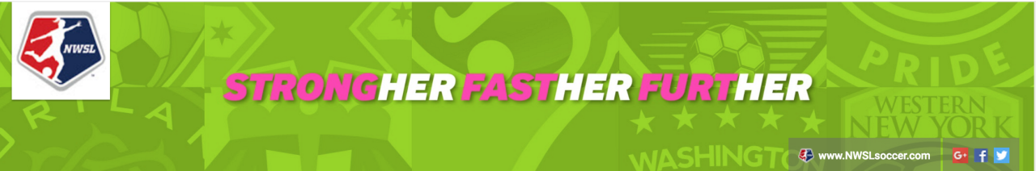
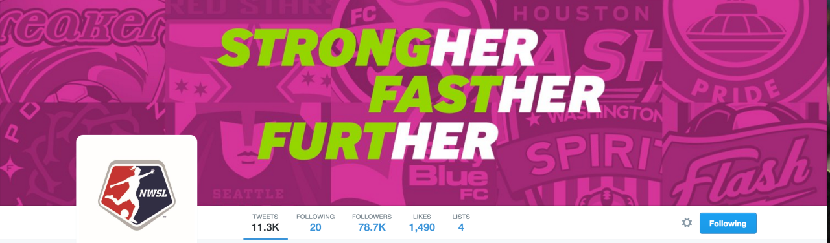
Terrible Design
YouTube Banner
Twitter Banner
Notes:
The league unveiled these 2 banners simultaneously on YouTube and Twitter, immediately sparking laughter from fans.

Slide 8
Design Problems
Odd spellings
Terrible Colors
Do not match the logo
Pink
“why are teams continuing to pander to this small part of the American public?”(Phelan, 2016)
Difficult to read
Notes:
It was an attempt add the word her to each part of the slogan, which led to highlighting something that isn’t a word causing some hilarity in the community. The chosen colors are also terrible. While they aren’t terrible, the backgrounds are very busy looking and the league chooses to put it’s log on everything which doesn’t match the graphic colors at all. Additionally, there has been a bunch of discussion about how the league needs to stop pandering to young girls who can’t give the league in money. It’s not a good target audience.

Slide 9
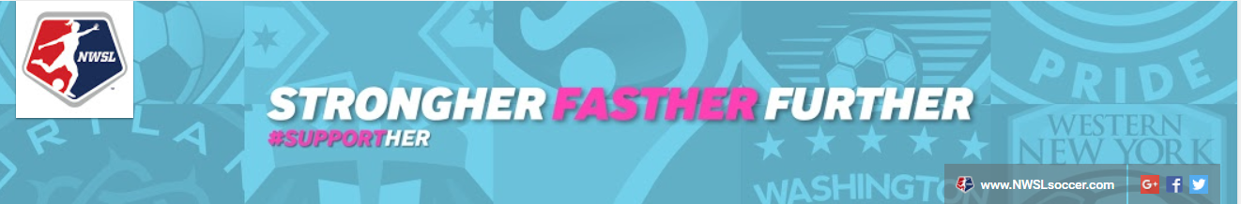
Results
Multiple News articles
Trending #Furt
Still in use 3 years later
A lot of comedy
Redesign
Notes:
The result was a number of news articles that referred to the snafu, a twitter hashtag that remains in use today and a redesign that still isn’t fantastic.

Slide 10
Of course, the “furt” joke isn’t a new phenomenon for women’s soccer fans either. They seem to enjoy taking something that was intended to appeal to them, rejecting it wholeheartedly with plenty of jokes on Twitter and then adopting it in their own way.
(Linehan, 2016)
Notes:
As Meg Linehan tells us:

Slide 11
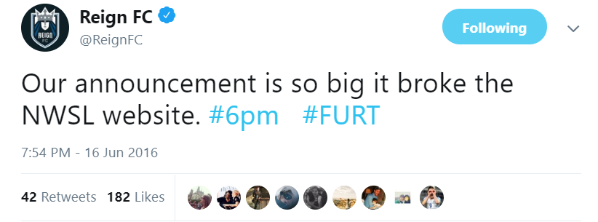
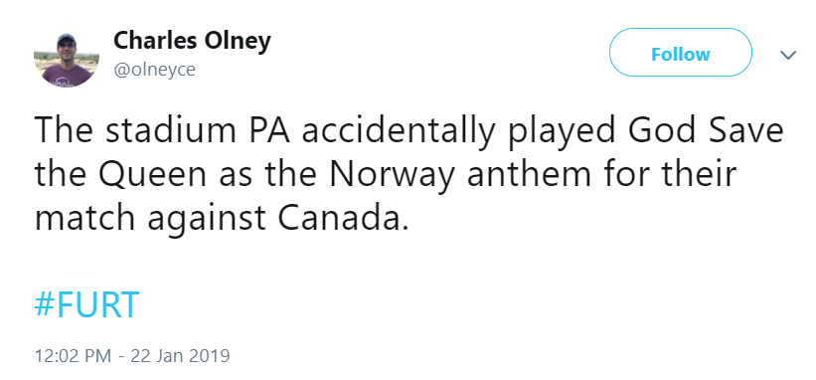
Notes:
Throughout 2016, the hashtag was used on multiple occasions anytime something went wrong in the league such as when the website crashed after Reign FC made an announcement. The hashtag remains in use today as shown by Olney’s tweet about the anthem mishap during a Canadian National Team game last month.

Slide 12
This mistake reached much further than the follow up real campaign
#Supporther
~2 people used this tag, the main NWSL account and the [former] NWSL Commissioner.
It was taken over by the Hillary campaign.
Notes:
This graphic design error reached a much larger audience than the follow up idea which was poorly thought through and happened to coincide with the exact same tag used by the Clinton campaign.

Slide 13
Negative Publicity
Initially, there was a lot of bad publicity
Waste time combating that
Waste time on a redesign
Loss of focus on goal
1st league to have a 4th season

Slide 14
Positive
Comedy
Hashtag is still in use
Journalists still refer to any mishaps as furt
It wasn’t a major error.

Slide 15
Summary
Professional Design Staff is important.

Slide 16
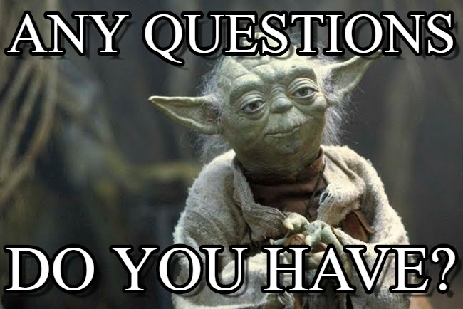

Slide 17
References
Barker, L. (2016, July 11). NWSL Week 12 in review: WNY's Embarrassing Field. Retrieved from https://www.sbnation.com/soccer/2016/7/11/12153008/nwsl-week-12-in-review-western-ny-s-tiny-field-was- unnecessary-and
Linehan, M. (2016, December 28). NWSL: The ten best moments from the 2016
season. Retrieved from http://www.excellesports.com/news/nwsl-ten-best-moments-2016/
NWSL. (n.d.). National Women's Soccer League. Retrieved February 14, 2019, from http://www.nwslsoccer.com/
Olney, C. (2019, January 22). The stadium PA accidentally played God Save the Queen as the Norway anthem for their match against Canada.[Tweet]. https://twitter.com/olneyce/status/1087757413728616450
Phelan, A. (2016, May 04). NWSL teams should reconsider their marketing strategies. Retrieved from http://www.unusualefforts.com/nwsl-marketing-strategies/
ReignFC. (2016, June 16). Our announcement is so big it broke the NWSL website. [Tweet]. https://twitter.com/ReignFC/status/743592579653001216

