Slide 1
Production Network Testing Lab
Multi-Vendor Datacenter Automation with gNMI
Deploy • Configure • Monitor • Validate
Notes:
Elevator pitch: This is a production-grade datacenter network lab that lets you deploy, configure, monitor, and validate multi-vendor network fabrics using containerized switches. Everything built here works identically in production. The only thing that changes is the inventory file.

Slide 2
The Problem
• Datacenter network automation is fragmented — every vendor has its own CLI, API, data models, and metric formats
• Testing network changes in production is risky — no safe place to iterate
• Monitoring across vendors requires vendor-specific dashboards and queries
• Configuration validation is manual and error-prone
• Existing platforms that integrate these functions are typically vendor-locked, proprietary, or expensive
"How do you test a BGP configuration change across 4 different vendor types before pushing to production?"
Notes:
Key question to pose to the audience. This sets up the entire presentation. Most teams either don't test cross-vendor changes, or they test on one vendor and hope it works on the others.

Slide 3
Unmet Needs in the Market
• Multi-vendor gNMI automation — very little reference material for cross-vendor gNMI config with a single dispatcher pattern
• Telemetry normalization — mapping vendor-specific metric names to universal names barely exists as reusable examples
• Validation as code — industry embraced config-as-code, but validation is still 'SSH in and check'
• Laptop-runnable multi-vendor lab — most Containerlab examples are single-vendor or topology-only
Not competing with CloudVision, Apstra, or NSO. Showing what's possible with open-source tools and gNMI. The integration across vendors is the value.
Notes:
This project isn't a new tool — it's a working, integrated, open-source reference architecture. The individual tools (Ansible, Grafana, Prometheus, gNMIc) aren't novel — the integration across vendors is. Vendor docs show single-vendor examples. This project shows the cross-vendor reality including the ugly parts like SR Linux rate limits and OpenConfig gaps.

Slide 4
What This Project Is
• 2 spine switches (route reflectors) + 4 leaf switches + 4 clients
• Full CLOS fabric: OSPF underlay, iBGP overlay, EVPN/VXLAN
• 4 vendors: Nokia SR Linux, Arista cEOS, SONiC, Juniper cRPD
• Runs on a laptop via Containerlab + OrbStack (macOS ARM)
• Everything is infrastructure-as-code, version controlled
Demo: ./lab start → containers come up in ~2 minutes
Notes:
A containerized datacenter network running real network operating systems. Demo opportunity: Show ./lab start and ./lab status.

Slide 5
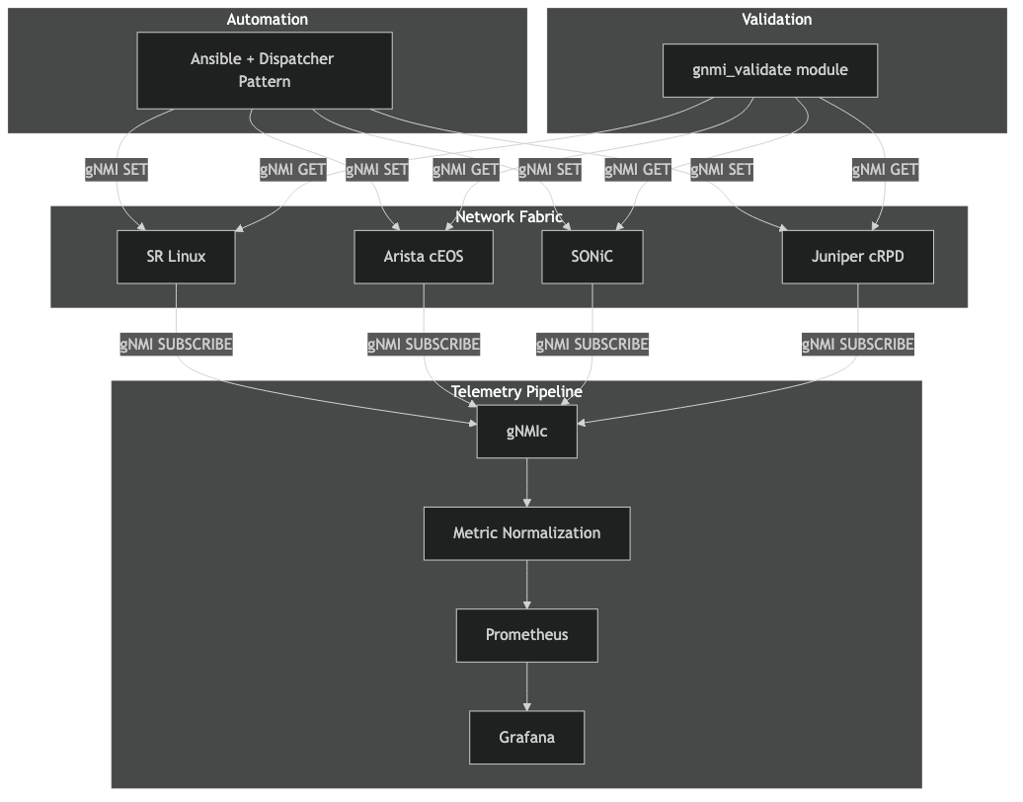
Architecture
• gNMI: single transport for config, telemetry, validation
• OpenConfig for telemetry, native YANG for config
• Dispatcher pattern auto-routes to vendor-specific roles
Notes:
gNMI is the single transport for config (SET), telemetry (SUBSCRIBE), and validation (GET). OpenConfig for telemetry gives vendor-neutral dashboards. Native YANG for config gives full feature access. Ansible dispatcher pattern auto-routes to vendor-specific roles based on OS detection. Everything is infrastructure-as-code, version controlled.

Slide 6
Multi-Vendor Dispatcher Pattern
1. Dynamic inventory queries gNMI capabilities from each device
2. OS detected automatically (srlinux, eos, sonic, junos)
3. site.yml uses conditionals to route to vendor-specific roles
4. Same playbook, same variables, different vendors
- name: Configure SR Linux include_role: { name: gnmi_interfaces } when: ansible_network_os == 'nokia.srlinux' - name: Configure Arista include_role: { name: eos_interfaces } when: ansible_network_os == 'arista.eos'
Notes:
This is the core automation innovation. Walk through how it works. Demo opportunity: Run ansible-playbook -i inventory.yml site.yml and show it configuring interfaces, LLDP, OSPF, BGP, EVPN across all devices.

Slide 7
EVPN/VXLAN Fabric
• OSPF provides underlay reachability between loopbacks
• iBGP with route reflectors (spines) distributes EVPN routes
• VXLAN tunnels extend L2 domains across the fabric
• 5 tenant VLANs mapped to VNIs (10010–10050), 2 L3 VRFs
• Data model in group_vars/leafs.yml — change YAML, re-run playbook, fabric reconfigures
Demo: ping 10.10.100.12 — traffic traverses leaf1 → spine → leaf2 via VXLAN
Notes:
Explain the overlay architecture. Demo opportunity: docker exec clab-gnmi-clos-client1 ping 10.10.100.12 — traffic traverses leaf1 → spine → leaf2 via VXLAN.

Slide 8
Telemetry & Monitoring
Two-tier telemetry:
• Tier 1: OpenConfig paths (vendor-neutral)
• Tier 2: Native vendor paths (OSPF, EVPN)
Normalization pipeline:
• gNMIc collects via gNMI SUBSCRIBE
• Event processors → universal metric names
• network_interface_in_octets works for all vendors
9 Grafana dashboards:
• Universal Interfaces
• Universal BGP
• Universal LLDP
• Interface Performance
• BGP / OSPF / EVPN Stability
• Network Congestion
• Vendor SR Linux (native drill-down)
Demo: Open Grafana at localhost:3000 — Universal Interfaces dashboard with all vendors
Notes:
Two-tier telemetry approach. Tier 1 OpenConfig for vendor-neutral metrics. Tier 2 native vendor paths for features OpenConfig doesn't cover. Demo: Open Grafana, show Universal Interfaces dashboard, then drill into vendor-specific view.

Slide 9
Validation Framework
Custom gnmi_validate Ansible module:
• pygnmi queries device state via gNMI GET
• Compares actual state vs expected state from inventory
• Supports OpenConfig + vendor-native YANG (origin field)
• Structured pass/fail with diffs and remediation hints
Validation playbooks:
• validate-bgp.yml — BGP sessions ESTABLISHED?
• validate-evpn.yml — EVPN routes advertised/received?
• validate-lldp.yml — LLDP neighbors match topology?
• validate-interfaces.yml — interfaces oper-up?
Demo: Run validation → break something → re-validate → see failure + remediation hint
Notes:
Custom gnmi_validate Ansible module uses pygnmi to query device state via gNMI GET. Compares actual state against expected state from inventory variables. Demo: Run ansible-playbook playbooks/validate.yml, show structured output. Then intentionally break something (shut an interface) and re-run to show failure detection.

Slide 10
Production Portability
Everything built here transfers directly to production
Component | Lab | Production | What Changes
Ansible playbooks | Same | Same | Nothing
Grafana dashboards | Same | Same | Nothing
gNMI subscriptions | Same | Same | Nothing
Validation checks | Same | Same | Nothing
Inventory file | containerlab IPs | datacenter IPs | Only this
develop in lab → validate → update inventory → run same playbook against production
Notes:
This is the key differentiator. Migration path: develop in lab, validate, update inventory (device IPs/credentials), run same Ansible playbook against production. Same dashboards, same queries, same validation checks.

Slide 11
Engineering Challenges
SR Linux gNMI Rate Limit
60 connections/minute per device. Solved by batching gNMI SET operations into single calls with multiple update-path/update-value pairs using Jinja2 loops. Reduced ~50 connections per host to ~15.
OpenConfig Gaps
SR Linux doesn't expose OSPF or EVPN via OpenConfig. Solution: dual-schema approach using the gNMI origin field — OpenConfig for telemetry, native YANG for config.
Metric Normalization at Scale
4 vendors × different path formats × different naming conventions. Built a normalization pipeline in gNMIc that produces identical metric names regardless of source vendor.
Notes:
Interesting problems solved along the way. The SR Linux rate limit was the trickiest — 60 connections/minute for CPU protection. We batch all operations into single gnmic calls. OpenConfig gaps required a dual-schema approach using the gNMI origin field.

Slide 12
Building with AI
18 weeks estimated
• Cross-domain knowledge on tap — Ansible, gNMI, YANG, 4 vendor CLIs, Python, Grafana, Docker
• Faster iteration on vendor-specific quirks
• Documentation stays current — docs updated with every code change automatically
• Spec-driven development — requirements → design → tasks before writing code
• Honest feedback loop — AI challenges assumptions
• Clean commit discipline — conventional commits, pre-commit hooks, push after every change
~4 days actual
50 commits • 12–15 March 2026
AI didn't replace network engineering expertise — it amplified execution across domains
Notes:
The design spec estimated 18 weeks of human effort across 9 phases. With AI-assisted development (Kiro), the project went from first commit to production-ready in ~4 calendar days with 50 commits. AI bridges knowledge gaps across Ansible, gNMI, YANG models, 4 vendor CLIs, Jinja2, Python, Prometheus, Grafana, Docker, and Containerlab. Every change is committed with descriptive conventional commit messages. The git log reads like a changelog, not a wall of WIP. AI handles commit message formatting, pre-commit hook compliance, and push cycle automatically. Key takeaway: AI amplified the ability to execute across multiple technology domains simultaneously.

Slide 13
CI/CD & Testing
1. Lint
Ruff, Mypy, yamllint, ShellCheck, ansible-lint
2. Security
Bandit, Trivy, Checkov, Gitleaks
3. Tests
Unit + Property-based (Hypothesis)
• Unit tests: deployment, configuration, telemetry, validation, state management
• Property-based tests: state management invariants, telemetry properties
• Integration tests: end-to-end workflows, multi-vendor, monitoring stack
• Pre-commit hooks enforce all lint + security checks locally before push
Notes:
3-stage GitHub Actions pipeline. Pre-commit hooks enforce all lint + security checks locally before push. Test structure covers unit, property-based, and integration tests.

Slide 14
Key Numbers
Metric | Value
Vendors supported | 4 (SR Linux, Arista, SONiC, Juniper)
Network devices | 6 (2 spines + 4 leafs)
Client nodes | 4
Ansible roles | 26
Grafana dashboards | 9
Telemetry metrics | ~1,560 OpenConfig + native
Validation checks | 5 categories
CI pipeline stages | 3 (lint, security, tests)
Tenant VLANs / L3 VRFs | 5 VLANs (VNI 10010–10050) / 2 VRFs
Design estimate vs actual | 18 weeks → 4 days with AI
Notes:
Key metrics for the project. Good reference slide for Q&A.

Slide 15
Live Demo Sequence
1. Show topology.yml
2. Deploy: ./lab start
3. Show running containers: ./lab status
4. Configure fabric: ansible-playbook site.yml
5. Verify OSPF + BGP neighbors
6. Test client connectivity via EVPN/VXLAN (ping)
7. Show Grafana dashboards (localhost:3000)
8. Run validation playbook
9. Break something → re-validate → see failure + remediation
10. Fix it → re-validate → all green
Notes:
If doing a live demo, follow this sequence. All commands need orb -m clab prefix on macOS ARM. The break-and-fix cycle is the most impactful demo moment — shut an interface, show failure detection with remediation hint, then fix it.

Slide 16
Questions?
Production Network Testing Lab
Notes:
Anticipated questions:
Q: Why not Terraform/Nornir/Napalm?
A: Those focus on config management. This is a complete platform — deployment, config, telemetry, monitoring, and validation in one stack. Ansible chosen for network ops adoption.
Q: Why gNMI instead of NETCONF/RESTCONF?
A: gNMI provides streaming telemetry (not just config), uses efficient gRPC/protobuf, and is the industry direction. One protocol for SET, GET, and SUBSCRIBE.
Q: Does this scale to production?
A: Yes. Same playbooks, dashboards, subscriptions. Prometheus and gNMIc support horizontal scaling. Only the inventory file changes.
Q: Why OpenConfig for telemetry but native YANG for config?
A: OpenConfig telemetry gives vendor-neutral dashboards. But OpenConfig config support is incomplete — SR Linux doesn't support EVPN via OpenConfig. Native YANG gives full feature access.
Q: What about the SR Linux rate limit?
A: 60 gNMI connections/minute for CPU protection. We batch operations into single gnmic calls using Jinja2 loops. Reduced from ~50 to ~15 connections per host.

