Slide 1
10520CS235100 Data Structures Homework 3
2017/04/20 14:30 ~ 2017/05/04 23:59

Slide 2
S-Expression
empty tree ::= ()
tree ::= empty tree | (w tree tree)

Slide 3
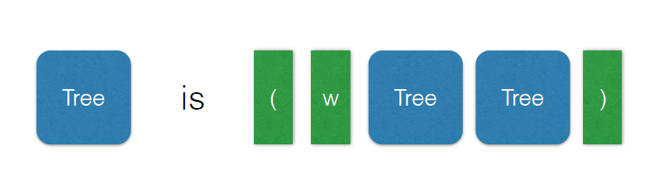
How to Parse

Slide 4
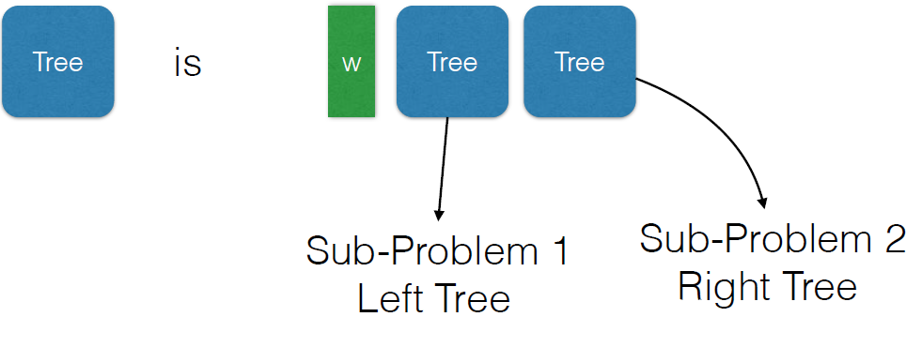
How to Parse

Slide 5
Tree Structure
class Node
{
public:
int weight; // weight can be negative!
Node *left, *right;
Node():weight(0),left(NULL),right(NULL){}
Node(int d):weight(d),left(NULL),right(NULL){}
};

Slide 6
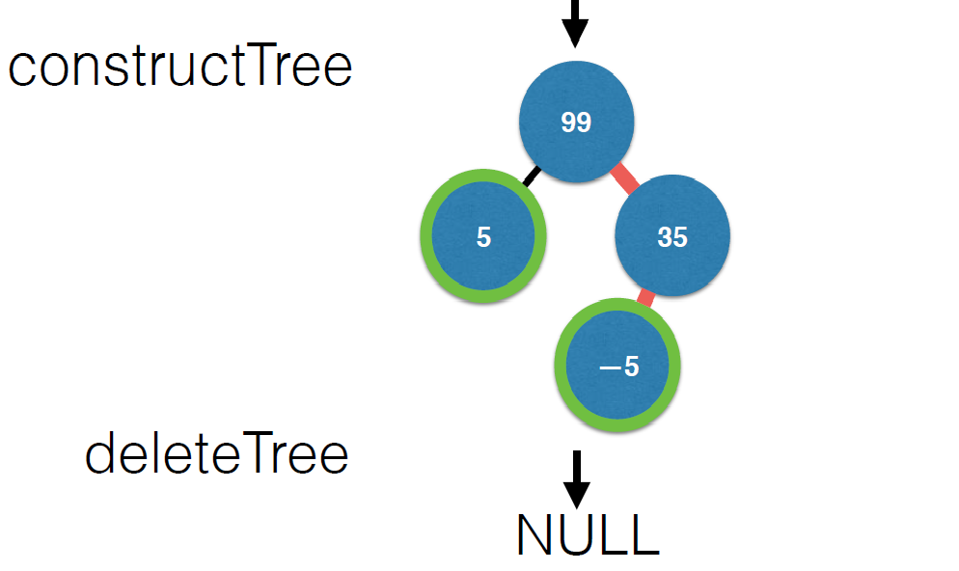
(99(5()())(35(-5()())()))
(99(5()())(35(-5()())()))

Slide 7
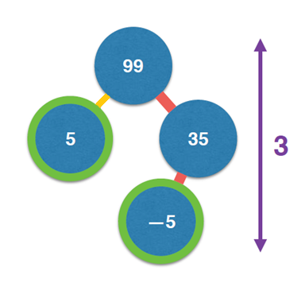
Targets
treeHeight = 3
Height of the tree
treeWeight = 134
Sum of node weights
leafNum = 2
Leaf node number
minPathWeight = 104
min weight from root to leaf
(99(5()())(35(-5()())()))

Slide 8
Target
The target of this homework is to implement a Binary Tree.

Slide 9
Target
The functions of the Binary Tree that you need to implement.
Node* constructTree(Node *root, std::string treeStr)const
Node* deleteTree(Node *root)const
int treeHeight(const Node *root)const
int treeWeight(const Node *root)const
int leafNum(const Node *root)const
int minPathWeight(const Node *root)const

Slide 10
Target
Node* constructTree(Node *root, std::string treeStr)const Input a tree string in S-expression, construct the tree and return the pointer to its root node.
Node* deleteTree(Node *root)const Delete and release the memory allocation of each node, and return a nullptr.

Slide 11
Target
int treeHeight(const Node *root)const Return the height of the tree.
int treeWeight(const Node *root)const Return the sum of node weights.

Slide 12
Target
int leafNum(const Node *root)const Return the number of leaf nodes.
int minPathWeight(const Node *root)const Return the min path weight from root to leaf.

Slide 13
File Structure
readonly
makefile
1.in is a released test file
main.cpp contains a testing function
class “Node” represents the DS of a linked list node
In the BinearyTreeOps.cpp
class “MyBinaryTreeOps” contains your implementation

Slide 14
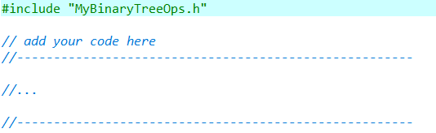
MyBinaryTreeOps
MyBinaryTreeOps.h
MyBinaryTreeOps.cpp

Slide 15
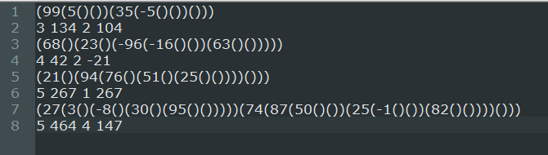
1.in
(99(5()())(35(-5()())()))
3 134 2 104
treeHeight
minPathWeight
treeWeight
leafNum

Slide 16
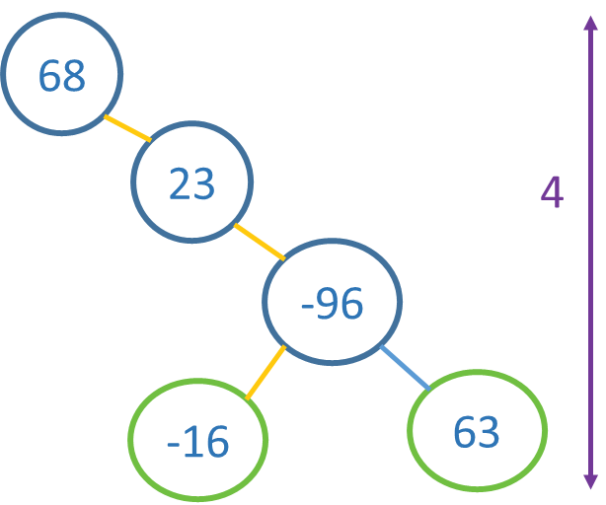
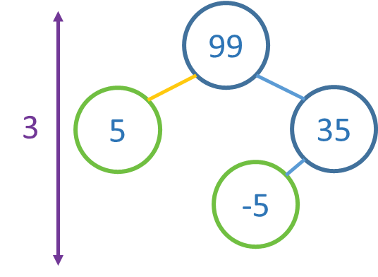
1.in
99+5+35+(-5) = 134
68+23+(-96)+(-16)+63=42
99+5=104
68+23+(-96)+(-16)=-21

Slide 17
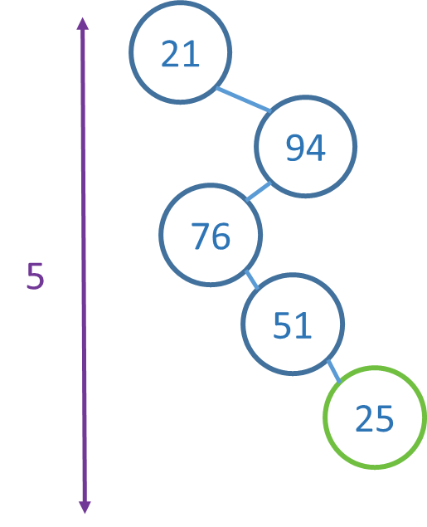
1.in
(21()(94(76()(51()(25()())))()))
(21()(94(76()(51()(25()())))()))
(21()(94(76()(51()(25()())))()))
(21()(94(76()(51()(25()())))()))
(21()(94(76()(51()(25()())))()))
(21()(94(76()(51()(25()())))()))
21+94+76+51+25=267
21+94+76+51+25=267

Slide 18
1.in
(27(3()(-8()(30()(95()()))))(74(87(50()())(25(-1()())(82()())))()))
(27(3()(-8()(30()(95()()))))(74(87(50()())(25(-1()())(82()())))()))
(27(3()(-8()(30()(95()()))))(74(87(50()())(25(-1()())(82()())))()))
(27(3()(-8()(30()(95()()))))(74(87(50()())(25(-1()())(82()())))()))
(27(3()(-8()(30()(95()()))))(74(87(50()())(25(-1()())(82()())))()))
(27(3()(-8()(30()(95()()))))(74(87(50()())(25(-1()())(82()())))()))

Slide 19
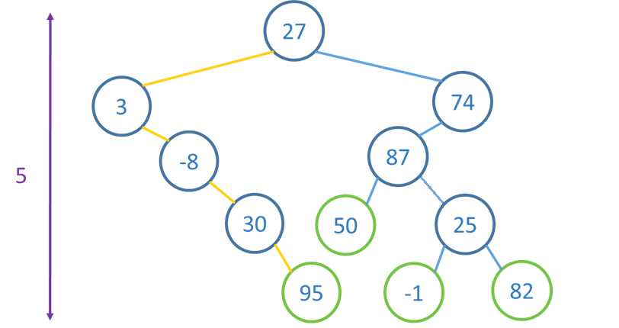
1.in

Slide 20
How to compute MinWeightPath?
Multiple Approaches. Please choose based on your preference
1) Brute-Force
2) Recursive
3) Doubly Linked Tree (need to override Node class)
4) Bottom-up Approach

Slide 21
Message
• [Undefined BinaryTreeOps::*******]
The function is not implemented.
• [Wrong ********]
Different types of Wrong Answer
• [Accepted]

Slide 22
Notice
Each of the test cases contains up to TEN-THOUSAND trees!
• Each tree may have HUNDREDS of nodes.

Slide 23
Submission
make clean
Remove object files (*.o) and the executable
Archive your source codes (whole hw3 folder) into a zip file named [studentID]_hw3.zip
E.g. 105062649_hw3.zip
Submit the zip file to ilms system BEFORE the deadline

Slide 24
Demo
Notes:
mingw32-make -f makefile

