Slide 1
A search for Self-Consistency in BATSE Gamma-Ray Burst Emissions Using Agglomerative Clutstering
Thomas Cannon

Slide 2
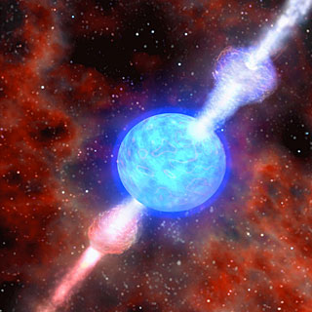
What is a Gamma-Ray Burst (GRB)?
Bright emission of gamma-rays to high X-rays
Field still undecided on the proper model
Durations range from fractions of a second to minutes
Observed about once a day
Uniform distribution across the sky

Slide 3
Historical Context

Slide 4
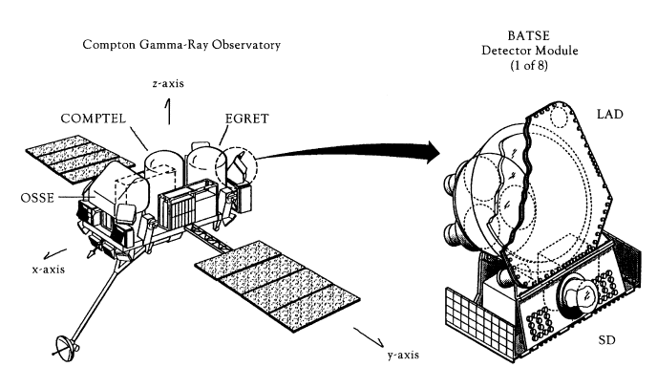
BATSE (CGRO)
Ran from April 1991 to June 2000
Trigger starts high-resolution data stream
4-channel data at 64 ms
20-50keV 50-100keV 100-300keV 300-1MeV

Slide 5
BATSE Data

Slide 6
GRB’s are Composed of Pulses
Complex characteristics combined with low signal to noise makes pulse definition difficult
Hard-to-Soft evolution and Lag: Every Pulse Has its own Lag
Inspiration from BATSE GRB pulse catalog

Slide 7
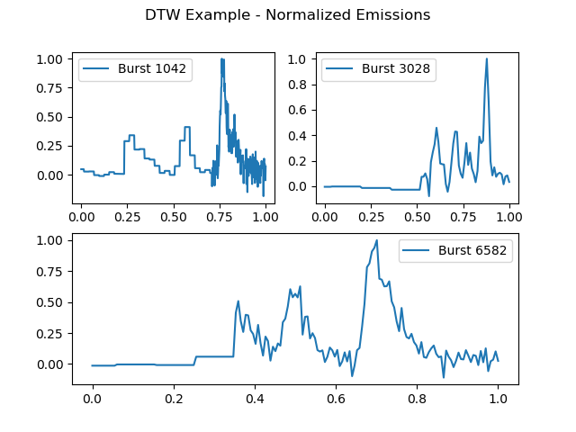
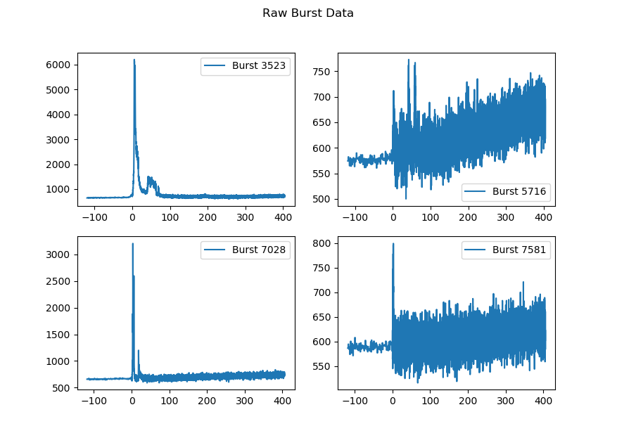
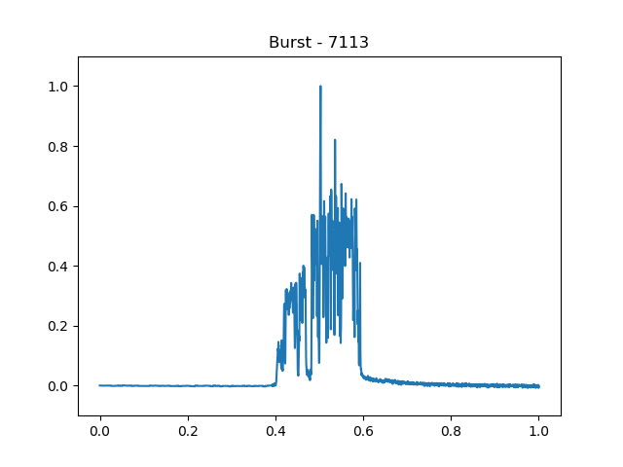
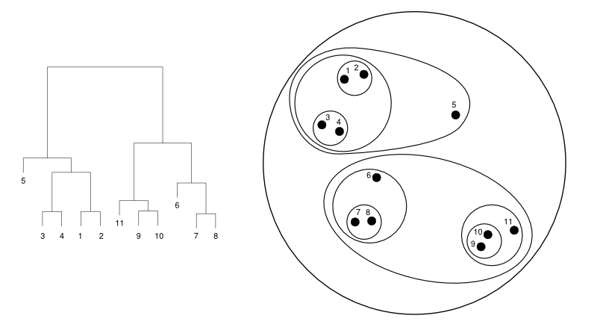
Objective: Cluster and Classify GRB Complexity

Slide 8
Similarity Matrices

Slide 9
Euclidean Distance

Slide 10
Zero-Normalized Cross-Correlation (ZNCC)

Slide 11
Normalized Manhattan Distance

Slide 12
Dynamic Time Warping

Slide 13
Agglomerative Clustering

Slide 14
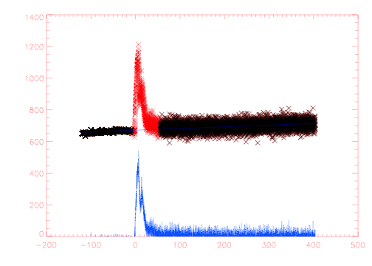
Data Preparation
Background slope removed
Justification: The detected background slope is independent of GRB’s and is mainly the result of the orbital mechanics of CGRO through earth’s Magnetosphere
Bursts temporally normalized based on t90 times
Justification: GRB pulse properties correlate with pulse duration⁽¹⁾

Slide 15
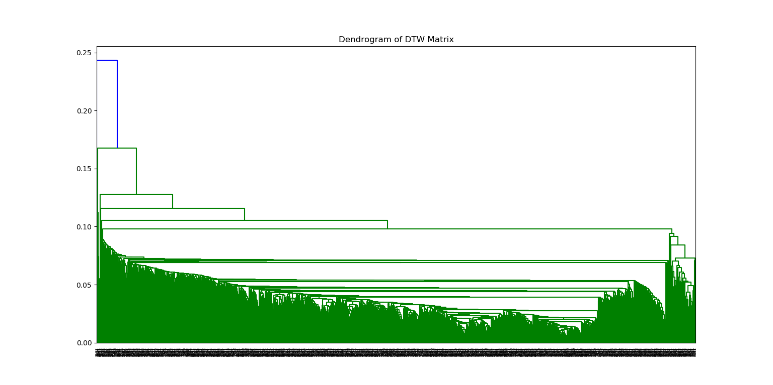
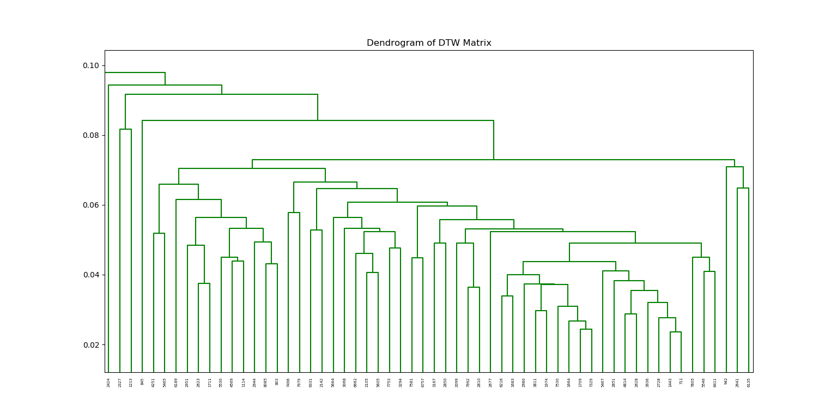
The Dendrogram

Slide 16
Results
Bursts of the same nodes remain comparable despite the resolution of the normalized data

Slide 17
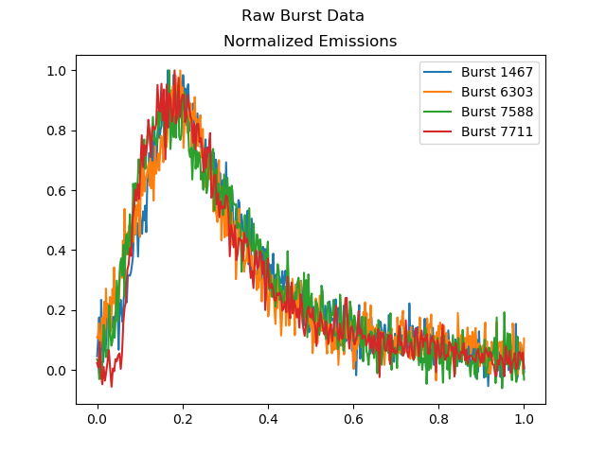
Results
Bursts of adjacent nodes show a continuum of GRB property evolution

Slide 18
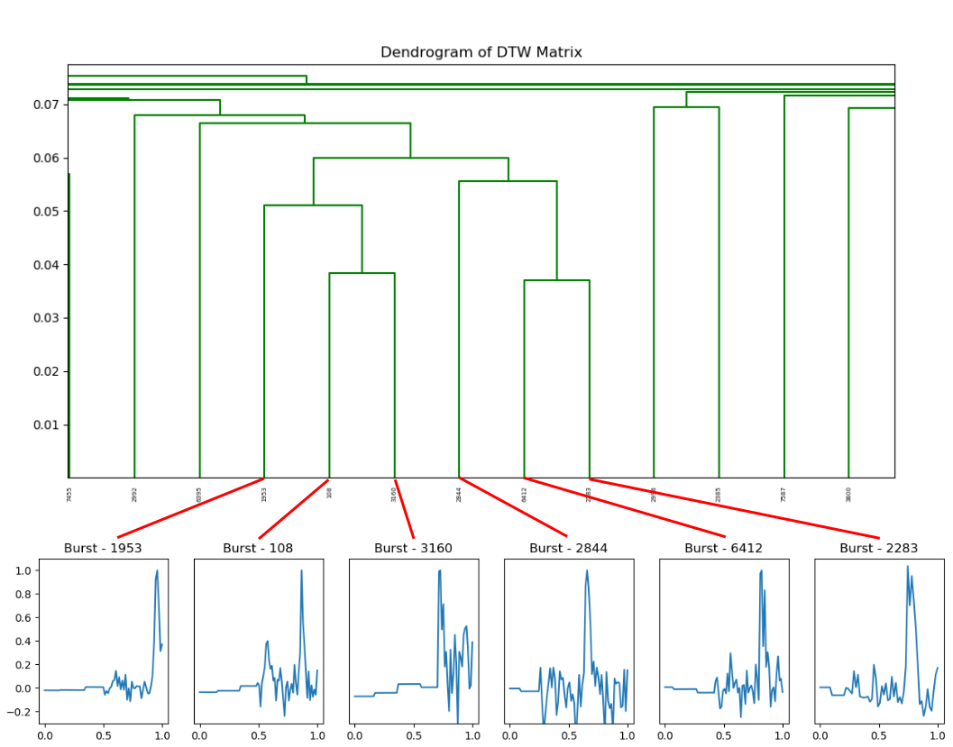
Results

Slide 19
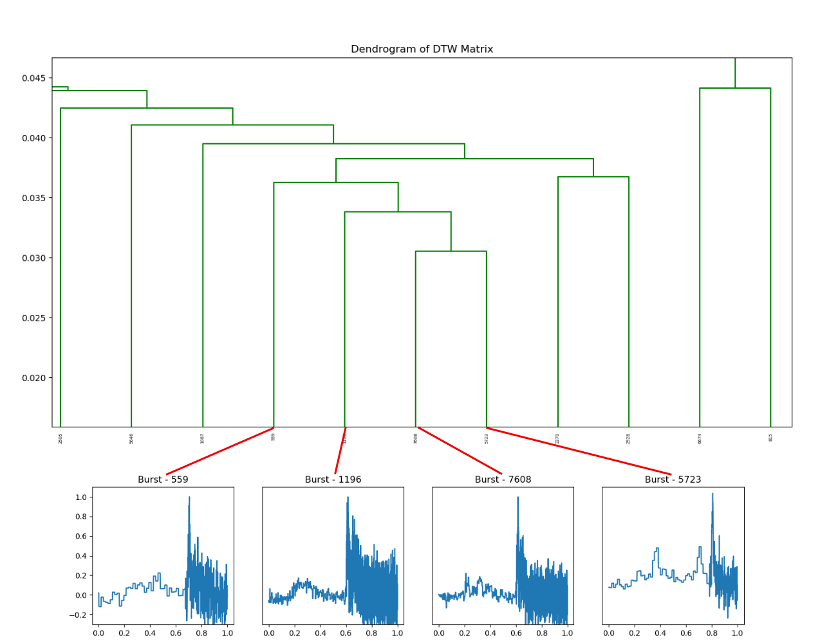
Results

Slide 20
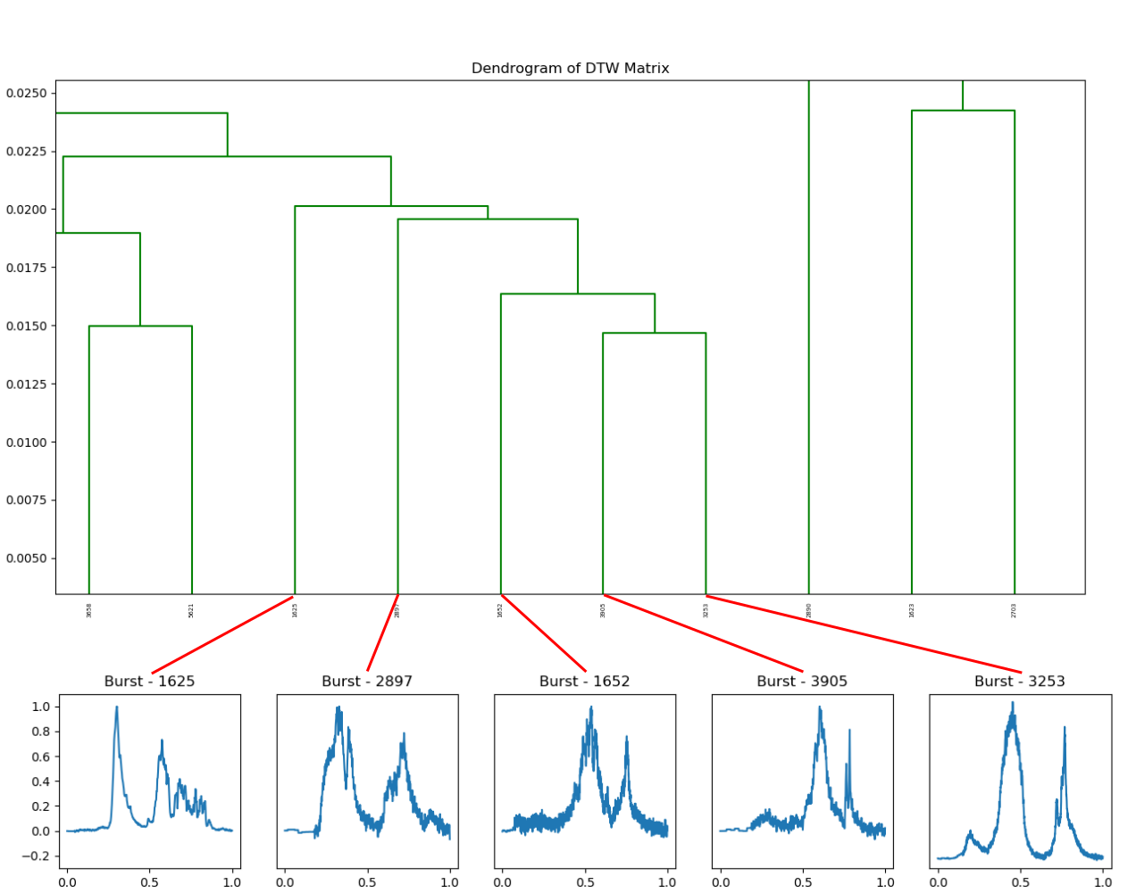
Results

Slide 21
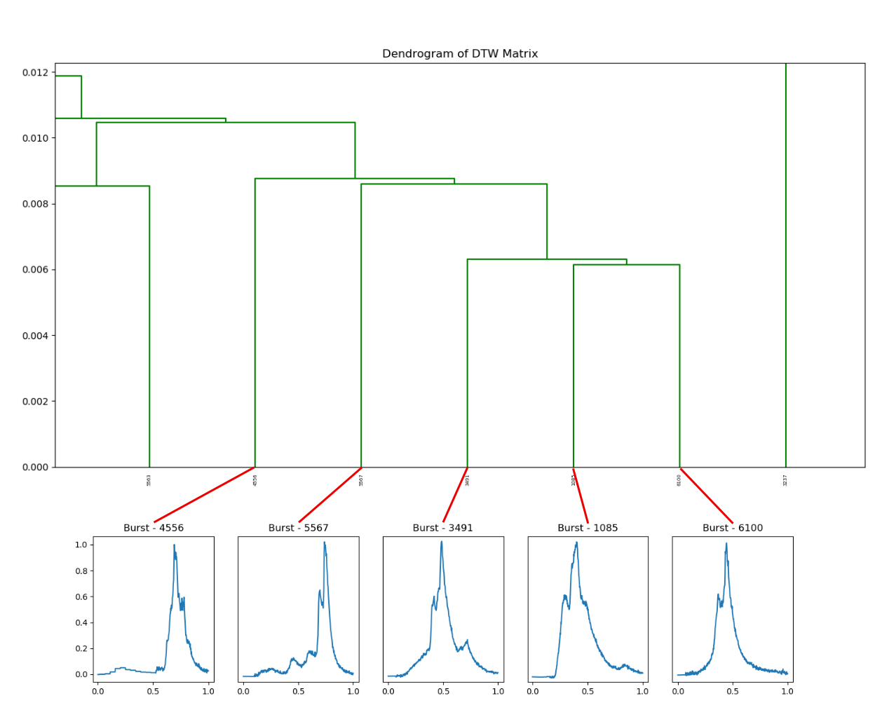
Results

Slide 22
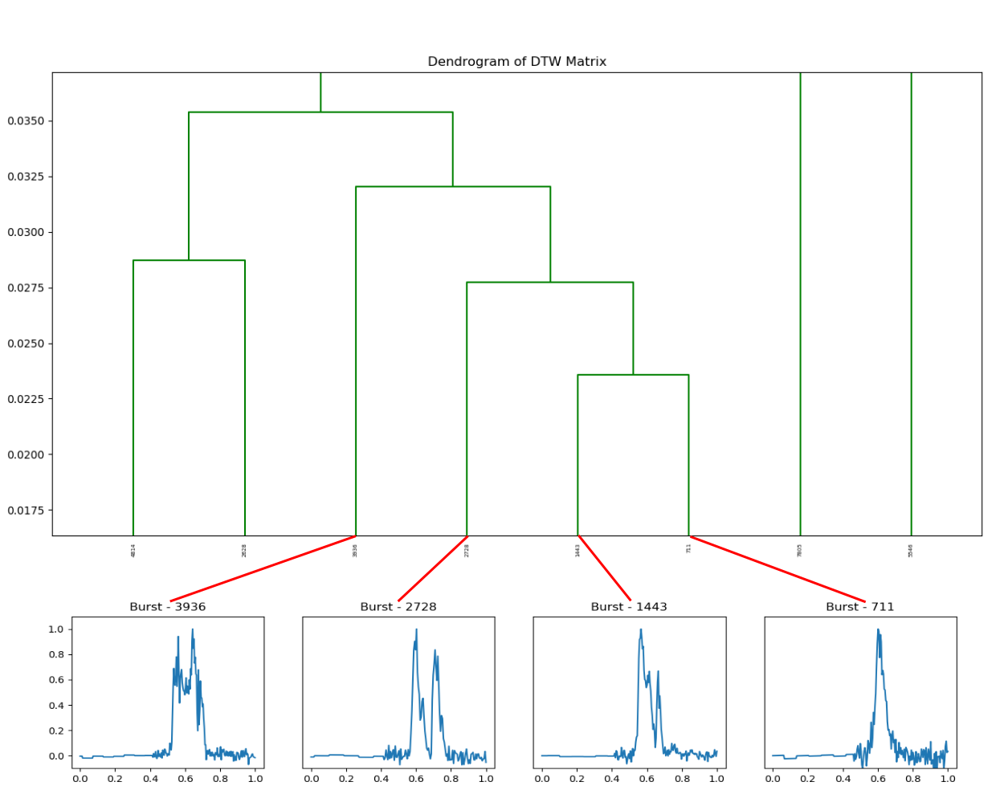
Results

Slide 23
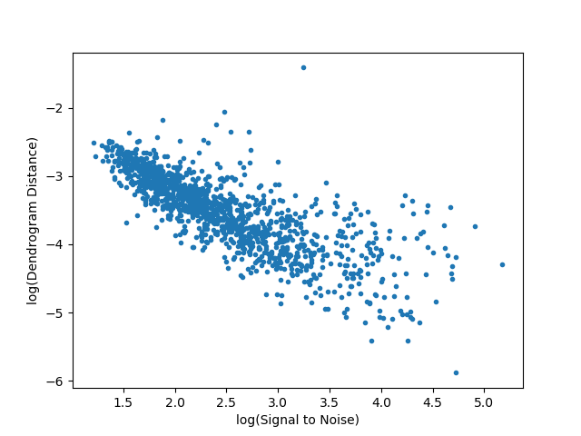
Results
Pearson coeff. = -0.79

Slide 24
Future Work

Slide 25
References
J. Hakkila and R. Preece, Unificaiton of pulses in long and short gamma-ray bursts: evidence from pulse properties and their correlations, ApJ 740 (2011) 104

