Slide 1
A Search for Self-Consistency in BATSE Gamma-Ray Burst Emissions Using Agglomerative Clustering
Thomas Cannon

Slide 2
Historical Context
1963 – Partial Test Ban Treaty and the Vela Satellites
The Vela satellites carried the ability to detect gamma-ray radiation from nuclear explosions originating on earth
1973 – Discovery of flashes of gamma radiation out in space.
1991 – BATSE on board the CGRO launched.
1991/1992 - Isotropic distribution and daily frequency.
1997 – First redshift was obtained on GRB 970228.
GRBs occur outside of our galaxy and far back in time, confirming cosmological origin

Slide 3
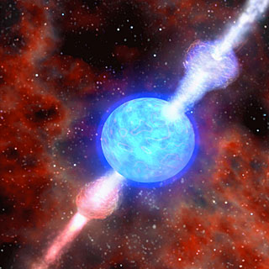
What is a Gamma-Ray Burst (GRB)?
Bright emission of gamma-rays to high X-rays
Too bright to be from an isotropic source
Field still undecided on the proper model
Beamed radiation from merging binary compact objects or Core-collapse

Slide 4
GRBs are Composed of Pulses
Pulses fit wit the Norris model
Supplemented by residual model to improve fit
Complex characteristics combined with low signal-to-noise makes pulse definition difficult
Emissions undergo Hard-to-Soft evolution
Durations range from fractions of a second to minutes

Slide 5
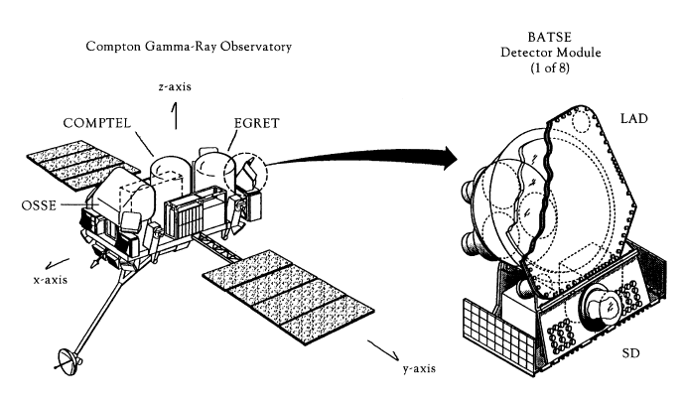
BATSE (CGRO)
Ran from April 1991 to June 2000
Trigger starts high-resolution data stream
4-channel data at 64ms

Slide 6
BATSE Data
64ms ASCII Data
Recorded in 256ms before trigger criterion begins recording in 64ms
Relevant header data
(trig#): unique BATSE trigger number
(npts): total number of samples to follow
(nlasc): total number of samples concatenated prior to trigger. In other words, the start of the 64ms data
Column data
Each column represents a different spectral energy channel
Channel 1: 20-50 keV
Channel 2: 50-100 keV
Channel 3: 100-300 keV
Channel 4: >300 keV
Four our proposes, we will be combining the channels into summed four-channel data

Slide 7
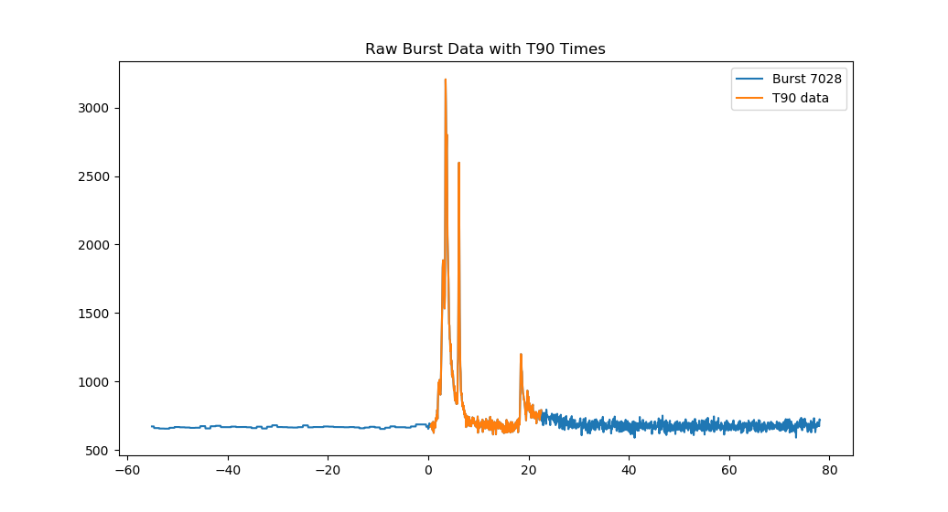
BATSE Data
T90 Duration Table
The BATSE trigger number
T90 times
Duration of the time interval during which 90% of the total observed counts have been detected
Uncertainty in T90
The start time of the T90 interval, relative to the trigger time (nlasc)

Slide 8
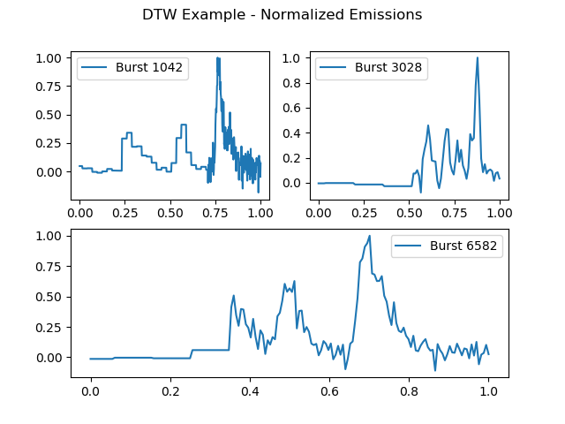
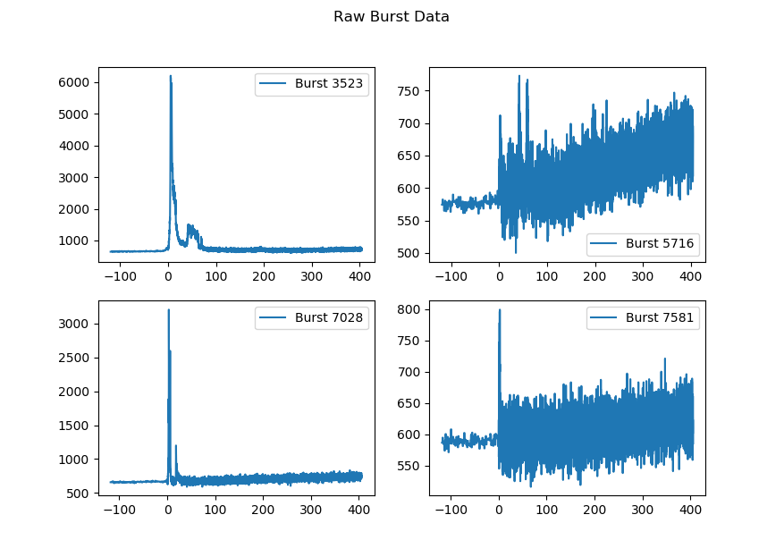
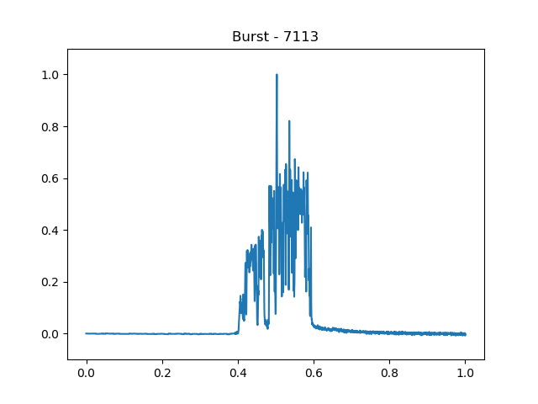
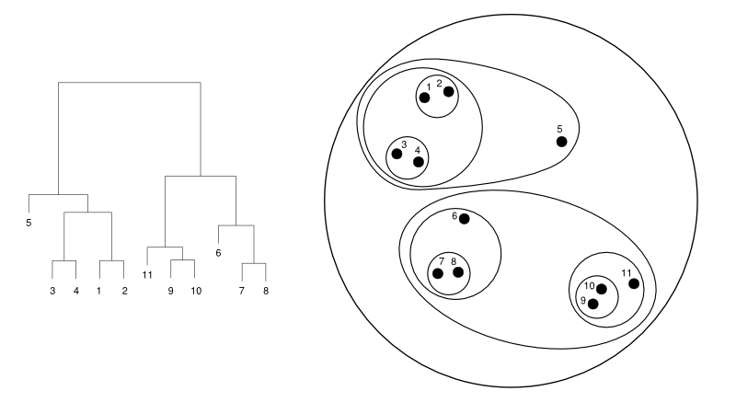
Objective: Cluster and Classify GRB Complexity

Slide 9
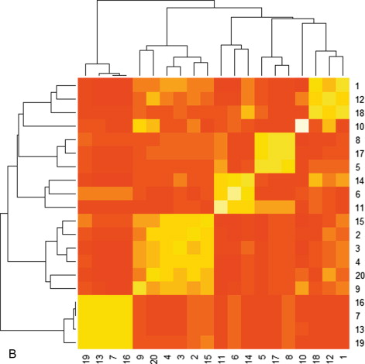
Similarity Matrices
Distance Measures
Euclidean
Normalized Manhattan
Zero-Normalized Cross-Correlation
Dynamic Time Warping

Slide 10

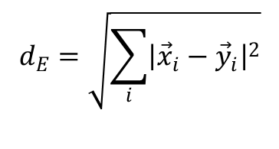
Euclidean Distance
$$d_{E}=\sqrt{\sum_{i}{{\left|{\vec{x}}_{i}−{\vec{y}}_{i}\right|}^{2}}}$$

Slide 11
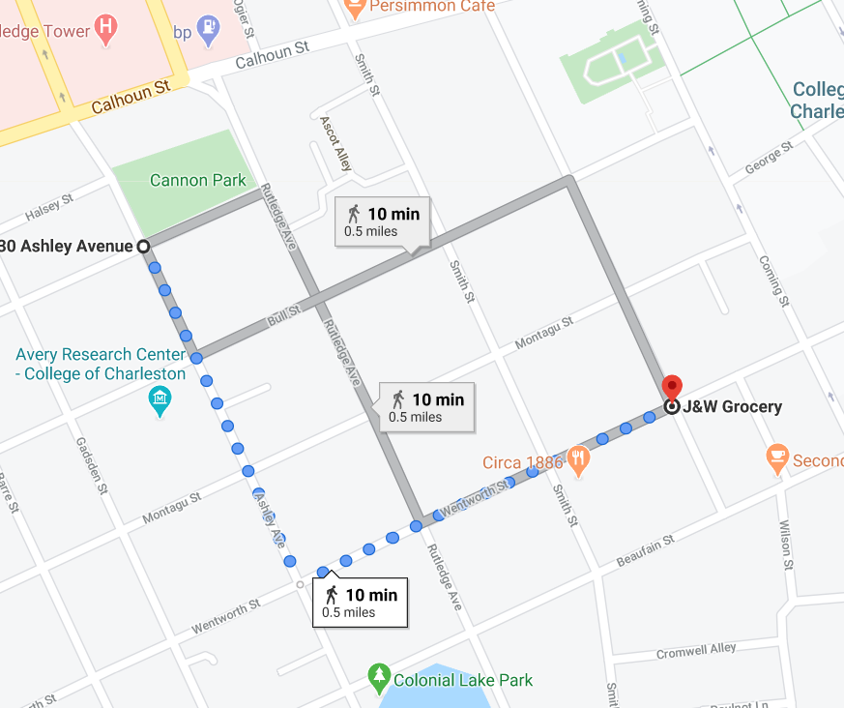
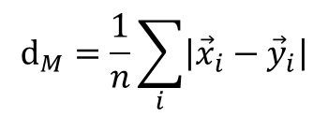
Normalized Manhattan Distance
$$ⅆ_{M}=\frac{1}{n}\sum_{i}{\left|{\vec{x}}_{i}−{\vec{y}}_{i}\right|}$$

Slide 12
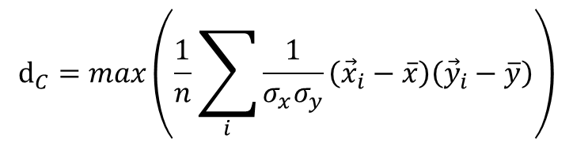
Zero-Normalized Cross-Correlation (ZNCC)
$$ⅆ_{C}=\max\left(\frac{1}{n}\sum_{i}{\frac{1}{σ_{x}σ_{y}}\left({\vec{x}}_{i}−\overline{x}\right)\left({\vec{y}}_{i}−\overline{y}\right)}\right)$$
Difference from a normal cross correlation is subtracting the mean and dividing by the standard deviation
Then select the max from the ZNCC array

Slide 13
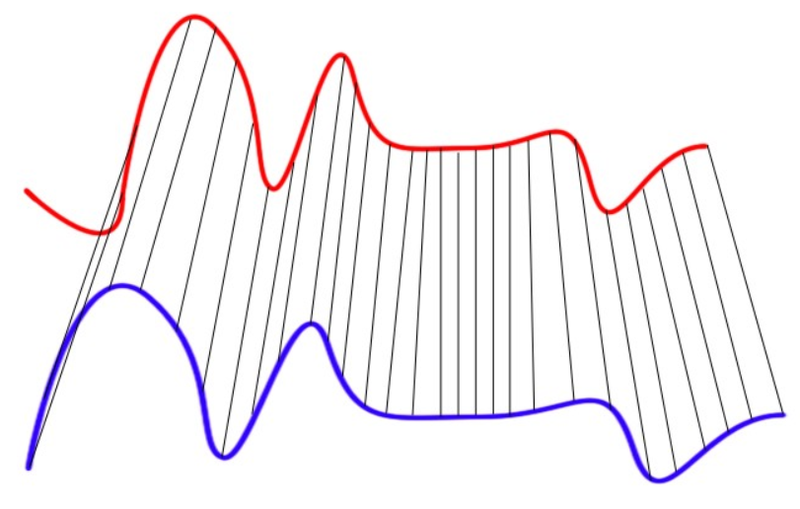
Dynamic Time Warping
Allows for comparison of time series features between two data sources that are out of phase with one another.

Slide 14
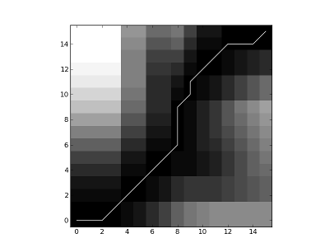
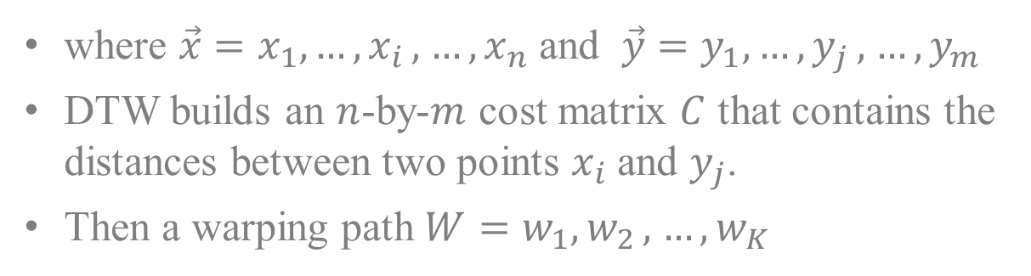
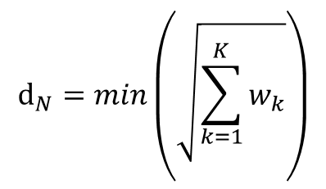
Dynamic Time Warping
where ${\vec{x}=x}_{1}{, …,x}_{i},{ …,x}_{n}$ and ${\vec{y}=y}_{1}{, …,y}_{j},{ …,y}_{m}$
DTW builds an $n$-by-$m$ cost matrix $C$ that contains the distances between two points $x_{i}$ and $y_{j}$.
Then a warping path ${W=w}_{1}{, w}_{2},{ …,w}_{K}$
$$ⅆ_{N}=\min\left(\sqrt{\sum_{k=1}^{K}{w_{k}}}\right)$$

Slide 15
Agglomerative Clustering
With an upper triangular matrix, where each entry contains the similarity distances between every unique pair of GRB emission episodes, treat each entry as its own cluster.
By the values in the matrix, the two GRBs considered the most similar out of the entire matrix are then merged into one cluster. The matrix is then updated to reflect the merger by considering new position values that represent the combined cluster.
If every GRB emission episode is within the same cluster, then stop. Otherwise, return to step 2.

Slide 16
Data Preparation
Choosing quality data
Quality ASCII files
Ensuring a proper T90 time in the duration table
Hand picking single-emission episodes
Eliminating categorical short emissions
Emissions with calculable backgrounds

Slide 17
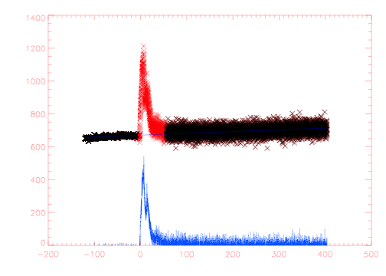
Data Preparation
Background slope removed
The detected background slope is mainly the result of the orbital mechanics of CGRO through earth’s magnetosphere and other gamma-ray sources
Emissions temporally normalized based on t90 times
Justification: GRB pulse properties correlate with pulse duration
Emission amplitudes normalized
Emission amplitudes are the results of multiple factors including background noise, detector sensitivity, binning, and distance from the prompt emission

Slide 18
Building the Matrices
Resampled the Emissions between every GRB
Each pair of emissions has a different number of bins
Fourier downsampling is applied to the emissions with the larger number of bins
Because each pair of emissions was sampled differently, we end up relying on similarity measures that were normalized. As in, the similarity of any two pairs of emission needs to be on the same scale.
Each method of calculating similarity measurements was used to create matrices
Results from calculating the similarity measures were constructed into an upper triangular matrix, representing the similarities between every pair of emissions

Slide 19
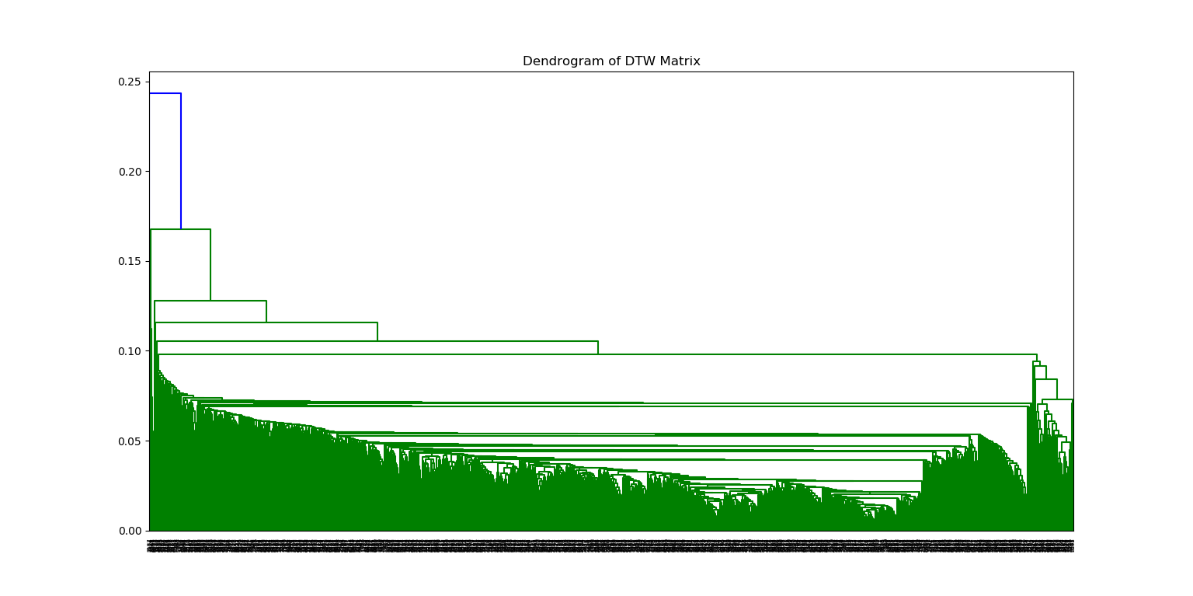
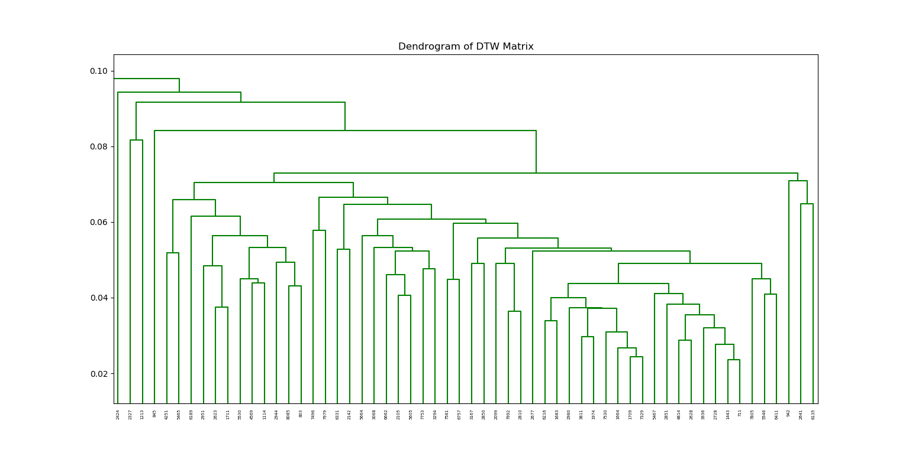
The Dendrogram

Slide 20
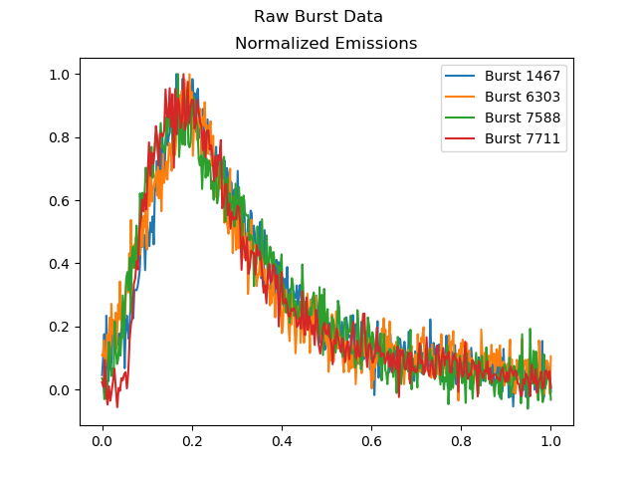
Results
For most all but the Euclidean similarity measure, emissions remain comparable despite the inconsistent resolution of each emissions time bins relative to one another.

Slide 21
Results
Qualitatively, the DTW matrix creates the most visually consistent clusters of emission features
Each technique is difficult to compare because they each approach the problem differently
Emissions of adjacent leaves show visually comparable features between emissions
Emissions of adjacent leaves show a continuum of GRB property evolution
Vertical leaf distance in the Dendrogram is correlated to signal-to-noise
First clustering attempt on GRB time series.

Slide 22
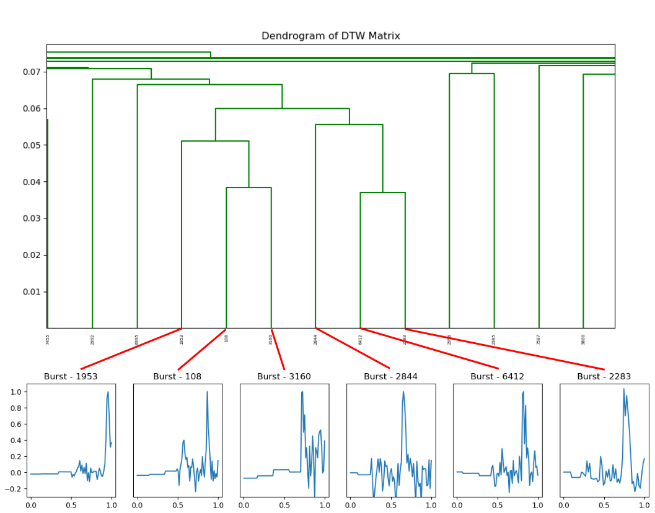
Results

Slide 23
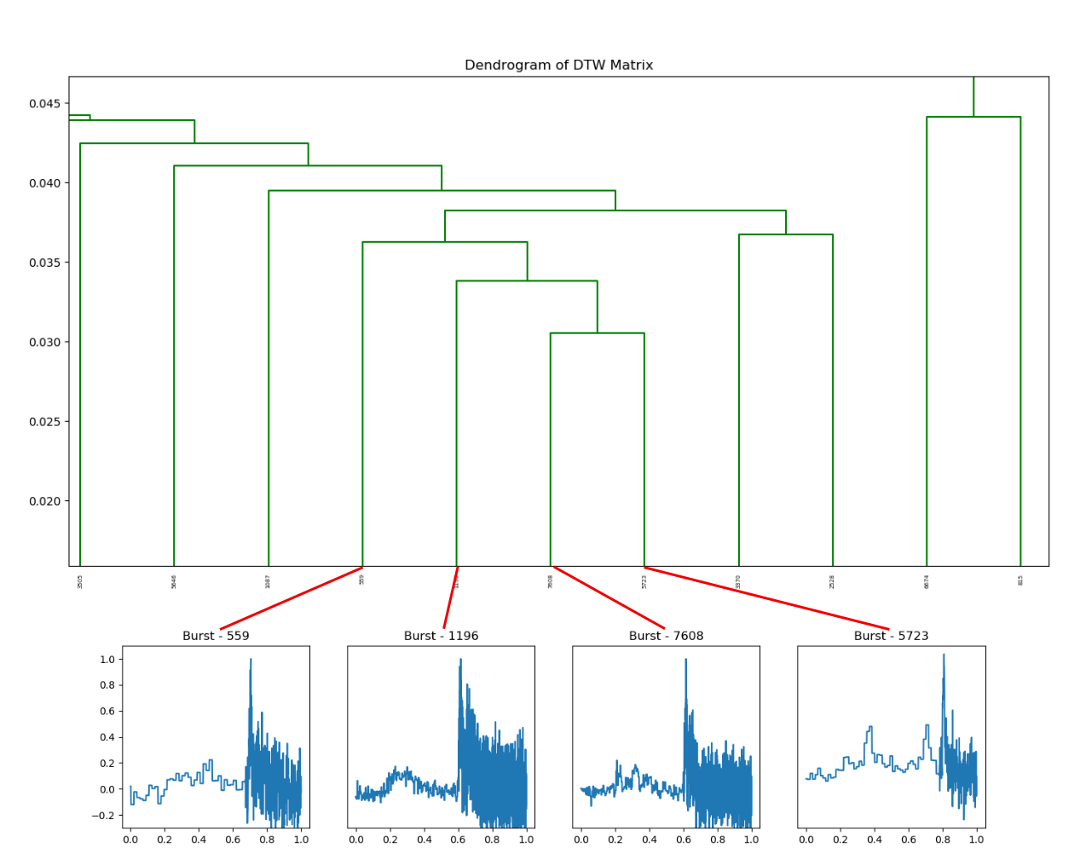
Results

Slide 24
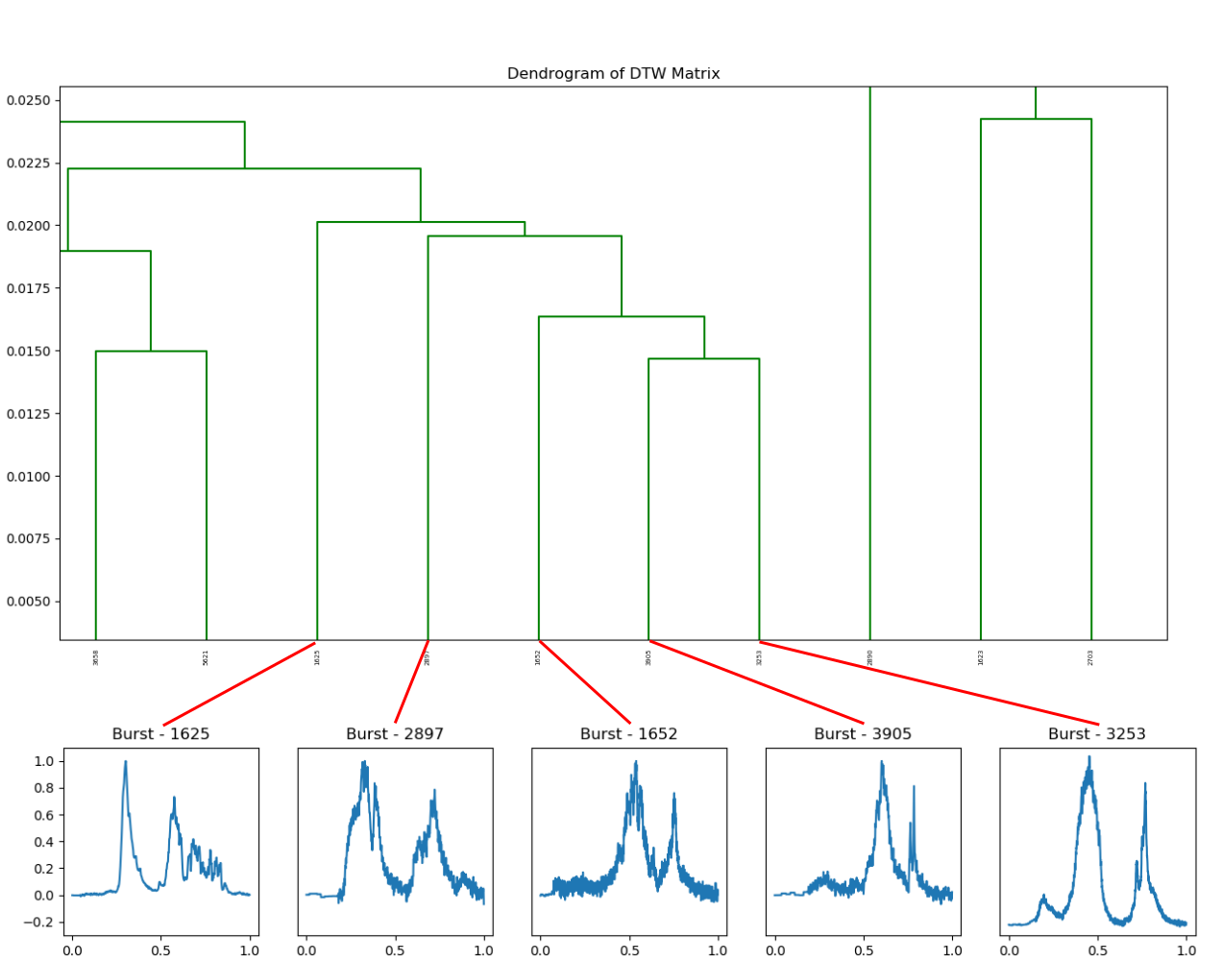
Results

Slide 25
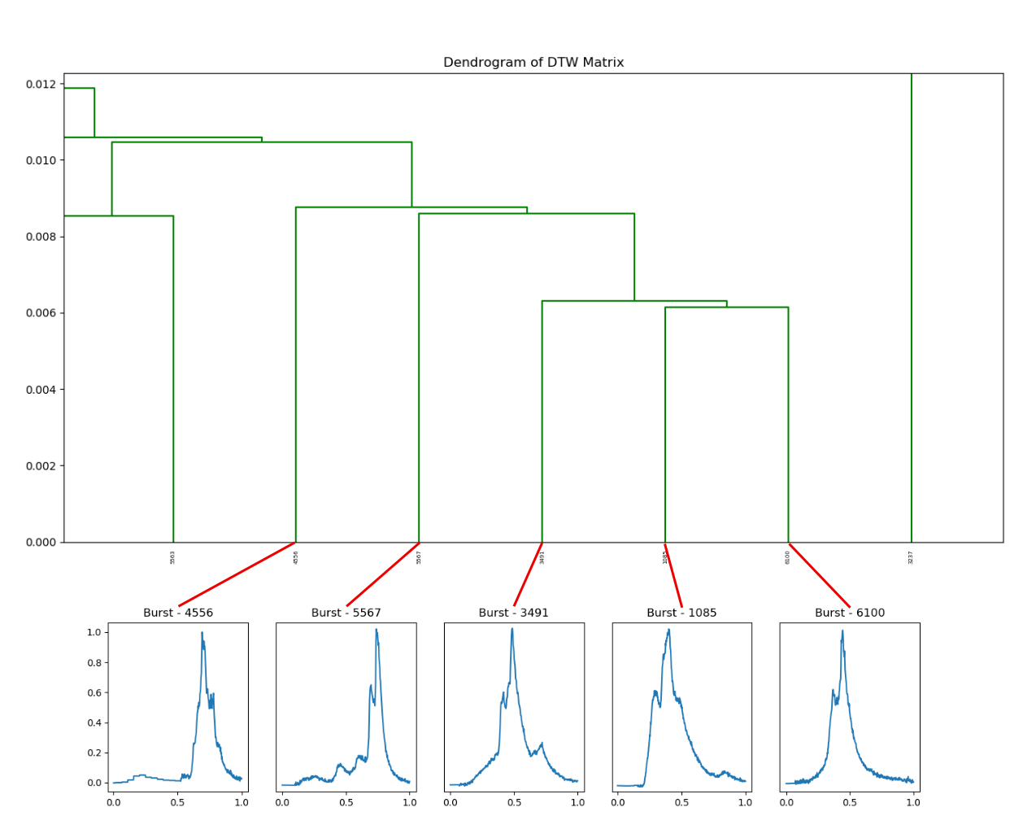
Results

Slide 26
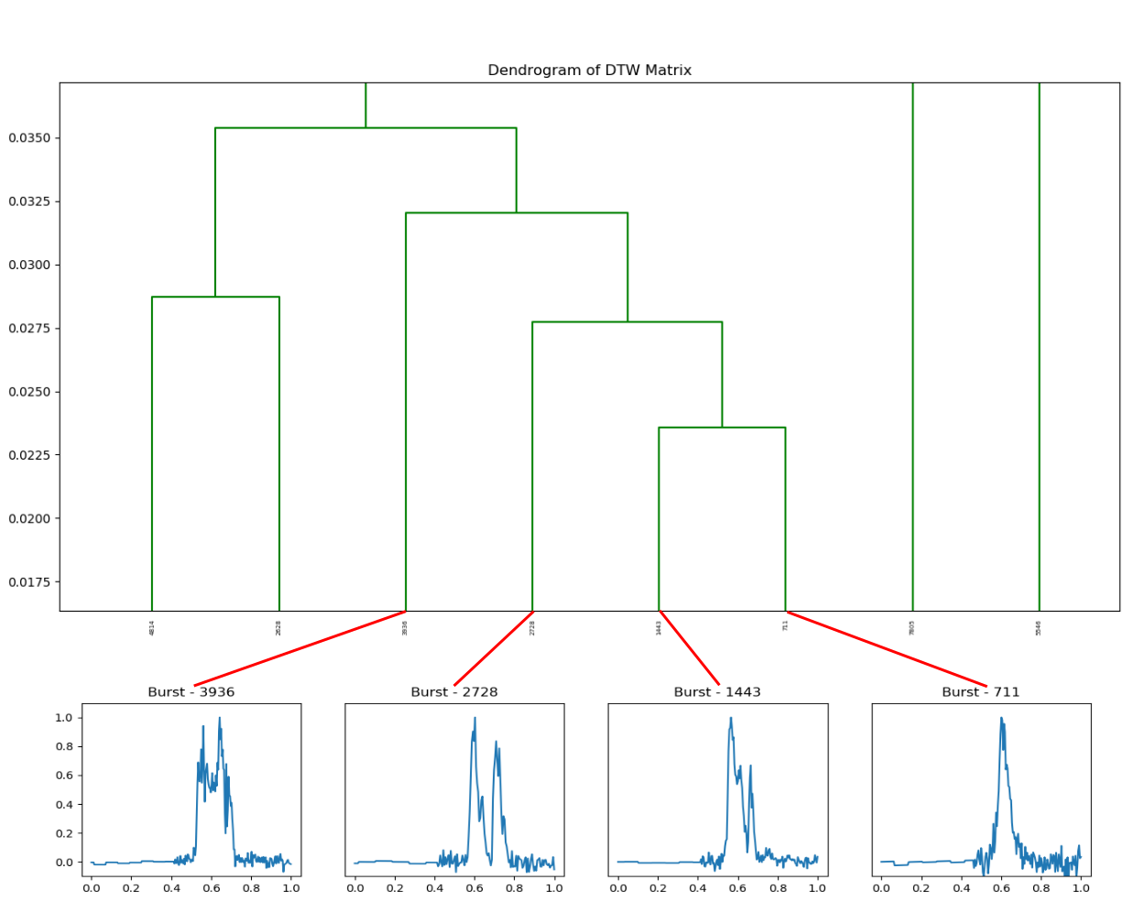
Results

Slide 27
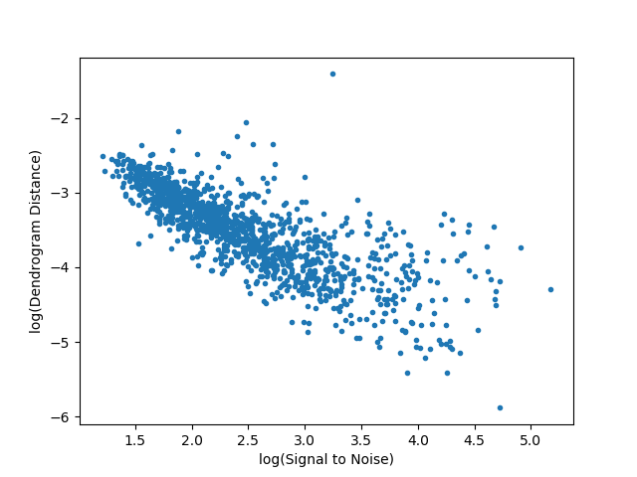
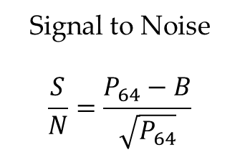
Results
Signal to Noise
$$\frac{S}{N}=\frac{P_{64}−B}{\sqrt{P_{64}}}$$
Pearson coeff. = -0.79

Slide 28
References
Berndt, D. & Clifford,J. 1994, Using dynamic time warping to find patterns in time series, in: KDD Workshop, Seattle, vol. 10, 359–370
Faloutsos et al. 1994, Fast subsequence matching in time-series databases, in: Proceedings of the ACM SIGMOD International Conference on Management of Data, 419–429
Fishman, G.J. 1992, Gamma-ray Bursts - Observations, Analyses, and Theories, 265
Golenetskii, S. V., Mazets, E. P., Aptekar, R. L., & Ilinskii, V. N. 1983, Nature, 306, 451
Hakkila, J., 2020, unpublished manuscript
Hakkila, J., et al. 2003, ApJ, 582, 320
Hakkila, J., et al. 2008, ApJ, 677, L81
Hakkila, J., et al. 2015, ApJ 815.2, 134
Hakkila, J., et al. 2018, ApJ 863.1, 77
Hakkila, J., & Cumbee, R. S. 2009, in AIP Proc. 1133 (ed. Meegan, Gehrels, \& Kouveliotou), 379
Hakkila, J., & Preece, R. 2011, ApJ, 740, 104
Hakkila, J., & Preece, R. 2014, ApJ, 783, 2
Igleisas, F., Energies 2013, 6, 579-597; doi:10.3390/en6020579
Day, W.H.E., Edelsbrunner, H. 1984, Efficient algorithms for agglomerative hierarchical clustering methods. Journal of Classification 1, 7–24, https://doi.org/10.1007/BF01890115
Jain, A. K., Murty, M. N., & Flynn, P. J. 1999. Data clustering: A review. ACM Computing Surveys, 31(3), 264–323
Kate, R. 2016, Using dynamic time warping distances as features for improved time series classification, Data Min. Knowl. Discov, 2, 283–312
Keogh, E. 2002, Exact Indexing of Dynamic Time Warping. In Proceedings of the 28th International Conference on Very Large Data Bases, Hong Kong, China, 20–23 August, 406–417
Klebesadel, R. W., Strong, I. B., & Olson, R. A. 1973, ApJ, 182, L85
Kouveliotou, C., Meegan, C. A., Fishman, G. J., Bhat, N. P., Briggs, M. S., Koshut, T. M., Paciesas, W. S., & Pendleton, G. N. 1993, ApJ, 413, L101

Slide 29
References
Lewis J. 1995, Fast normalized cross-correlation. Vision Interface, 10, 120–123
Liang, E., & Kargatis, V. 1996, Nature, 381, 49
Liao, T.W. 2005, Clustering of time series data—A survey. Pattern Recognition, 38, 1857–1874
Łuczak M. 2016, Hierarchical clustering of time series data with parametric derivative dynamic time warping. Expert Syst Appl, 62, 116–130
Mallozzi, R. 2001, BATSE Instrument Description, July, 2020, https://gammaray.nsstc.nasa.gov/batse/instrument/batse.html
Meegan, C. A., Fishman, G. J., Wilson, R. B., Horack, J. M., Brock, M. N., Paciesas, W. S., Pendleton, G. N., & Kouveliotou, C. 1992, Nature, 355, 143
Mukherjee S., et al. 1998, ApJ, 508, 314
Norris, J. P., Nemiroff, R. J., Bonnell, J. T., Scargle, J. D., Kouveliotou, C., Paciesas, W. S., Meegan, C. A., \& Fishman, G. J. 1996, ApJ, 459, 393
Norris, J. P. 2002, ApJ, 579, 386
Norris, J. P., Bonnell, J. T., Kazanas, D., Scargle, J. D., Hakkila, J., \& Giblin, T. W. 2005, ApJ, 627, 324
Paciesas et al. 1999, The Astrophysical Journal Supplement Series, 122, 465 495
Paciesas et al. 1996, 4B Gamma-Ray Burst Catalog (revised), July, 2020, https://gammaray.nsstc.nasa.gov/batse/grb/catalog/4b/
Paczynski, B. 1991, Acta Astron., 41, 257
Ramirez-Ruiz, E., & Fenimore, E. E. 2000, ApJ, 539, 712
Rodgers, J.L. 1988, Nicewander, W.A. Thirteen ways to look at the correlation coefficient. Am. Stat., 42, 59–66
Stéfan van der Walt, S. Chris Colbert and Gaël Varoquaux. 2011, The NumPy Array: A Structure for Efficient Numerical Computation, Computing in Science & Engineering, 13, 22-30
van Paradijs, J., et al. 1997, Nature, 386, 686
Virtanen, P. et al. 2020, SciPy 1.0: Fundamental Algorithms for Scientific Computing in Python. Nature Methods, 17, 261-272
Wang, Xiao & Yu, Fusheng & Pedrycz, Witold & Wang, Jiayin 2019, Hierarchical clustering of unequal-length time series with area-based shape distance, Soft Computing. 23, 6331- 6343, 10.1007/s00500-018-3287-6
Yoo J-C, Han T. 2009, Fast Normalized Cross-Correlation. Circuits, Systems, and Signal Processing, 28, 6, 819–843.

