Slide 1
CS5112: Algorithms and Data Structures for Applications
Lecture 1: Dijkstra’s algorithm
Ramin Zabih
Some slides from: K. Wayne

Slide 2
Administrivia
Web site is: https://github.com/cornelltech/CS5112-F18
As usual, this is pretty much all you need to know
Course staff:
Instructors: Ramin Zabih (rdz@cs.cornell.edu) & Greg Zecchini (gez3@cornell.edu)
TA: Richard Bowen (rsb349@cornell.edu), TBA
Consultants/graders: Iris Zhang (wz337@cornell.edu), TBA

Slide 3
Basic information
CS5112 work is constant but not very time intensive
Homework every 2 weeks or so, quiz every week
1 prelim 10/25 and final 12/4, both in-class closed book
Open book doesn’t actually help in my experience
Greg will teach the 5 evening clinics 6:30pm-8pm
Greg and Ramin will lecture, with a few guest lectures
We are working on getting consultants to help students who don’t have a lot of programming experience

Slide 4
Academic integrity
Each student is expected to abide by the Cornell University Code of Academic Integrity
https://theuniversityfaculty.cornell.edu/academic-integrity/
Any work submitted by a student in this course for academic credit will be the student's own work
Exception: you do the homework assignments in groups of two
We take this seriously. Students have been expelled from Cornell for violations. Copying code is easy to catch.

Slide 5
Today
Clinic this evening (here!)
HW1 out tonight, due in 2 weeks
Based primarily on today’s lecture and clinic
First quiz a week from today
Placement exam available tonight, due in 24 hours
If you were a CS major, possibly worth your time

Slide 6
Clinics schedule
Evening sessions to review some of the fundamentals underlying much of this course's content
Attendance is mandatory
Schedule (dates final, topics tentative):
8/23 Graphs and Graph Algorithms
8/30 Hashing and Related Data Structures
9/6 Sorting and Searching
9/20 Development tools (UNIX commands, Github, etc.)
10/4 Cloud Development

Slide 7
Course theme: algorithms and applications
Algorithms are the key tool in CS, but without applications it’s hard to appreciate their importance
We will focus on 3 key application areas:
Cryptocurrency
AI (artificial intelligence)
AR/VR (augmented/virtual reality)
BUT this is not a course about those applications
Application of algorithms is often not obvious!

Slide 8
Lecture Outline
The shortest path problem
Dijkstra’s algorithm
Applications: image editing and pirate grammar

Slide 9
Two very common approaches in CS
Given a problem where you are searching for a solution:
Try everything (exhaustive search)
Do what seems best at the moment, repeatedly (greedy algorithms)
Exhaustive search (almost) never works on serious problems
Greedy algorithms are widely used
Currently famous example: SGD for neural networks
Note: there are other approaches we will cover
Such as dynamic programming

Slide 10

The shortest path problem
General version: given a graph with edge weights, a starting node $s$ and a target $t$, find shortest path from $s$to $t$
Claim: this problem is impossible to solve!

Slide 11
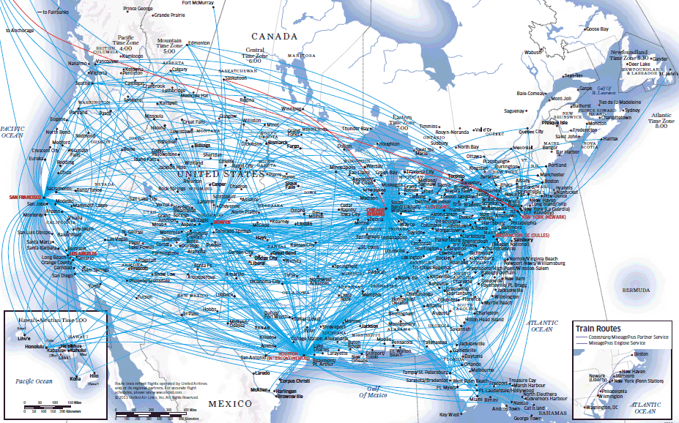
Obvious application of shortest paths: airfare
Nodes are cities, edges are direct flights, weights are airfare
What is the cheapest way to get from LGA to Ithaca?
Presumably you can charter a plane

Slide 12
Fixing the problem definition
Suppose that there is a flight from Boise to El Paso, and back again, that the airline pays you $1 to fly around
Further, suppose that you can get to Boise (or El Paso)
You can make an arbitrary amount of money by just flying back and forth!
This is a cycle in the graph whose sum of weights is negative
Easy solution: require positive edge weights
Or maybe detect negative cycles?

Slide 13
Not so obvious applications
Making fake photographs
Speech recognition/predicting stock prices by DTW
Pirate grammar!
Modeling a Cornell student (at end of class)

Slide 14
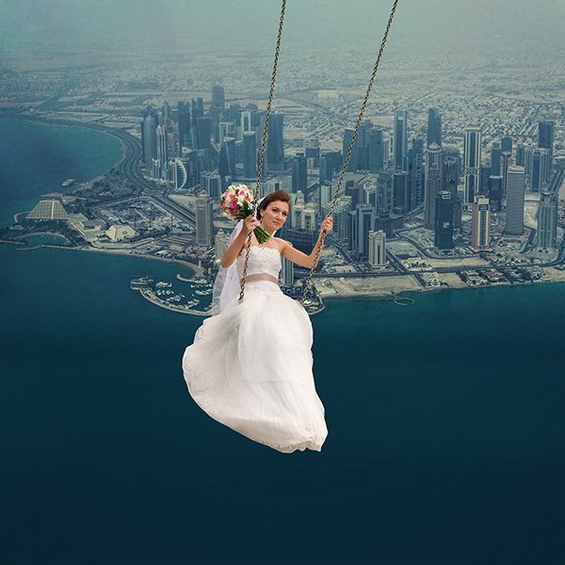
Making fake photographs
Sneak preview: will cover this in the AR/VR section of CS5112
How do we create images like this:
Given an image, how do you cut out an object from it?
You don’t want to manually select the pixels

Slide 15
Intelligent scissors
Idea: shortest paths
E.N. Mortensen and W.A. Barrett, Interactive Segmentation with Intelligent Scissors, SIGGRAPH 1995
Adobe calls this the “Magnetic Lasso”
Video here
More details in November!

Slide 16
Dynamic Time Warping (DTW)

Slide 17
Rules of Pirate grammar
Pirates always start their sentences with “Barkeep!”
90% of the time they next say “More” (i.e., they order)
10% of the time they next say “Yer a” (i.e., they insult)
If they say “More”, they next say:
60% “Of your best”
40% “Of the same”
Lots more rules, discovered by experts in pirate linguistics
Question: what sentence is a pirate most likely to say?

Slide 18
Pirate grammar as a graph
“Barkeep!”
.9
“More”
.6
“of your best”
“grog!”
.1
.4
“Yer a”
“of the same”
“wimpy”
“grub.”
“scurvy”
“chicken.”

Slide 19
Simplified pirate grammar
“Barkeep!”
.9
“More”
.6
“of your best grog!”
.1
.4
“Yer a”
“of the same wimpy grub.”
“scurvy chicken.”
1

Slide 20
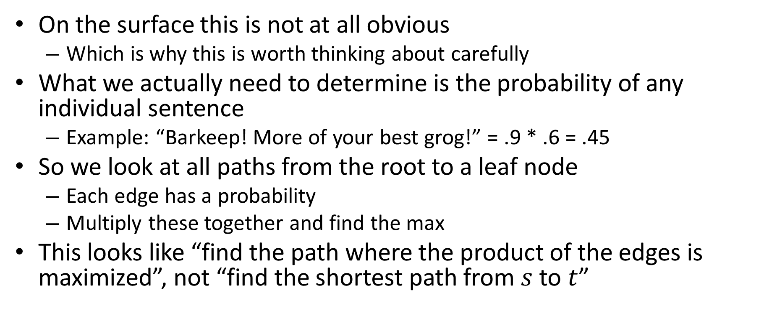
How to make this into shortest paths?
On the surface this is not at all obvious
Which is why this is worth thinking about carefully
What we actually need to determine is the probability of any individual sentence
Example: “Barkeep! More of your best grog!” = .9 * .6 = .45
So we look at all paths from the root to a leaf node
Each edge has a probability
Multiply these together and find the max
This looks like “find the path where the product of the edges is maximized”, not “find the shortest path from $s$ to $t$”

Slide 21

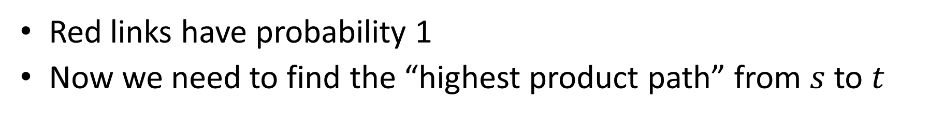

Easy part: Add a fake source and sink
“Barkeep!”
.9
“More”
.6
“of your best grog!”
$$s$$
$$t$$
.1
.4
“Yer a”
“of the same wimpy grub.”
“scurvy chicken.”
1
Red links have probability 1
Now we need to find the “highest product path” from $s$ to $t$

Slide 22
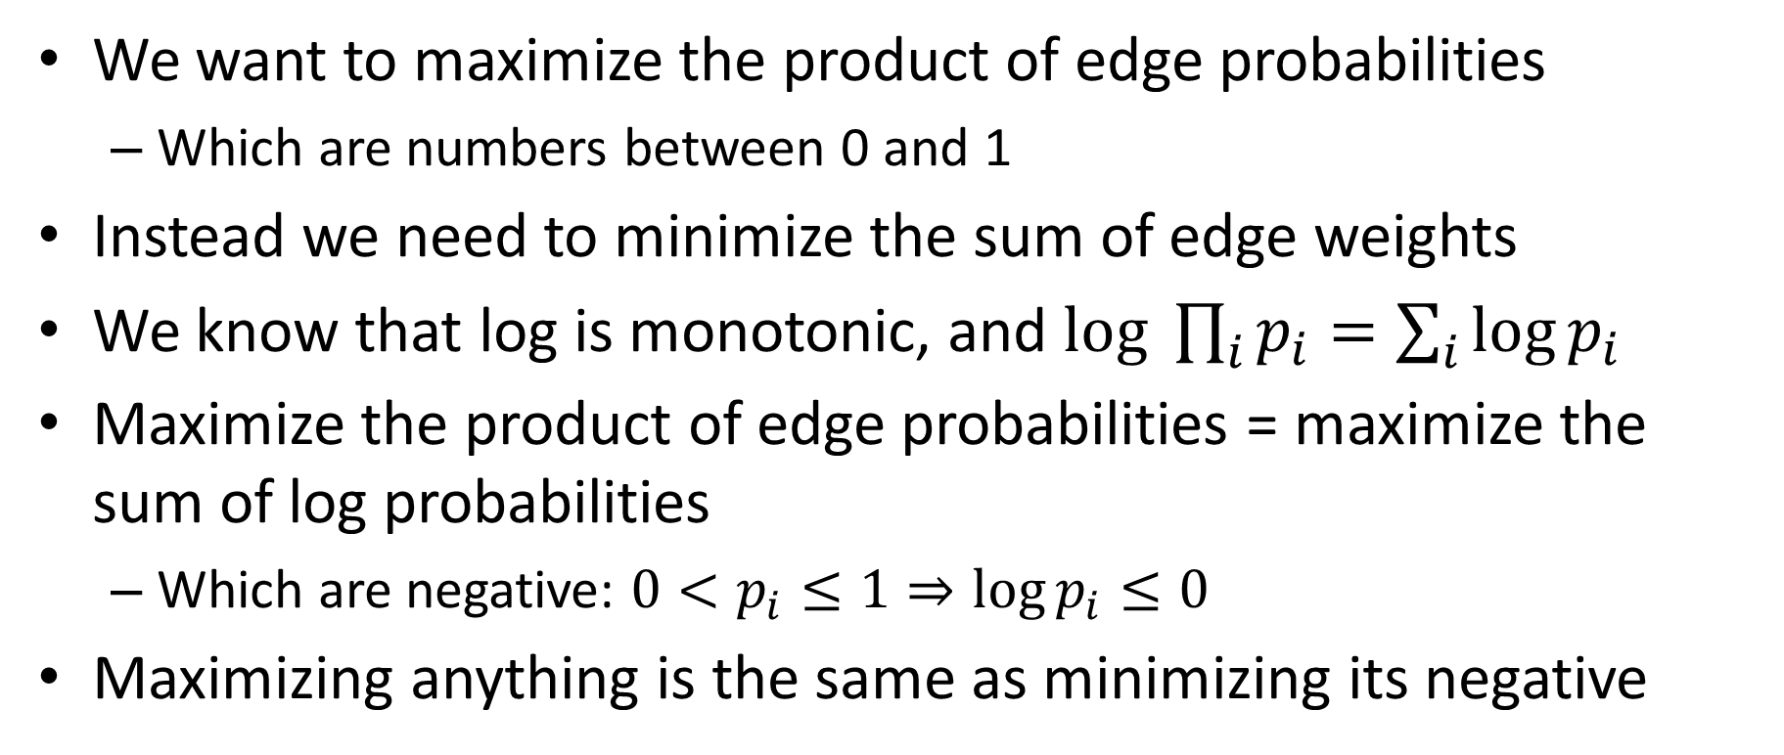
Algebra to the rescue
We want to maximize the product of edge probabilities
Which are numbers between 0 and 1
Instead we need to minimize the sum of edge weights
We know that log is monotonic, and $log \prod_{i}{p_{i}=\sum_{i}{\log{p_{i}}}}$
Maximize the product of edge probabilities = maximize the sum of log probabilities
Which are negative: $0<p_{i}≤1⇒\log{p_{i}≤0}$
Maximizing anything is the same as minimizing its negative

Slide 23
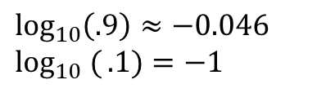
Algebra in action
“Barkeep!”
.9
“More”
.6
“of your best grog!”
$$s$$
$$t$$
.1
.4
“Yer a”
“of the same wimpy grub.”
“scurvy chicken.”
1
$$\log_{10}\left(.9\right)≈−0.046$$
$$\log_{10} ({.1)=−1}$$

Slide 24
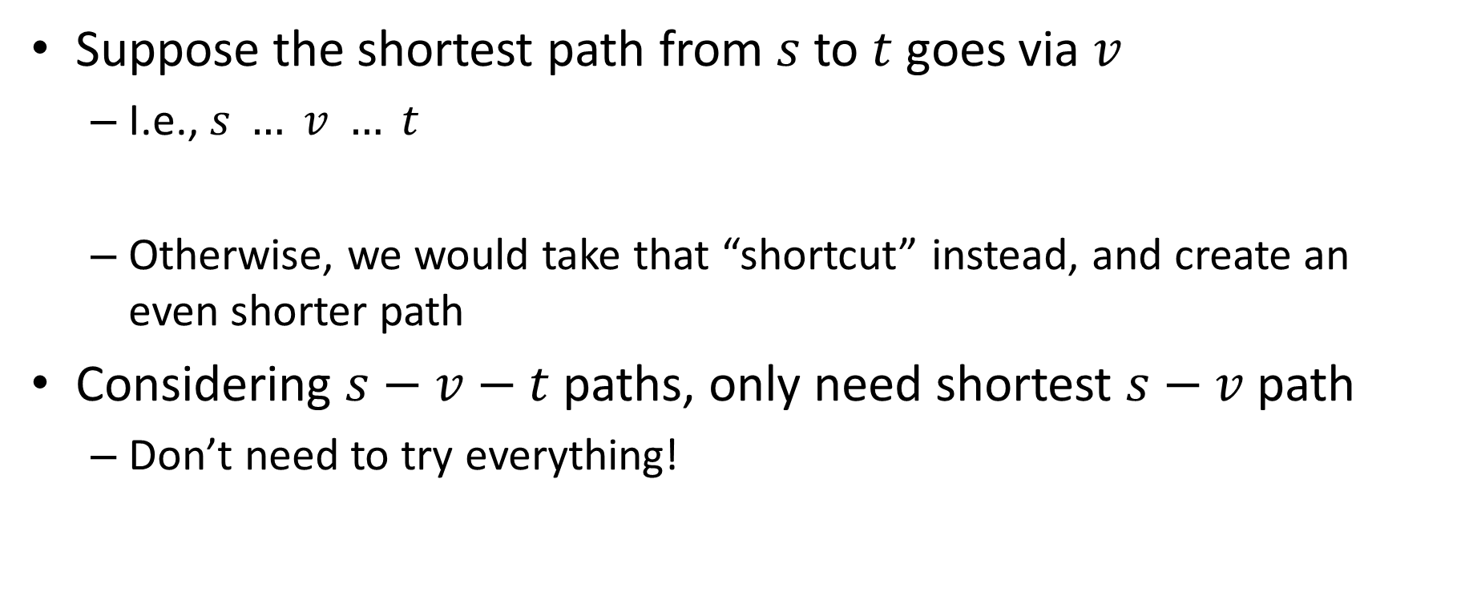
Key property of shortest paths
Suppose the shortest path from $s$ to $t$goes via $v$
I.e., $s … v … t$
Otherwise, we would take that “shortcut” instead, and create an even shorter path
Considering $s−v−t$ paths, only need shortest $s−v$path
Don’t need to try everything!
shortest s-v path

Slide 25
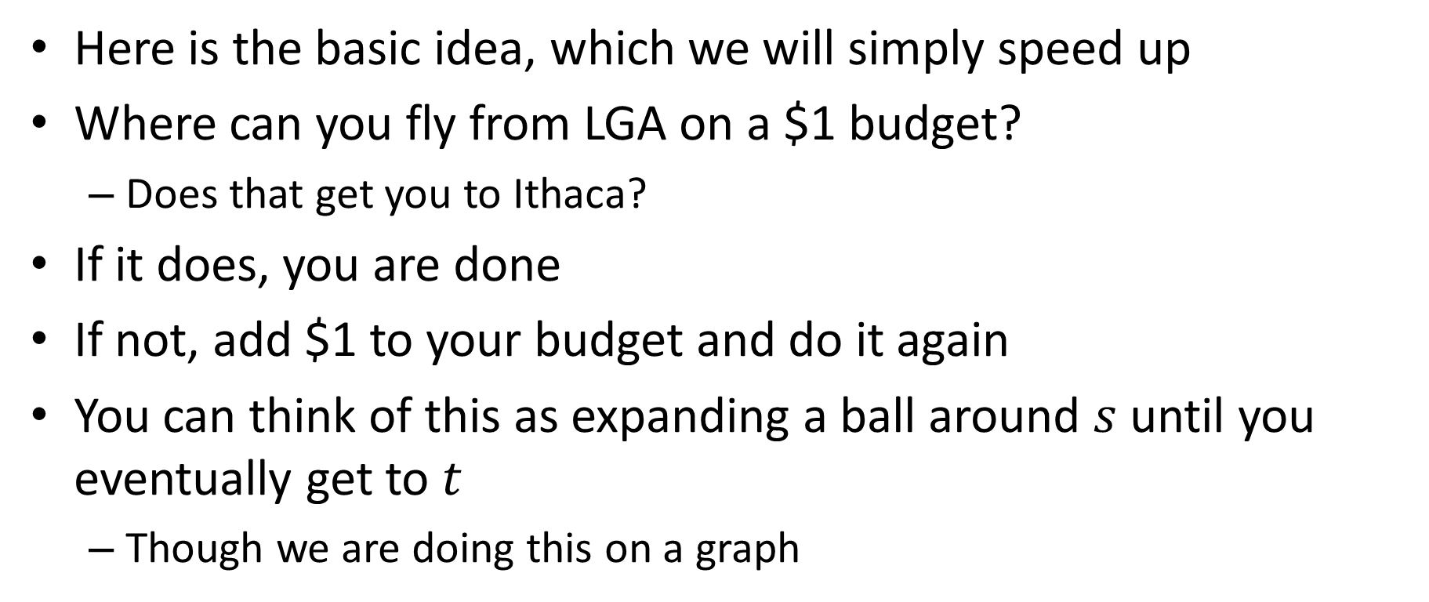
Shortest paths by increasing budgets
Here is the basic idea, which we will simply speed up
Where can you fly from LGA on a $1 budget?
Does that get you to Ithaca?
If it does, you are done
If not, add $1 to your budget and do it again
You can think of this as expanding a ball around $s$ until you eventually get to $t$
Though we are doing this on a graph

Slide 26







Example
For $1 can get to $u$
For $2 can also get to $v$
Gray area shows budget at $2
At $3 we can also get to $x$via $u$
Key concepts:
Explored nodes: $\{s,u,v\}$
Fringe: $\{x,y,z\}$
$$y$$
3
$$u$$
1
1
2
$$s$$
4
$$x$$
2
2
$$v$$
2
3
$$z$$

Slide 27
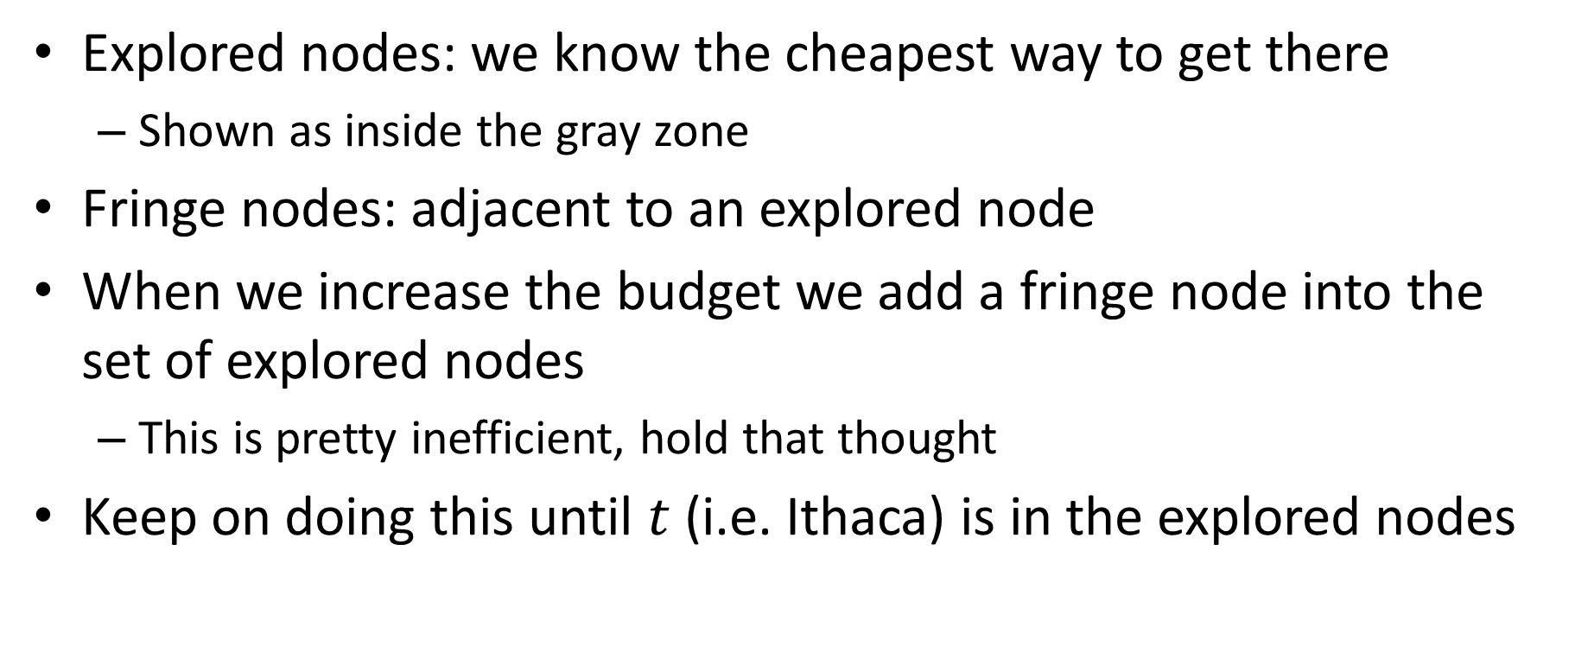
Key concepts
Explored nodes: we know the cheapest way to get there
Shown as inside the gray zone
Fringe nodes: adjacent to an explored node
When we increase the budget we add a fringe node into the set of explored nodes
This is pretty inefficient, hold that thought
Keep on doing this until $t$ (i.e. Ithaca) is in the explored nodes

Slide 28
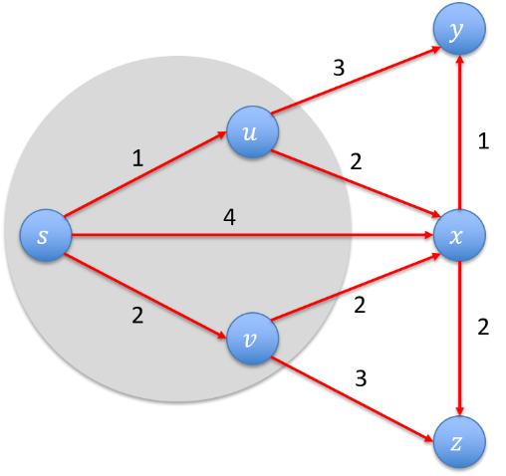
Budget approach is crazy
Suppose the cheapest flight from LGA is $500
In our example, imagine increasing by $.01
So we consider $2.01, $2.02, …
But we know that nothing will happen until we increase our budget to $3
Why not just do this directly?

Slide 29
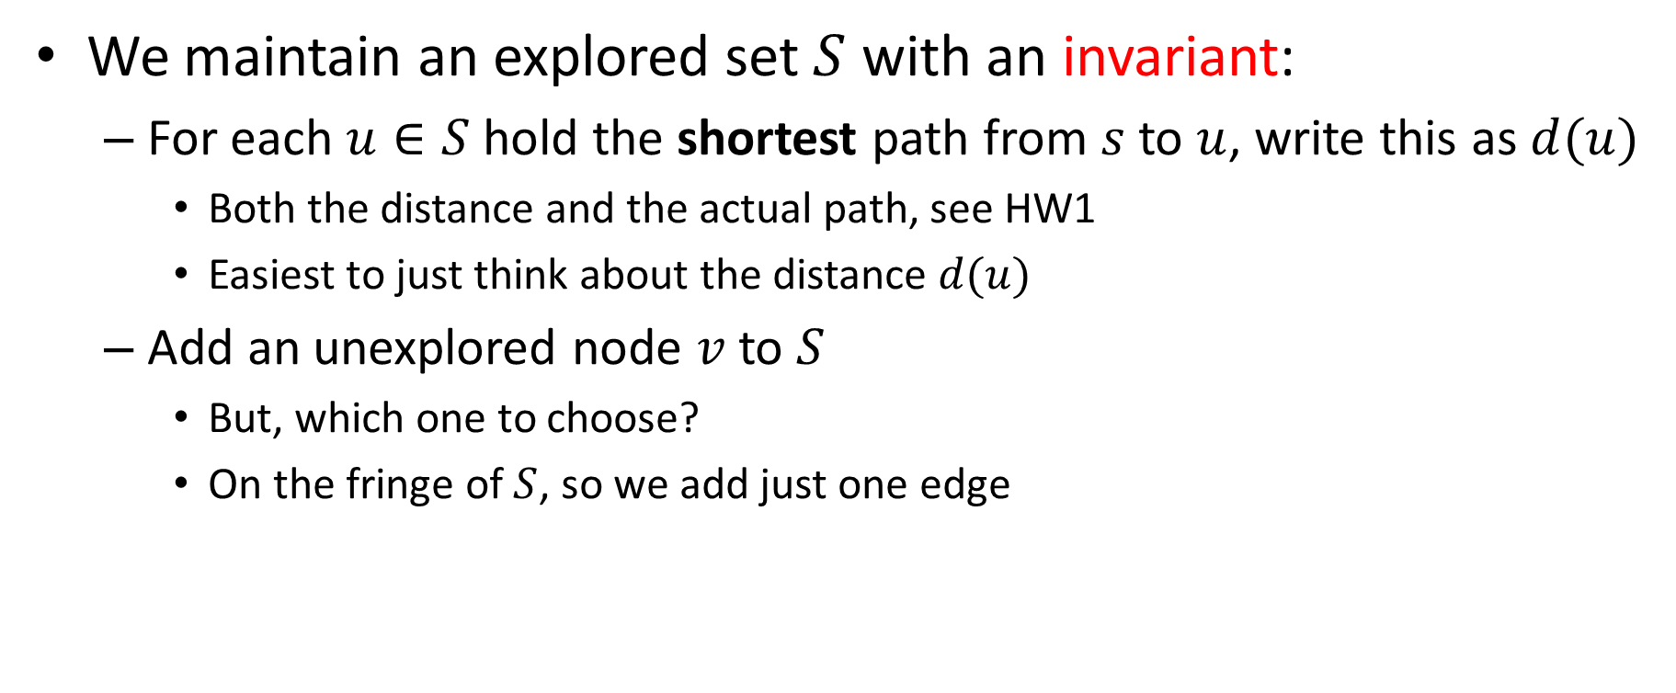
Dijkstra’s algorithm
We maintain an explored set $S$ with an invariant:
For each $u∈S$hold the shortest path from $s$ to $u$, write this as $d(u)$
Both the distance and the actual path, see HW1
Easiest to just think about the distance $d(u)$
Add an unexplored node $v$to $S$
But, which one to choose?
On the fringe of $S$, so we add just one edge

Slide 30

Choice of edge for a fringe node
The fringe node $v$ can be adjacent to several nodes in $S$
If we choose to add $v$, pick the right node in $S$to connect it to
w₁
v
d(u1)
d(u1) + w₁
versus
d(u2) + w₂
u1
w₂
S
s
u2
d(u2)

Slide 31
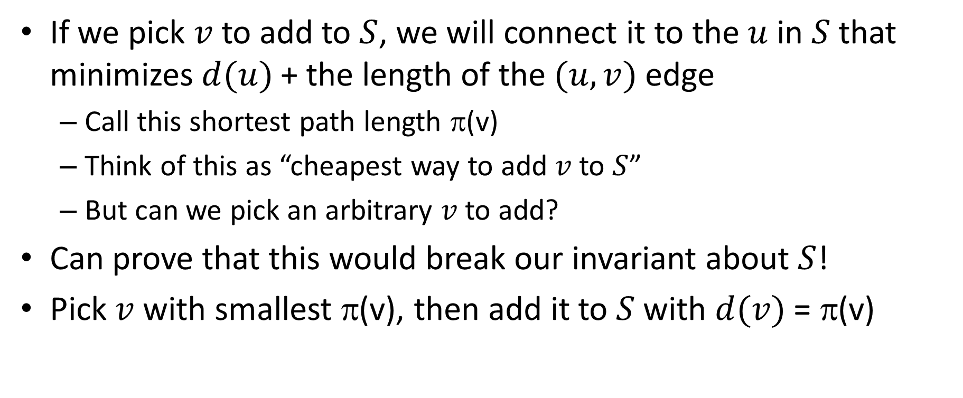
Choice of fringe node
If we pick $v$ to add to $S$, we will connect it to the $u$ in $S$that minimizes $d(u)$+ the length of the $(u,v)$ edge
Call this shortest path length π(v)
Think of this as “cheapest way to add $v$ to $S$”
But can we pick an arbitrary $v$ to add?
Can prove that this would break our invariant about $S$!
Pick $v$with smallest π(v), then add it to $S$with $d(v)$ = π(v)

Slide 32
Shortest path example
2
23
3
9
s
18
Cost of path s-2-3-5-t = 9 + 23 + 2 + 16 = 48.
14
2
6
6
30
4
19
15
5
11
5
6
20
16
7
t
44

Slide 33
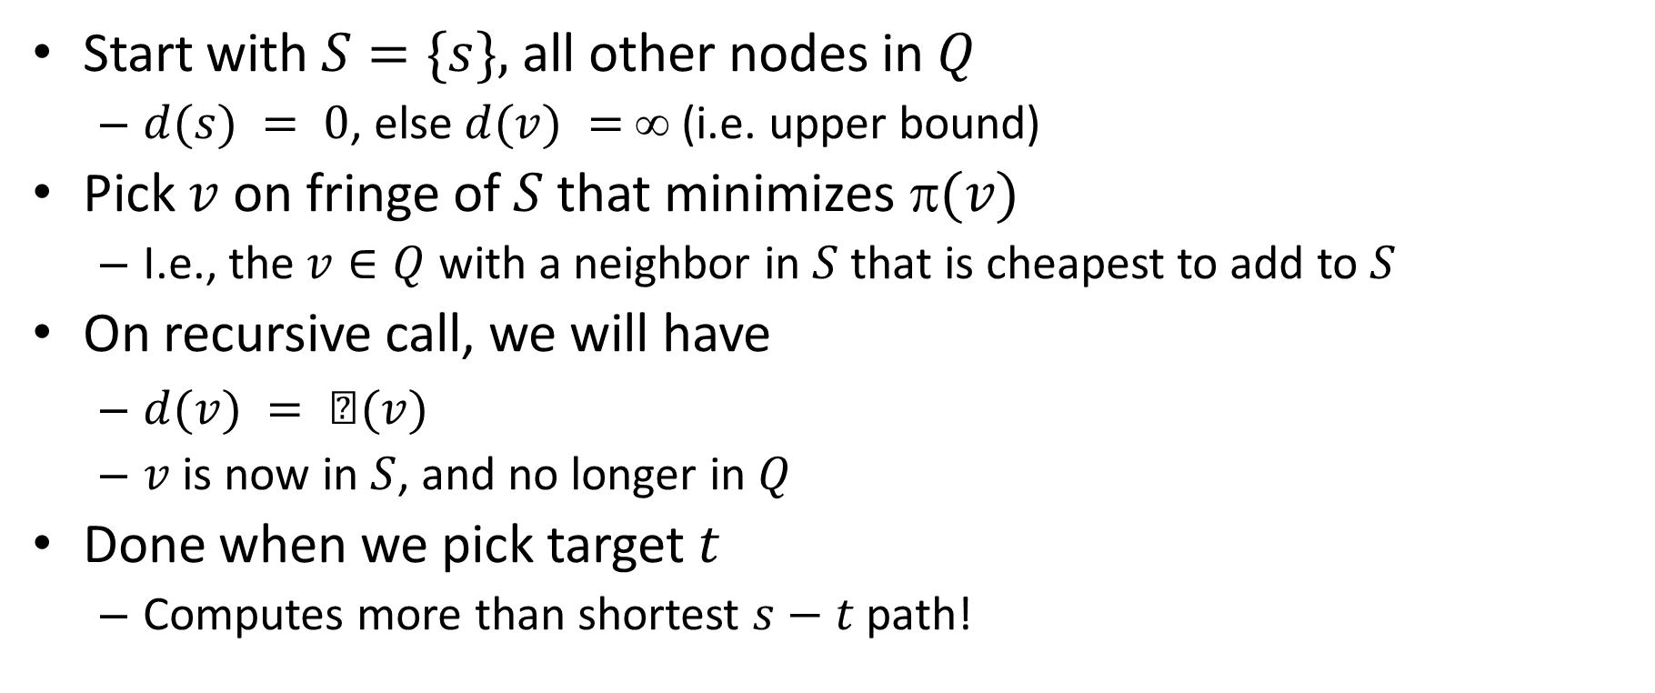
HW1 algorithm
Start with $S=\{s\},$all other nodes in $Q$
$d(s) = 0$, else $d(v) =$∞ (i.e. upper bound)
Pick $v$on fringe of $S$that minimizes $(v)$
I.e., the $v∈Q$ with a neighbor in $S$that is cheapest to add to $S$
On recursive call, we will have
$d(v) = (v)$
$v$ is now in $S$, and no longer in $Q$
Done when we pick target $t$
Computes more than shortest $s−t$path!

Slide 34
Dijkstra's Shortest Path Algorithm
Find shortest path from s to t.
Blue edges: shortest path to a node within S.
Green edges: what we would add for each fringe vertex.
2
24
3
9
s
18
14
2
6
6
30
4
19
5
11
15
5
6
20
16
7
t
44

Slide 35
S = { s }
Q = { 2, 3, 4, 5, 6, 7, t }
∞
∞
2
24
3
0
9
s
∞
18
14
6
6
2
∞
30
∞
4
19
11
15
5
5
6
20
16
7
t
44
∞
∞

Slide 36
S = { s }
Q = { 2, 3, 4, 5, 6, 7, t }
π(2)
∞
∞
9
X
2
24
3
0
9
s
∞
14
18
14
X
6
6
2
∞
30
∞
4
19
11
15
5
5
6
20
16
7
t
44
π(7)
∞
15
∞
X

Slide 37
S = { s }
Q = { 2, 3, 4, 5, 6, 7, t }
min
∞
∞
9
X
2
24
3
0
9
s
∞
14
18
14
X
6
6
2
∞
30
∞
4
19
11
15
5
5
6
20
16
7
t
44
∞
15
∞
X

Slide 38
S = { s, 2 }
Q = { 3, 4, 5, 6, 7, t }
∞
∞
9
X
2
24
3
0
9
s
∞
14
18
14
X
6
6
2
∞
30
∞
4
19
11
15
5
5
6
20
16
7
t
44
∞
15
∞
X

Slide 39
S = { s, 2 }
Q = { 3, 4, 5, 6, 7, t }
π(3)
∞
33
∞
X
9
X
2
24
3
0
9
s
∞
14
18
14
X
6
6
2
∞
30
∞
4
19
11
15
5
5
6
20
16
7
t
44
∞
15
∞
X

Slide 40
S = { s, 2 }
Q = { 3, 4, 5, 6, 7, t }
∞
33
∞
X
9
X
2
24
3
0
9
min
s
∞
14
18
14
X
6
6
2
∞
30
∞
4
19
11
15
5
5
6
20
16
7
t
44
∞
15
∞
X

Slide 41
S = { s, 2, 6 }
Q = { 3, 4, 5, 7, t }
32
∞
33
∞
X
X
9
X
2
24
3
0
9
s
∞
14
18
14
X
6
6
2
44
∞
∞
4
30
X
19
11
15
5
5
6
20
16
7
t
44
∞
15
∞
X

Slide 42
S = { s, 2, 6 }
Q = { 3, 4, 5, 7, t }
32
∞
33
∞
X
X
9
X
2
24
3
0
9
s
∞
14
18
14
X
6
6
2
44
∞
∞
4
30
X
19
11
15
5
5
6
20
16
7
t
44
∞
15
min
∞
X

Slide 43
S = { s, 2, 6, 7 }
Q = { 3, 4, 5, t }
32
∞
33
∞
X
X
9
X
2
24
3
0
9
s
∞
14
18
14
X
6
6
2
44
35
∞
X
∞
4
30
X
19
11
15
5
5
6
20
16
7
t
44
59
∞
∞
15
X
X

Slide 44
S = { s, 2, 6, 7 }
Q = { 3, 4, 5, t }
min
32
∞
33
∞
X
X
9
X
2
24
3
0
9
s
∞
14
18
14
X
6
6
2
44
35
∞
X
∞
4
30
X
19
11
15
5
5
6
20
16
7
t
44
59
∞
∞
15
X
X

Slide 45
S = { s, 2, 3, 6, 7 }
Q = { 4, 5, t }
32
∞
33
∞
X
X
9
X
2
24
3
0
9
s
∞
14
18
14
X
6
6
2
44
35
34
∞
X
X
∞
4
30
X
19
11
15
5
5
6
20
16
7
t
44
51
59
∞
∞
15
X
X
X

Slide 46
S = { s, 2, 3, 6, 7 }
Q = { 4, 5, t }
32
∞
33
∞
X
X
9
X
2
24
3
0
9
s
∞
14
18
14
X
6
6
2
44
35
34
∞
X
X
∞
4
30
X
19
11
15
5
5
6
20
min
16
7
t
44
51
59
∞
∞
15
X
X
X

Slide 47
S = { s, 2, 3, 5, 6, 7 }
Q = { 4, t }
32
∞
33
∞
X
X
9
X
2
24
3
0
9
s
∞
14
18
14
X
6
6
2
35
34
45
∞
44
X
X
X
∞
4
30
X
19
11
15
5
5
6
20
16
7
t
44
50
51
59
∞
∞
15
X
X
X
X

Slide 48
S = { s, 2, 3, 5, 6, 7 }
Q = { 4, t }
32
∞
33
∞
X
X
9
X
2
24
3
0
9
s
∞
14
18
14
X
6
6
2
35
34
45
∞
44
X
X
X
∞
4
30
X
19
11
15
5
min
5
6
20
16
7
t
44
50
51
59
∞
∞
15
X
X
X
X

Slide 49
S = { s, 2, 3, 4, 5, 6, 7 }
Q = { t }
32
∞
33
∞
X
X
9
X
2
24
3
0
9
s
∞
14
18
14
X
6
6
2
35
34
45
∞
44
X
X
X
∞
4
30
X
19
11
15
5
5
6
20
16
7
t
44
50
51
59
∞
∞
15
X
X
X
X

Slide 50
S = { s, 2, 3, 4, 5, 6, 7 }
Q = { t }
32
∞
33
∞
X
X
9
X
2
24
3
0
9
s
∞
14
18
14
X
6
6
2
35
34
45
∞
44
X
X
X
∞
4
30
X
19
11
15
5
5
6
20
16
7
t
44
min
50
51
59
∞
∞
15
X
X
X
X

Slide 51
S = { s, 2, 3, 4, 5, 6, 7, t }
Q = { }
32
∞
33
∞
X
X
9
X
2
24
3
0
9
s
∞
14
18
14
X
6
6
2
35
34
45
∞
44
X
X
X
∞
4
30
X
19
11
15
5
5
6
20
16
7
t
44
50
51
59
∞
∞
15
X
X
X
X

Slide 52
S = { s, 2, 3, 4, 5, 6, 7, t }
Q = { }
32
∞
33
∞
X
X
9
X
2
24
3
0
9
s
∞
14
18
14
X
6
6
2
35
34
45
∞
44
X
X
X
∞
4
30
X
19
11
15
5
5
6
20
16
7
t
44
50
51
59
∞
∞
15
X
X
X
X

Slide 53
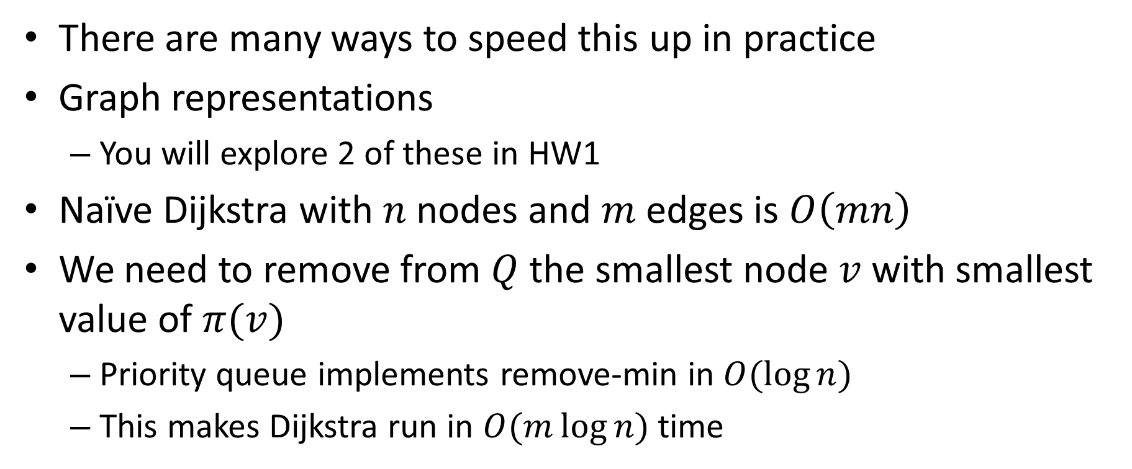
Implementation notes
There are many ways to speed this up in practice
Graph representations
You will explore 2 of these in HW1
Naïve Dijkstra with $n$ nodes and $m$ edges is $O\left(mn\right)$
We need to remove from $Q$ the smallest node $v$ with smallest value of $π(v)$
Priority queue implements remove-min in $O(\log{n)}$
This makes Dijkstra run in $O(m\log{n)}$ time

Slide 54
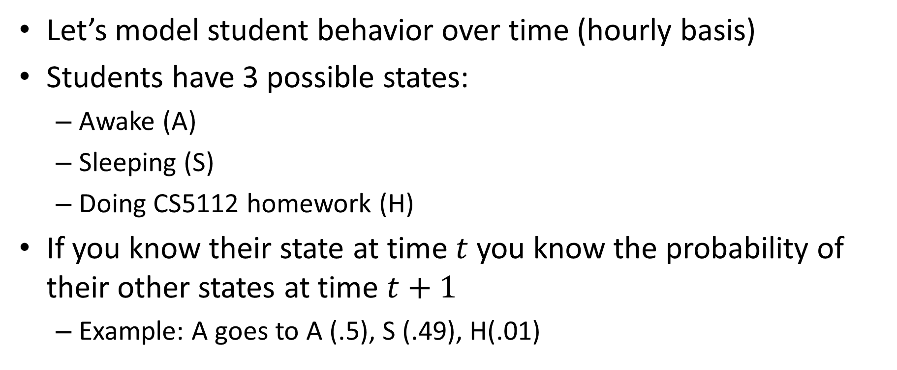
Another class of examples
Let’s model student behavior over time (hourly basis)
Students have 3 possible states:
Awake (A)
Sleeping (S)
Doing CS5112 homework (H)
If you know their state at time $t$ you know the probability of their other states at time $t+1$
Example: A goes to A (.5), S (.49), H(.01)

Slide 55
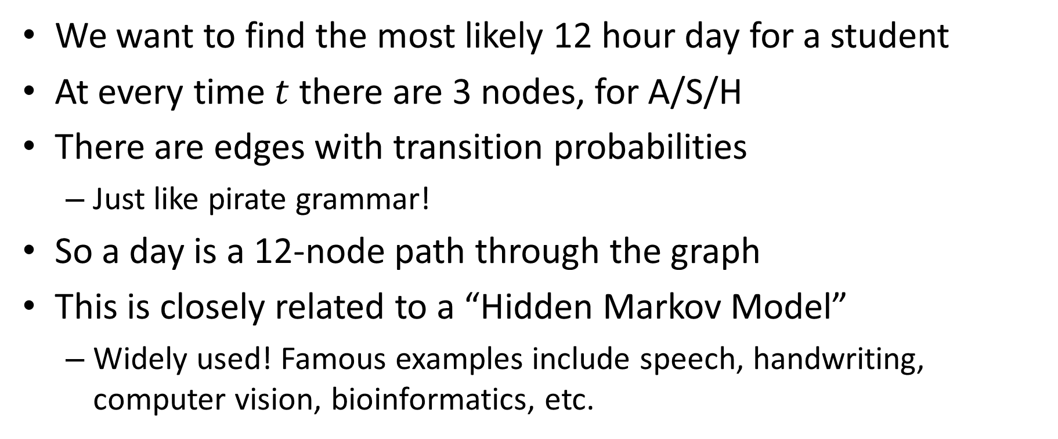
Trellis graph
We want to find the most likely 12 hour day for a student
At every time $t$ there are 3 nodes, for A/S/H
There are edges with transition probabilities
Just like pirate grammar!
So a day is a 12-node path through the graph
This is closely related to a “Hidden Markov Model”
Widely used! Famous examples include speech, handwriting, computer vision, bioinformatics, etc.

Slide 56



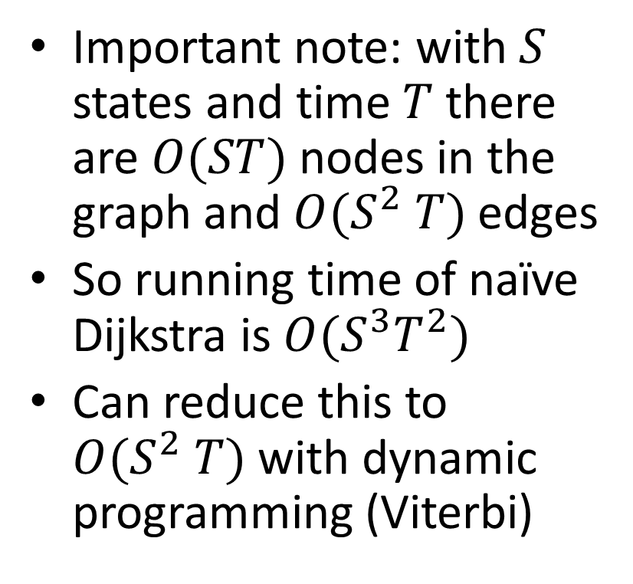



Example
Important note: with $S$ states and time $T$ there are $O(ST)$ nodes in the graph and$O(S^{2} T)$edges
So running time of naïve Dijkstra is $O(S^{3}T^{2})$
Can reduce this to $O(S^{2} T)$with dynamic programming (Viterbi)
$$A$$
.5
$$A$$
$$A$$
.49
$$S$$
.01
$$S$$
$$S$$
$$H$$
$$H$$
$$H$$
$$t=1 t=2 t=3$$

