Slide 1
Bravo’s search interest performance in South Africa

Slide 2
Executive summary
Internal
Rough outline – will QA and improve at the end
36% growth in mattress brand search interest (8% p.a). The growth is driven by both:
Increased utilisation of the internet to search for mattress
Increased national internet penetration (+12%)
Bravo brand search interest growth (+60%) exceeded national growth while the rest of the market experience more modest growth (24%)
As a result of Bravo’s strong growth, their search market share has increased (+17%) from 35% in 2017 to 41% in 2021
Sealy is the most popular brand in the market capturing 32% of search interest market share
Their largest competitors are Restonic (20%) and Cloud Sine (17%)
Sealy’s search interest growth (+60%) exceeded growth in Cloud Nine (+31%), however, Restonic experienced higher growth (+71%)
Sealy, Bravo’s most popular brand experienced that largest growth (+60%) of major mattress brands
Since Sealy makes up over 75% of Bravo’s of search interest, it was the dominant driver of it’s strong performance
In addition, all other Bravo brands also experienced increased interest levels
Search interest share is highest in Gauteng (40%) followed by Kwa-Zulu natal, Western Cape and Easter Cape
Of these top 4, interest in Kwa-Zulu natal has more than double (+111%) followed by Gauteng (+47%), Wester Cape (+37%). In contrast, Eastern Cape had reduced interest (-22%)
Notes:
https://www.statista.com/statistics/484933/internet-user-reach-south-africa/
60.73/53.92 = 1.1262
1.36^(1/4) = 1.07999

Slide 3
Potential questions
Internal
Where does the analysis take us?
When is the best time to advertise during the year?
How are market dynamics changing? Bigger vs. smaller brands
How does marketing spend and sales correlate to interest
What happened in 2019 and 2020 with respect to decreased interest in ‘Sealy Posturepedic’?
Was there less marketing / advertising?

Slide 4
Data Limitations
Internal
Data caveats, not necessarily shared
When is the best time to advertise during the year?
How are market dynamics changing? Bigger vs. smaller brands

Slide 5
Overall market

Slide 6
National search interest in mattress brands over time (Interest levels have been indexed to 2017 levels)
+13%
+4%
+2%
+14%
Search interest has consistently increased year-on-year
There has been a 36% increase over the past 5 years (8% p.a.)
Over the same period, internet penetration in South Africa has increase by 12%
Therefore, the significant increase is also attributable to consumers growing propensity to search online for mattress brands
…
Notes:
Key insights
Online interest has increased YoY
Gauteng, KZN, Western cape and eastern cape make up make up 90% of search behavior while Northern cape’s contribution is negligible (and therefore excluded)

Slide 7
Bravo vs. rest of market

Slide 8
Bravo vs. rest of market search interest (Interest levels have been indexed to 2017 levels)
+7%
+16%
+11.2%
+5.3%
+11%
+16%
-2%
-2%
-2.3%
+2.6%
+15%
+11%
Bravo has consistently grown (+12.5% p.a.) leading to a 60% growth in search interest over the past 5 years while the rest of the market had more modest growth (+5.5% p.a.) leading to an overall growth of 24%
The primary driver of the difference was Bravo’s continued growth since 2019 while the rest of the market experienced two years of consecutive declines
Bravo’s strong performance ensured overall national interest increased year-on-year by capturing the losses in the rest of the market
Over the past 5 years Bravo increased its share of search interest (+17%) from 35% in 2017 to 41% in 2021,
Bravo’s gains are attributable to consistent year-on-year growth in interest
Bravo lost market share in 2018 due to competitor search interest growth (+15%) exceeding their own growth (+11%)
Thereafter, Bravo increased their market share for 3 consecutive years of the
(5.3%)

Slide 9
Analysis by brand

Slide 10
Search interest overtime by province (Interest levels have been index to 2017 levels)
Improve heading wording
Brand market share
Interest proportion of Bravo or Other
 |  | Bravo
Rank | Brand | Proportion of market | Proportion of bravo
1 | Sealy | 32% | 77.7%
2 | Edblo | 4% | 10.0%
3 | Slumberland - combined | 3% | 7.6%
4 | King Koil - combined | 2% | 4.7%
 |  | Rest of market
Rank | Restonic | Proportion of market | Proportion of rest of market
1 | Cloud nine - combined | 17% | 41.8%
2 | Simmons | 7% | 16.7%
3 | Tempur | 6% | 14.2%
4 | Rest Assured | 5% | 12.9%
5 | Serta | 4% | 11.1%
6 | Dunlopillo | 1% | 3.3%
Rank | Brand | Bravo or other | Proportion of serach interest
1 | Sealy | Bravo | 32%
2 | Restonic | Other | 20%
3 | Cloud nine - combined | Other | 17%
4 | Simmons | Other | 7%
5 | Tempur | Other | 6%
6 | Rest Assured | Other | 5%
7 | Serta | Other | 4%
8 | Edblo | Bravo | 4%
9 | Slumberland - combined | Bravo | 3%
10 | King Koil - combined | Bravo | 2%
11 | Dunlopillo | Other | 1%
12 | Forgeron | Other | 0%
13 | Ashleigh's | Other | 0%
14 | Ashleighs | Other | 0%
15 | Dreamland | Other | 0%

Slide 11
Interest in the 5 most popular brands over time (Search interest levels as expressed as a proportion of Sealy’s interest in 2021)
Top 4 province analysis
over past 5 years
Analysis
Sealy remained the most popular mattress brand throughout the past 5 years
In 2017, compared to it’s top 2 competitors, Sealy was 50% more popular than Cloud Nine and 67% more popular than Restonic
In 2021, Sealy increased the gap between its top 2 competitors with 61% more popularity than Restonic (now the second most popular brand) and 92% more popular than Cloud Nine
Simmons remained the 4th most popular brand through the period even after a significant decrease (-13%) in interest
Likewise, Tempur remained the 5th most popular brand with interest levels remaining flat (+0.0%)
+67%
+73%
+31%
-13%
+0.0%

Slide 12
Market share by brand (Interest levels have been index to 2017 levels)
Notes:
Key insights
Sealy has steadily increased it’s market share by 5.3% p.a. from 26% in 2017 to 32% in 2021
Sealy’s largest competitor is Restonic. Their market share has increased by 7.45% p.a. since 2017. However, in recent year’s they have not increased their market share
Could nine’s market share has flucataed around 17% over the past 5 years with insignificant growth over the period
The remaining 2 brands in the top 5, Simmons and Tempur, have experience a downwards trend since 2017 losing 30% and 25% of their search interest respectively
Together, Bravo’s remaining 3 brands, Edblo, Slumberland and King Koil have had interest remain flat around 9%
The remaining brands in the market make up ~11% of search interest market share

Slide 13
Search interest in Bravo brands overtime (Interest levels have been index to 2017 levels)

Slide 14
Search interest in competitor brands overtime (Interest levels have been index to 2017 levels)

Slide 15
Share of interest within Bravo brands and rest of market brands
Notes:
Key insights
As a proportion of total interest in Bravo brands, Sealy’s interest has grown and was it’s highest in 2018 (78.2%) followed by 2021 (77.3%)
However, Bravo’s second most popular brand Edblo has lost interest and hit a 5 year low in 2021 (9.99%)
Interest in Bravo’s smaller brands has fluctuated overtime, with Slumberland hitting a peak interest in 2021 (8%) whereas King Koil’s share was it’s lowest in 2021

Slide 16
Analysis by brand and province

Slide 17
Provincial search interest in mattress brands (Interest levels have been indexed to 2017 levels)
90% share of search interest comes from the top 4 provinces, namely: Gauteng (40%), Kwa-Zulu Natal (22%), Western Cape (19%) and Eastern Cape (8%)
Therefore, focus will be given to these 4 provinces in the analysis
Northern Cape’s interest is negligible and has been excluded
Over the past 5 years, of the top 4 provinces, Kwa-Zulu Natal had the highest growth in search interest (+111%) followed by Gauteng (+47%), Western Cape (+43%) and Eastern Cape (-22%)
Eastern Cape was the only province to experience a decline
Mpumalanga experienced the largest growth (+187%)
Notes:
Key insights
Online interest has increased YoY
Gauteng, KZN, Western cape and eastern cape make up make up 90% of search behavior while Northern cape’s contribution is negligible (and therefore excluded)
Purpose
Set the scene for growth, but who is growing
Set the scene for our focus on major province and their order

Slide 18
Search interest over time by province (Interest levels have been indexed to 2017 levels)
Top 4 province analysis
over past 5 years
Bravo
Overall, Bravo’s brands experienced significant growth across the top 4 provinces (>39% growth)
There was consistently year-on-year growth most years across provinces
In particular, each province exhibited peak search interest in 2021 following previous peak in 2020
Rest of market
In contrast, the rest of the market shrunk in Eastern Cape (-48%) and experienced modest growth in Western Cape (+7%)
Overall
The differences in growth over the past 5 years lead to Bravo outperforming the rest of the market across all provinces by at least 1.3x with performance in Eastern Cape being 2.7x better
1.3x
1.3x
1.8x
2.7x

Slide 19
Provincial performance of top 5 brands (Interest levels have been index to 2017 levels)

Slide 20
Search interest market share overtime for Gauteng and Kwa-Zulu Natal

Slide 21
Search interest market share overtime for Western Cape and Eastern

Slide 22
Sealy deep dive

Slide 23
Sealy Posturepedic search vs. all other Sealy search interest (Interest levels have been indexed to 2017 levels)
Overall, Sealy’s interest has grown consistently year-on-year resulting in a total increase of 67%
All other Sealy interest, excluding Sealy Posturepedic, was the primary driver behind this behavior having consistent growth (+16% p.a.) whereas Sealy Posturepedic search interest growth was volatile
Sealy Posturepedic search interest hit its peak in 2021
Sealy Posturepedic’s proportion of total search interest decreased from 31% in 2017 to a low of 16% in 2019
The decreased proportion was driven by both increases in non-Sealy Posturepedic searches and a decline in Sealy Posturepedic searches
Although interest in Sealy Posturepedic peaked in 2021, the proportion of total searches (24%) was still lower (-23%) than its peak in 2017 (31%)
Notes:
Key insights
Online interest has increased YoY
Gauteng, KZN, Western cape and eastern cape make up make up 90% of search behavior while Northern cape’s contribution is negligible (and therefore excluded)

Slide 24
Time analysis

Slide 25
Monthly mattress brand search interest (Interest levels have been indexed to November 2020)
Monthly search analysis
over past 5 years
Covid impact
Due to lockdown restrictions, April 2020 was the least popular month over the 5-year period
However, 2 months later, June 2020 was a historic high indicating a quick recovery in mattress interest
In addition, another peak was achieved 5 months later in November 2020
Thereafter, mattress interest maintained higher-than-average levels
Black Friday
November is a popular search month due to Black Friday’s retail hype
This is seen through November being the most popular month for the past 3 years
November

Slide 26
Average monthly mattress brand search interest (Interest levels are relative to average monthly interest)
Monthly search analysis
over past 5 years
Analysis
November experiences 27% more search interest than the average month
Black Friday drives online retail search interest, which likely includes mattress searches (see appendix for Black Friday impact)
November is 8% more popular than July, the second most popular month
July experiences 18% more search interest than the average month
July is also the coldest month across major metropolitan areas such as Johannesburg, Pretoria, Durban and Cape Town (see appendix)
The relationship between search interest and colder temperatures continues with the 4 of the 6 most popular months being the coldest months of the year (May – August)
Peak interest occurs in colder months
Black Friday

Slide 27
Furniture stores

Slide 28
Furniture and bed store interest overtime (…

Slide 29
Search interest market share for bed and furniture stores (…

Slide 30
Furniture and bed store search interest market share (2021) (…

Slide 31
Generic section on mattress and beds interest

Slide 32
Appendix

Slide 33
Black Friday impact

Slide 34
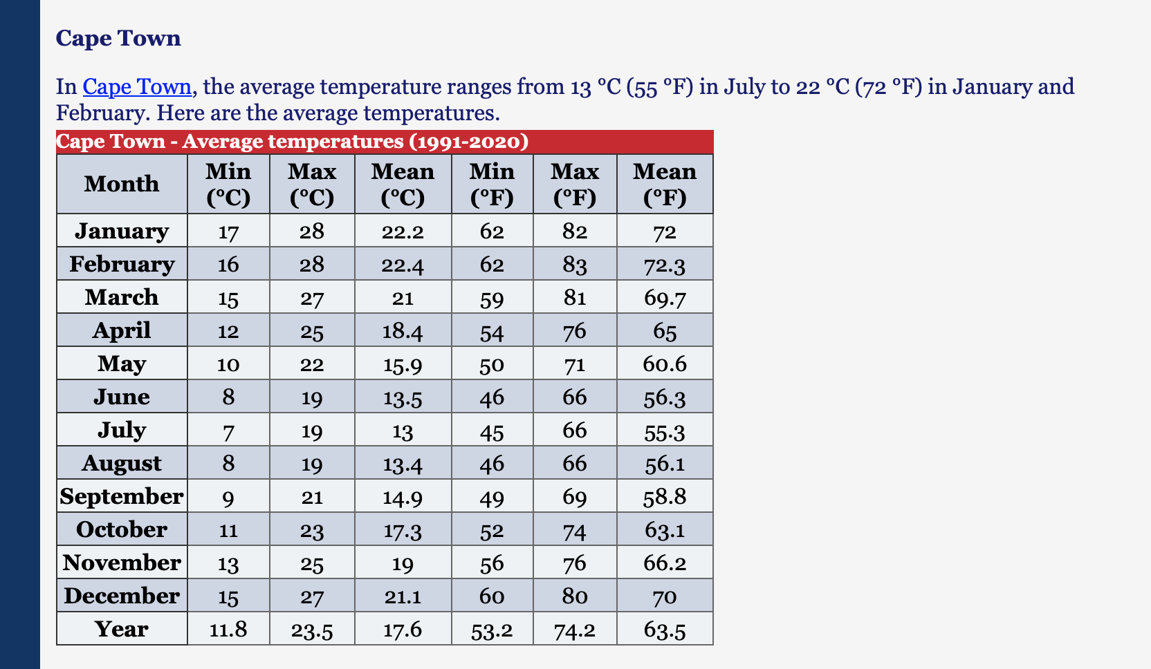
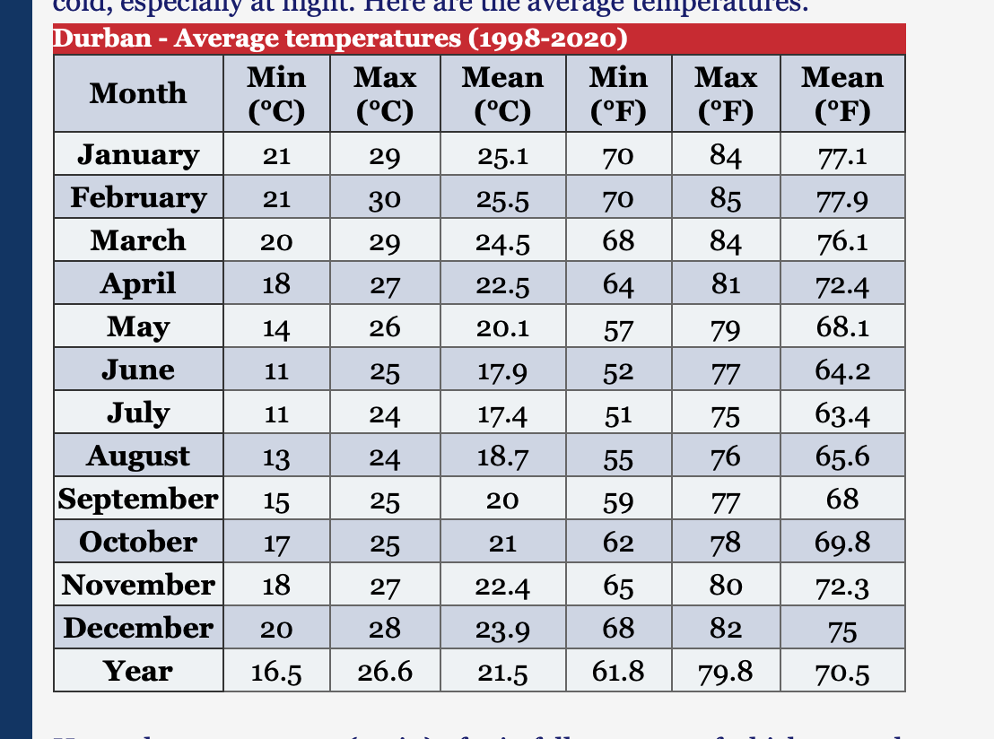
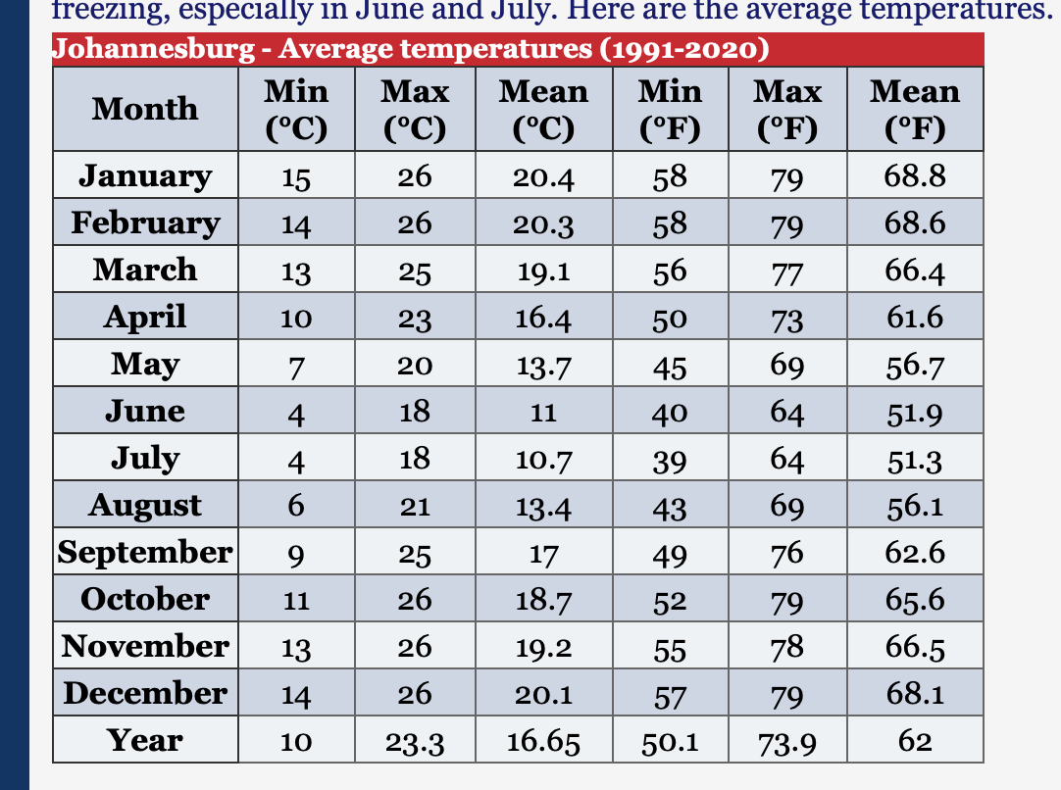
Average temperature (rebuild tables)
https://www.climatestotravel.com/climate/south-africa

Slide 35
Old Slides

Slide 36
Overall interest in mattress brands overtime (Interest levels have been index to 2017 levels)
4%
2%
13%
14%
Notes:
Key insights
Online interest has increased YoY
Gauteng, KZN, Western cape and eastern cape make up make up 90% of search behavior while Northern cape’s contribution is negligible (and therefore excluded)
Purpose
Set the scene for growth, but who is growing
Set the scene for our focus on major province and their order

Slide 37
Provincial search interest in mattress brands (Interest levels have been index to 2019 levels)
Notes:
Key insights
Of all the provinces, Mpumalanga has increased interest the largest having almost tripled (xx%) over the past 5 years
Of the top 4 provinces, KZN has experiences the largest growth, having over doubled in interest
The eastern cape has experience a decline in overall interest levels over the past 5 years
The remaining provinces have experienced modest growth of between XX% and YY% over the 5 year period

Slide 38
Bravo vs. rest of market search interest (Interest levels have been index to 2017 levels)
-2%
11.2%
5.3%
-2%
16%
11%
-2.3%
2.6%
16%
7%
11%
15%
Notes:
Key insights (index)
- Overall interest, seen previously, can be decomposed into Bravo and Rest of market
Bravo has had consistent growth in search interest from 2017, increase 60% over this period
Bravo had higher growth than the rest of the market since 2019
Rest of market has experienced an overall decrease in past 2 years
However, Bravo’s strong growth offset rest of market decline which resulted in interest growing over the past 2 years (see overall market above)
Key insights (market share)
Bravo lost market share in 2018 due to competitor search interest growth exceeding bravo’s
Thereafter, Bravo increased their market share for 3 consecutive years
Overall, this translates to a 17% growth in search market share since 2017, which is driven primarily but 2020 (11.2%) and 2021 (5.3%)

Slide 39
Search interest overtime by province (Interest levels have been index to 2017 levels)
Improve ordering
2.7x
1.3x
1.3x
1.8x
Notes:
Key insights
Bravo’s search interest growth over the past 5 years has exceeded rest of market across the 4 most popular provinces (between 1.3x and 2.7x more growth)
In particular, over the past year and reflecting the overall national trend, Bravo increased search interest within each province while Rest of market decline within each province.
Bravos’s search interest growth exhibits stable YoY growth across the majority of years

Slide 40
Monthly mattress brand search interest (Interest levels have been indexed to the month with the highest interest, November 2020)
November

Slide 41
Mattress brand interest by month (Interest levels have been indexed to the month with the highest interest, November)
Peak interest occurs in colder months
Black Friday

Slide 42
Mattress brand interest by month (Interest levels are relative to the average month)
Peak interest occurs in colder months
Black Friday

Slide 43
Interest in the 5 most popular brands overtime (Search interest levels as expressed as a proportion of Sealy’s interest in 2021)
+67%
+73%
+31%
-13%
0.0%
Notes:
Key insights
Sealy is the only brand which has increased YoY throughout the 5 year period
Over the 5-year period, Sealy experienced the largest growth (67%) exceeded only by Restonic’s growth (+73%)
However, Sealy was able to maintain it’s strong upward trend where as Restonic has been relatively flat over the past 3 years
Over the period, Restonic moved from the 3rd most popular brand to the second most popular brand by displacing Cloud nine who experienced more modest growth (+31%)
Simmons although experiencing growth in earlier years has ended that 5-year period with reduced interest after two year’s of significantly decline interest

Slide 44
Sealy Posturepedic vs. all other Seal interest overtime (Interest levels have been index to 2017 levels)
Notes:
Key insights
Excluding searches for Sealy Posturepedic, the Sealy brand experienced strong growth (+85%) over the past 5 years.
In contrast, popularity for Sealy Posturepedic has been less stable. In particular, interest dropped (-32%) in 2018 before making a modest recovery in 2020 (+15%) and even stronger recovery in 2021 (+60%) to reach an 5 year high in interest

