Slide 1
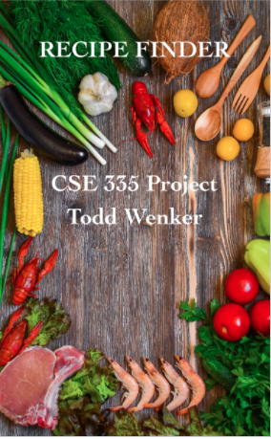
Recipe Finder
CSE 335 Final Project
Todd Wenker
4/27/18

Slide 2
Project Summary
Recipe Finder is an app that allows users to search for recipes using Recipe Puppy API.
The user can then look at what ingredients the recipe needs before viewing the site through WebKit.
The app uses core data to save and delete recipes.
The user can also find grocery stores near their location.

Slide 3
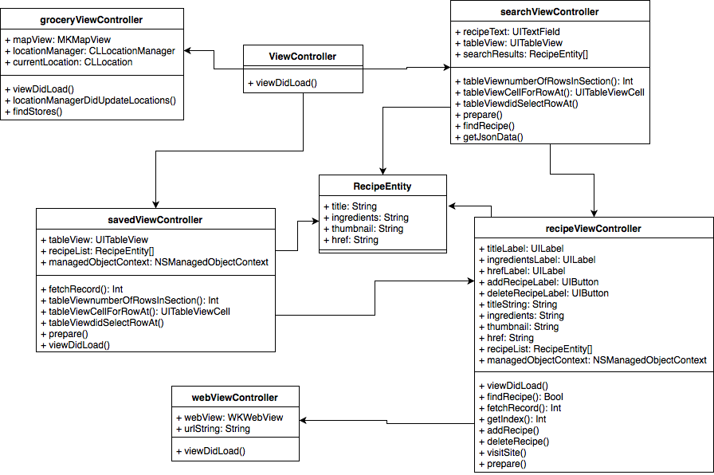
Class Diagram

Slide 4
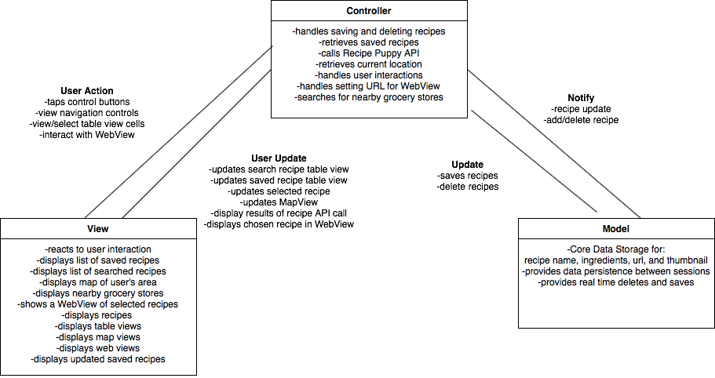
MVC Diagram

Slide 5
Capabilities and Limitations
Easy to search and manage recipes.
API limitations
  Data returned.
  Www.recipezaar.com redirects.
Specific list for ingredients.
Webkit.

Slide 6
Lessons Learned
API choice is vital.
More time spent on planning.

Slide 7
Possible Improvements
A better API that provides more valuable data.
Easier to navigate app.
Better utilization of WebKit.
Add thumbnail image.

Slide 8
END!

