Slide 1
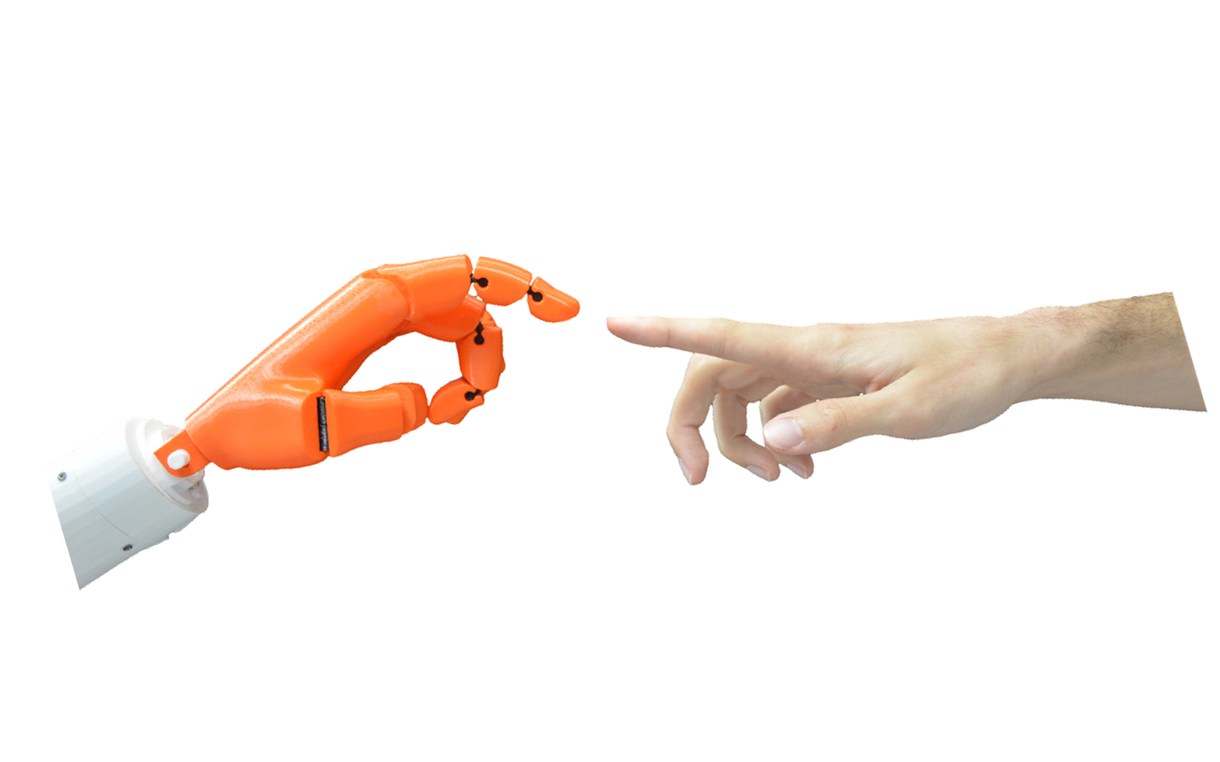

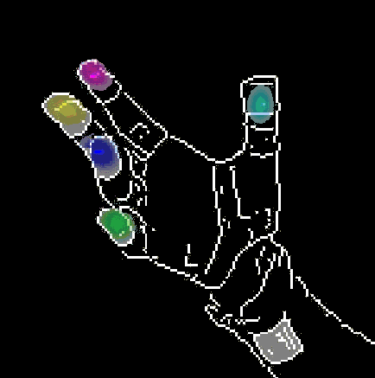
Rule Of Thumb:
Deep derotation for improved fingertip detection
Aaron Wetzler, Ron Slossberg, Ron Kimmel
Technion, Israel Institute of
Technology, Haifa, Israel
Notes:
Hello, my name is Aaron and today Im going to present Rule of Thumb, which is work we published last year at BMVC
and is part of ongoing research in Human Machine Interfaces
at the Technion CS GIP lab. The work was done in collaboration with Ron Slossberg and
my PhD supervisor professor Ron Kimmel.
The focus of this work is on how to determine the global 3D orientation of an articulated object observed by a depth camera
and then use this to improve part based detection within the image. So, as a design principle we choose to only
work on individual camera frames and our framework does not rely on tracking, kinematic constraints or an explicit prior model
of the articulated object. And here we specifically apply the method to improving
fingertip localization in depth images of a users hand as captured by a RealSense 3D camera.

Slide 2
Motivation
Decouple effect of global rotation on image appearance
Cannot do directly out-of-plane -> do it by proxy
  First predict 3D global orientation
  Then convert it into an in-plane image derotation
Image space is complex, we need a large dataset
Notes:
The basis of this work is that we wish to somehow decouple
the effect of global rotation on the image appearance. We cannot do this directly so
instead we do it by proxy and produce an inplane rotation which is aimed at partially factoring out
global rotation.

Slide 3
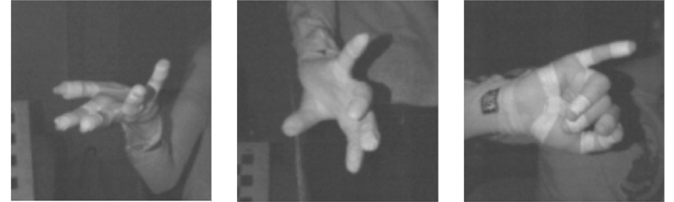
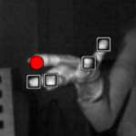
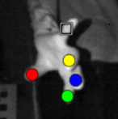
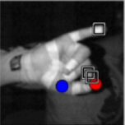
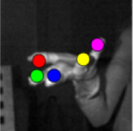
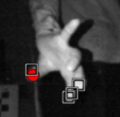
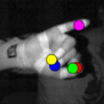
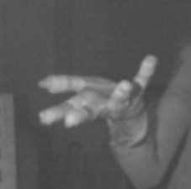
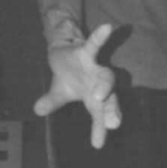
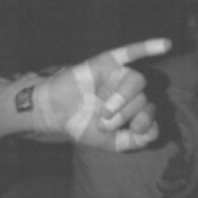
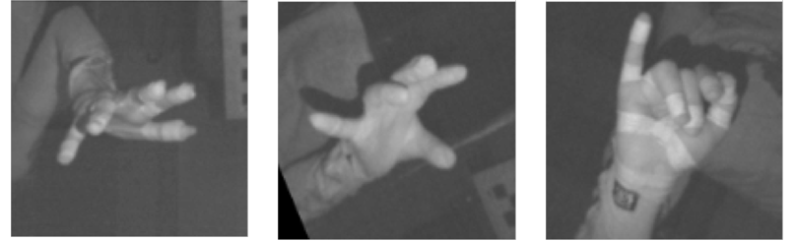
Derotation
Notes:
Here we see etc.
Before we dive into the details of each of these sections we need to deal with
what is arguably an equivalently difficult problem: obtaining a sufficiently large data
set of hand images with accurate annotations.

Slide 4
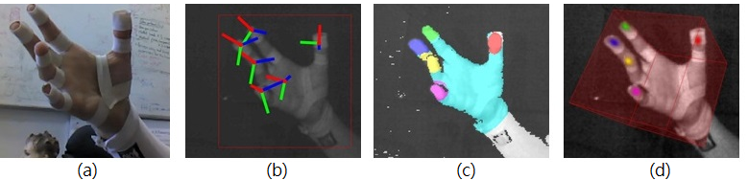
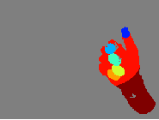
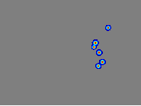
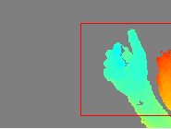
HandNet
Training data: 202198 images
Test data: 10000 images
Validation data: 2773
http://cs.technion.ac.il/~twerd/HandNet/

Slide 5
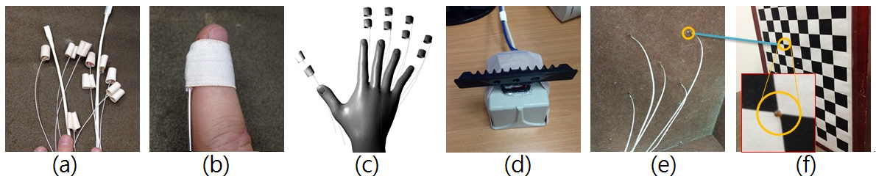
Recording setup
Notes:
We position the sensors rigidly at the same location as callibration board points
which allows us to assume that every point recorded on callibration board corresponds exactly to that
of the sensor. We then find the intrinsic camera callibration using the Zhang method in the Bouguet Toolbox, and for each intrinsic
board position we also record the magntic sensor data locations and rotations.

Slide 6
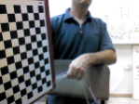
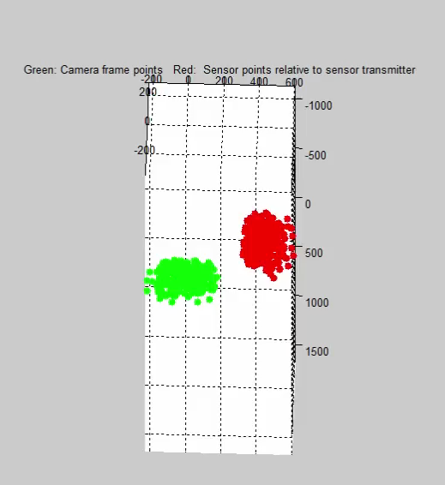
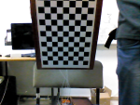
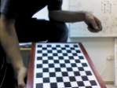
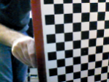
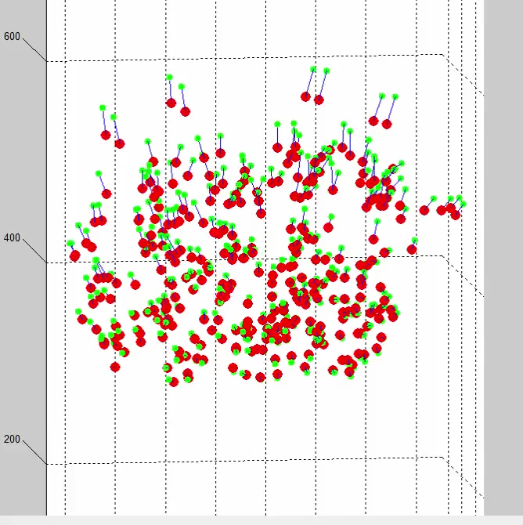
Callibration
We first perform accurate intrinsic parameter callibration using Bouget Callibration Toolbox while also recording sensor data
We use the EPnP method of Lepetit et al. to compute the sensor axis pose relative to the camera and transfer all sensor data into the camera frame
We use a second order polynomial to correct for sensor distortion
We synchronize by finding the nearest neighboring timestamps
Notes:
To determine the RealSense camera pose with respect to the sensor coordinate frame we use
the perspective-n-point ASPnP method of Zheng et al. with the 2D points being the detected corner pixels
while the 3D is provided by the detected sensor 3D coordinates.

Slide 7
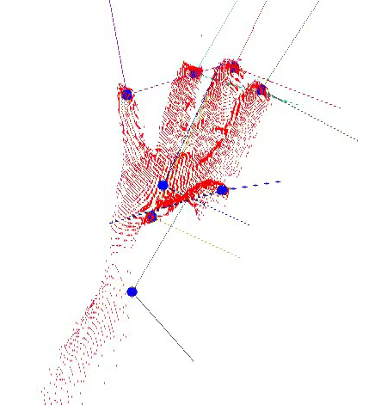
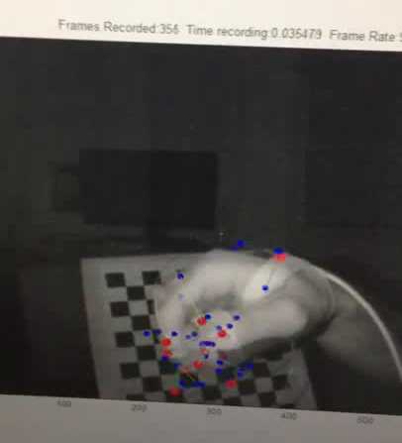
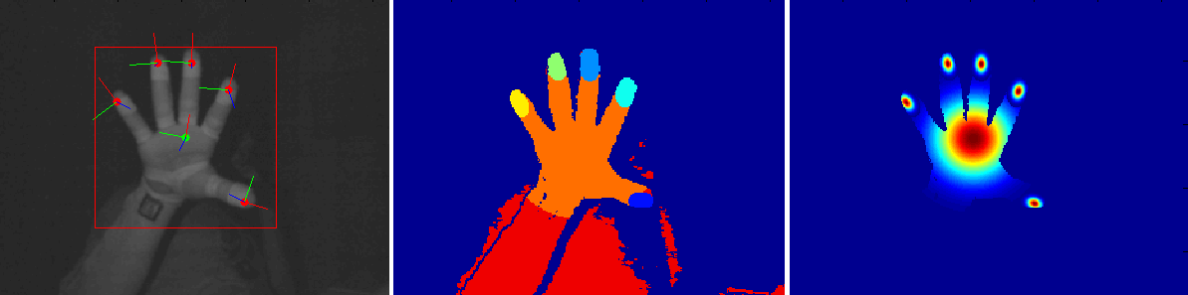
Recording raw data
Pointcloud + sensor data Recording session
Notes:
We project spheres at the locations of interest
onto the depth images and create a label image.
Alternatively we position gaussians at relevant locations.
blah blah
In general, we believe these sensors
could be more widely used by the vision community for data annotation
as we found the sensors to be robust, very fast and configurable.

Slide 8
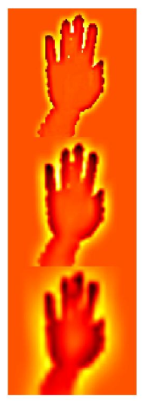
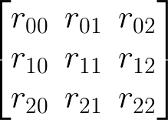

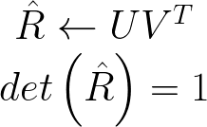

DeROT – 3D Orientation prediction
Prediction:
Projection
Input Multi-scale Convolutional Neural Network Regression Output
Max pooling
conv
ReLU
conv
ReLU
conv
ReLU
conv
ReLU
Max pooling
concat
fc
ReLU
fc
reshape
conv
ReLU
conv
ReLU
Max pooling
Based on Tompson et al.
Input Projection onto SO(3) Output
SVD
Proj
Notes:
Using a rule which we call Rule of Thumb to normalize the inplane rotation of the image
Like many other recent works we take advantage of the expressive power of deep neural networks.

Slide 9
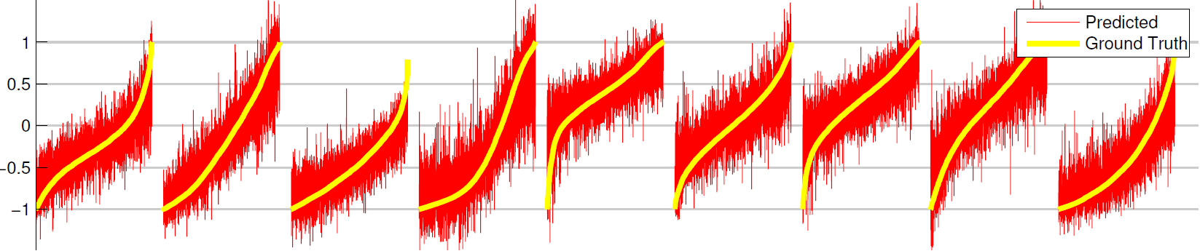
DeROT – 3D Orientation prediction

Slide 10
DeROT – Rule of Thumb
Images of a hand can almost always be rotated so that the thumb is on the right side (arbitrary choice)
Can be generalized to any object provided there is a bias in the data in the way the object is oriented
If hand orientation was random then the thumb would point towards or away from the camera 33% of the time. Rule of Thumb works because in practice thumb points towards or away from the camera only 13% of the time.

Slide 11
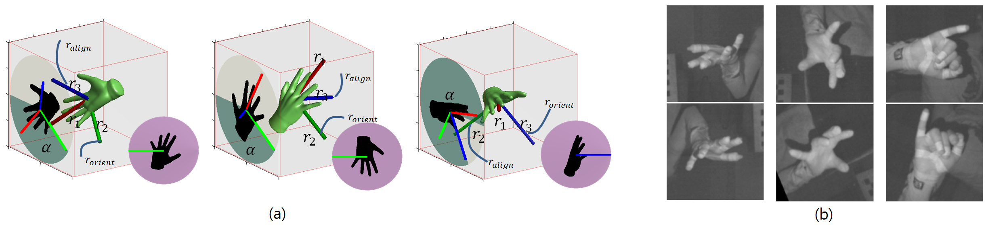
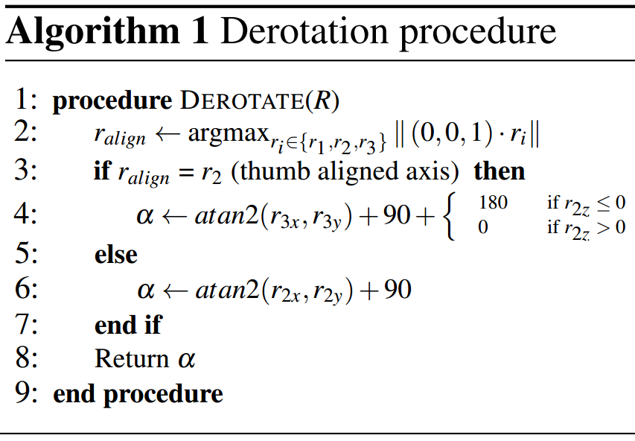
DeROT – Rule of Thumb
13%
87%

Slide 12
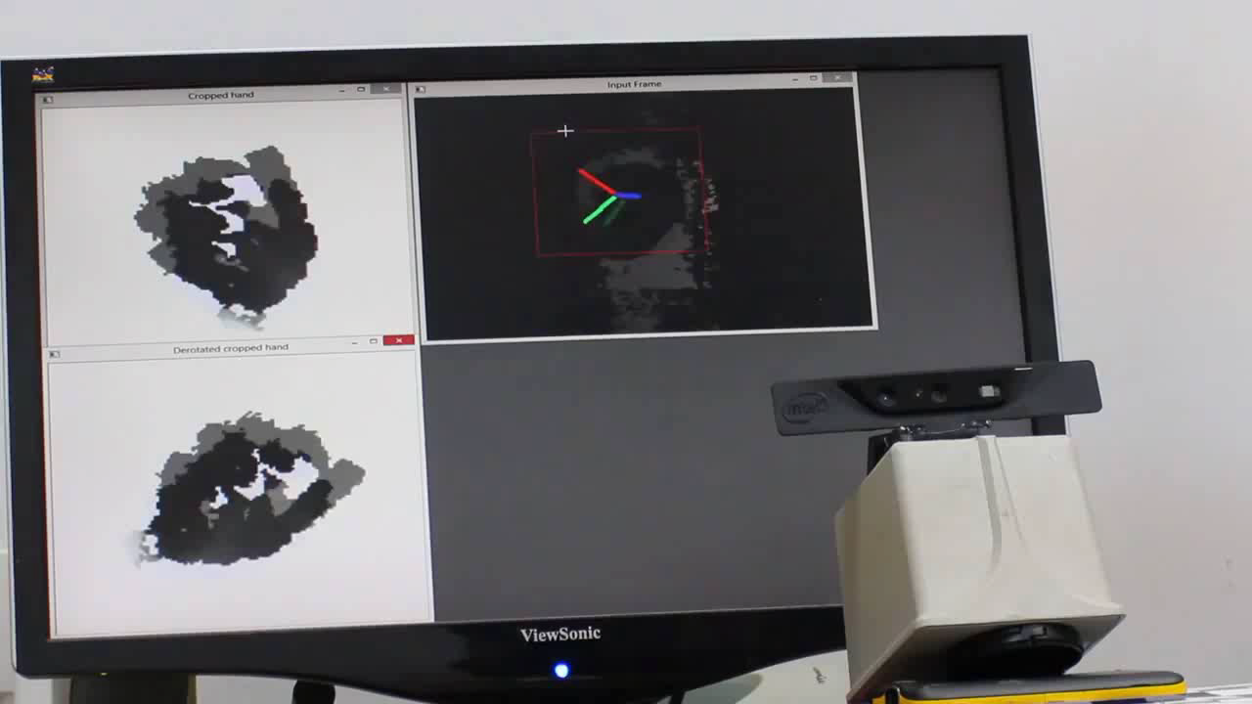
Rule of Thumb

Slide 13
Fingertip detection pipeline
DeROT
Input
image
Orientation CNN
Proj to SO(3)
Rule of Thumb
Input
image
Fingertip detector
Output
image
α

Slide 14

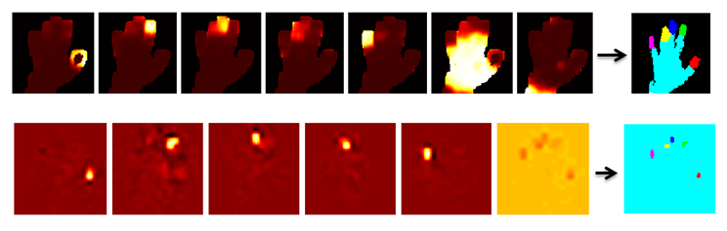

Fingertip detectors
We test two popular machine learning approaches
  Random Decision Tree (RDT)
  Convolutional Neural Network CNN)
Based on Keskin et al.
Based on Tompson et al.

Slide 15
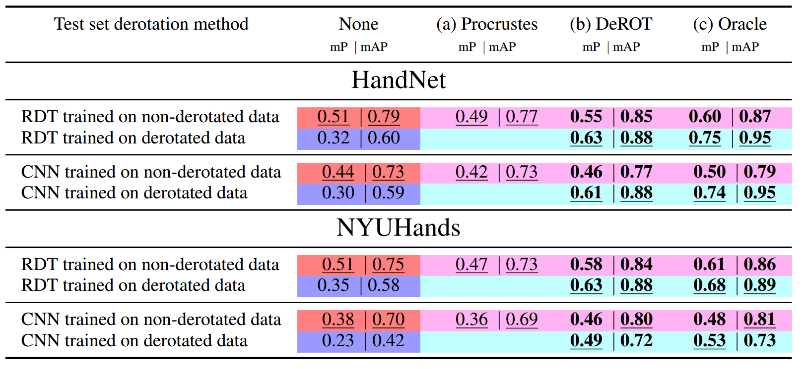
Results

Slide 16
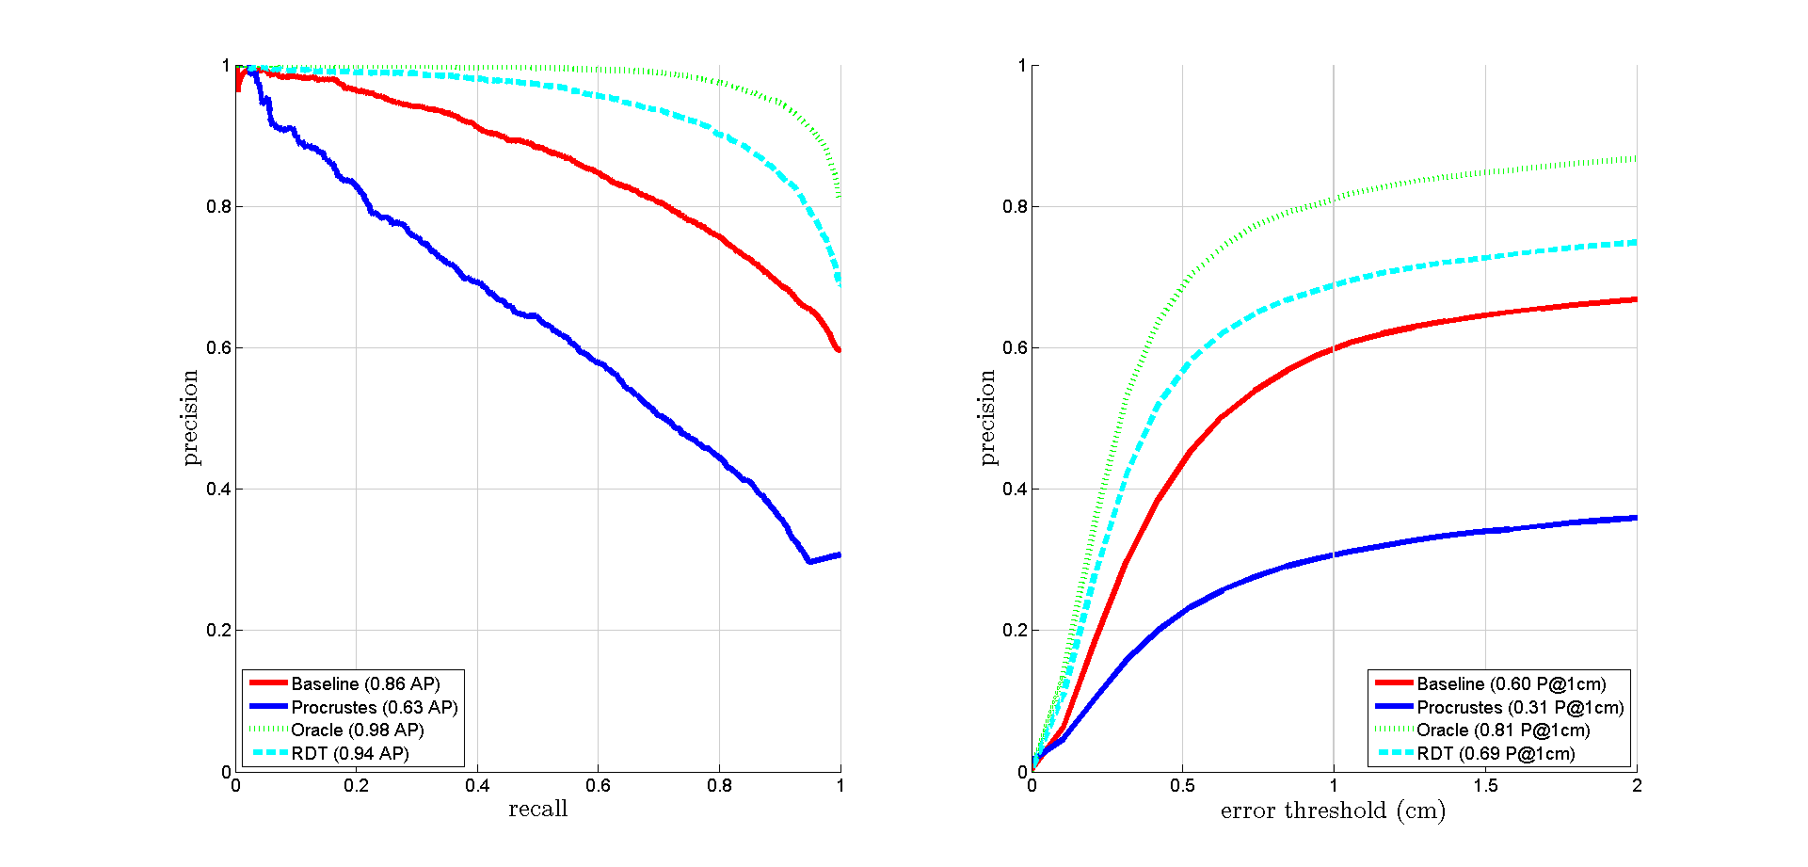
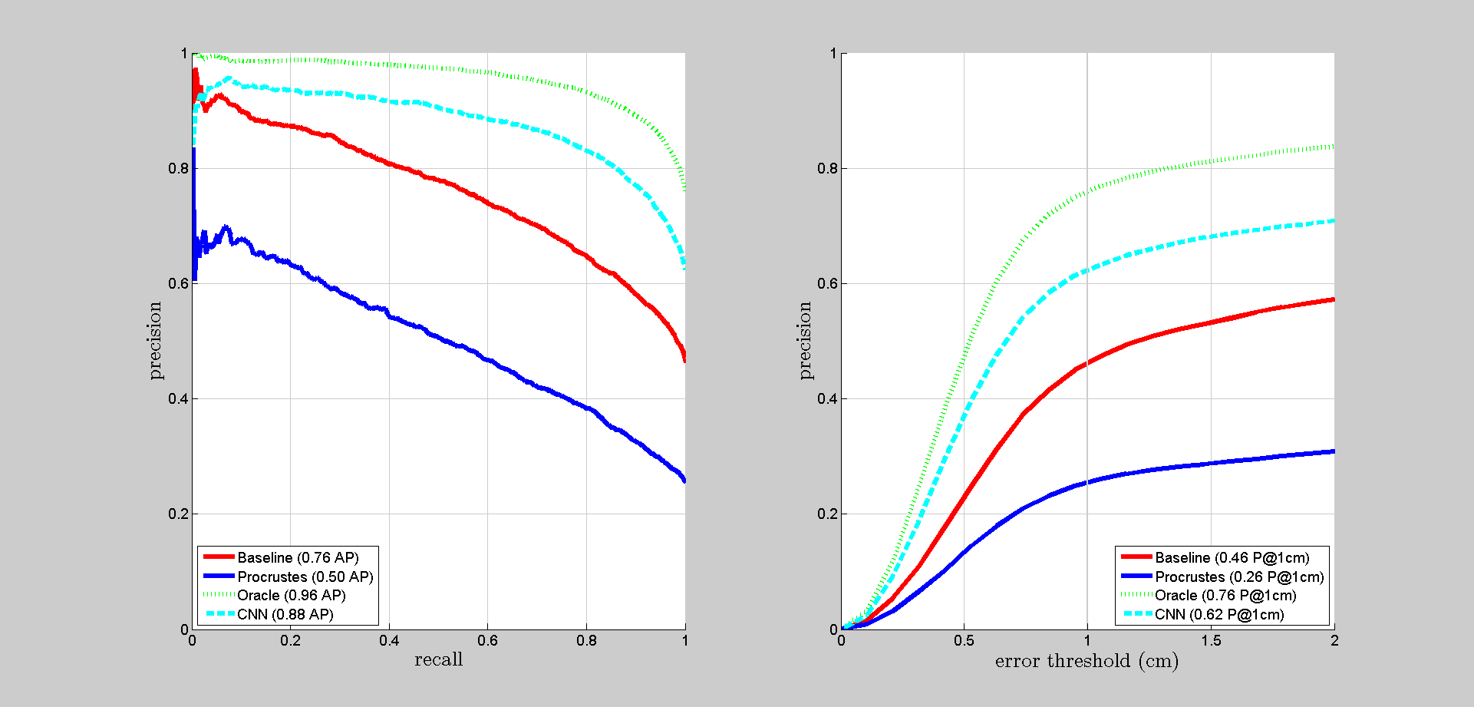
Results
Random Decision Tree (RDT) Convolutional Neural Network (CNN)

Slide 17
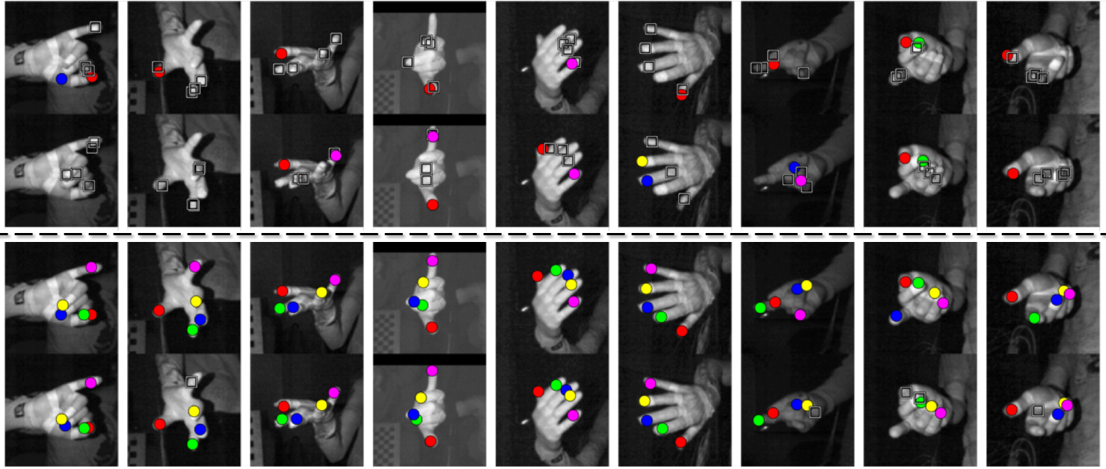
Results
RDT
CNN
No DeROT
RDT
CNN
With DeROT

Slide 18
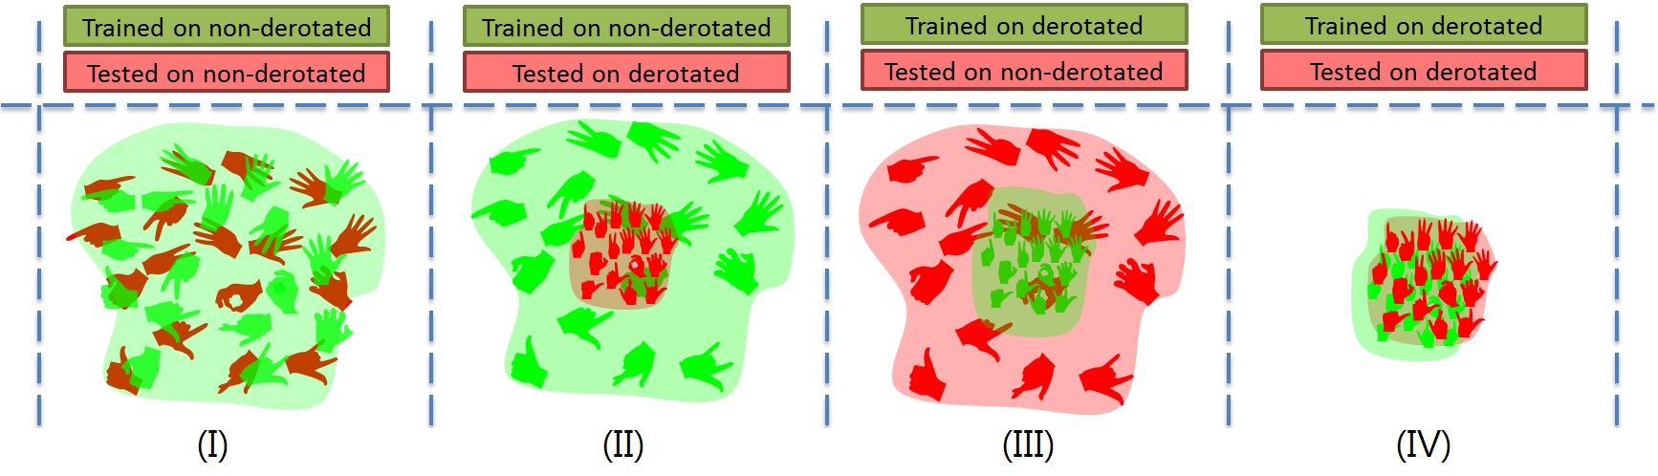
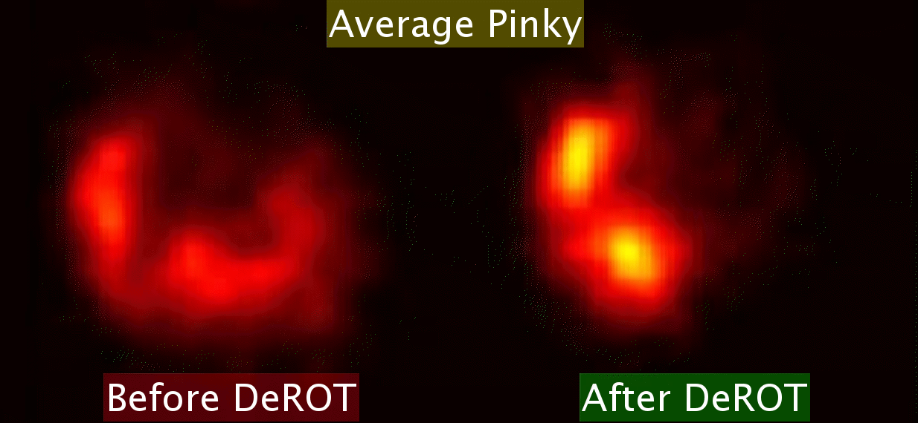
Insights
Derotation makes the space to be learnt and tested on more compact
Derotation has a visible impact on the positional variability of parts
DeROT

Slide 19
Conclusions / tl;dr
Magnetic sensors calibrated to a camera frame can be a powerful and accurate tool for computer vision research
Directly predicting a rotation matrix is a robust and viable approach to rotation regression
DeROT significantly improves fingertip localization by reducing pose variance
DeROT can be used as an alternative to data augmentation especially for pre-existing large datasets
Would be interesting to try for RGB only or IR only images

Slide 20
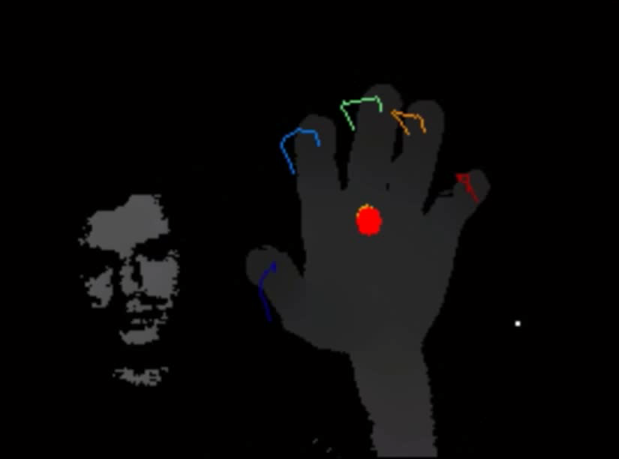
Contact:
Thank you!
Questions?
twerd@cs.technion.ac.il (Aaron)
http://cs.technion.ac.il/~twerd/
http://cs.technion.ac.il/~twerd/HandNet/

