Slide 1
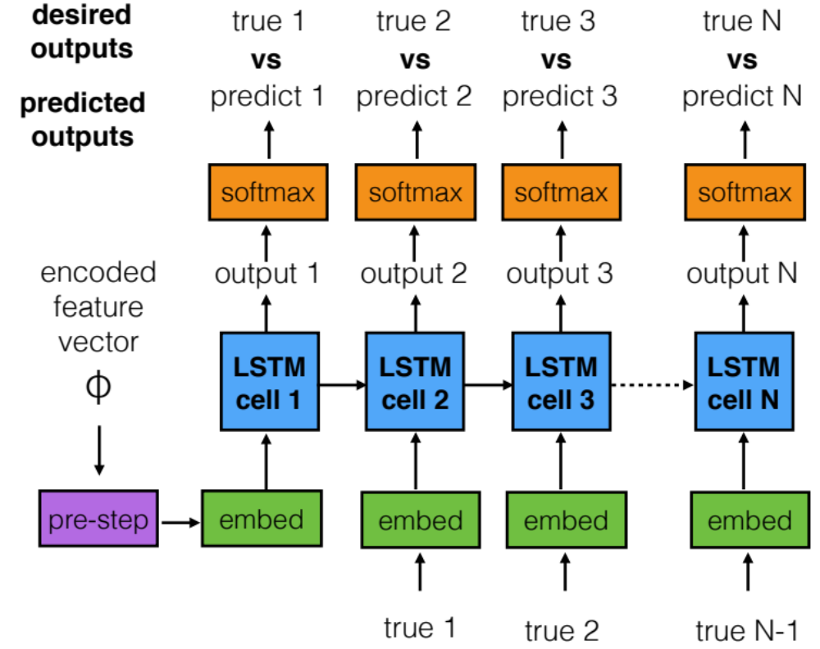
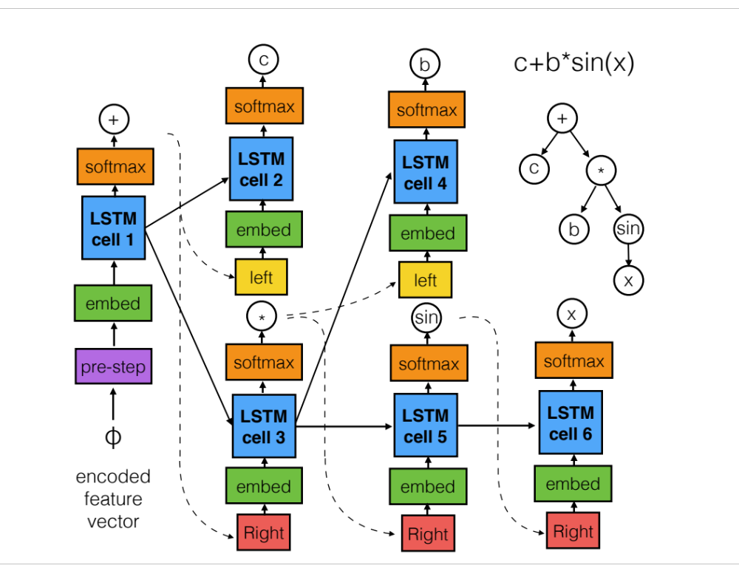
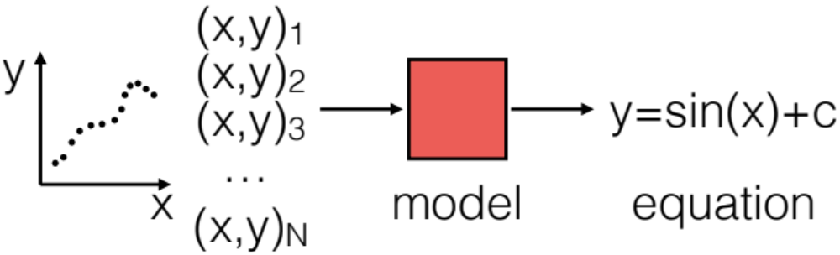
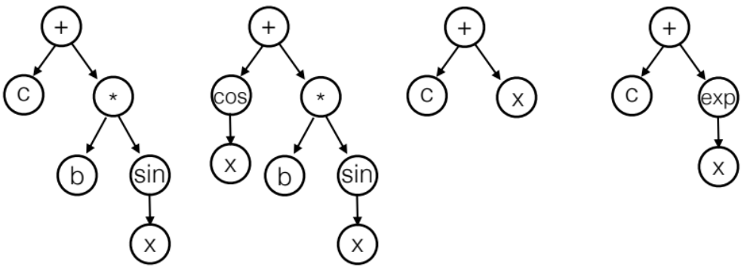
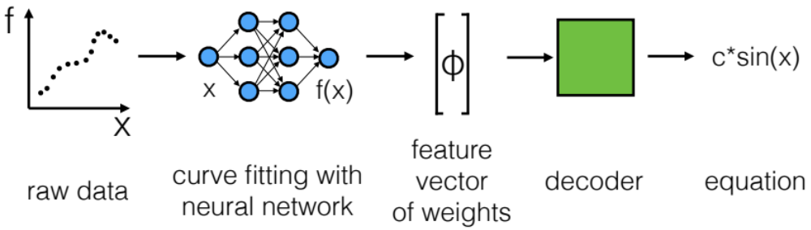
Accelerating Symbolic Regression with Deep Learning
Tyler William Hughes, Siddharth Buddhiraju, Rituraj
Introduction / Motivation
Sequence
Decoder:
Train LSTM cells, embedding cells, and softmax() prediction cells on equation sequence.
Ask RNN to predict equation based on new feature vector.
Results
We teach an AI system to generate equations that describe trends in raw data.
In regression problems, we assume an underlying model and fit for the undetermined constants. In our approach, the model, itself, is generated and then fit by a standard regression procedure.
This method can be used to generate human-understandable insight into data that may be too complicated to interpret by eye. This has implications in several realms, for example:
Training Loss
vs. epoch
(decoder)
(seq. vs tree)
Training Loss vs. epoch (encoder)
Generating theories to describe data from scientific experiments.
Discovering profitable relationships in data that were previously hidden.
table of train/test accuracy
Tree Decoder:
Train LSTM cells, embedding cells, and softmax() prediction cells with equation tree as a template.
Ask model to construct new equation tree.
Problem Definition
input: a set of data points in the form of (x,y) pairs
brief discussion of why this is bad
output: an analytical expression that describes the dataset (including undetermined constants)
Analysis
A few incorrect predictions, explanation about why they were wrong
Approaches
common solution: genetic algorithm optimization problem
Challenges & Solutions
Main issues:
Search space is exponentially large
Does not learn from features in data
Multiple encodings are possible with the same dataset using the neural network fit.
Presence of undetermined constants map a single equation to several feature vectors.
Sequence decoder does not guarantee syntactic correctness. Need to include parentheses as equation element.
Generating and training LSTM trees is computationally demanding.
regularize the encoding NN
Future Directions:
1D convolution encodings
Tuning hyper-parameters
Many more training examples
give many examples of different constants
our solution: encoder-decoder machine translation problem
hard code heuristics for syntactic correctness
References
reuse and prune full tree model
cite important symb. reg. previous work

